Slide 1

KARPAGAM INSTITUTE OF TECHNOLOGY, COIMBATORE. (Approved by AICTE and Affiliated to Anna University) ( Accredited by NBA(CSE,IT,ECE)
NAAN MUDHALVAN
TEAM NO – CD1_08
GROCERY WEBSITE
VIMAL R | 721220104061
PRAVEEN P | 721220104031
ANBURAJ G | 721220104002
PRAKASH G | 721220104030

Slide 2
PROBLEM STATEMENT
Many individuals and families find it increasingly challenging to allocate time for in-person grocery shopping due to busy schedules, long commutes, and other commitments. This results in time constraints and inconvenience, making it difficult for them to access fresh and essential groceries.
Individuals with disabilities, the elderly, and those with limited mobility may face significant challenges when it comes to visiting physical grocery stores. Accessible and convenient grocery shopping options are essential to ensure everyone's needs are met.
Efficient delivery logistics, including timely deliveries and accurate order fulfillment, are critical to the success of a grocery delivery system. The system should address challenges related to delivery time slots and order accuracy.

Slide 3
PROPOSED SYSTEM
These existing grocery delivery systems typically include features like a user-friendly interface, search and filter options, loyalty programs, product recommendations, secure payment processing, and various delivery or pickup choices. They often have dedicated mobile apps for easy access, and some offer subscription services for unlimited delivery.
These services aim to make grocery shopping more convenient and time-saving for customers, especially for those who prefer to avoid crowded stores or have limited time for in-person shopping. The specific features and services offered may vary by location and company, but the core concept is to provide a seamless online shopping and delivery experience for groceries.

Slide 4
TECHNOLOGY
Server-side scripting – HTML, CSS, Javascript
Storage – My SQL Database
Payment Processing – Square, paypal or stripe
Geolocation – Google Map API
Analytics and monitoring – Google analytics, Mixpanel.
Customer support tools – Chat, Email, Helpdesk System

Slide 5
BENEFITS
The system offers advanced features like search, filters, and product recommendations, making it easier for customers to find and compare products. This enhances the overall shopping experience and helps users make informed choices.
The system provides unparalleled convenience for customers. They can order groceries from the comfort of their homes or workplaces, eliminating the need for physical store visits.
The system helps reduce overcrowding in physical stores, which is a common issue during peak shopping hours. This contributes to a more pleasant and stress-free shopping experience for those who do visit stores.
Robust security measures and data protection enhance customer trust. By providing secure payment options and respecting data privacy, the system promotes confidence among users.

Slide 6
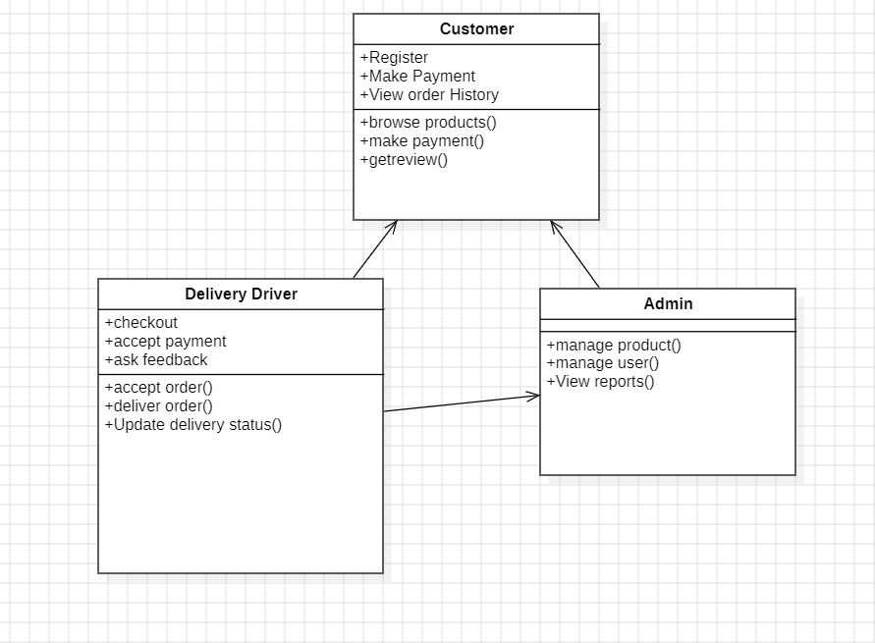
USECASE DIAGRAM

