Slide 1
Weather Forecasting Using Machine Learning
Real-Time Predictions & Dashboard with Streamlit app
Presented by: Dinesh Sharma, Prakash Gaurav, Rafi Qamar Date: 12 April 2025

Slide 2
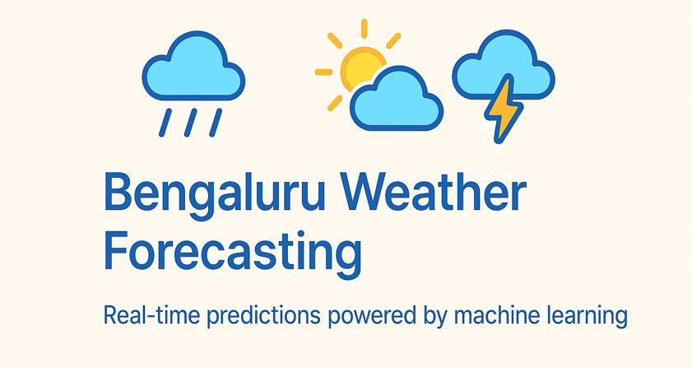
Problem Statement
Weather forecasting is crucial for many sectors: agriculture, transport, energy, etc.
Goal: Build an ML model to forecast key weather metrics and present them on a live dashboard.

Slide 3
Data Source & Collection
Source: Open-Meteo API
Scraped 35 years of historical hourly weather data (1990–present)
Key columns: temperature, humidity, wind speed, direction, pressure, precipitation, cloud coverage

Slide 4
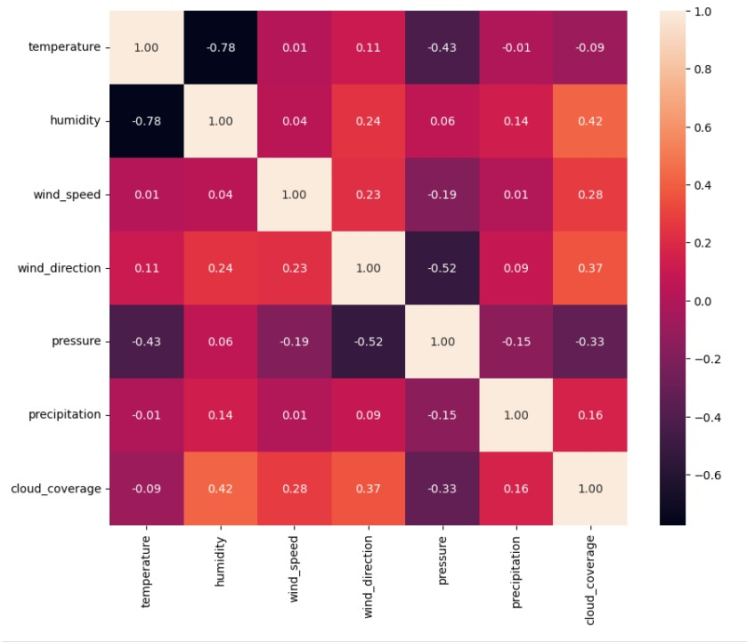
Exploratory Data Analysis (EDA)
Analyzed long-term trends and seasonal patterns
Visualized temperature, precipitation, and wind behavior over time
Derived insights to support feature engineering

Slide 5
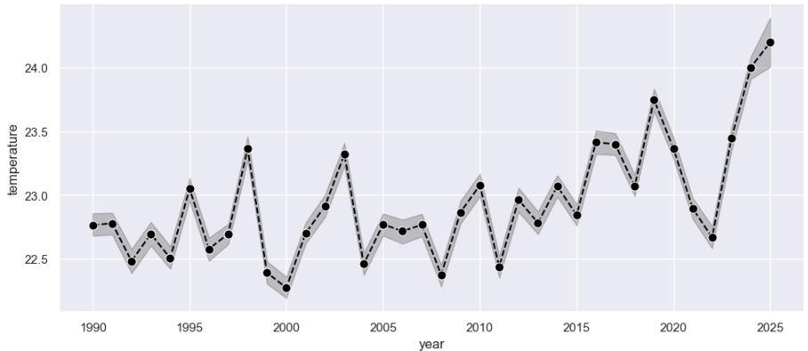
Feature Engineering
Extracted date_time features: hour, dayofweek, month
Created cyclical features using sin/cos transforms
Selected relevant features: wind_direction, pressure, cloud_coverage, etc.

Slide 6
Machine Learning Model
Used XGBoost Regressor
Tuned hyperparameters via GridSearchCV
Predicted: Temperature, Humidity, Wind Speed

Slide 7
Model Performance
Evaluated using RMSE and MAE
Good correlation between actual and predicted values
Robust model with generalized performance

Slide 8
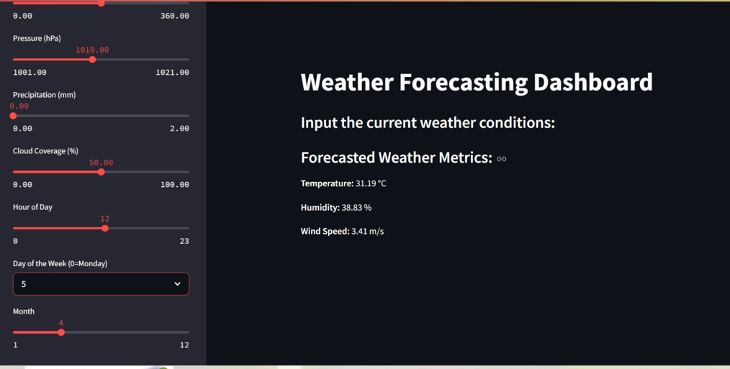
Streamlit Dashboard
Interactive input of weather conditions via sidebar
Real-time predictions using trained model
Displayed forecasted temperature, humidity, and wind speed

Slide 9
Automation & Deployment
Saved model using joblib
Live dashboard built with Streamlit
Supports real-time manual inputs or future integration with APIs

Slide 10
Conclusion & Future Work
Accurate weather prediction from historical patterns
User-friendly dashboard for live usage
Next steps: predict weather conditions (e.g., 'rainy'), API automation, streamlit integration
Thank you

