Slide 1
Software Development Methodology
1 Waterfall – Linear Model
2 Agile – Scrum – Incremental Iterative Model

Slide 2
Demerits
Requirement Changes
in the middle or end
Client is kept in dark till UAT
Less Client involvement in early stage of project
Testers may be waiting for code drop ($ waste)
Less synergy b/w business, developers, testers
No possibility of early client feedback
Waterfall – Linear Model

Slide 3
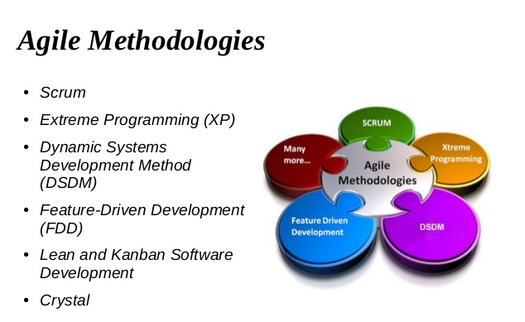
Agile

Slide 4
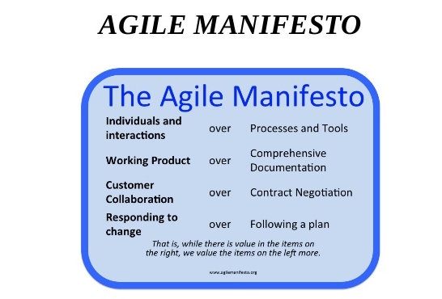
Agile Manifesto

Slide 5
Agile – Scrum – Incremental Iterative Model

Slide 6
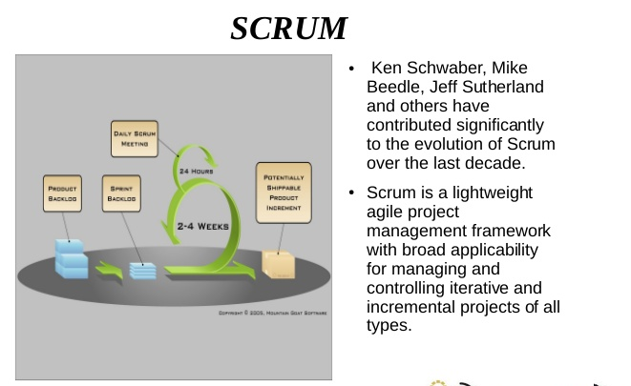
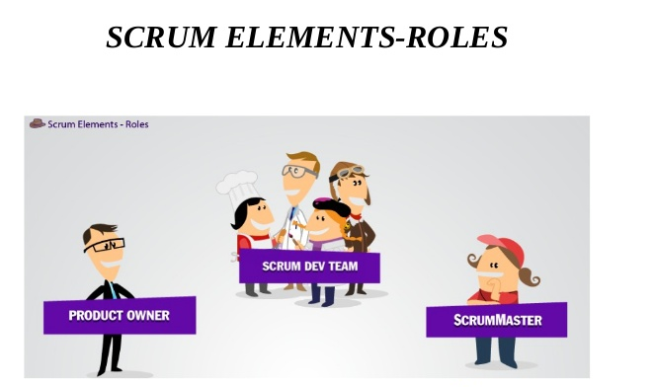
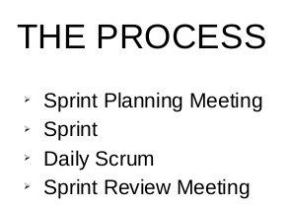

Slide 7
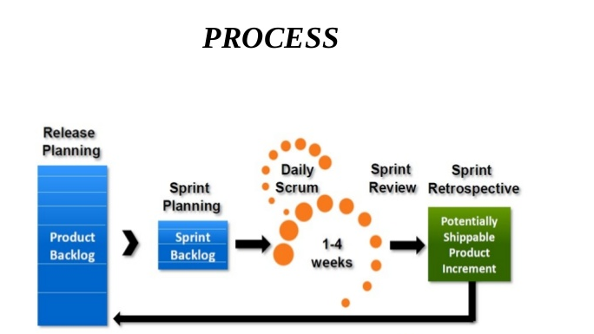

Slide 8
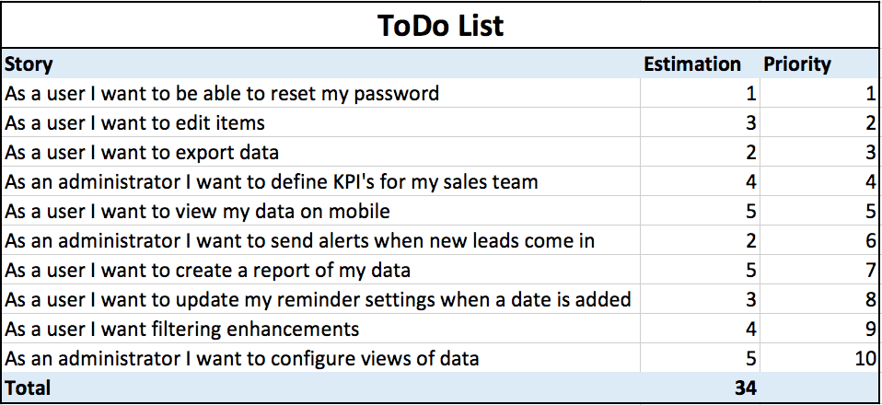
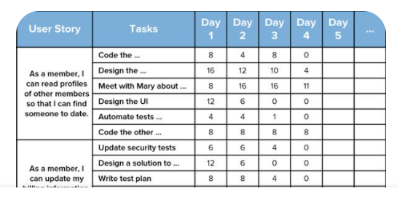
Product Backlog
Sprint Backlog

Slide 9
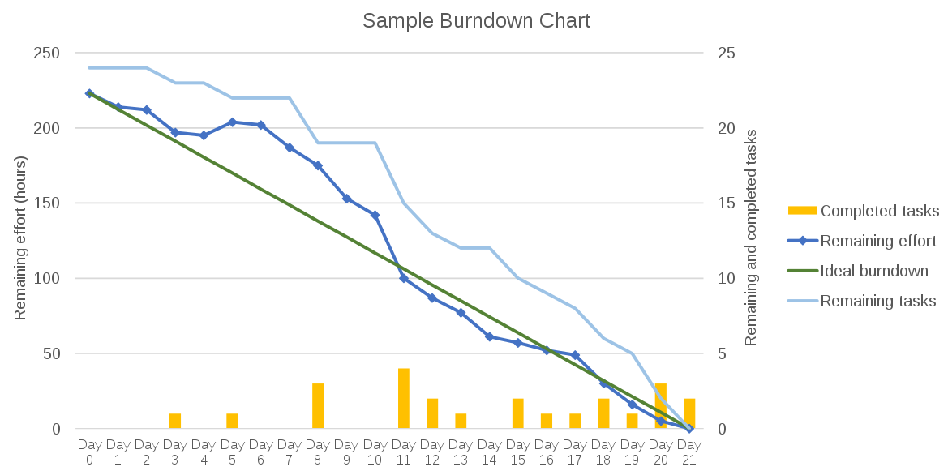
Burnt Down Charts

Slide 10
Kanban Board

