Slide 1

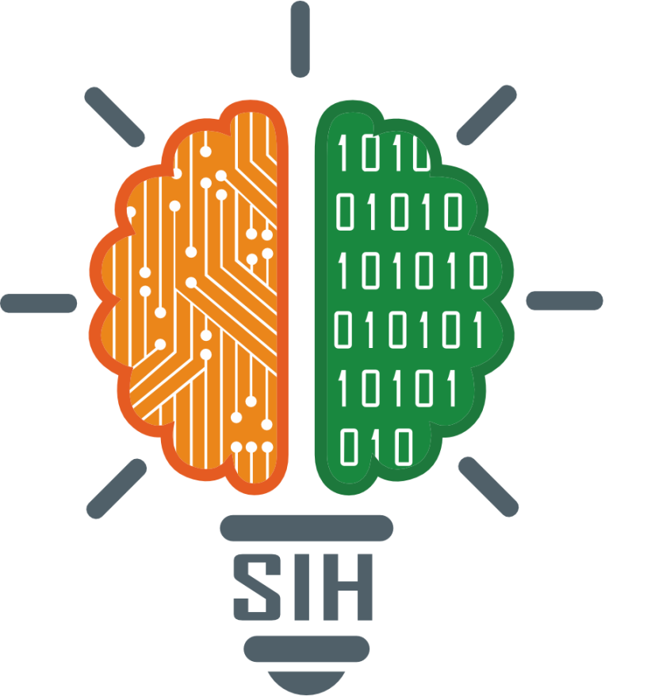

SMART INDIA HACKATHON 2024
Travel & tourism Itinerary Planner
Problem Statement ID –SIH1591
Problem Statement Title-Student Innovation
Theme-Travel & Tourism
PS Category- Software
Team ID- 20799
Team Name – Map$s^{2}$

Slide 2

TO ENHANCE TRAVEL AND TOURISM OF A&N
Map$s^{2}$
Proposed solution
Customizable Filters: A traveler can select options he or she preferred, for instance, one can filter the places that have temples, parks , hills, waterfall, beach , etc . This function helps the traveler to enjoy planning according to own preference and this will increase the satisfaction level.
Real-Time Updates: The challenges on the way belong to poor climate, occurrences, and the limitation of access for persons on the way. Telling them about the state of weather and the accessibility of paths smooth their trip. Due to the nature of relativity of the updates, the necessary changes can be made without interfering with the users plans. It, thus, means organizational decision makers can erect their decisions on a more complete dataset.
Interactive Maps: May induce simplification of guidance point references, as is especially the case with less recognized locations. With the help of the interactive maps the travelers find their way to the destination they want to get to thus increasing the trust and reducing the stress coming with being lost.
Reviews and Ratings: It brings an added understanding of the event among the peers and thus makes the reviews given by the other peers helpful to the audience. The reviews and rating help the individuals to make appropriate decisions on where to go for what and what activities to undertake through sharing of experience.
How it addresses the problem
Efficiency:
Integrated Solution: This application will present all the information that the traveler is likely to need in his or her traveling process in one place. People are then able to best organize their travel plans, without having to run back and forth between various apps or websites which is quite cumbersome.
Up-to-Date Information: This assists the travelers in availing the updates on the changes and occurrences in the weather, events and the status of the entry to the different areas that a traveler might wish to access.
User-Friendly Navigation: It also mean that fear of being lost is also a thing of the past when you are able to use GPS enabled directions to move from one point to another.
Customization:
Recommendations : That can help select the places to go by his or her own choice. The app has the ability to know whether the user loves history, many foods or heart pounding etc.
Filtering Features: Pre-set filters however allow the traveler to have the several options which he or she can peruse through different arrays. So, you wish to visit temples; parks or some other amazing tourist destination.
Innovation and Uniqueness of the solution
Examples of adoption of new and distinct ideas also constitute providing the enhanced scale and variance of services, destinations, and unpopular and less-known locations. Incorporating local information creates enjoyment because it enables visitors to gain a bird’s eye view of that specific region’s customs and ways of life thus making travelling more meaningful. Also, the app educates travelers on how they can reduce the plastic problem and support businesses friendly to the environment; the traveler is therefore forced to make an environmentally conscious decision.

Slide 3

FEASIBILITY AND VIABILITY
Map$s^{2}$
Analysis of the feasibility of the idea:
Market demand:
The global Tourism industry is stimulating and there is marked increase in the tourist arrivals in the Andaman & Nicobar Islands.
This trend is good for your travel application.
Technical Viability:
Hence, accurate and detailed mapping mechanisms like the GPS and real-time updates enables smart information dissemination.
Mobile OSs have APIs and development tools for implementing location based services (LBS) which underpins technological applicability.
User Adoption:
With regard to the importance of both design and functionality of the object in relation to its further use, it is necessary to state that in this case the two factors significantly interconnect.
Ease of use is boosted by the system layout, an option menu, advance word, and personal recommendations.
Potential Challenges and Risks:
Technical Issues: With testing learning incidence and adequate quality control challenges such as bugs and data mistakes can be reduced.
User Engagement: Park said that to sustain user focus beyond the download of the app, the following are necessary; provision of relevant and timely content, interaction and rewards such as sweepstakes.
Competition: The key aspects that have to be taken into consideration are that the product should have differentiated features and be characterized by higher usability.
Data Privacy: Use secure data (encrypt your data, utilizing secure API), and adhere to applicable laws (the GDPR, CCPA).
Strategies for Overcoming Challenges:
Robust Testing: Test adequately whenever the software is under development and any problems that are found, fixed immediately.
User Feedback: Stakeholders/Users – engage the users and proceed to adopt their recommendations to enhance the engagement.
Differentiation: The emphasis should be made on the highlight features and maximization of the usability.

Slide 4
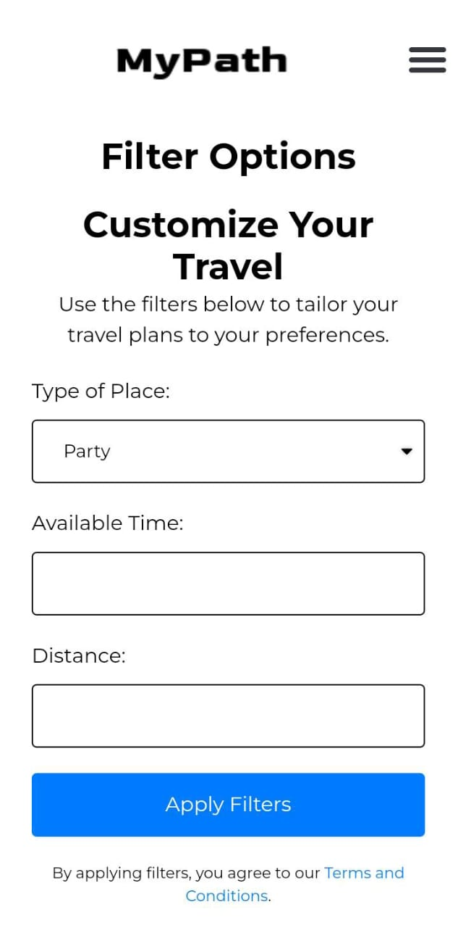

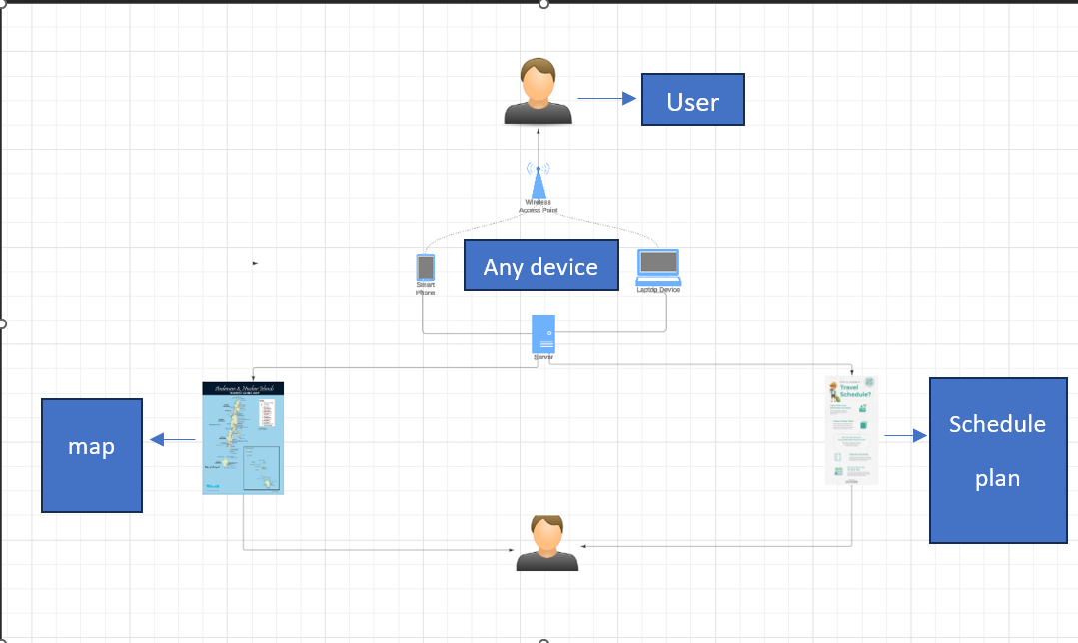
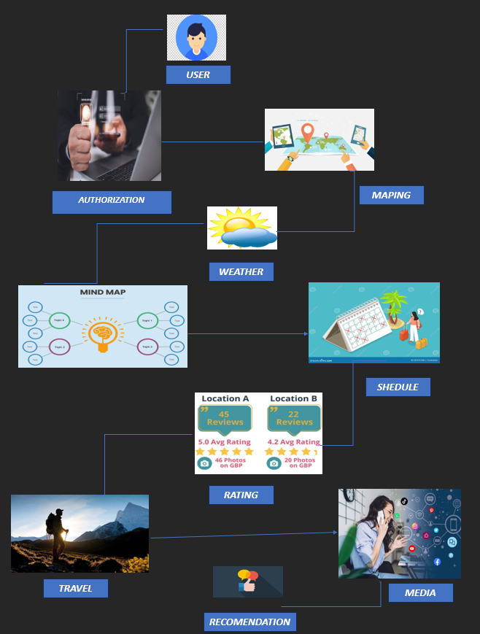
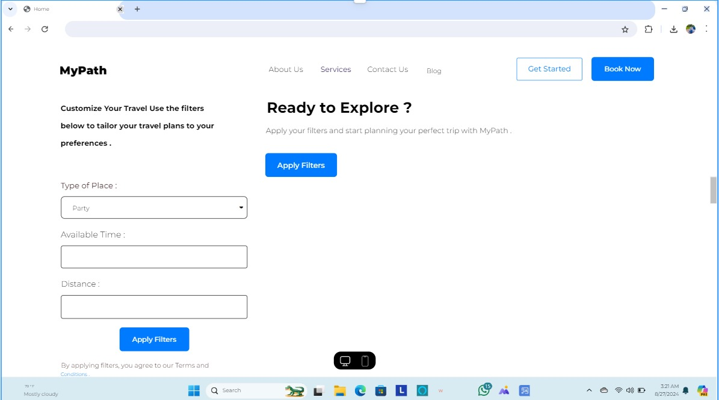

TECHNICAL APPROACH
Map$s^{2}$
Video link of the Prototype: https://youtu.be/IQAsamnLml4
Frontend Dev | Backend Dev | Framework | Database
HTML | Node.js | Express.js | SQL
CSS | - | Flutterflow | Firebase
JAVASCRIPT | - | - | -
PRODUCT STATUS : 75% product built completed and further build is on progress. Testing and implementation process are next to be undergone

Slide 5



IMPACT AND BENEFITS
Map$s^{2}$
Potential Impact on the Target Audience:
Enhanced Travel Experience: It way it gives and includes the travel planning services in the way’s widest definition, offering solutions according to the customer. This app will be having a chatbot which will be integrated with the customized option to enhance the travelling experience.
Increased Convenience: Arranging the names of the events, Speakers and Signed Interpreter side by side in a reasonable order for the day .
Informed Decisions: They include, update on the products, option of getting real time feeds from the user.
Benefits of the Solution:
Social:-
Always promote local areas or the area’s resources and cultural amenities.
Gives advices to the travelers in order to make their travels safe and numbers to call in case of any distress
Economic:-
Lead to increased rate of domestic tourism as well as improvement of the overall economy.
Business categories that generate relations with various businesses within their locations
hence gateways for such businesses.
Environmental:-
Encourages eco-friendly travel practices.
Highlights sustainable tourism options.

Slide 6

RESEARCH AND REFERENCES
Map$s^{2}$
+
Database Implimentation:
https://firebase.google.com/
https://dev.mysql.com/doc/
Web-Development[Bothfrontend&Backend] :
https://replit.com/~
https://code.visualstudio.com/
https://www.geeksforgeeks.org/nodejs/
https://github.com/sauravguptadx/WholeSale-ReactJS
Research
https://scholar.google.com/
https://www.researchgate.net/
The official website of Andaman & Nicobar Administration
Best Travel Agency, Andaman Tourism - Experience Andamans
Tour Packages - Book Holiday Packages for Your Next Holiday Trip (thomascook.in)
Patent links:
https://www.lonelyplanet.com/articles/first-time-andaman-islands
https://www.andamantourism.gov.in/
https://www.lonelyplanet.com/articles/first-time-andaman-islands
Youtube links :
https://youtu.be/GwbrKNrlXZs?si=S5fsC__9b4Fi1Ar5
https://youtu.be/5CtbYRLZVRc?si=SEPmxuTZnoWO8xo7
https://youtu.be/q43hYTqNFXc?si=BhBS4EScCP4Is8B_

