Slide 1

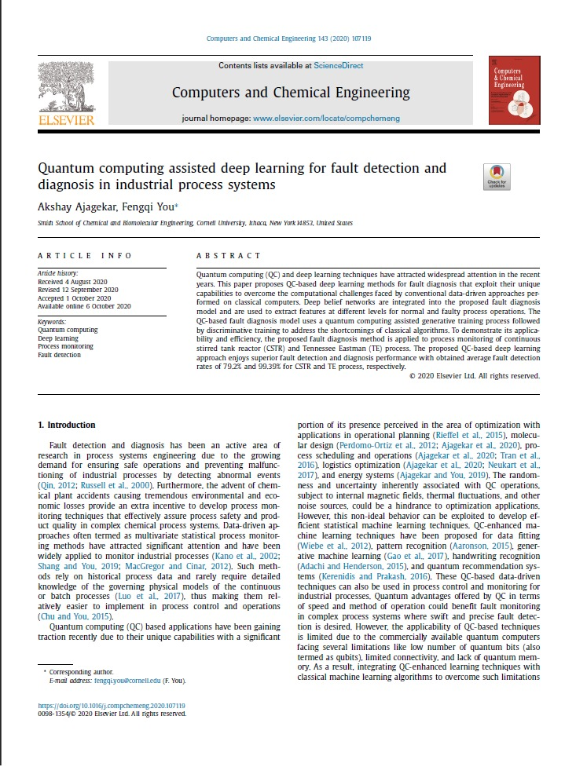
Quantum computing assisted deep learning for fault detection and diagnosis in industrial process systems
Presented by – Prakash Kumar (210107103)
Course code – CL 311
Date – 29/08/2023

Slide 2
Table of Content
Introduction (3-7)
Background
Objective
Literature Gaps
Literature Comparison
Methods (8-11)
Results and Discussion (12-15)
Summary (16-18)
Conclusion
Future Research Avenues
References (19)

Slide 3
INTRODUCTION

Slide 4
Background
Preventing plant accidents causing environmental and economical losses.
Computational limitation of classical training algorithm for deep learning model.
Growing demand for ensuring safe operations and preventing malfunctioning by detecting abnormal events.

Slide 5
Objective
To propose a quantum computing-based fault diagnosis model for complex industrial chemical process systems.
Demonstrate the applicability of the proposed model through two case studies on a CSTR and TE process.
Optimizes the training part with the help of quantum computing as compared to traditional data driven approach.

Slide 6
Literature Gaps
Applicability of QC based techniques
The applicability of QC-based techniques is limited due to the commercially available quantum computers have low number of quantum bits, limited connectivity and lack of quantum memory.
PCA Limitations
PCA-based methods do not take into account the temporal correlations between process data and information between classes when determining the lower dimensional representations.
Linear Methods
Most of the analytical approaches are limited to linear and some specific nonlinear models, hence need for complex methods for detection system.
Ref. Wiebe et al., 2012
Ref. Venkatasubramanian et al.,2003
Ref. Lee et al., 2006

Slide 7
Literature Comparison
Applicability of QC based techniques
Overcomes current quantum hardware limitations by proposing a hybrid approach that leverages both classical and quantum resources effectively.
PCA Limitations
The use of deep learning allows the model to capture temporal dependencies and class-specific information, improving the accuracy of fault detection.
Linear Methods
The paper leverages deep learning, which is well-suited for handling complex, nonlinear relationships within the data.
Ref. Wiebe et al., 2012
Ref. Venkatasubramanian et al.,2003
Ref. Lee et al., 2006

Slide 8
METHODS

Slide 9
Methodological Approach
Classical Data-Driven Methods
RBM and Quantum Techniques
Restricted Boltzmann Machines (RBMs)
Partial Least Squares (PLS)
Independent Component Analysis (ICA)
Fisher Discriminant Analysis (FDA)
Principal Component Analysis (PCA)
Adiabatic Quantum Computing
RBMs as the initial data interaction with the proposed QC model.

Slide 10
Quantum-Powered Fault Diagnosis
Proposed QC-Based Deep Learning Model
Industrial Validation
Application of QC-based model for fault detection and evaluation on:
Trained using historical process data.
Tested on separate datasets with normal and faulty states.
Quantum computing techniques for improved fault detection.
Tennessee Eastman (TE) chemical process.
Continuous Stirred Tank Reactor (CSTR) process.

Slide 11
Quantum Advantage and Experiment Details
Quantum Advantage
Experimental Settings (TE Process and CSTR Process)
Continuous and real-valued historical process data.
Enhanced fault detection rates in case studies.
Reduced false positives compared to classical techniques.
Normalization of training data.
Utilization of all 52 process variables as input for the QC-based model.

Slide 12
RESULTS AND DISCUSSION

Slide 13
Fault Detection with Local Classifier:
Local classifier outputs probabilities between 0 and 1 for normal or faulty states.
Threshold probability of 0.5 determines sample state (normal or faulty).
The average False Detection Rates for training is 99.57% and validation is 99.39%.
Fault Identification with QC-Based Model:
Repeating sub-network utilizes deep belief networks (DBN) and local classifier.
Output probabilities from the sub-network serve as inputs for the global classification network.
Abstractions of normal and faulty states are merged to diagnose new process data samples.

Slide 14
Performance Comparison:
QC-based model achieves 99.39% average detection rate and 5.25% false positive rate.
Quantum Processing Unit:
AQC-based device with 2,048 qubits and 5,600 couplers.
Outperforms PCA and DBN-based models in fault detection rates.
Demonstrates high efficiency in distinguishing normal and faulty state.
Limits RBM energy function size to 52 units per layer.
Weight and bias updates computed using samples from the quantum processing unit.

Slide 15
Learning Algorithm:
Contrastive divergence (CD) learning algorithm for RBM training.
CD-k learning with Gibbs chain for k steps to generate training samples.
Modified variation for RBMs with Gaussian visible units.
Model Parameters and Trade-off:
DBN-based sub-network parameters fine-tuned with backpropagation.
Gradients of loss function estimated for iterative parameter updates.
Minimization of categorical cross-entropy loss for maximum likelihood estimates.
QC-based model achieves a balance between high FDR (99.39%) and low FAR (5.25%), efficient in distinguishing faulty data from normal operation states.

Slide 16
SUMMARY

Slide 17
Conclusion
Quantum computing reduces computation effort and combines quantum and deep neural networks to offer a competitive edge.
Competitive performance against classical methods as we get average Fault Detection Rate (FDR) of 80% and total average False Alarm Rate (FAR) of 1.3% for rare fault detection.
Demonstrates robust generalization, even without feature screening and achieves higher accuracy in classifying different fault states.

Slide 18
Future Research Avenues
Scaling Quantum Computing:
Explore quantum computing scalability for complex industrial chemical processes.
Investigate performance with a growing number of process variables.
Assess quantum computing's potential compared to classical techniques as systems become larger and more complex.
Improving Quantum Generative Training:
Enhance quantum generative training techniques.
Explore different quantum algorithms for improved sampling abilities.
Aim for faster convergence and superior deep learning model performance.

Slide 19
References
Ajagekar, A. , Humble, T. , You, F. , 2020. Quantum computing based hybrid solu- tion strategies for large-scale discrete-continuous optimization problems. Comp. Chem. Eng. 132, 106630 .
Ajagekar, A. , You, F. , 2019. Quantum computing for energy systems optimization: Challenges and opportunities. Energy 179, 76–89 .
Perdomo-Ortiz, A. , O’Gorman, B. , Fluegemann, J. , Biswas, R. , Smelyanskiy, V.N. , 2016. Determination and correction of persistent biases in quantum annealers. Sci. Rep. 6, 18628 .
Lv, F.Y. , Wen, C.L. , Bao, Z.J. , Liu, M.Q. , 2016. Fault diagnosis based on deep learning. 2016 American Control Conference (ACC) 6 851–6 856 .
Benedetti, M. , Realpe-Gómez, J. , Biswas, R. , Perdomo-Ortiz, A. , 2016. Estimation of effective tem peratures in quantum annealers for sampling applications: A case study with possible applications in deep learning. Phys. Rev. A 94, 022308 .
Rieffel, E.G. , Venturelli, D. , O’Gorman, B. , Do, M.B. , Prystay, E.M. , Smelyanskiy, V.N. , 2015. A case study in programming a quantum annealer for hard operational planning problems. Quant. Inform. Process. 14, 1–36 .

Slide 20
THANK YOU

