Slide 1
CAPSTONE | PROFESSIONAL REVIEW II
Intelligent Traffic Management
and Emergency Response Platform
A simulation-validated system for adaptive traffic control, incident awareness, and emergency priority on the Vijayawada corridor.
SUMO + TraCI
SAFE SIGNAL CONTROL
EMERGENCY ROUTING
B. Prakash Raj | 23BCE9434 M. Venkat Komal | 23BCE9377
D. Preethi Darahasa | 23BCE8318 K. Vivek | 23BCE9396
Guide N. Purnachand | SCOPE | VIT-AP University
REVIEW II | 2026

Slide 2
JOURNEY SINCE REVIEW I
From planned system to measurable working modules
The implementation now has a corridor model, guarded control logic, emergency coordination, a live operator layer, and a trainable anomaly pipeline.
M0-M1
M2
M3-M5
M6
M7
Foundation and live corridor
Safety kernel
Adaptive control
Anomaly pipeline
Emergency response
Docker/event contracts and a real Vijayawada SUMO corridor
Signal interlocks and adversarial verification
Benchmarks, A-CA-MP and cycle supervision
Graph detection, calibration and operator gate
Dispatch and green-corridor preemption
Review II evidence
We report measured gains where they are proven, and explicitly state the remaining M6 model-accuracy and live-integration gaps.
ITMS | PROFESSIONAL REVIEW II
02

Slide 3
CONTEXT
Why one connected response is needed
Fixed plans, late reporting, and isolated emergency handling create avoidable delay and risk.
01
Fixed timers
02
Late incident awareness
03
Emergency delay
04
Fragmented control
Pre-set schedules cannot react to changing queues, demand, or blocked lanes.
A road blockage can propagate congestion before operators have reliable evidence.
Ambulances still face the same signal sequence as general traffic.
Optimisation, incident handling, and priority are often separate systems.
Our response
Sense traffic state -> decide safely -> coordinate emergency movement -> preserve an audit trail
The controller is deliberately constrained: every signal request is validated by a safety boundary before it can reach the simulator.
ITMS | PROFESSIONAL REVIEW II
03

Slide 4
ARCHITECTURE
A closed-loop system with safety at the command boundary
One event vocabulary lets SUMO, operators, and future roadside sources feed the same decision flow.
01
SENSE
02
ANALYSE
03
DECIDE
04
ARBITRATE
05
ACT
->
->
->
->
SUMO / vehicle positions / operator input
Traffic state + graph anomaly scores
Adaptive signals / route / corridor plan
Interlocks, priorities, audit and fallback
TraCI signal commands and dashboard events
COMMON EVENT CONTRACT
Vehicle positions | signal changes | incident candidate / confirmed / cleared | emergency commands
Phase 1 uses Redis Streams; service boundaries and contracts are designed for an eventual Kafka-backed deployment.
ITMS | PROFESSIONAL REVIEW II
04

Slide 5
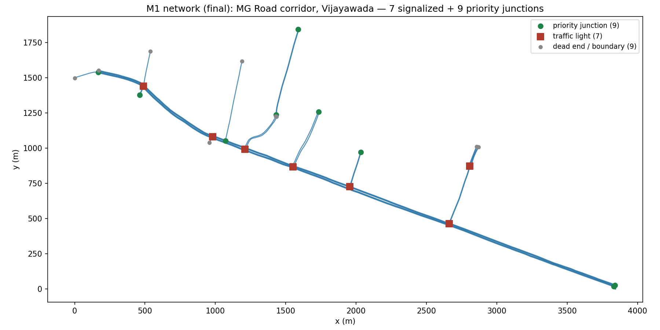
SIMULATION TESTBED
The Vijayawada MG Road corridor is the shared evaluation ground
The same seven-signal model underpins controller, incident, and emergency-response experiments.
7
73
signalized junctions
controlled links
plus 9 priority junctions
used by M6 graph features
103
1 Hz
medical facilities
live map updates
available to dispatch routing
SUMO state published to UI
Evaluation principle: hold the demand and random seeds constant while comparing the controller arms.
ITMS | PROFESSIONAL REVIEW II
05

Slide 6
M5 | ADAPTIVE TRAFFIC CONTROL
A-CA-MP makes local pressure decisions inside a safe cycle envelope
The controller remains adaptive; the supervisor ensures each demanded phase is served before the bounded cycle closes.
CONTROL LOGIC
-19.9%
-11.4%
-11.6%
Observe
queues and pressure
light-demand delay
medium-demand delay
heavy-demand delay
vs tuned Webster | 10/10 held-out seeds
vs tuned Webster | significant gate result
vs tuned Webster | zero violations
v
Select highest-pressure
valid phase
Why the supervisor matters
v
It activates in only 0.6-1.0% of phase changes, yet removes the heavy-demand interlock violations seen with the ceiling alone.
Arbiter enforces minimum green, clearance, conflict lockout and maximum wait.
ITMS | PROFESSIONAL REVIEW II
06

Slide 7
M6 | INCIDENT AWARENESS
The detection pipeline is built end to end; model accuracy is the current gap
We separate implementation completeness from validation completeness and report the proof-of-training metrics honestly.
01
FEATURES
02
GRAPH MODEL
03
CALIBRATE
04
HUMAN GATE
05
AUDIT
73 links x 10 traffic features per tick
Temporal graph autoencoder scores unusual links
Conformal threshold + persistence and cooldown
Operator confirms or rejects a candidate
State machine and hash-chained history
PROOF-OF-TRAINING RESULT
Recall
Latency
Status
Next evidence
0.50
40 s
105+
30 runs
target >= 0.90
target < 30 s
dedicated automated tests
record normal traffic; train 50-80 epochs
ITMS | PROFESSIONAL REVIEW II
07

Slide 8
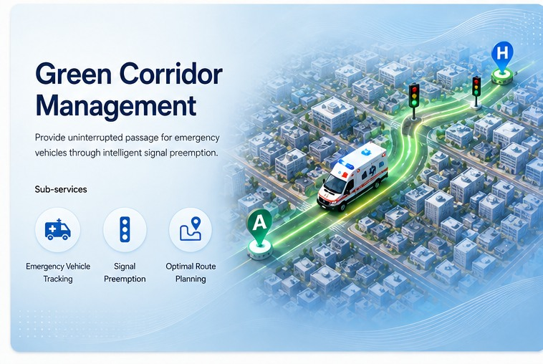
M7 | EMERGENCY RESPONSE
Dispatch and green-corridor coordination reduce emergency delay
Instead of each signal reacting in isolation, the route is reserved and released as the vehicle passes.
3.5-4.3
25-31
31-46
EV time saved
less time lost
fewer EV stops
% reduction vs reactive preemption
% reduction vs reactive preemption
% reduction; statistically significant
Dispatch decision
Hospital destinations come from real map data; the router selects a clinically suitable destination using live traffic cost.
Measured with no meaningful cross-street traffic penalty.
ITMS | PROFESSIONAL REVIEW II
08

Slide 9
INTEGRATION AND DEMONSTRABLE SYSTEM
The live operator flow now drives the controlled simulation
The web app is not a mock-up: it receives live events, displays candidates, and can affect the running SUMO scenario.
LIVE RUN
SUMO corridor controlled by
A-CA-MP
Redis event stream
and API service
WebSocket operator
dashboard
Approved
command
->
->
->
Current verified capabilities
Live vehicle/signal state at 1 Hz | Candidate confirmation/rejection API | Operator-driven anomaly injection | Dynamic emergency re-routing
Note: benchmarked M7 preemption is completed; wiring that engine into the live operator demo is an explicit remaining integration task.
ITMS | PROFESSIONAL REVIEW II
09

Slide 10
VALIDATION DISCIPLINE
Results are gated with safety checks, paired comparisons, and traceable artefacts
The project deliberately treats negative results and caveats as findings - not hidden exceptions.
A
Safety first
B
Fair comparison
C
Reproducible artefacts
Nine property tests each generate 10,000 adversarial cases. The safety kernel rejects unsafe timing plans before they reach SUMO.
Controller arms share demand and random seeds. Results use paired held-out evaluation seeds and confidence intervals.
Raw runs, scripts, event schemas, tests, and benchmark gates are preserved in the repository.
What we do not overclaim
M6 graph detector is correctly wired but undertrained; the camera-based vision stream remains future scope; simulation demand and pedestrian behaviour are still simplified.
ITMS | PROFESSIONAL REVIEW II
10

Slide 11
STATUS AND NEXT REVIEW PLAN
Build is strong where evidence exists; close the accuracy and integration gaps next
A review-ready project is one that makes its tested boundaries as clear as its achievements.
1
Validated now
M0-M5 foundations, safe adaptive control, M7 dispatch/corridor benchmarks
2
Implemented, needs evidence
M6 graph-detection pipeline; expand normal-data collection and train the shipped model
3
Next integration
Connect the benchmarked M7 corridor engine to the live operator workflow
4
Future scope
Camera/YOLO evidence stream, calibrated field demand, pedestrian-aware signal phases
ITMS | PROFESSIONAL REVIEW II
11

Slide 12
Thank you
Questions and discussion
We are ready to demonstrate the corridor, explain the measurement gates, and discuss the M6 training plan.
B. Prakash Raj | M. Venkat Komal | D. Preethi Darahasa | K. Vivek
Guide: N. Purnachand | SCOPE | VIT-AP University
ITMS | PROFESSIONAL REVIEW II

