Slide 1

DDMM – Project Review
Project Title:
Machine Learning-Based Prediction of Bulk Modulus of Crystalline Materials
Student
B. Gnana Prakash - CB.SC.U4AIE23014
Dataset: Matbench log_kvrh (10,987 materials) · Code: github.com/Prakash686/ML-based-Bulk-Modulus-Prediction

Slide 2
Introduction & Problem Statement
Bulk modulus (K) measures a material's resistance to uniform compression - a key property for structural materials, energy systems and electronics. It is normally obtained from first-principles (DFT) calculations, which are accurate but computationally expensive, making large-scale screening of new materials slow.
This project develops an ML framework that:
• Converts crystal structures into meaningful numerical descriptors (composition + structure)
• Trains and systematically compares Linear Regression, Random Forest, MLP and Gradient Boosting
• Predicts log10(K_VRH) for unseen materials in milliseconds instead of hours of DFT
• Identifies which descriptors drive stiffness, for physical interpretability
• Delivers an interactive web app to predict K from a formula or a crystal structure file
2

Slide 3
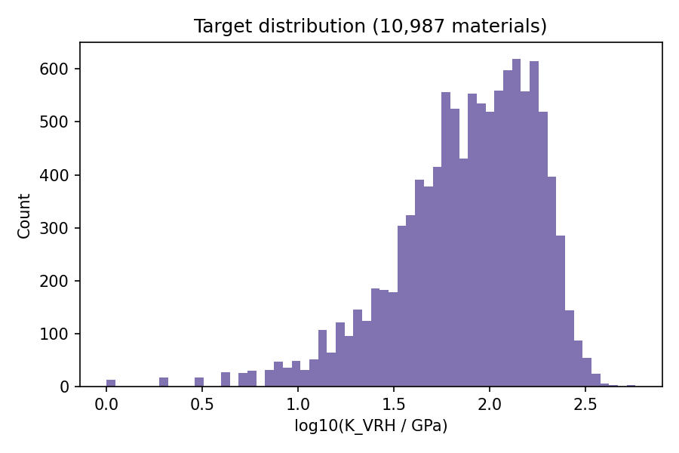
Dataset – Matbench log_kvrh
Standardised materials-ML benchmark derived from the Materials Project
Property | Value
Samples | 10,987 crystals
Input | Crystal structure (pymatgen)
Target | log10(K_VRH / GPa)
K range | 1 – 575 GPa
Median K | 86 GPa
Split | 80% train / 20% test
K_VRH = Voigt-Reuss-Hill average: Hill takes the mean of the Voigt (upper) and Reuss (lower) bounds.
Why log10? K spans >2 orders of magnitude; the log makes errors relative.
3

Slide 4
Methodology
End-to-end pipeline from crystal structure to prediction
1. Load
2. Featurize
3. Split
4. Train
5. Evaluate
6. Deploy
10,987 structures
+ log10 K values
65 descriptors
per material
80% train
20% test
+ 5-fold CV
Linear Reg.
Random Forest
MLP
Grad. Boosting
MAE, RMSE
R², MAE (GPa)
Streamlit app
formula / CIF
Tools: Python · pymatgen (structure parsing, element data) · scikit-learn · matplotlib · Streamlit · joblib (parallel featurization, ~20 s)
Reproducibility: every random step uses seed 42; the app reuses the exact same train/test split as the evaluation.
Fair comparison: all four models are trained on the same features and scored on the same 2,198 unseen test materials.
4

Slide 5
Descriptors – Crystals to Numbers
ML models cannot read a crystal directly, so each structure becomes 65 features
Composition descriptors (50)
Structure descriptors (15)
10 elemental properties:
• Atomic number, atomic mass
• Electronegativity (bond type)
• Atomic radius, molar volume (size)
• Melting point (bond strength proxy)
• Periodic row & group
• 1st ionization energy, valence electrons
× 5 statistics: fraction-weighted mean, std, min, max, range (Magpie-style)
• Number of elements and of atomic sites
• Volume per atom, mass density
• Lattice parameters a, b, c and angles α, β, γ
• Packing fraction = atomic sphere volume / cell volume
• Nearest-neighbour distance: mean, min, max, std (periodic, 5 Å cutoff)
Captures how atoms are arranged - not just which elements are present.
5

Slide 6
Models & Evaluation Setup
Model | Type | Configuration
Linear Regression | Linear baseline | Standardised features
Random Forest | Bagged tree ensemble | 500 trees, 33% features per split
MLP | Neural network | 256-128-64 hidden units, early stopping, standardised
Gradient Boosting | Boosted tree ensemble | 1,500 iterations, learning rate 0.03, L2 = 1.0
Validation
Metrics
• Hold-out test set: 2,198 materials never seen in training
• 5-fold cross-validation on the 8,789 training materials to check stability
• MAE (log10) - Matbench standard metric
• RMSE - penalises large errors
• R² - variance explained (1 = perfect)
• MAE in GPa - intuitive physical error
6

Slide 7
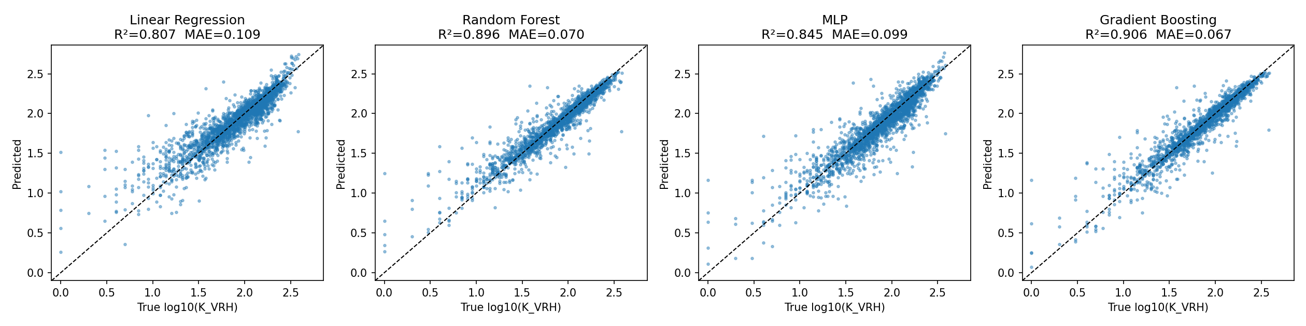
Results – Model Comparison
Hold-out test set (2,198 materials); CV = 5-fold mean ± std
Model | CV MAE | Test MAE | Test RMSE | Test R² | MAE (GPa)
Linear Regression | 0.109 ± 0.002 | 0.109 | 0.167 | 0.807 | 19.6
Random Forest | 0.071 ± 0.002 | 0.070 | 0.122 | 0.896 | 11.9
MLP | 0.091 ± 0.004 | 0.099 | 0.149 | 0.845 | 18.3
Gradient Boosting ★ | 0.067 ± 0.001 | 0.067 | 0.116 | 0.906 | 11.2
Gradient Boosting is best on every metric
MAE 0.067 ≈ 17% typical relative error
Tree ensembles beat linear & MLP: the relation is strongly non-linear
7

Slide 8
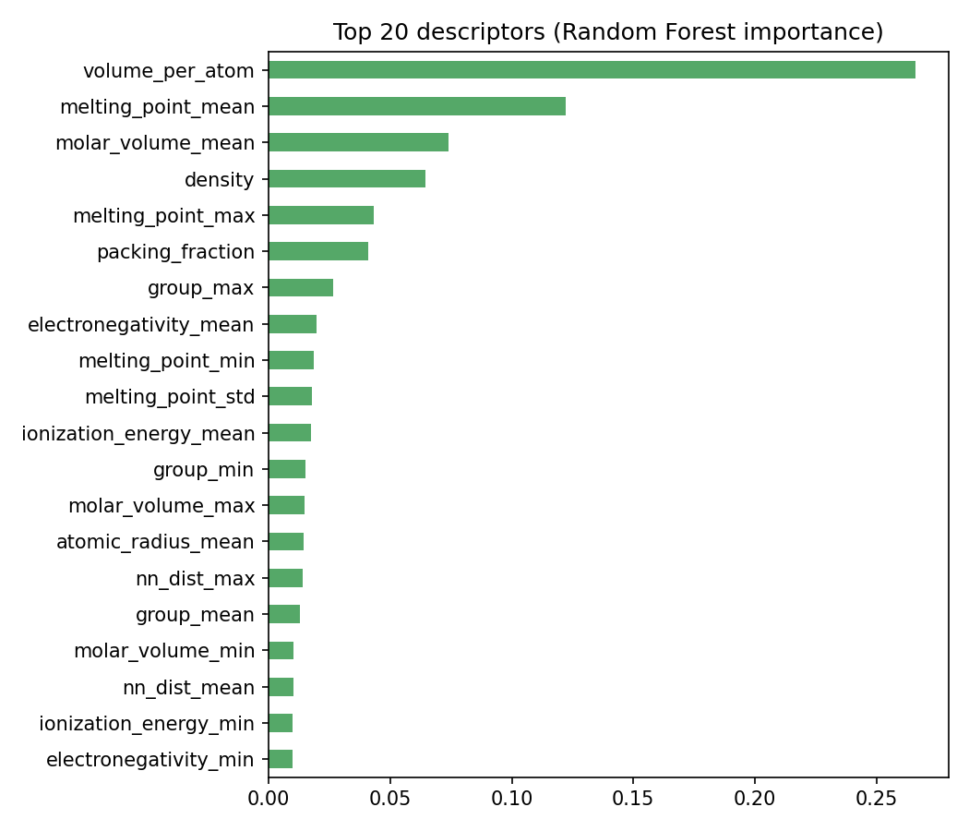
What Drives Bulk Modulus?
Random Forest feature importance - the model learns real physics
Descriptor | Physical meaning
Volume per atom | Tighter packing → stiffer
Mean melting point | Stronger bonds → stiffer
Mean molar volume | Larger atoms → softer
Density | Denser → generally stiffer
Packing fraction | Less free space → stiffer
• Atomic volume alone carries ~27% of the importance
• Matches known physics: K scales with bond strength / atomic volume
• Largest errors: very soft materials (K < 10 GPa), which are rare in the data
8

Slide 9
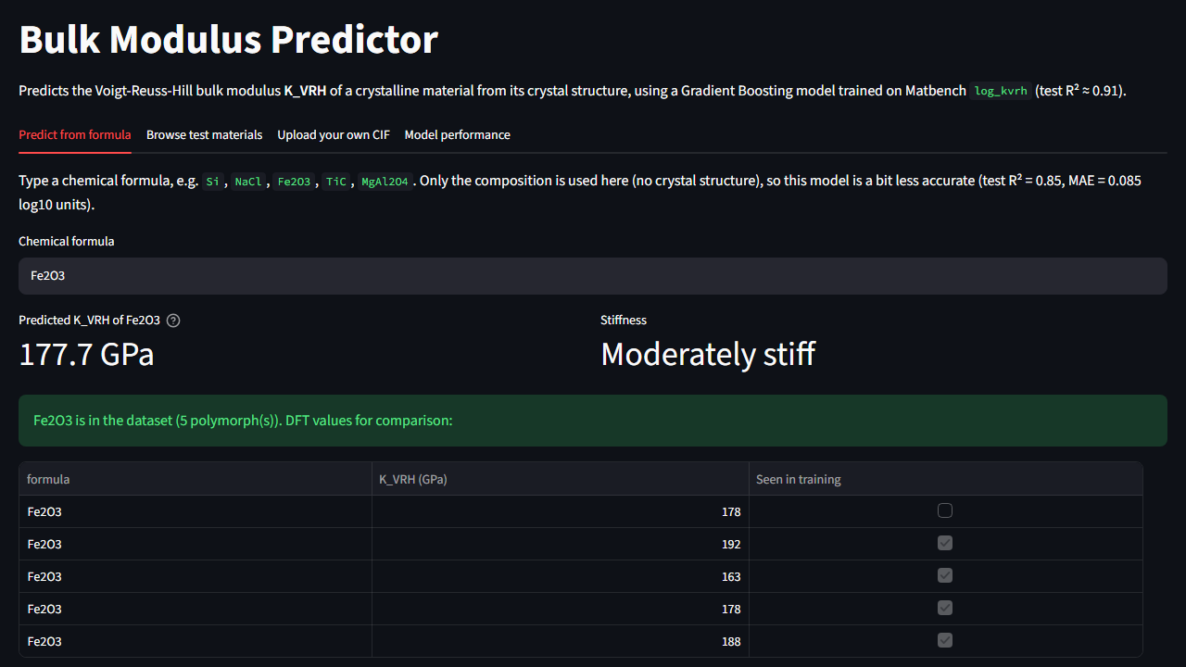
Interactive Prediction App
Streamlit web interface - run locally with one command
Four tabs
• Predict from formula - type e.g. Fe2O3 → 178 GPa (DFT: 163-192)
• Browse test materials - predicted vs. actual for unseen crystals
• Upload CIF - full-structure prediction (R² 0.91)
• Model performance - metrics & plots
How to run
pip install -r requirements.txt
streamlit run app.py
→ open http://localhost:8501
9

Slide 10
Conclusion & Future Work
Conclusion
Future work
• Built a complete ML pipeline predicting the bulk modulus of 10,987 crystals from structure
• Gradient Boosting best: R² = 0.906, MAE = 0.067 log10 (≈ 11 GPa)
• Tree ensembles clearly outperform Linear Regression and MLP
• Volume per atom and bond strength (melting point) are the dominant, physically meaningful descriptors
• Predictions in milliseconds vs. hours for DFT, enabling fast material screening
• Systematic hyper-parameter tuning (grid / Bayesian search)
• Graph neural networks (CGCNN, MEGNet) that learn directly from the atomic graph
• Evaluate on the official Matbench 5-fold protocol for leaderboard comparison
• Extend to shear modulus and other mechanical properties
Thank you
10

