Slide 1
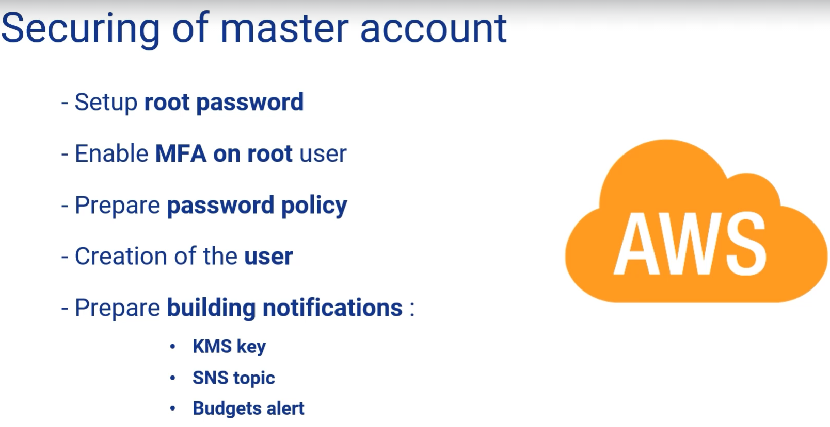
Secure the Management Account

Slide 2
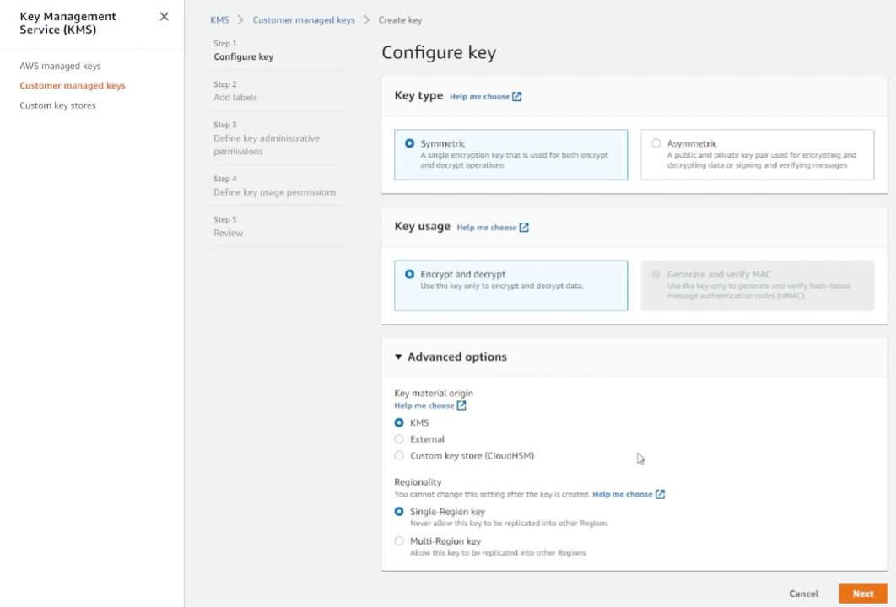
KMS Key

Slide 3
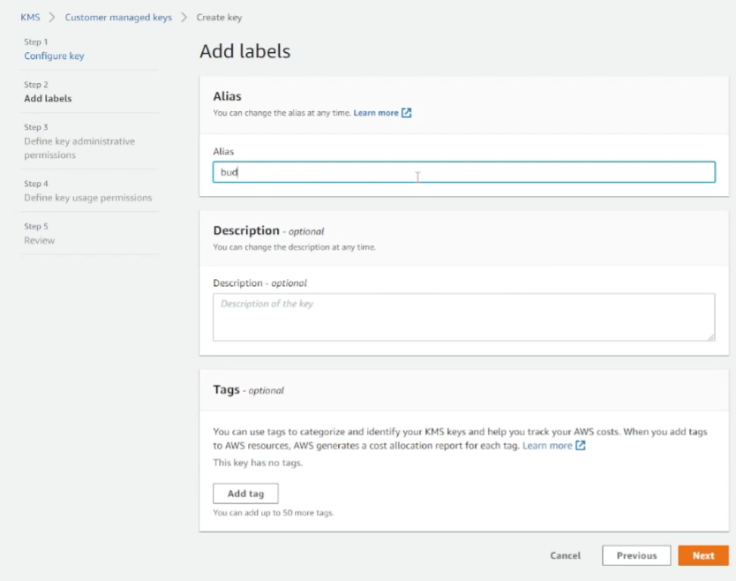
KMS Key

Slide 4
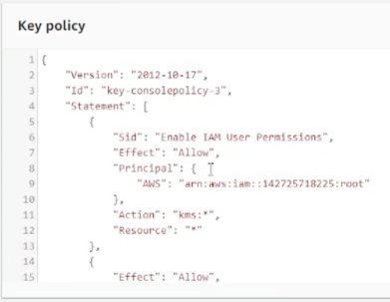
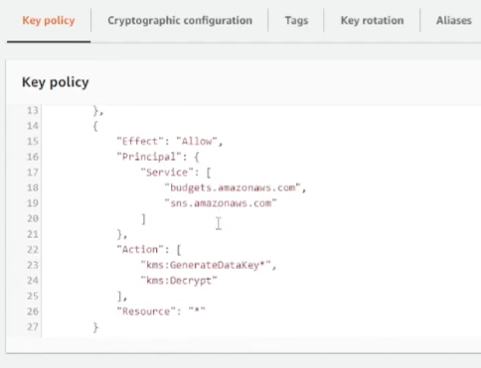
KMS Key
Notes:
Use the created Key for SNS topic for budgets

Slide 5
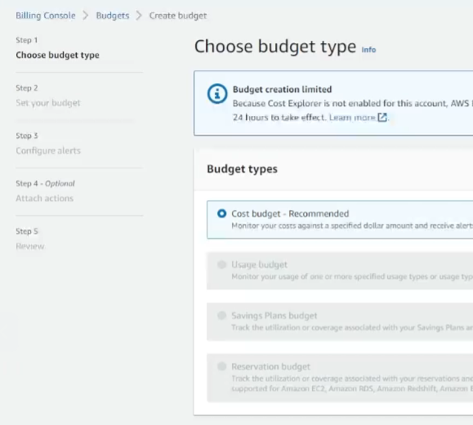
Budgets

Slide 6
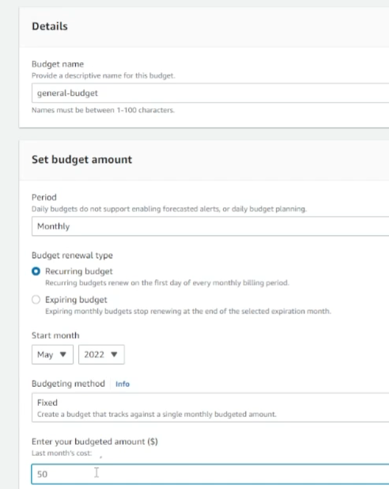
Budgets

Slide 7
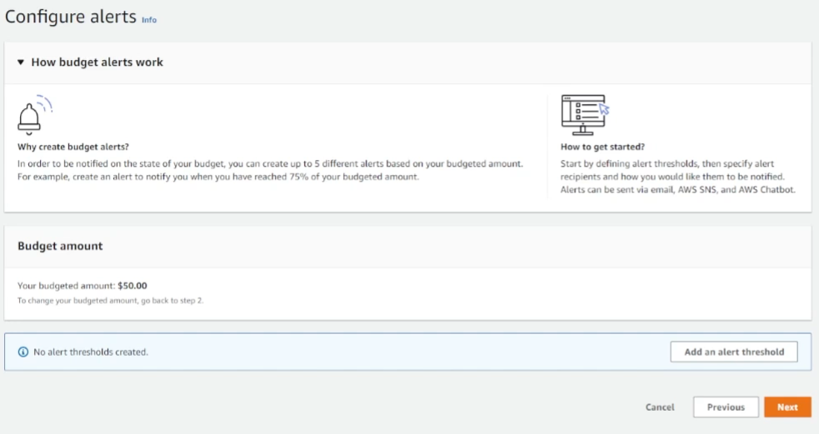
Budgets

Slide 8
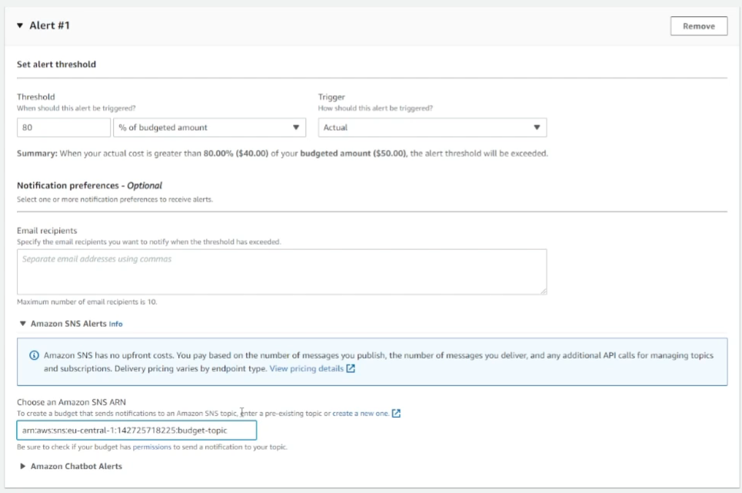
Budgets

Slide 9
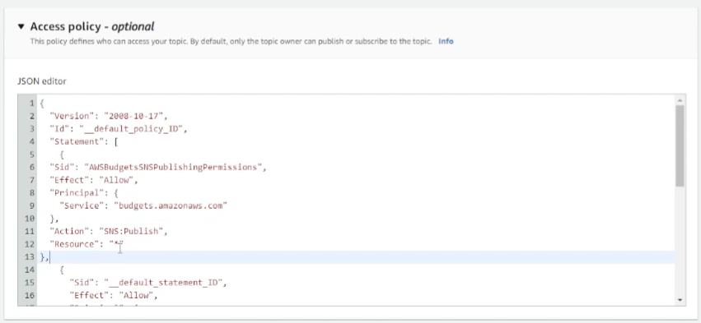
SNS Topic

Slide 10
Enable MFA for Landing zone administrator user

Slide 11
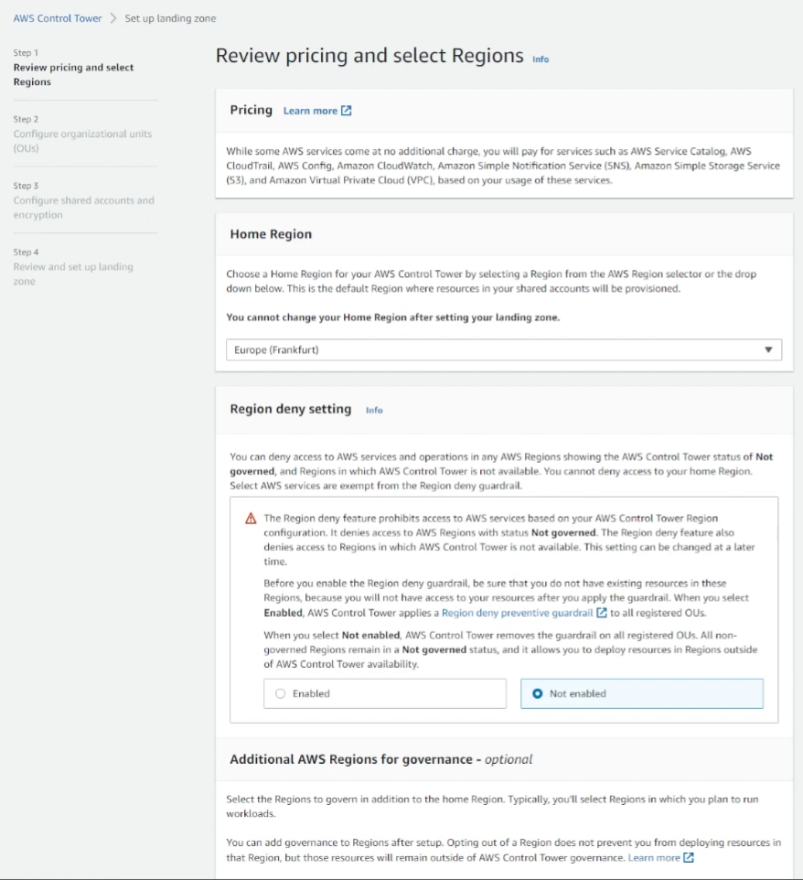
Control Tower
Notes:
Control Tower creates shared services (SNS, Roles) which are part of Home region. Select it based on the requirement

Slide 12
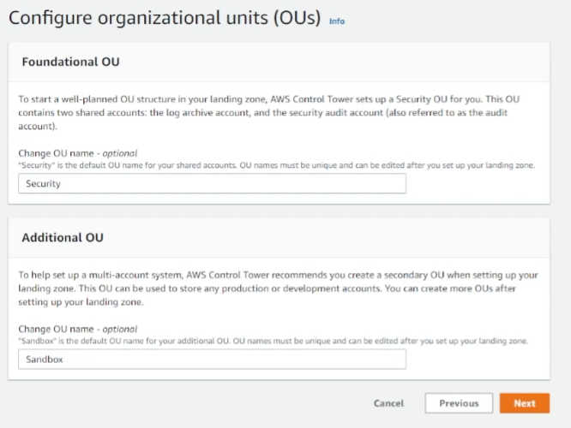
Control Tower
Notes:
Control Tower gives the default names . Security OU is for Security purpose

Slide 13
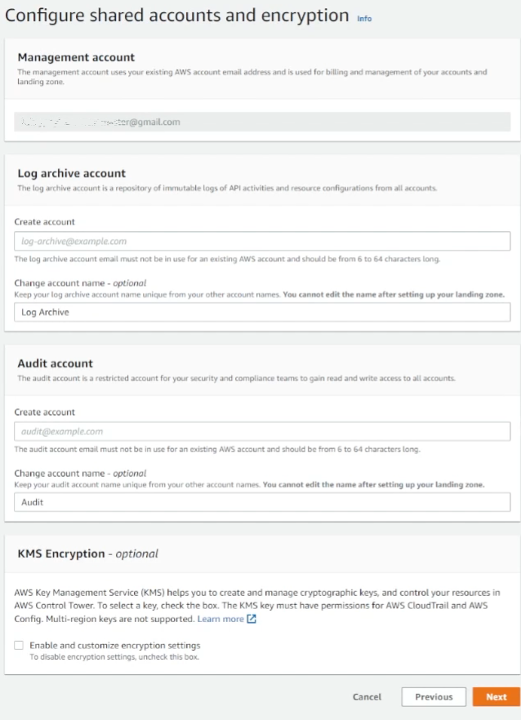
Control Tower
Notes:
Email id for account creation. The KMS, if you enable it is single Key used across securing control tower services (cloudwatch, cloud trail aws config)

Slide 14
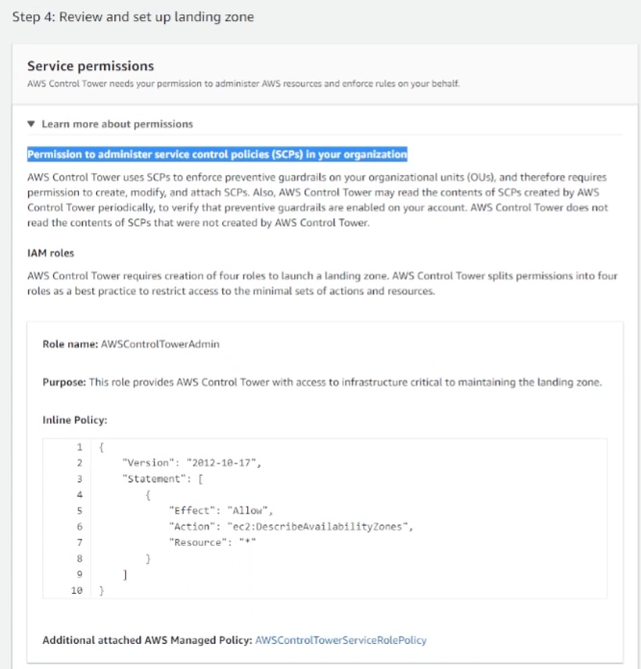
Control Tower
Notes:
ControlTowerAdmin created to control all services inside the organizations and the infrastructure creation to set up landing zone

Slide 15
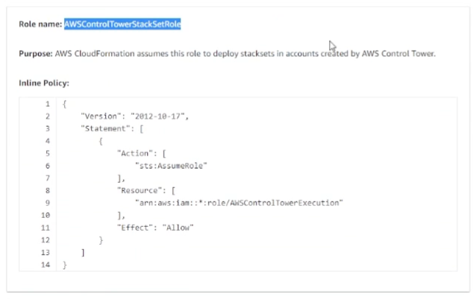
Control Tower

Slide 16
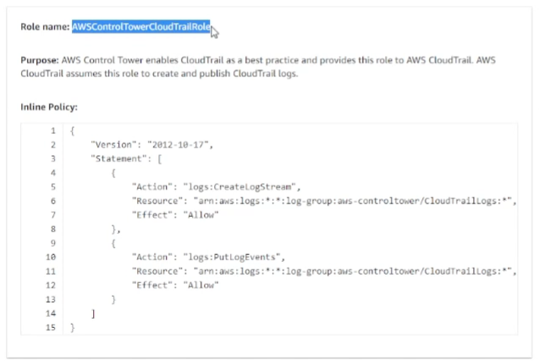
Control Tower

Slide 17
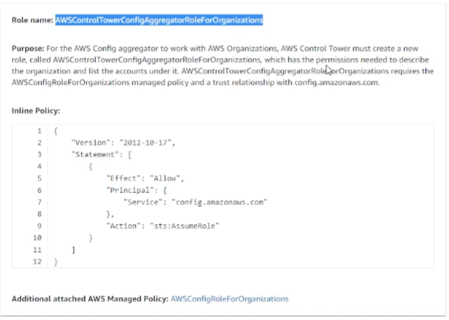
Control Tower
Notes:
This role used by the AWS config service to prepare the configuration

Slide 18
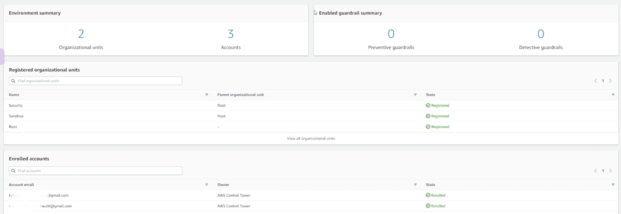
Control Tower
Notes:
It takes more than 40 mins to finish

Slide 19
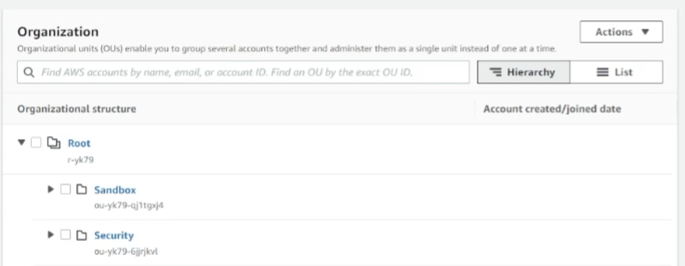
Control Tower
Notes:
This creates the SSO page with list of AWS accounts

Slide 20
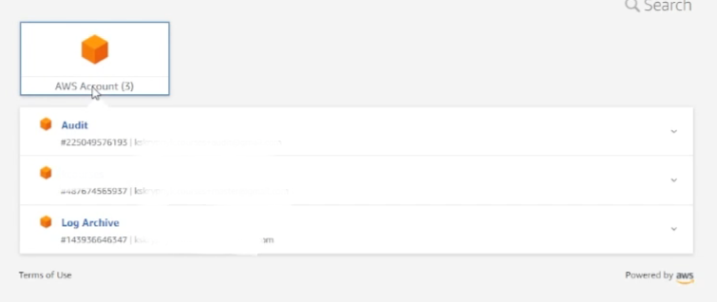
Control Tower

Slide 21
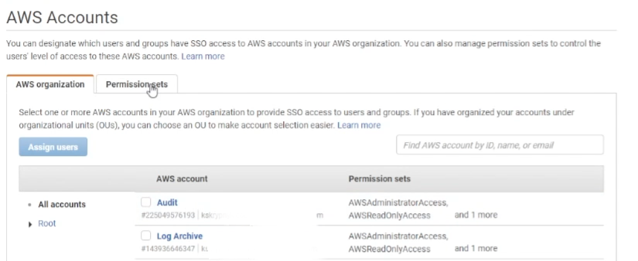
AWS SSO
Notes:
In the Users menu we can see the root user details. In groups , we can see the groups created by control tower. We can login to each account and see the roles created by control tower

Slide 22
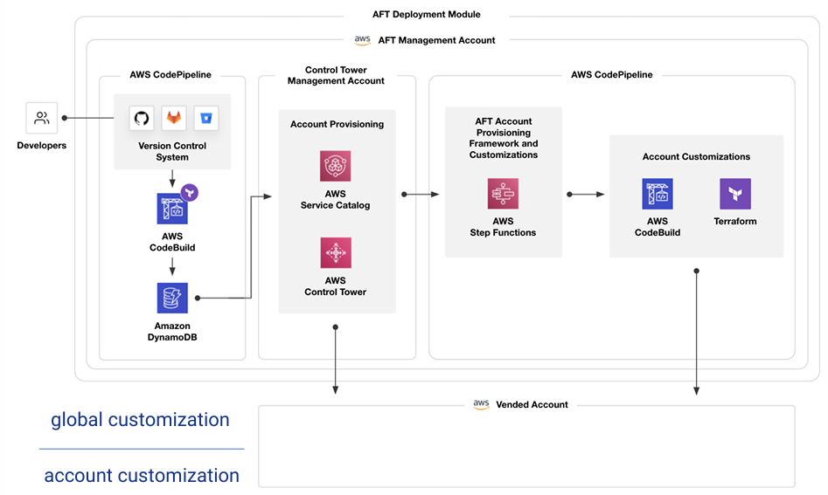
AFT (Account Factory for Terraform)
Notes:
It is new feature by AWS . It is a Terraform module that makes it easy to create and Customize new accounts with the Organization’s security guidelines.
This is available in Hashicorp website
AFT architecture has three high-level principles :
• AFT Pipeline (mandatory) is a main, automated pipeline for accounts creation and customization
• AFT Feature Options (optional) are built-in components- CloudTrail data event logging to S3- Removing default VPC in all regions- Automated enrolment in AWS Enterprise Support plan
• AFT Customization (optional) customization scripts implementation (Terraform and others

Slide 23
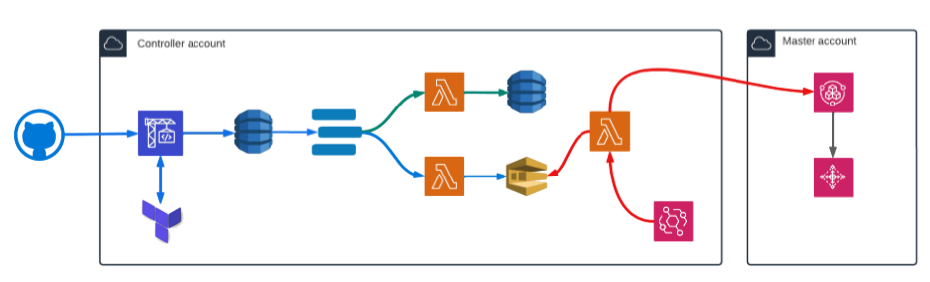
AFT (Account Factory for Terraform)
Notes:
Terraform version must be greater than 0.15
1 - Define Terraform script with account information and push on GIT changes Web hook configured in git to get the new changes
2 - CodeStar receive notification about changes and trigger CodeBuild with the implementation of TF scripts
3 - CodeBuild insert DynamoDB item with new account request
4 - DynamoDB triggering two lambda functions
5 - Lambda, triggered by the schedule of AWS EventBridge, pulls a message from SQS and does a request to AWS Account Factory
6 - AWS Account Factory creates of account using Control Tower and after triggers customization scripts
4.2 Lambda pushes the account request to the SQS queue
4.1 Lambda stores new account data on another DynamoDB table for audit

Slide 24
AFT (Account Factory for Terraform)
https://github.com/hashicorp-education/learn-terraform-aws-control-tower-aft
https://github.com/hashicorp-education/learn-terraform-aft-account-request
https://github.com/hashicorp-education/learn-terraform-aft-account-customizations
https://github.com/hashicorp-education/learn-terraform-aft-account-provisioning-customizations
https://github.com/hashicorp-education/learn-terraform-aft-global-customizations
Notes:
From your local Run the first repo to create buckets, code pipeline and code build. Provide the aws and github account details “terraform.tfvars”
Command : aws sts get-caller-identity – Make sure you use Lz admin user
Run the code build . If any any issues, check the region enabled and the service limits

Slide 25
AFT Account creation
https://github.com/hashicorp-education/learn-terraform-aft-account-request
Notes:
Provide the all the right details inside the scripts and push the changes
Login to control tower account . In dynamodb open the table aft-request Record inserted
Open the code pipeline see the status of the pipeline
Open SQS message pushed for Lambda
In cloudwatch you can see logs

