Slide 1
Support Vector Regressor
A library of Support Vector Machines.

Slide 2
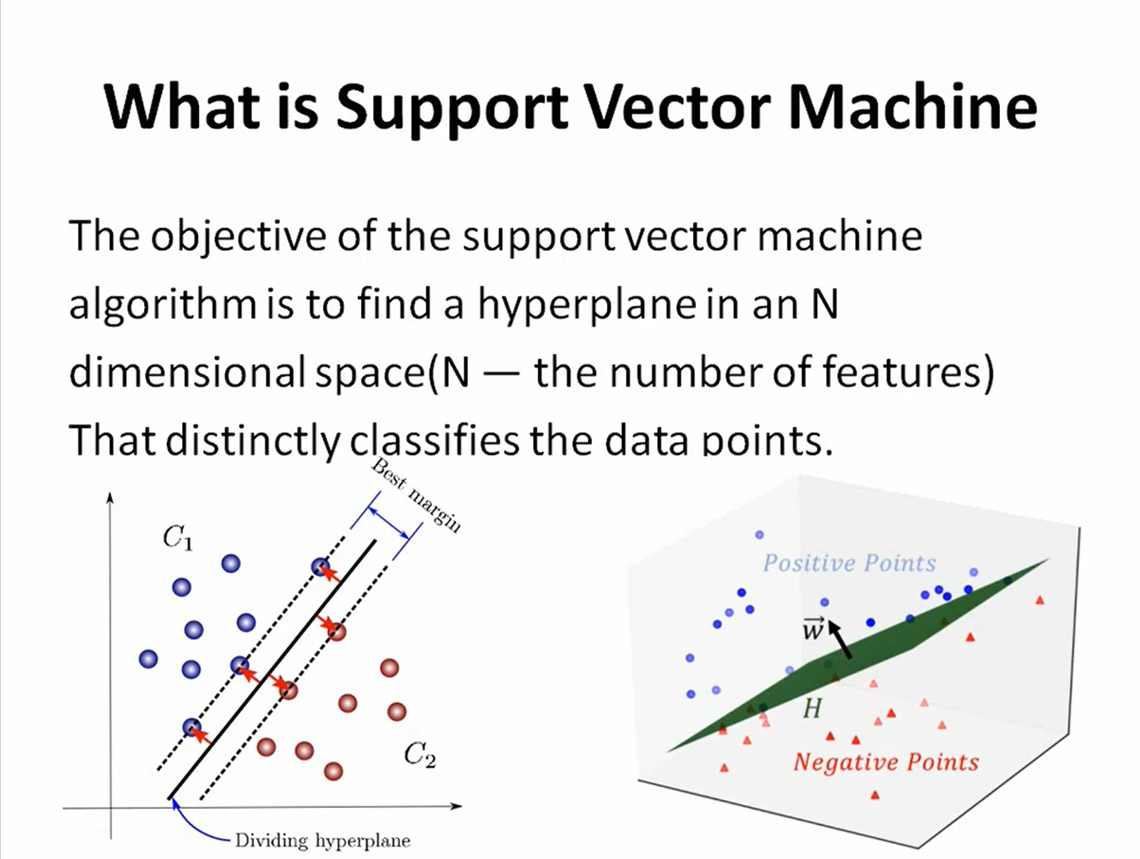

Slide 3
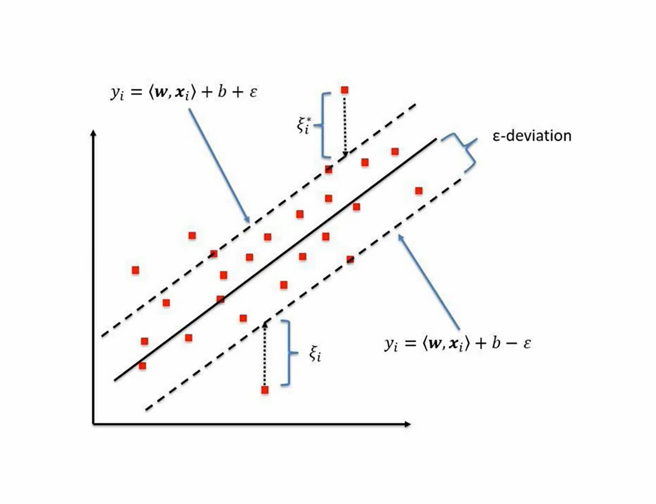

Slide 4
SVR PROPERTIES
Uses convex optimization technique.
Uses e-intensive loss.
Find e-intensive region using regression line. This region is called e-tube.
Basically it performs simple linear-regression in hyper-dimensional space.
Additional the model can detect the outliers to decrease over-fitting.

