Slide 1
E-Commerce Sales Analysis
By:
NSS Jaya Prakash
IIT kanpur

Slide 2
Sales and Profit Bar Chart

Slide 3
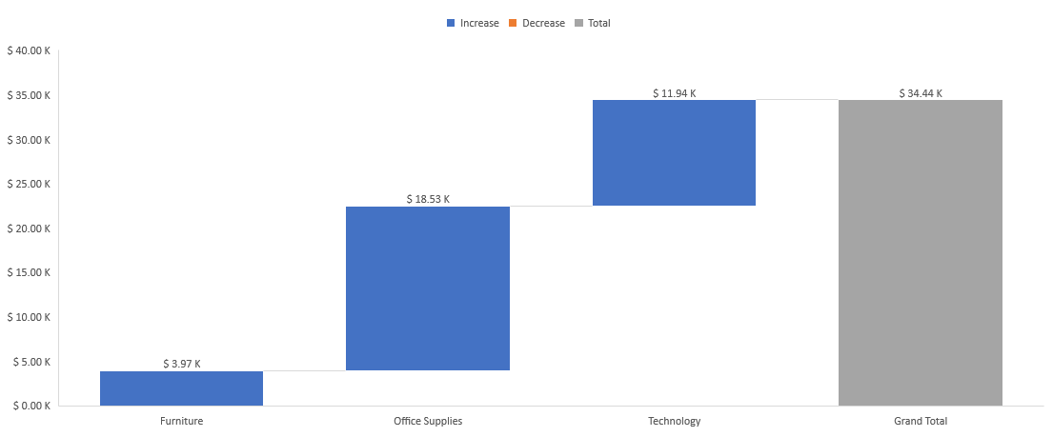
Category and Profit Waterfall chart

Slide 4
Category and Sales Chart

Slide 5
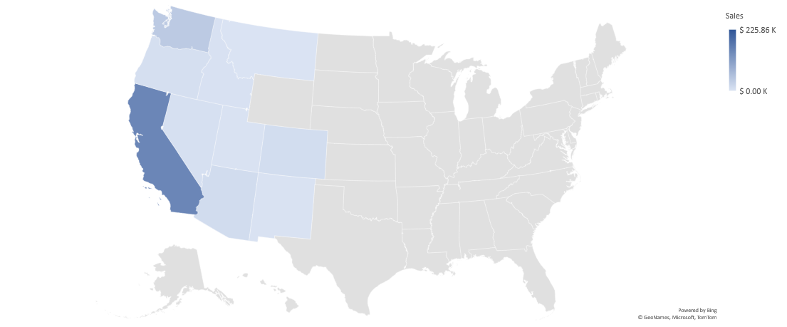
State and Sales Map Chart

Slide 6
Sub-Category and Sales Bar Chart

Slide 7
Tasks involved
By using different tools on each layout, I have generated the dashboard for Sales analysis.
Including slicer formatting, pivot tables, custom formatting of values, fill and border, filters, Report connections.
Worked on table design, pivot charts like bar chart, waterfall chart, pie chart, line graph, combo chart.
Generated a customized page layout for sales analysis.

Slide 8
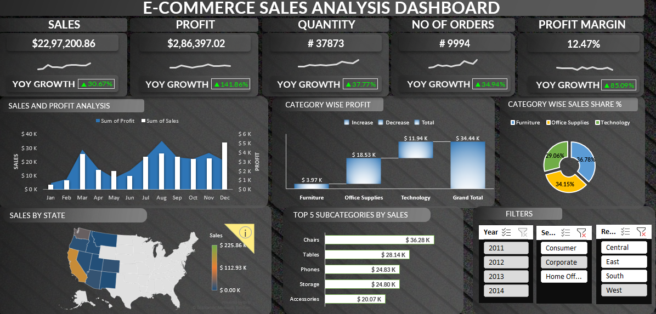
E-Commerce Sales Analysis Dashboard

