Slide 1
EDA analysis of Facebook Marketplace Dataset
By:
NSS Jaya Prakash
IIT Kanpur

Slide 2
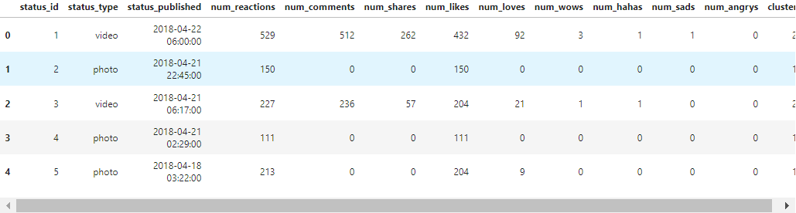
Dataset includes:
16 data columns with 7050 entries.
The column names include the following: “status_id, status_type, status_published, num_reactions, num_comments, num_shares, num_likes, num_loves, num_wows, num_hahas, num_sads, num_angrys, Column1, Column2, Column3, Column4”.

Slide 3
Data Cleaning:
Since the columns ‘Column1, Column2, Column3, Column4’ doesn’t have any data drop these columns.
Change the datatype of ‘status_published’ to datetime for easy analysis.
Making sure that no NaN values are present in the dataset.
Now, after cleaning the data, the data will have 12 rows and 7050 entries.

Slide 4
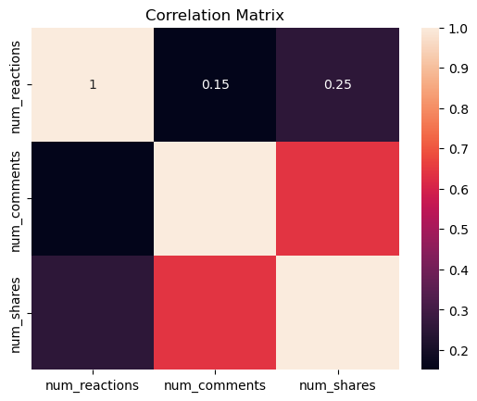
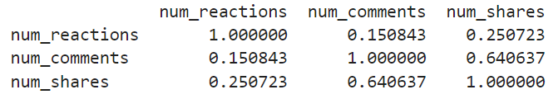
Question 1: Is there a correlation between the number of reactions (num_reactions) and other engagement metrics such as comments (num_comments) and shares (num_shares)? If so, what is the strength and direction of this correlation?
Selecting the columns and applying Correlation function on the columns.
Generating heatmap with the correlation matrix.
Correlation matrix

Slide 5
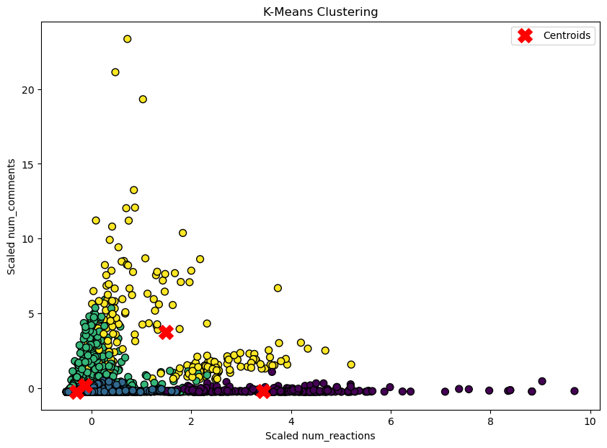
Question 2: Use the columns status_type, num_reactions, num_comments, num_shares, num_likes, num_loves, num_wows, num_hahas, num_sads, and num_angrys to train a K-Means clustering model on the Facebook Live Sellers dataset.
Select the relevant columns for clustering.
One-hot encode the status_type column since it's categorical
Apply feature scaling using standardization method.
Fit the K-Means model
Plot a scatterplot of clusters.

Slide 6
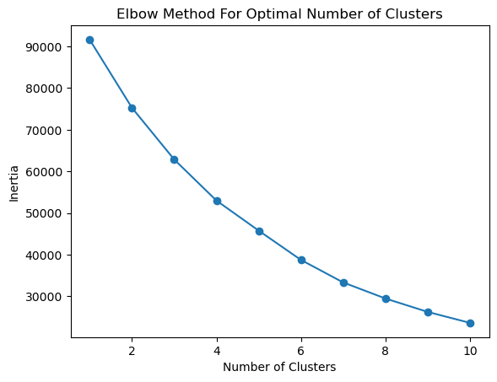
Question 3: Use the elbow method to find the optimum number of clusters.

Slide 7
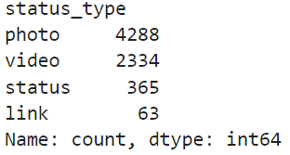
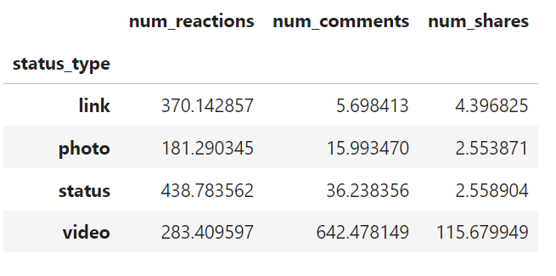
Question 4: What is the count of different types of posts in the dataset?
Question 5: What is the average value of num_reaction, num_comments, num_shares for each post type?

