Slide 1

NSS Jaya Prakash IIT Kanpur

Slide 2
Importing data

Slide 3
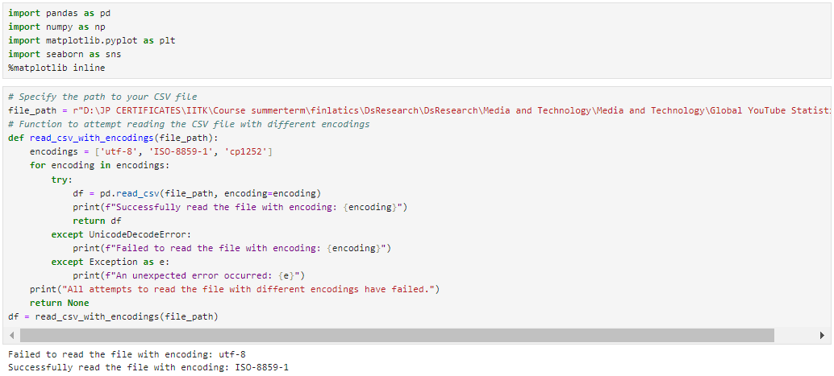

Slide 4
Data Cleaning

Slide 5
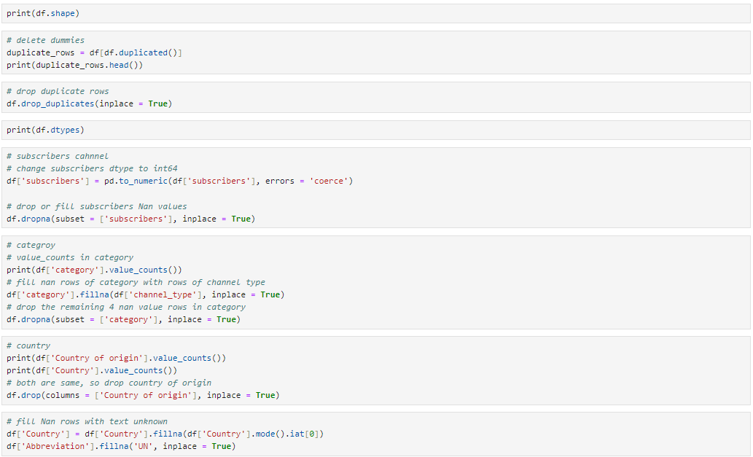

Slide 6
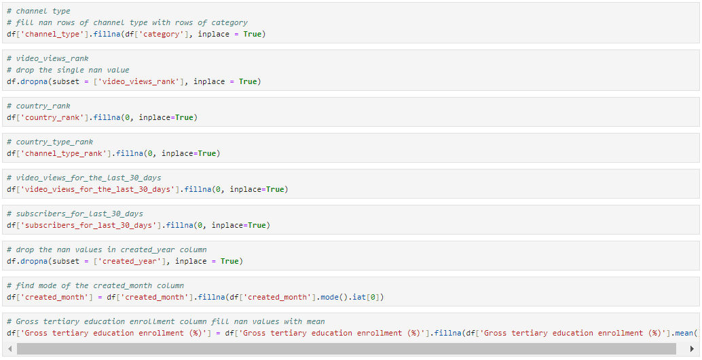

Slide 7
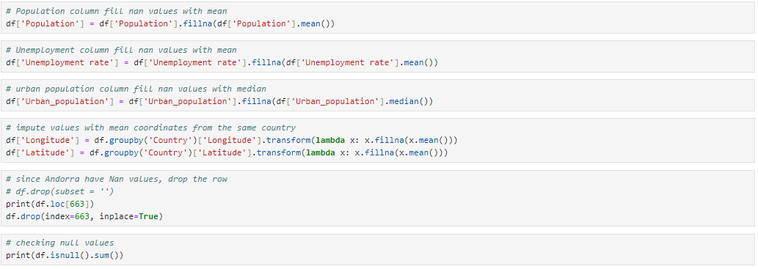

Slide 8
QUESTIONS

Slide 9
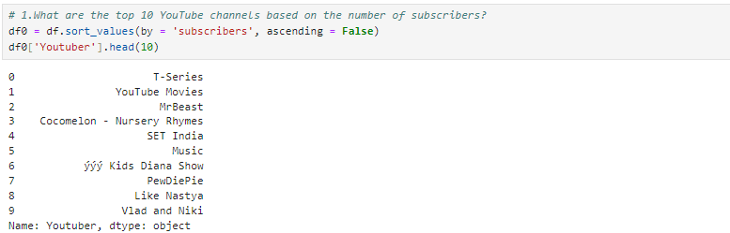
1. What Are The Top 10 YouTube Channels Based On The Number Of Subscribers?

Slide 10
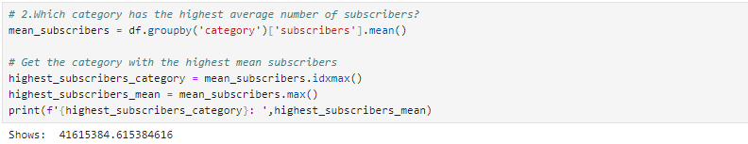
2. Which category has the highest average number of subscribers?

Slide 11
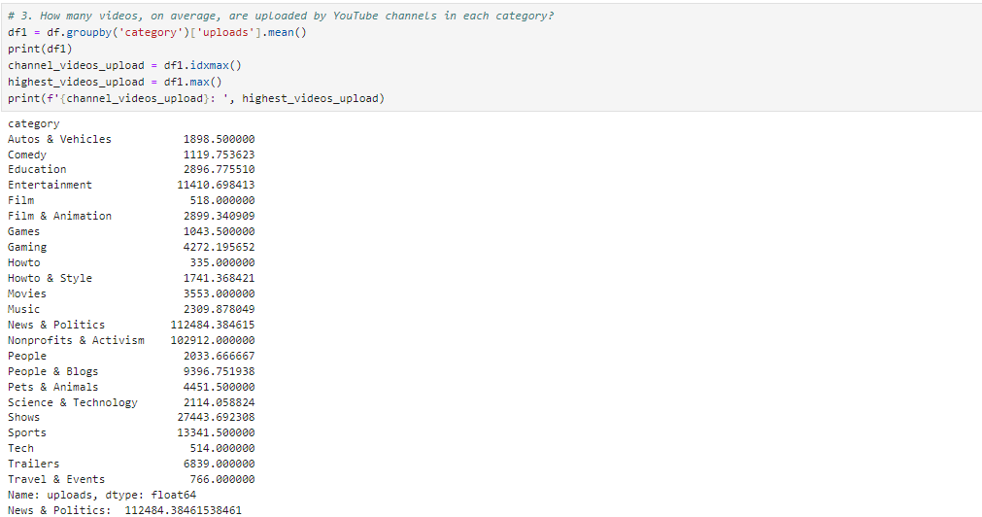
3. How many videos, on average, are uploaded by YouTube channels in each category?

Slide 12
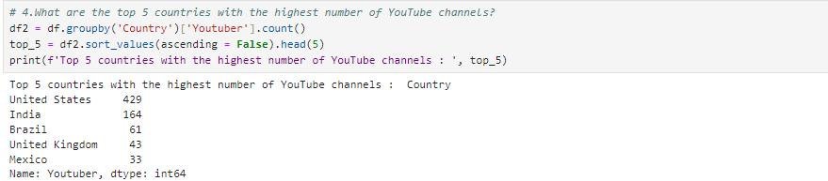
4. What are the top 5 countries with the highest number of YouTube channels?

Slide 13
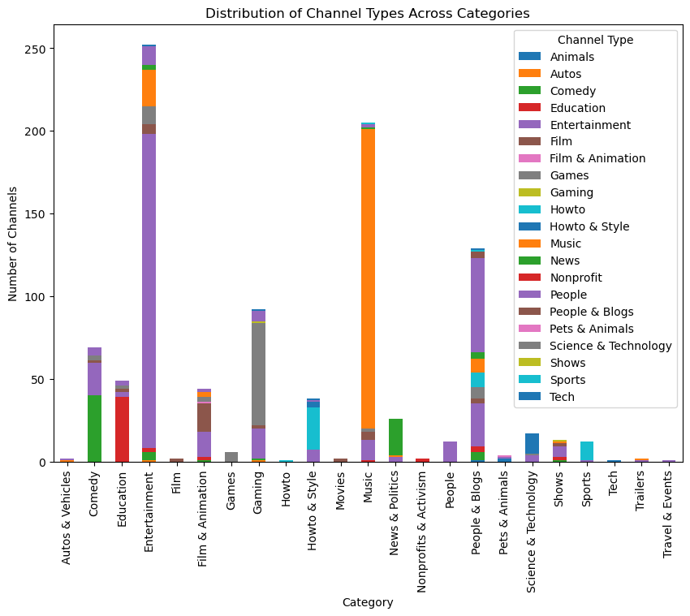
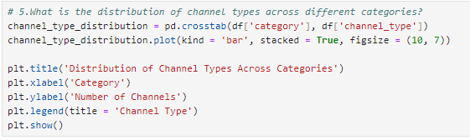
5. What is the distribution of channel types across different categories?

Slide 14
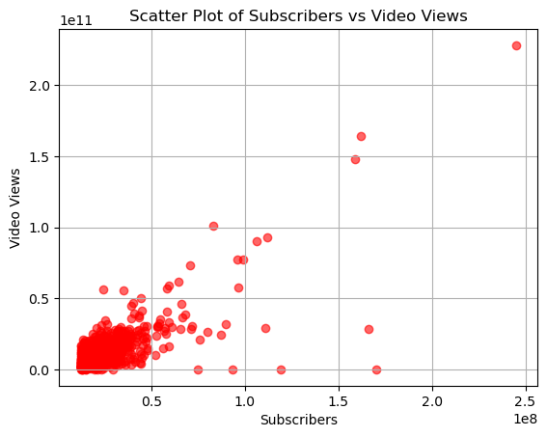
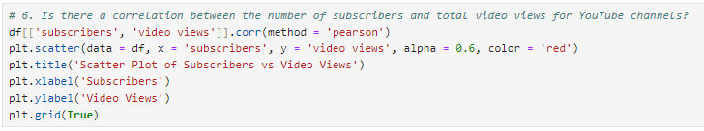
6. Is there a correlation between the number of subscribers and total video views for YouTube channels?

Slide 15
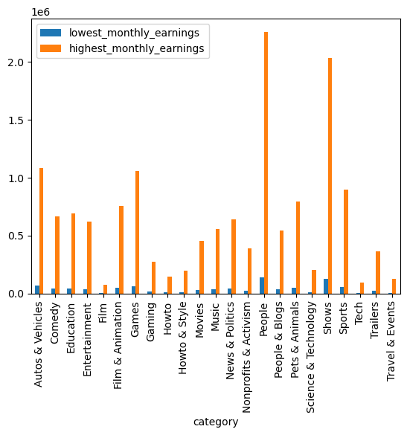

7. How do the monthly earnings vary throughout different categories?

Slide 16
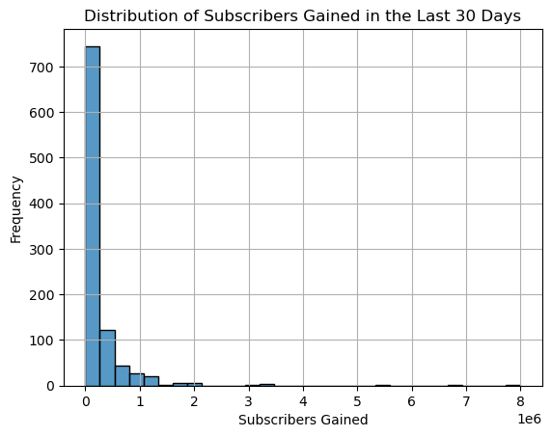
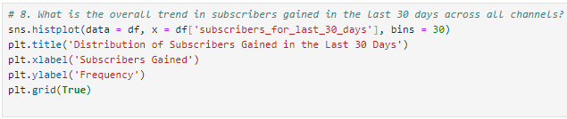
8. What is the overall trend in subscribers gained in the last 30 days across all channels?

Slide 17
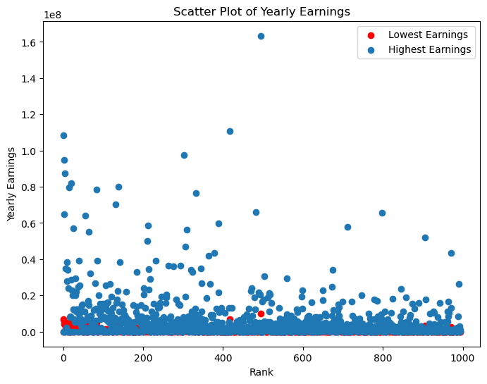
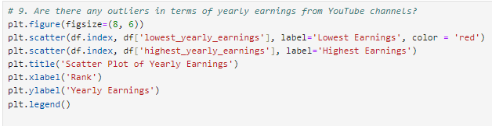
9. Are there any outliers in terms of yearly earnings from YouTube channels?

Slide 18
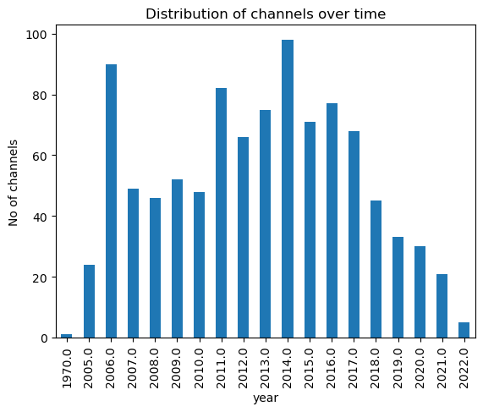
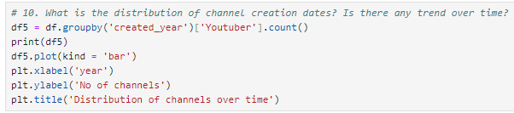
10. What is the distribution of channel creation dates? Is there any trend over time?

Slide 19
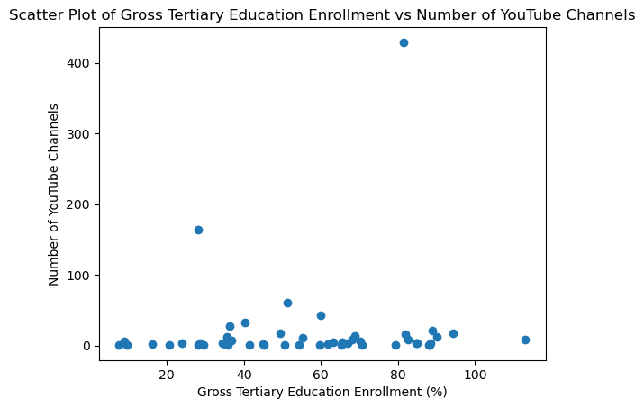
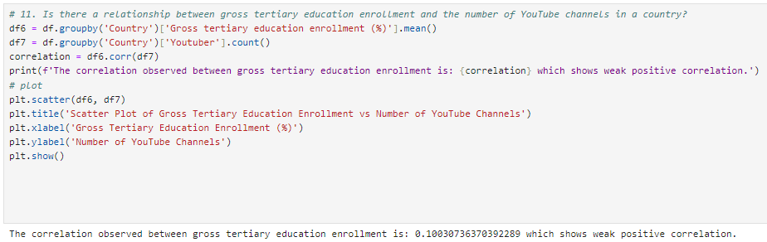
11. Is there a relationship between gross tertiary education enrollment and the number of YouTube channels in a country?

Slide 20
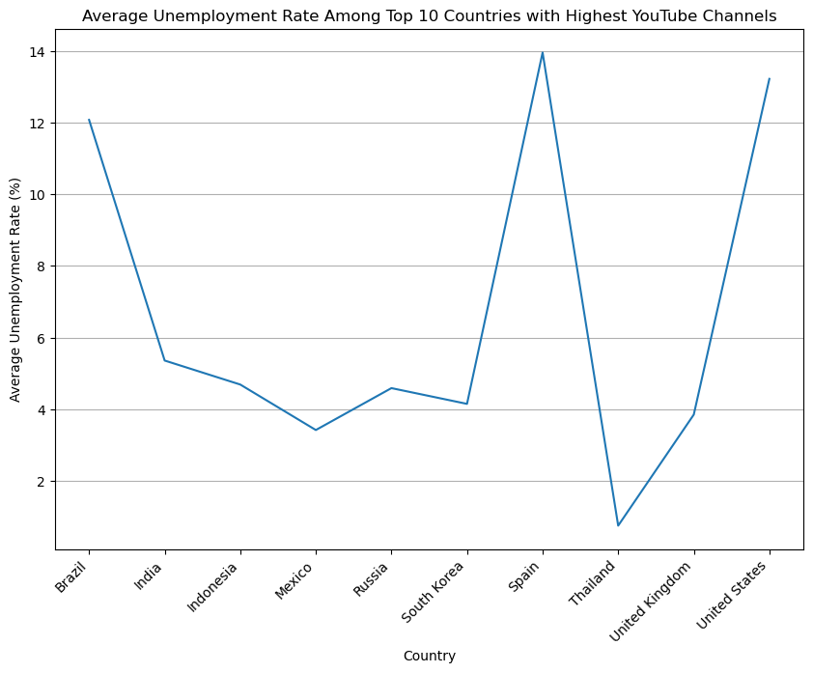
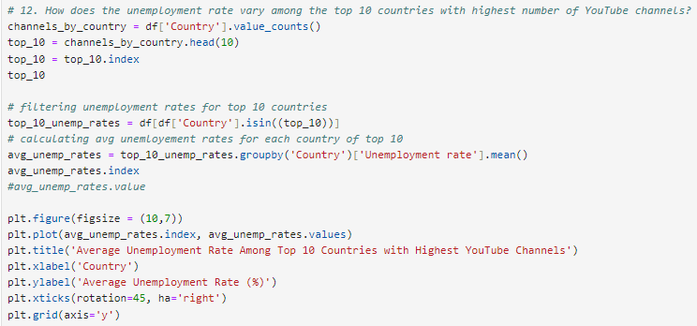
12. How does the unemployment rate vary among the top 10 countries with the highest number of YouTube channels?

Slide 21
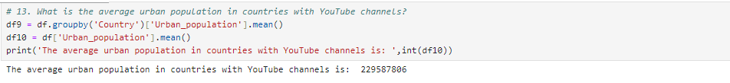
13. How does the unemployment rate vary among the top 10 countries with the highest number of YouTube channels?

Slide 22
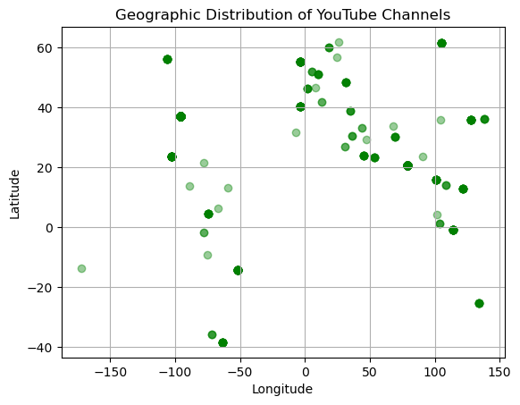
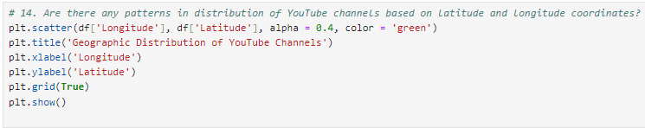
14. Are there any patterns in the distribution of YouTube channels based on latitude and longitude coordinates?

Slide 23
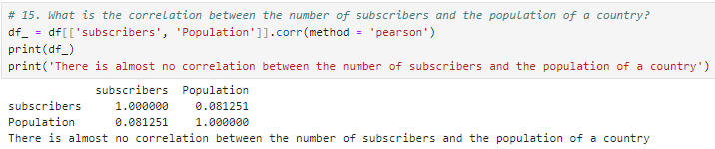
15. What is the correlation between the number of subscribers and the population of a country?

Slide 24
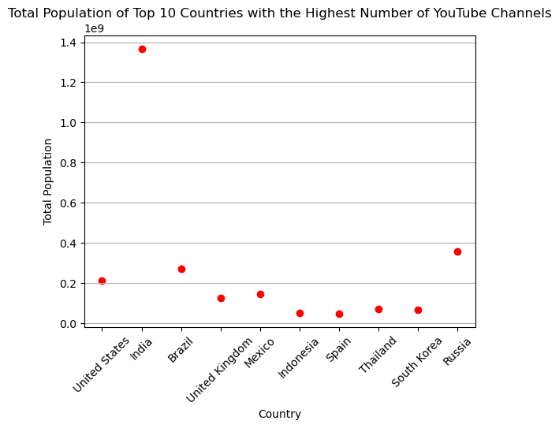
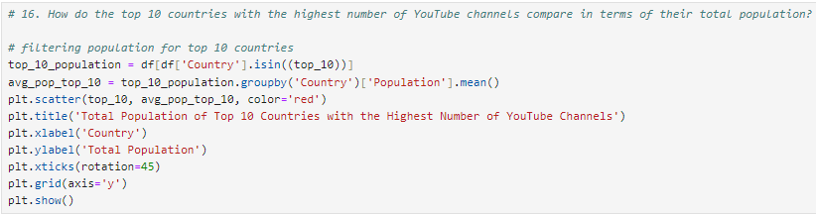
16. How do the top 10 countries with the highest number of YouTube channels compare in terms of their total population?

Slide 25
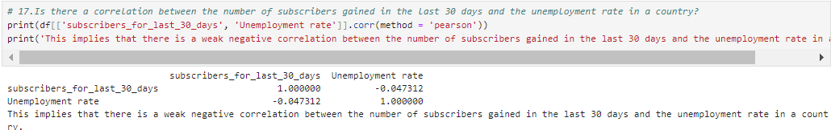
17. Is there a correlation between the number of subscribers gained in the last 30 days and the unemployment rate in a country?

Slide 26
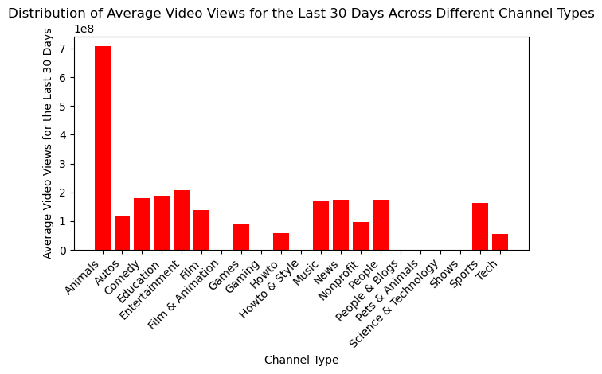
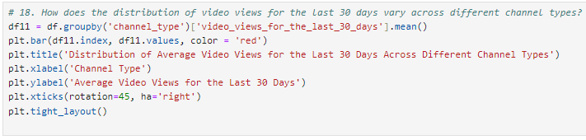
18. How does the distribution of video views for the last 30 days vary across different channel types?

Slide 27
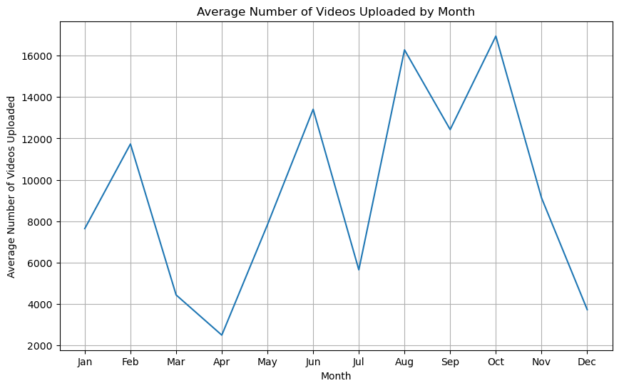
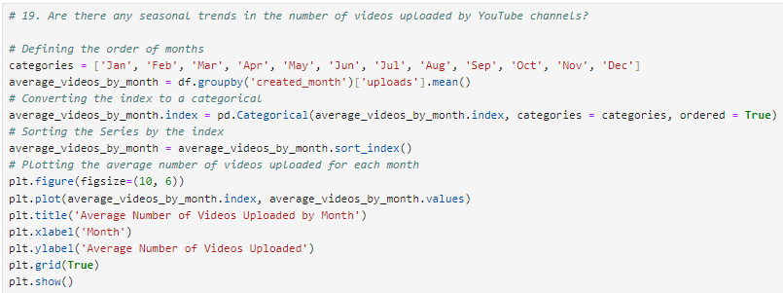
19. Are there any seasonal trends in the number of videos uploaded by YouTube channels?

Slide 28
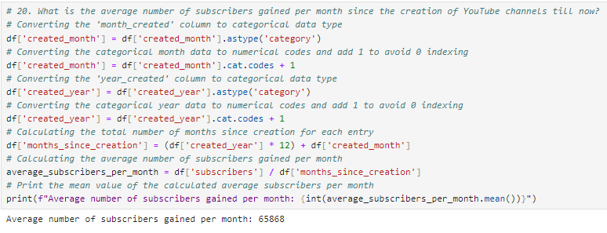
20. What is the average number of subscribers gained per month since the creation of YouTube channels till now?

