Slide 1
Emotion Detection From Voice
Prakash Dahal, 1828421

Slide 2
Agendas:
Introduction
Implementation
Resources used
Demonstration
Project Plan
Applications
Conclusion
Reference

Slide 3
Introduction:
Emotion Detection from voice.
Voice based, language independent
Feature extraction (mfcc, energy, pitch, so on)

Slide 4
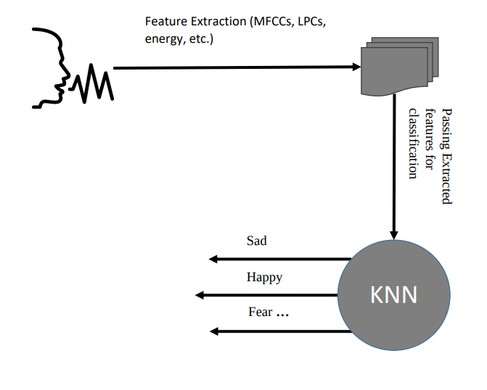
Implementation:

Slide 5
Resources Used:
Django Framework
Anaconda
Sublime Editor
Laptop
Internet

Slide 6
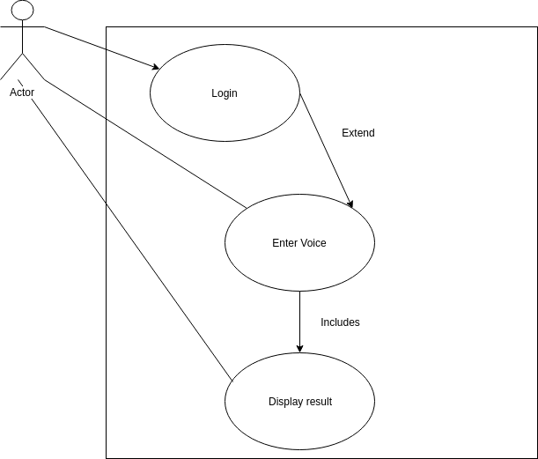
Demonstration:

Slide 7
Project Plan:
Dataset (SAVEE)
Feature Extraction
Train 80% of data
Test 20% of data
Result Displaying

Slide 8
Future Escalation:
Call Centre, chatbot, depression handling
Enhancement through facial expression
Different Platform Android, ISO

Slide 9
Conclusion:
Emotion Detection from voice is essential.
I can be highly implemented.
Neural Network Selection is challenging.
Accuracy is an challenging issue.
Thick data gives proper data.

Slide 10
References:
Akash Shaw, R. K. V. S. S., 2016. Emotion Recognition and Classification in Speech using Artificial Neural Networks. International Journal of Computer Applications, Volume 145, pp. 5-9.
Chandni, et al., 2015. An automatic emotion recognizer using MFCCs and Hidden Markov Models. Brno, IEEE.
Dhankar, A., 13-16 Sept. 2017. Study of deep learning and CMU sphinx in automatic speech recognition. Udupi, India, IEEE.
Intan Sari Areni, S. W. I. ,. A., 7-8 Oct. 2017. Solution to abbreviated words in text messaging for personal assistant application. Semarang, Indonesia, IEEE.
Jun Deng, X. X. Z. Z. S. F. B. S., 2018. Semisupervised Autoencoders for Speech Emotion Recognition. IEEE/ACM TRANSACTIONS ON AUDIO, SPEECH, AND LANGUAGE PROCESSING, 26(1), pp. 31 - 43.
Prashant Upadhyaya, O. F. M. R. A. Y. V. V., 22-24 March 2017. Continuous hindi speech recognition model based on Kaldi ASR toolkit. Chennai, India, IEEE.
Saikat Basu, J. C. M. A., 2017. Emotion recognition from speech using convolutional neural network with recurrent neural network architecture. Coimbatore, IEEE

Slide 11
Thank You

