Slide 1
Feature Management App
Demo

Slide 2
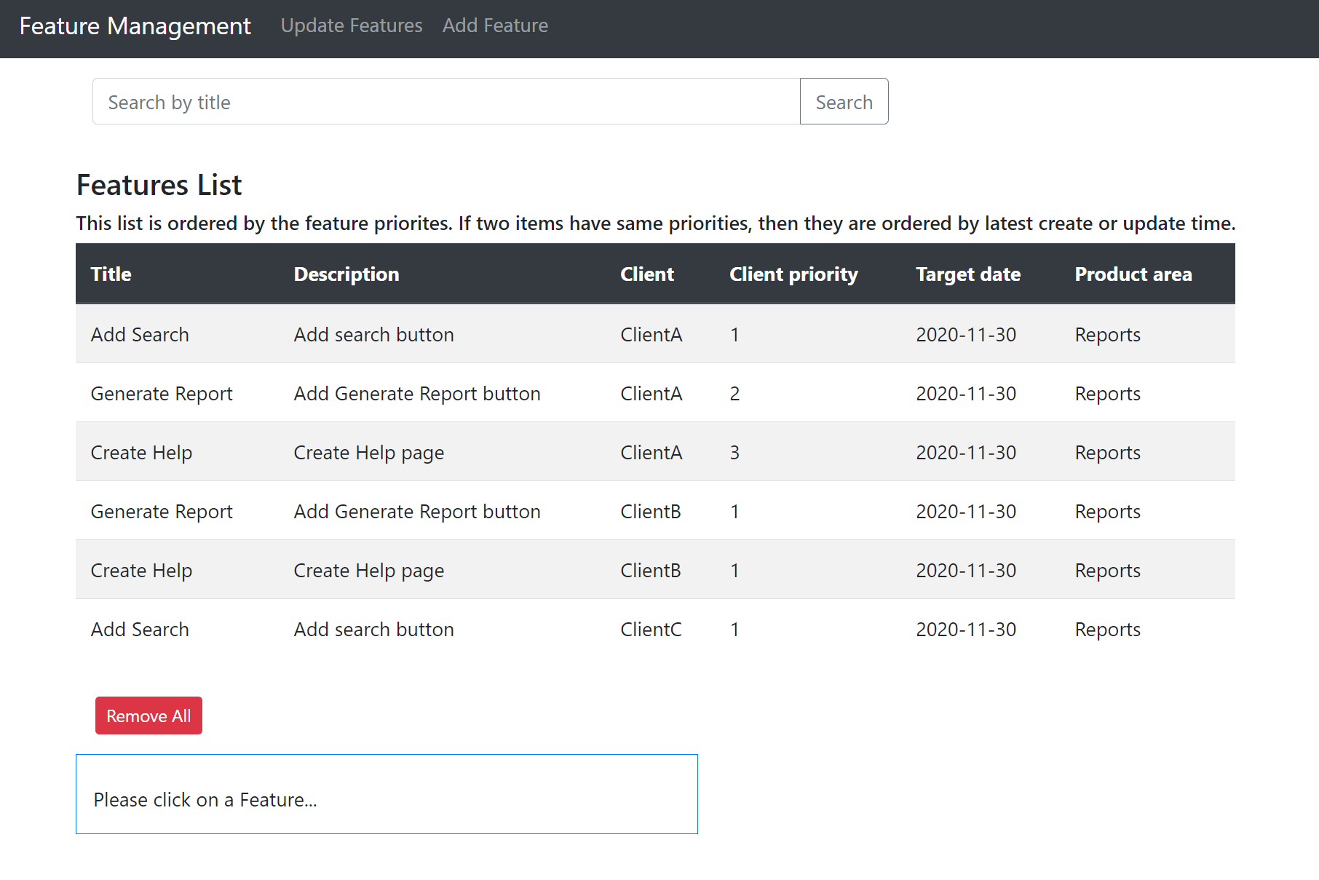
Home Page for All Features

Slide 3
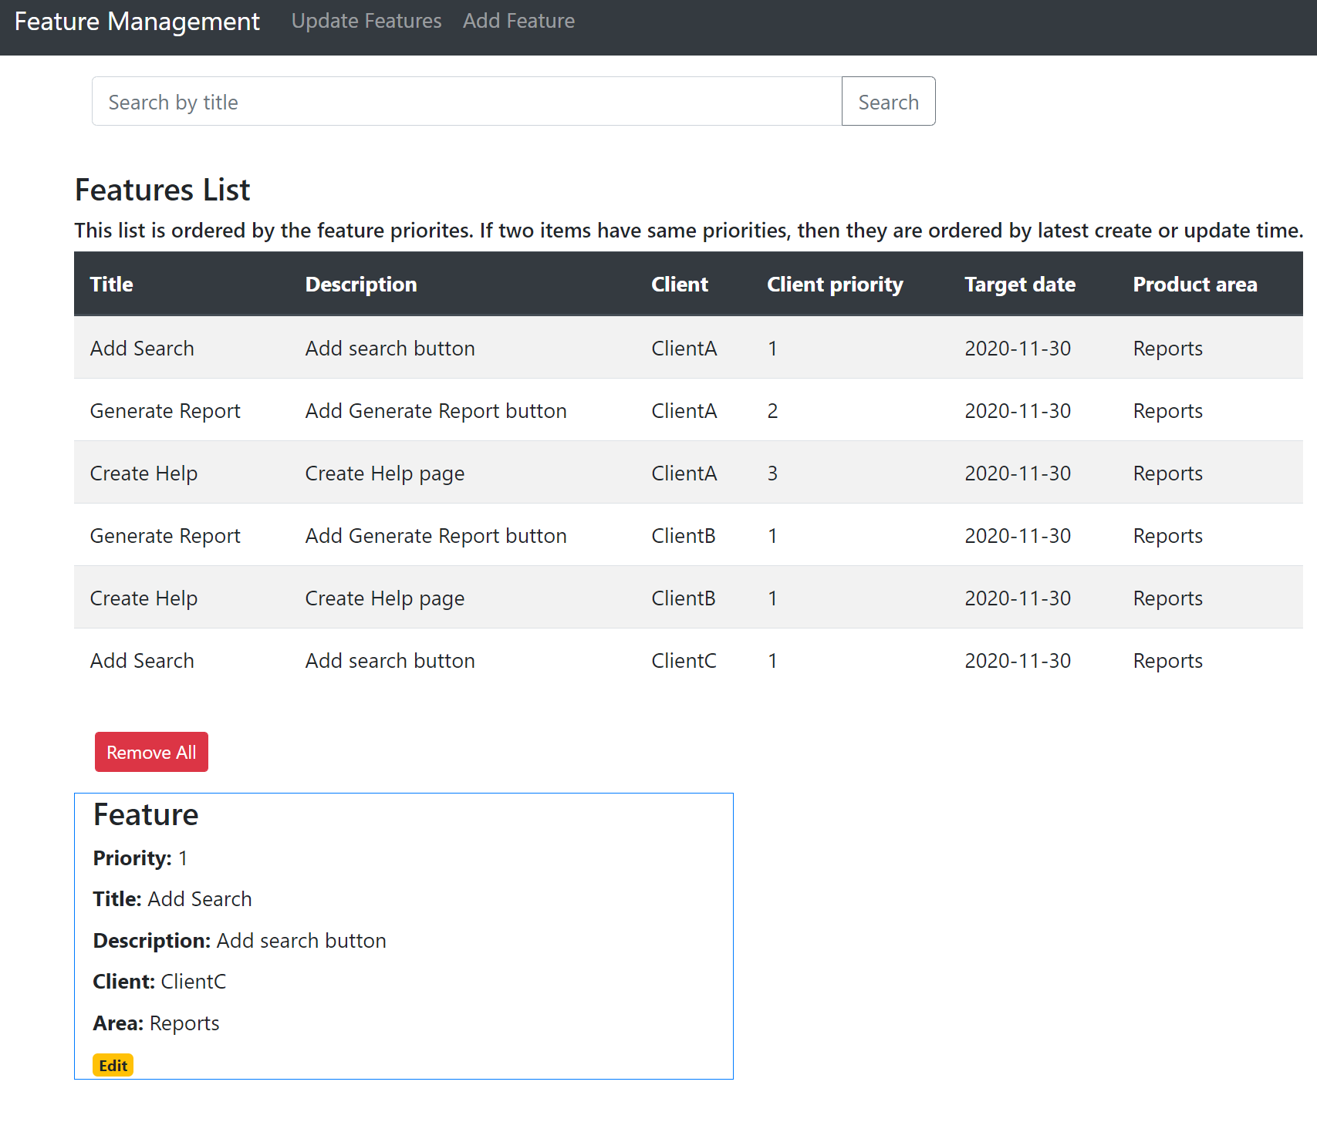
Select a Row for Details Page

Slide 4
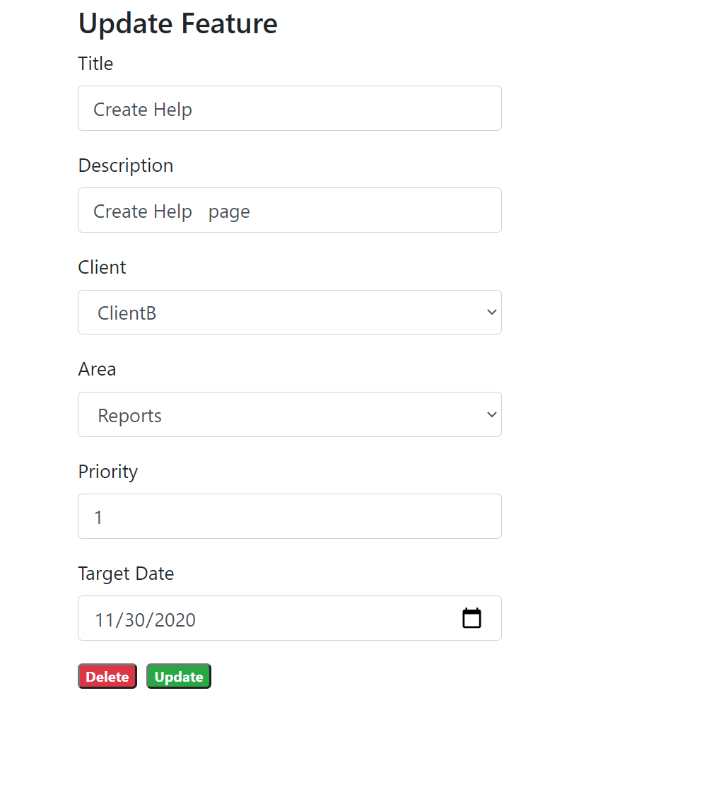
Update Feature

Slide 5
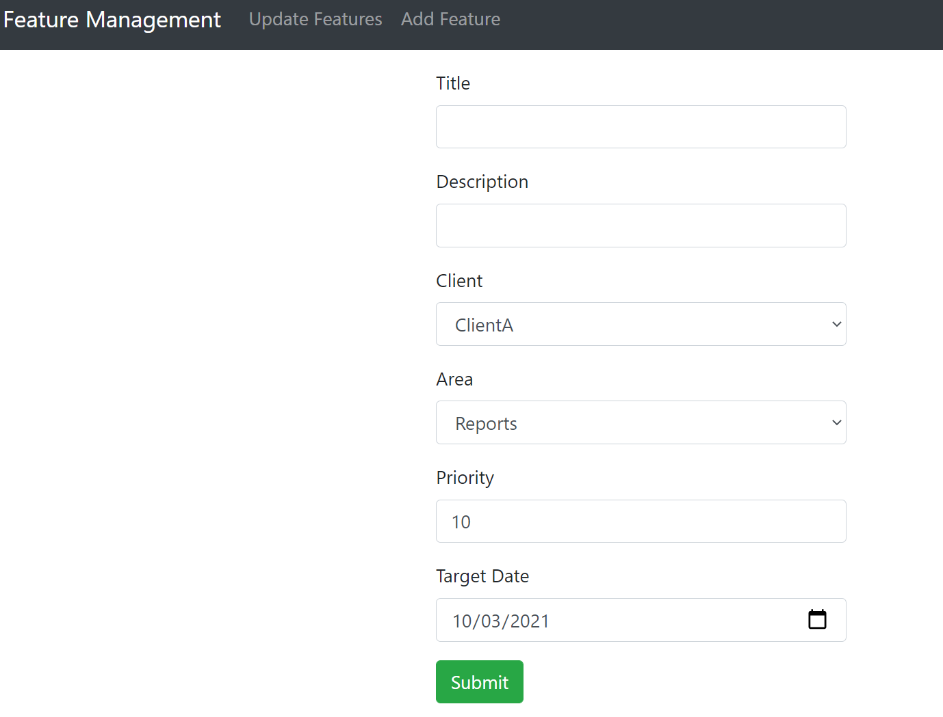
Add Page

