Slide 1
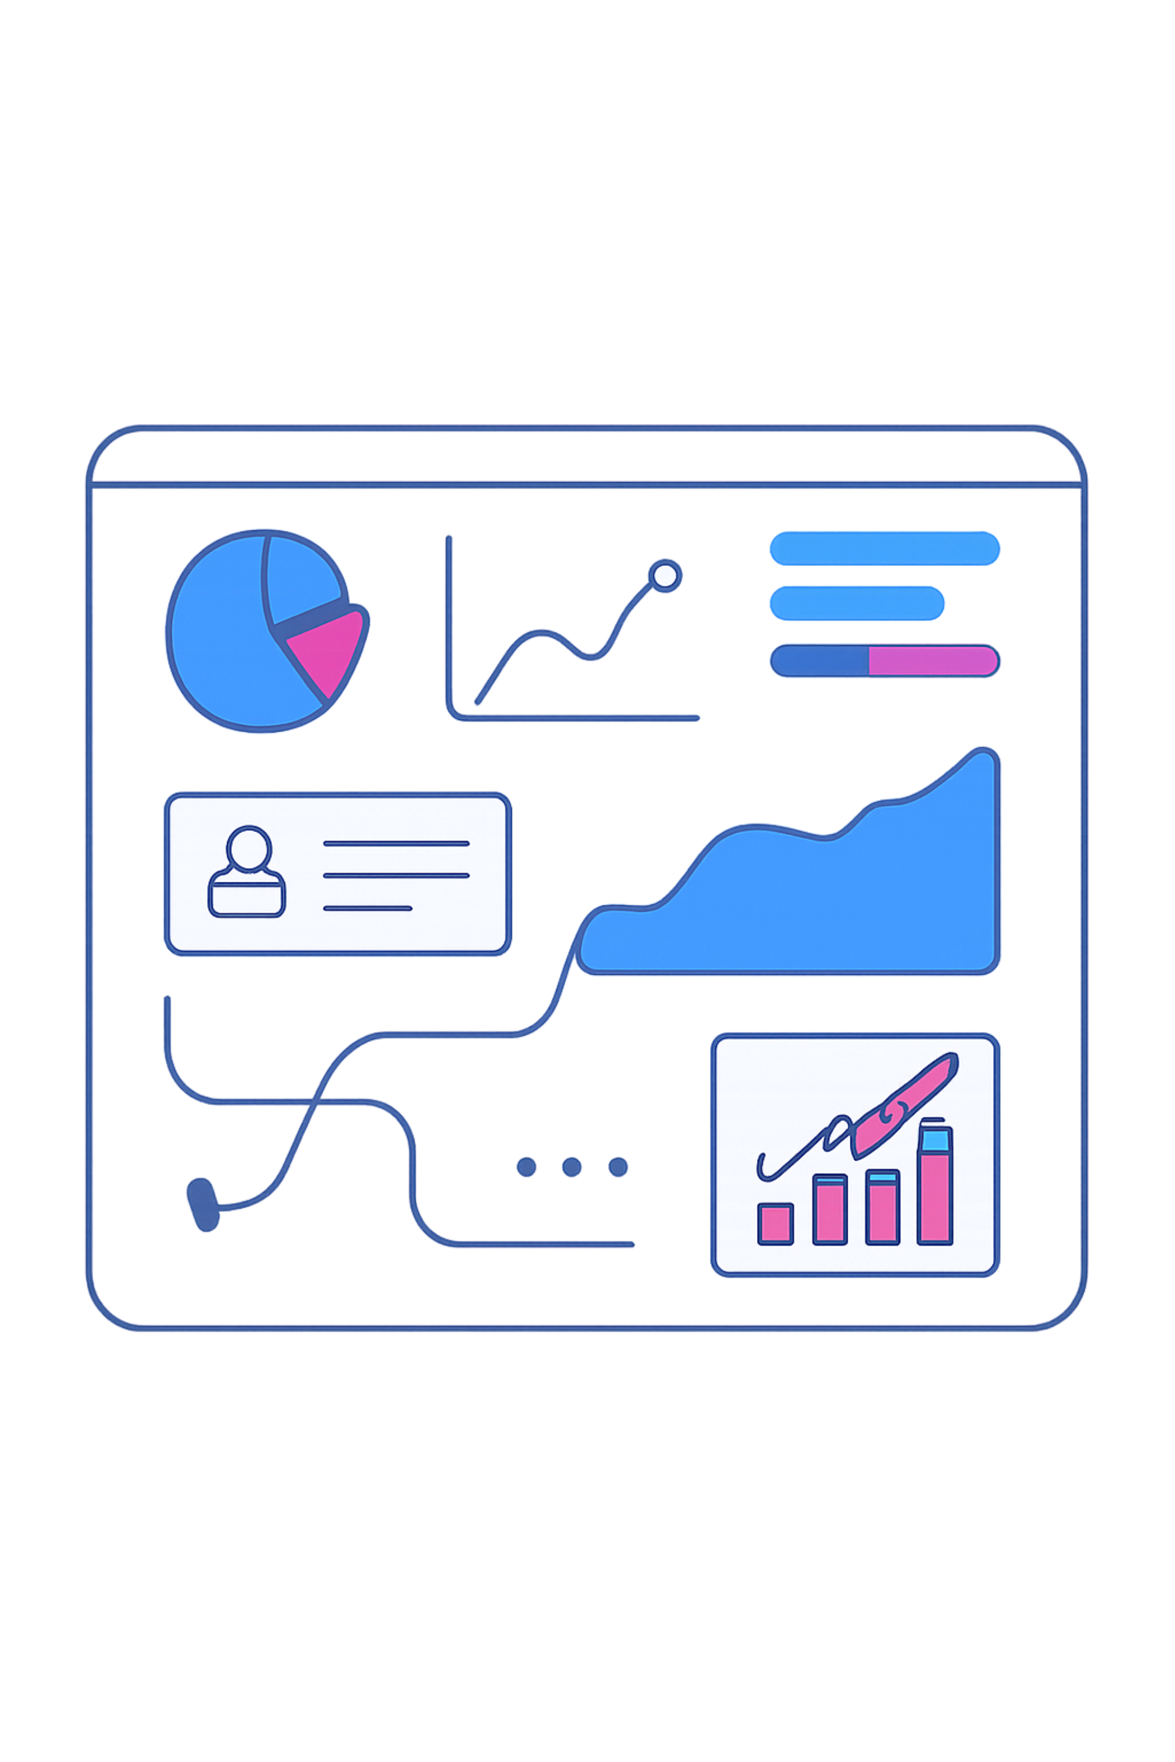
Banking Dashboard — Risk & Decisions
Power BI dashboards to analyse lending risk and support loan decisions.

Slide 2

Problem
Understand Risk
Minimise Loss
Learn risk analytics in banking & financial services.
Use data to reduce lending losses.
Informed Decisions
Approve only likely-to-repay applicants.

Slide 3

About Dataset
Multiple interlinked tables: Banking Relationship, Clients‑Banking, Gender, Investment Advisor, Period.

Slide 4

Data Cleaning
Engagement Timeframe — new column
Engagement Days — days since joining
Income Band — bins: Low & Mid
Processing Fees — from Fee Structure (e.g., high → 0.05)

Slide 5





Calculated Functions (DAX)
SUM
SUM(column) — e.g., Bank Deposit = SUM(Bank Deposits)
DISTINCTCOUNT
Distinct count — Total Clients example
SUMX
Row-wise expression sum — Total Fees = SUMX(...)
DATEDIFF
Engagement Days = DATEDIFF(Joined,B Today(), DAY)

Slide 6




KPIs — Overview
Total Clients
Total Loan
Total Deposit
Total Fees
DISTINCTCOUNT(Client ID)
Bank Loan + Business Lending + Credit Cards Balance
Bank Deposit + Savings + FX + Checking
SUMX(Total Loan * Processing Fees)

Slide 7

Account Metrics
Bank Loan = SUM(Bank Loans)
Business Lending = SUM(Business Lending)
Credit Card Balance = SUM(Credit Card Balance)
Checking Accounts = SUM(Checking Accounts)
Savings Account = SUM(Saving Accounts)
Foreign Currency = SUM(Foreign Currency Account)

Slide 8
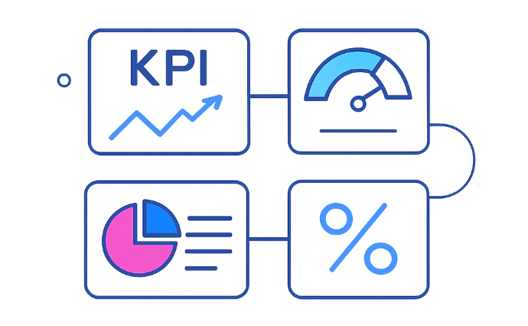
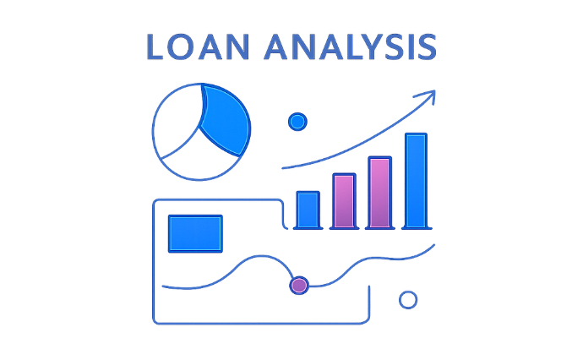
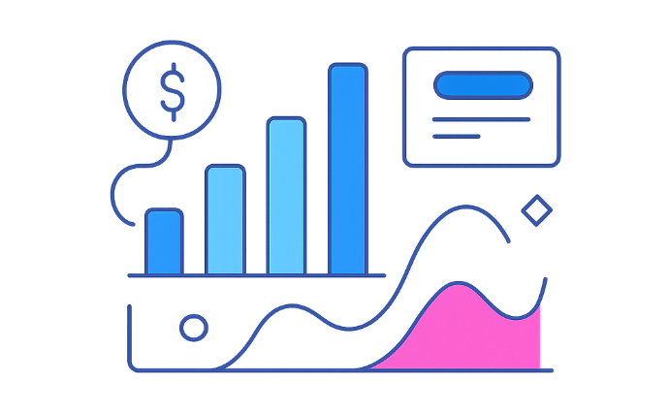
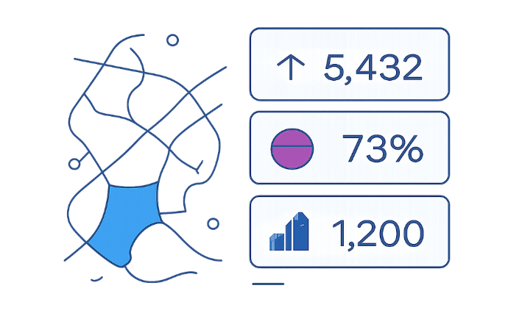
Visualizations
Home
Loan Analysis
Deposit Analysis
Summary Dashboard

Slide 9

Insights & Implications
Identify total loan exposure by investor & nationality
Discover which bank types hold more clients (e.g., private banks)
Inform strategy: client acquisition & risk policies
Track engagement length and account activity

Slide 10
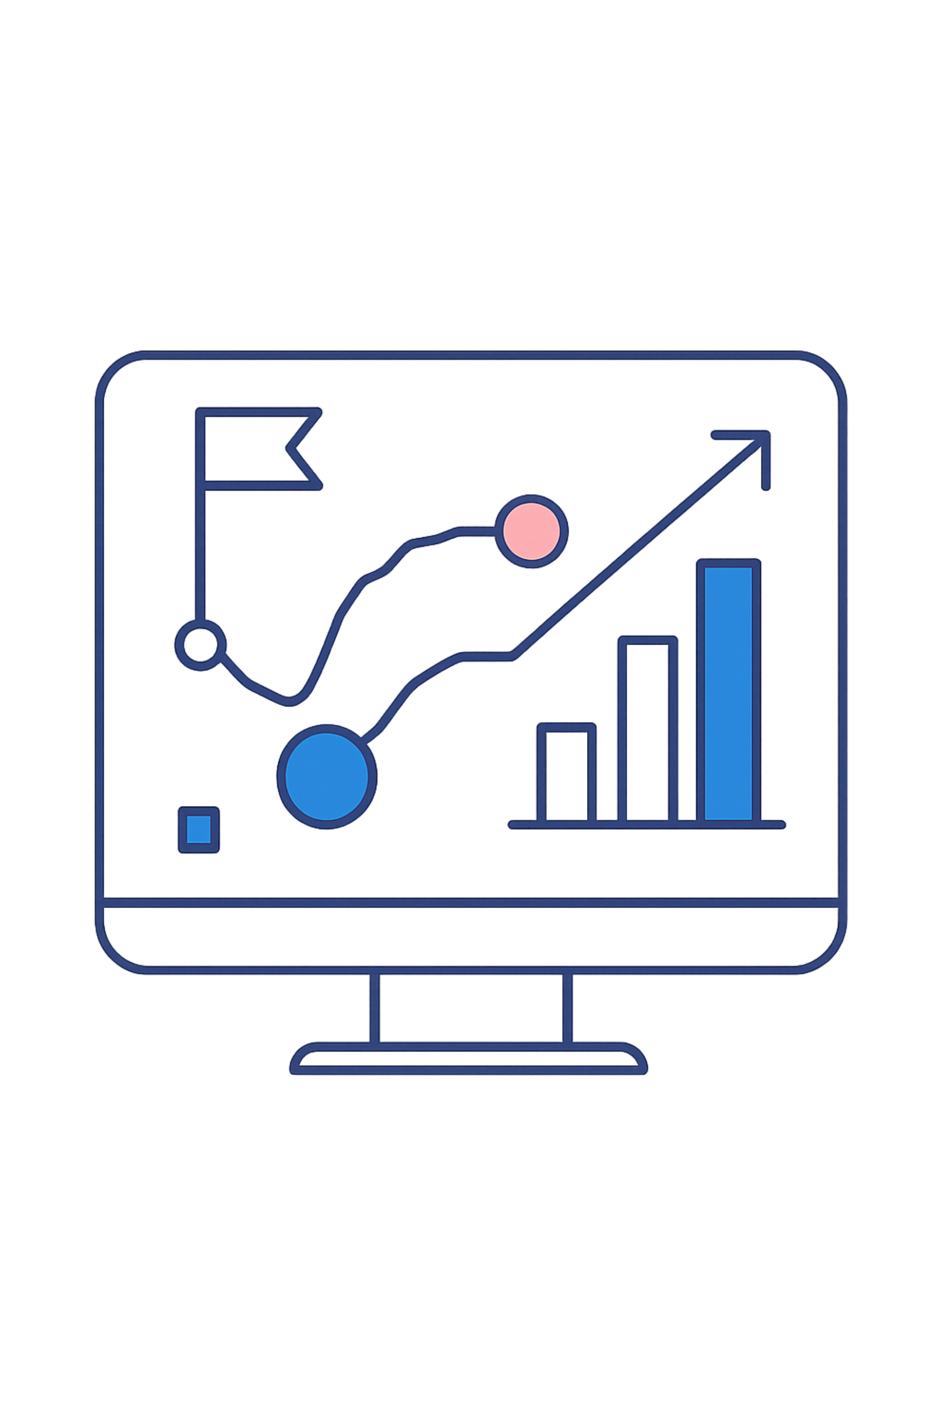
Conclusion & Future Work
Conclusion
Future Work
Power BI dashboards effectively surface key banking KPIs for risk decisions.
Use dashboards to monitor total loans, client distribution, nationality insights, and account types to guide strategy.

