Slide 1
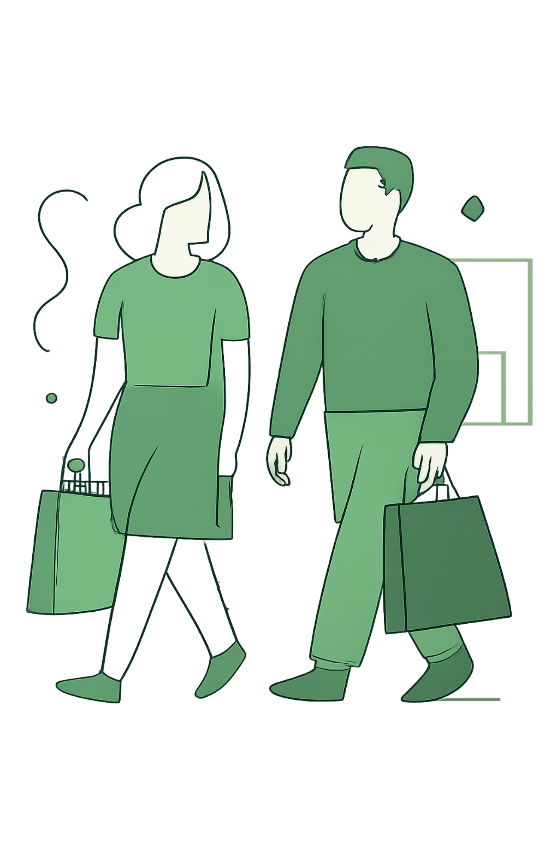
Customer Shopping Behavior Analysis
3,900 purchases • 18 features • Actionable insights

Slide 2

Dataset Summary
Scope
Key Features
3,900 rows • 18 columns
Demographics, purchase details, behavior, subscription
Missing Data
37 missing review ratings

Slide 3
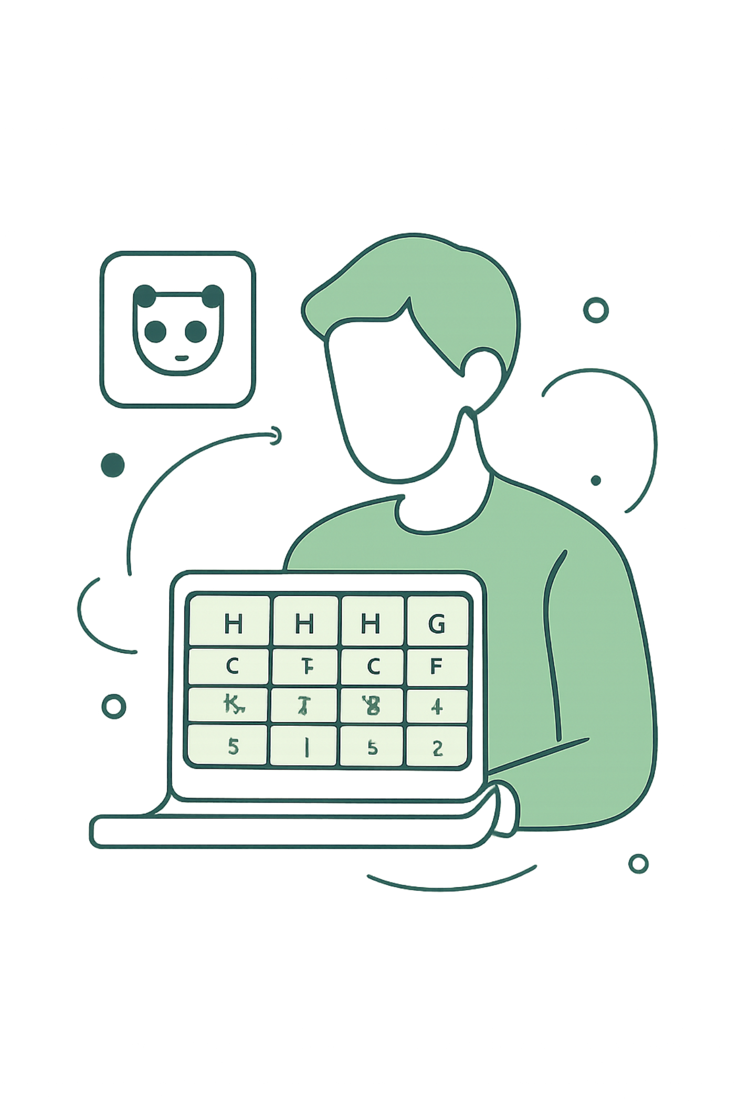
EDA — Python Workflow
01
Load & Inspect
pandas df.info() and describe()
02
Clean
Impute review_rating by category median
03
Engineer
age_group, purchase_frequency_days
04
Integrate
Load cleaned DataFrame to PostgreSQL

Slide 4
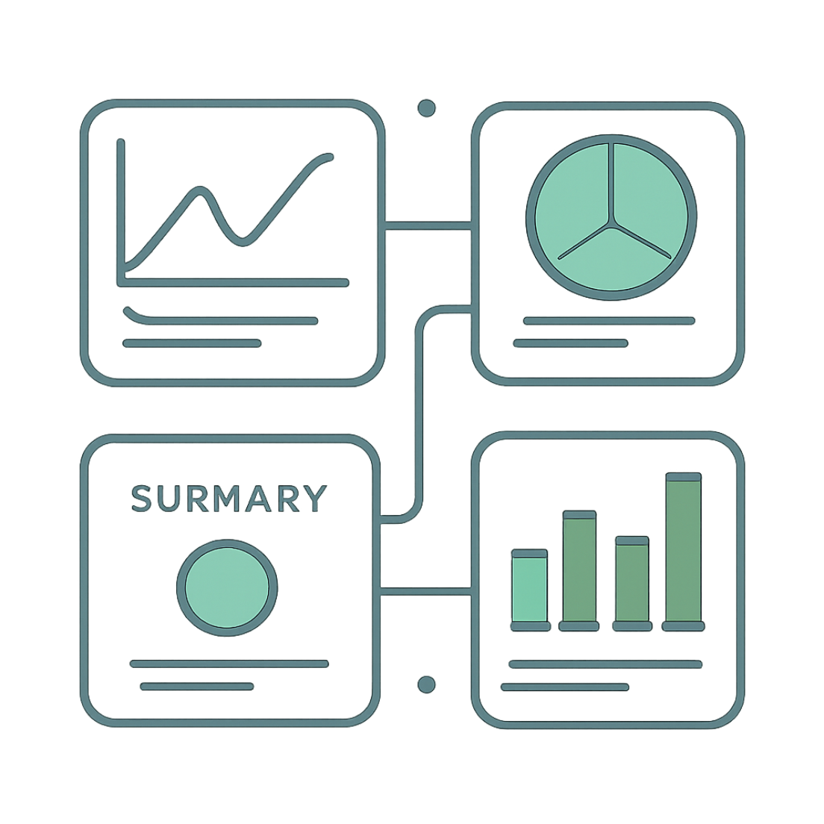
Summary Stats Snapshot
Avg Purchase
Avg Rating
$59.76
3.75 (3863 non-null)
Top Category Items
Blouse, Pants, Shirt

Slide 5

SQL Insights — Revenue & Segments
Revenue by Gender
Avg Spend
Subscribers vs Non
Customer Segments
Quick view of revenue distribution and segments

Slide 6



High-Value & Discount Behavior
Discount-Dependent Products
Top: Hat (50%), Sneakers (49.66%), Coat (49.07%), Sweater (48.17%), Pants (47.37%)
High-Spend Discount Users
839 rows: customers using discounts but spending above average

Slide 7


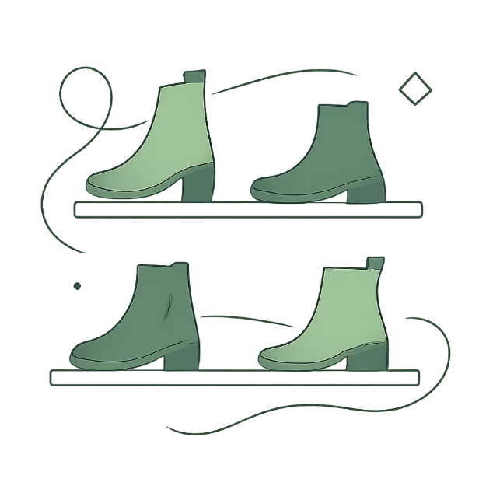
Product & Rating Highlights
Gloves
Sandals
Boots
Avg rating 3.86 — top
Avg rating 3.84
Avg rating 3.82

Slide 8
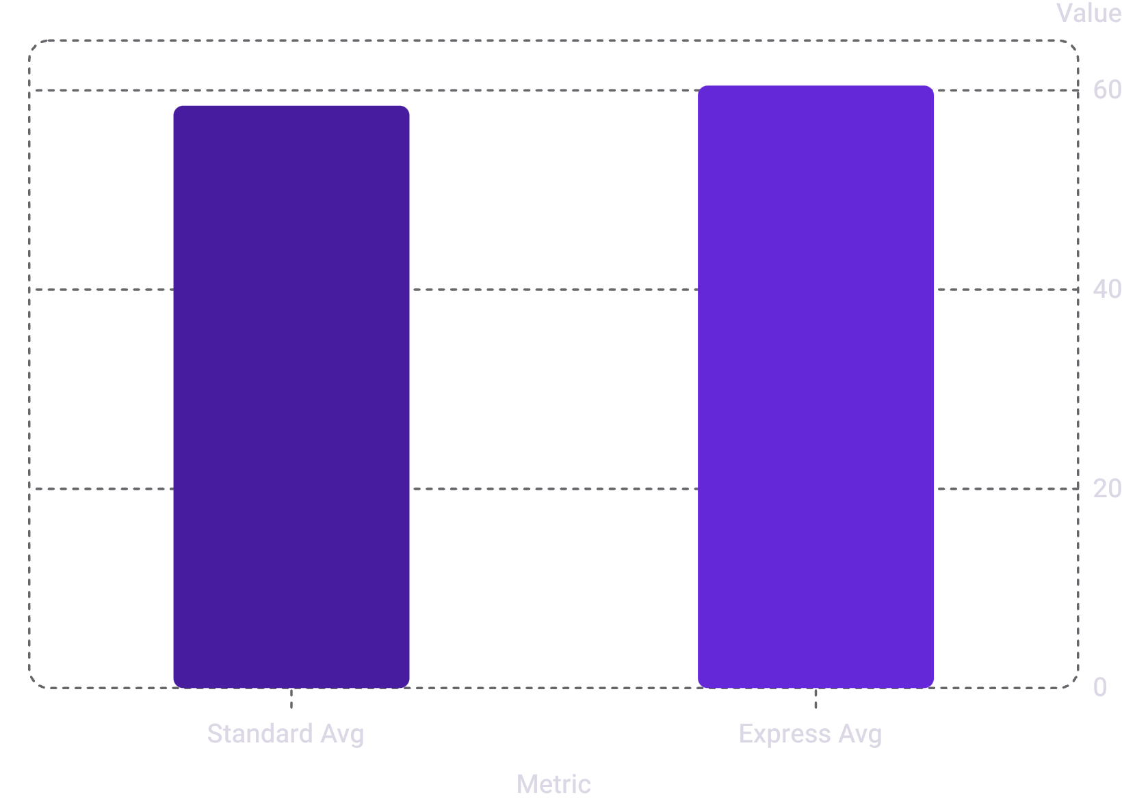
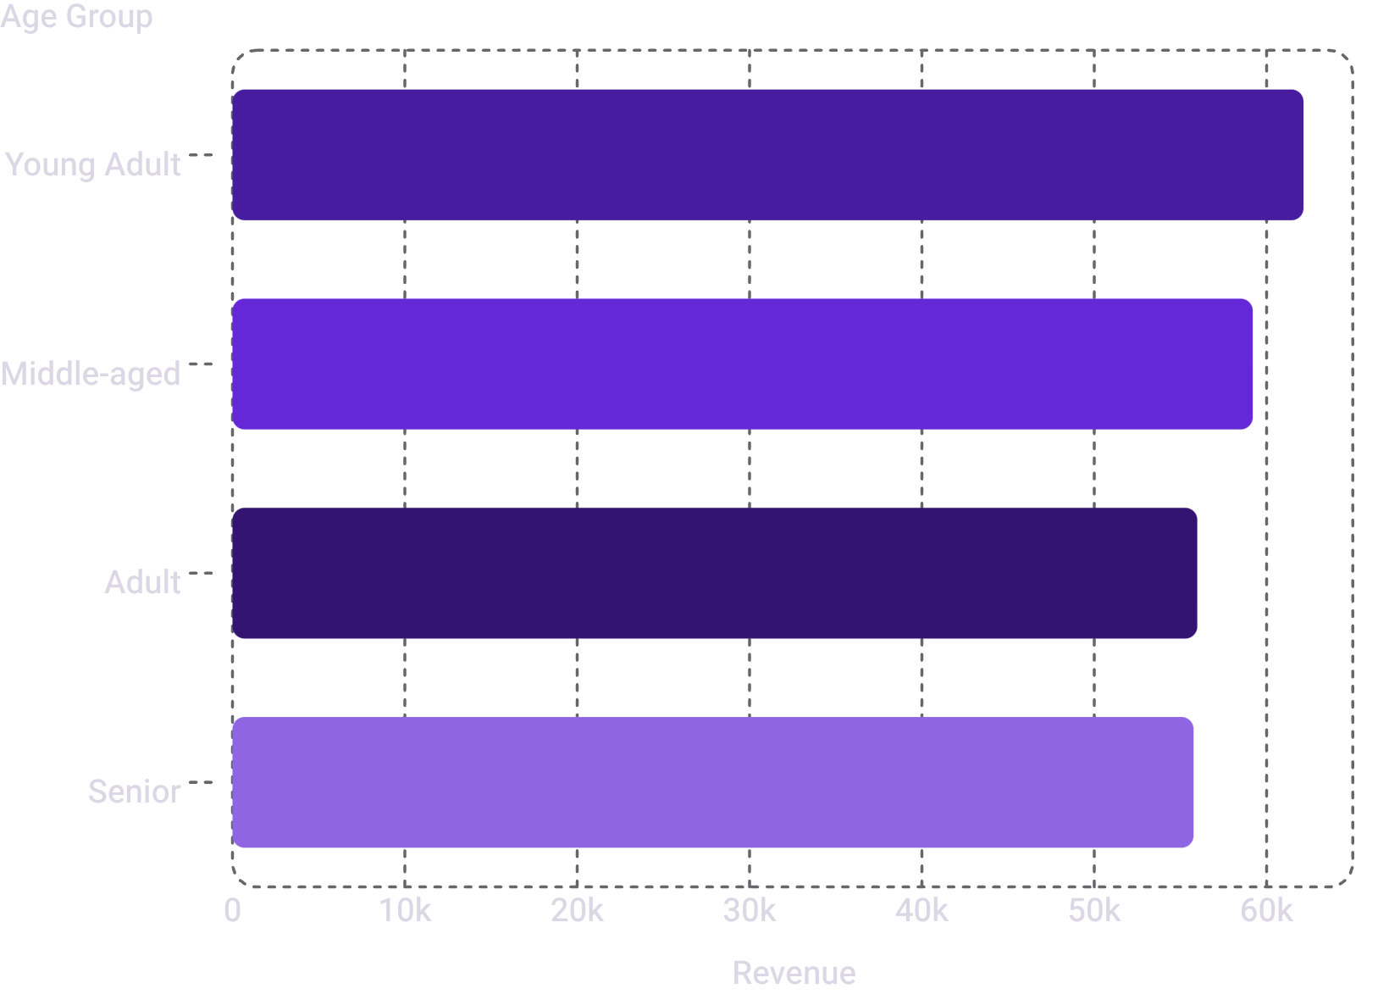
Shipping, Subscription & Age Revenue

Slide 9
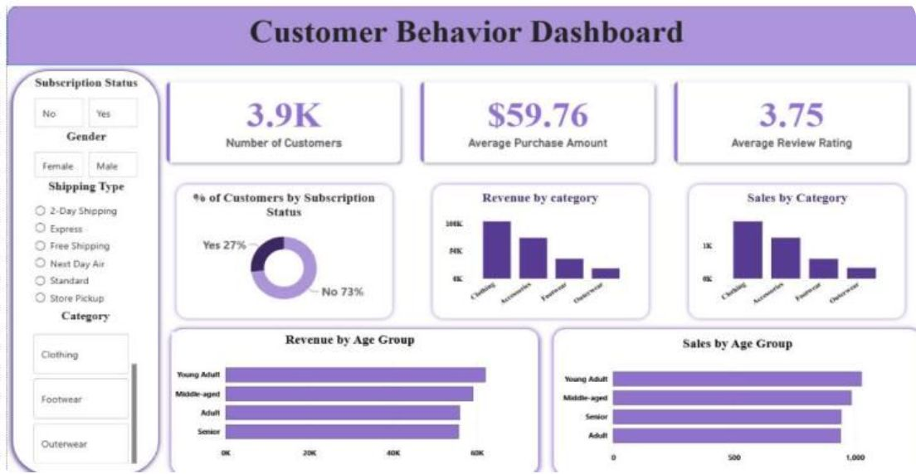
Power BI Dashboard
3.9K customers • $59.76 avg purchase • 3.75 avg rating
Subscribers: Yes 27% / No 73%
Filters: Subscription, Gender, Shipping, Category

Slide 10



Business Recommendations
1
2
3
Boost Subscriptions
Loyalty Programs
Review Discount Policy
Promote exclusive subscriber benefits
Reward repeat buyers to increase loyalty
Balance sales lift with margin control
4
5
Product Positioning
Targeted Marketing
Highlight top-rated & best-selling items in campaigns
Focus on high-revenue age groups and express-shipping users
Next steps: A/B test subscription offers; monitor discount impact on margin

