Slide 1
Basic Calculator
Project_1
Github link:-
https://github.com/PrakashPatel8979/Project_1-Calculator

Slide 2
Title: Tkinter Calculator GUI
Subtitle: A Simple Python-Based GUI Calculator
Presented by: [Prakash Patel]

Slide 3
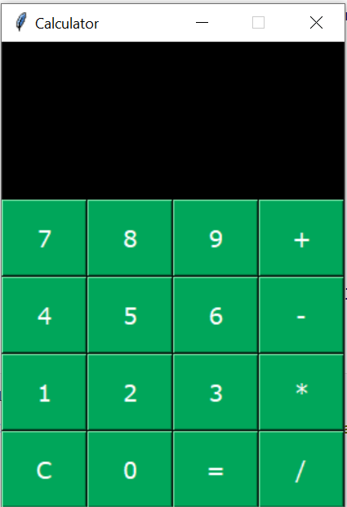
Features of the Calculator
Basic operations:
Add, Subtract, Multiply, Divide
Error handling for divisionn by zero
Clear button to reset input
User-friendly graphical interface

Slide 4
GUI Layout
Display label for showing input and result
Buttons: 0-9, operations (+, -, *, /), Clear (C), Equals (=)
Grid layout used for arranging components

Slide 5
Functions:
get_digit(digit) – adds digit to display
clear() – resets display
get_operator(op) – stores the first number and operator
get_result() – performs calculation

Slide 6
Core Logic Example
def get_operator(op):
global first_number, operator
first_number = int(result_label['text'])
operator = op
result_label.config(text='')
def get_result():
second_number = int(result_label['text'])
if operator == '+':
...
Captures operator input
Calculates based on selected operator

Slide 7
Button Configuration Example
btn7 = Button(root, text='7', command=lambda: get_digit(7))
btn7.grid(row=1, column=0)
Each button has a color, size, position
Uses lambda to pass digit to function

Slide 8
Final Interface Preview
Black background
Green buttons
White display text

Slide 9
Thank you

