Slide 1
Web Application pages
Homepage – It is used to display the global navigation and login to Socket web application.
About Us – This page will display the information about the company and features about our web application.
Login – This page displays with the form for the existing users to login into the application.
Registration – This page displays with the form for the new users to sign-up into the application.
Contact Us – This page displays the address and phone number of our company and also has a form for customers to contact us with their queries.
Policy – This page displays the terms & conditions information for the user to accept during the registration. User decline in this page will restrict the user to complete the registration.
Profile – This page displays the information about the customer who has logged into the application and provides the option for user to update his/her information at any time.
Vehicle – This page provides an option for user to add any new vehicle information for first time.
Charging Sign-in – This page displays a form for user to select the existing vehicle (added in vehicle page) and enters other information about the Charger station #, Approximate KM since last charge, estimated duration of stay etc.
History – This page will display the history about the various charging sessions for the logged user for last couple of months.

Slide 2
Application users, roles and their content responsibilities (Who can see what?)
User category:
Guest user
Member user (customer)
Super user (administrator)
User Roles:
Guest user – This is a normal user who access to homepage, about-us, login and contact-us pages. This user can access the application only after completing the registration form.
Member user – This is a registered user who has authorized access to the application and has access to all pages that the guest user has and also access to profile, vehicle, charging sign-in and history pages.
Super user – This is a administrator user who has access to the administration panel who can manage the front-page, logo, policy page. Also, manages and tracks each member user sessions and history.
Content Responsibilities
Following are the list of users who has access to their set of pages and their content:
Guest user – About Us, Contact Us, Login, Registration
Member user – About Us, Contact Us, Login, Registration, Profile, Vehicle, Charging Sign-In, Logout, History
Super user – Login, Manage Pages, Manage Policy, Manage Sessions, History, Logout

Slide 3
Navigation
The navigation in header is the only navigation for the application. That works also as global navigation.
Main navigation links
HOME: The name and logo of the app works as link to Home. Otherwise, no specific list named as HOME. This is to help application look spacious.
ABOUT: Information about the application can be found here.
REGISTER: The register page is linked here.
POLICIES: Policies (Terms and Condition) information.
CONTACT: Contact form and physical location is placed here.
Common Element
Header and Footer
Functionality
Graphics: Images are used to make the experience visually easy.
Video: ‘How to use app’ video is place on home page which will provide visual guidance when it is needed.
Sign In and Register Pages: These pages are forms with the features like check boxes, drop down menus and text boxes.
Contact: The form to connect with the customer case team with a specific message.

Slide 4
Business Rules
Public
The data provide by user is highly confidential.
Misuse of user’s information is almost none.
The application is legal and the privacy is respected.
The information given by user is not be sold.
Admin
The rules for public is also applicable for the employees managing the app.
Information of the employees working for the project must be recorded and up to date.
The application must be functioning properly.
Any technical issues should be solved as soon as possible.
As the project is technical, technical head will be the key role for the project.
Technology Choices
Front End – HTML5, CSS3, JavaScript, AJAX, jQuery, Bootstrap framework
Middleware – ASP.NET
Databases – MSSQL
Supported Browsers – Chrome, IE 11, Firefox, Opera

Slide 5
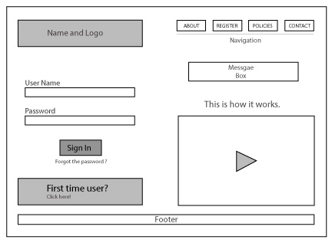
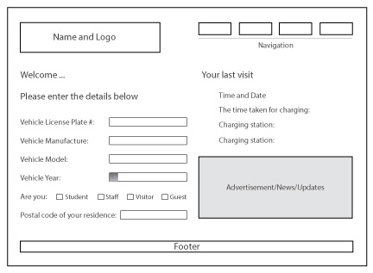
Wire Frames
Landing/Home Page
Vehicle page

Slide 6
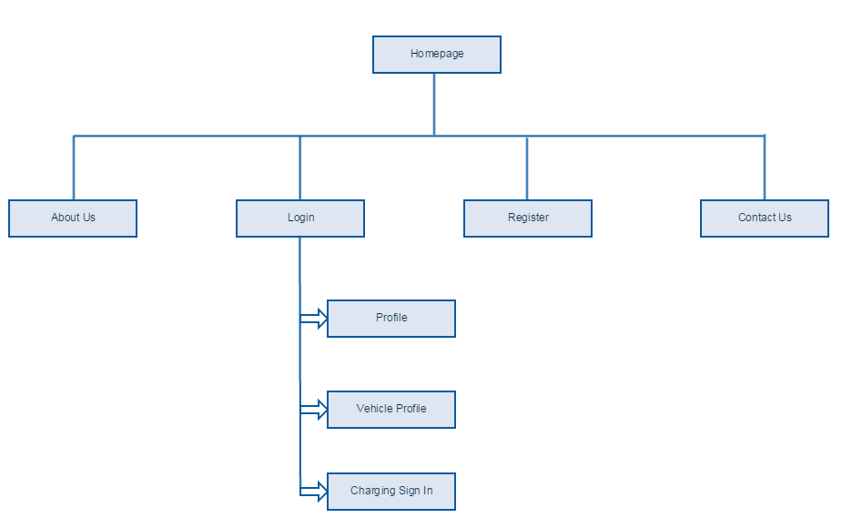
Site Architecture
High-Level architecture diagram for the web application

Slide 7
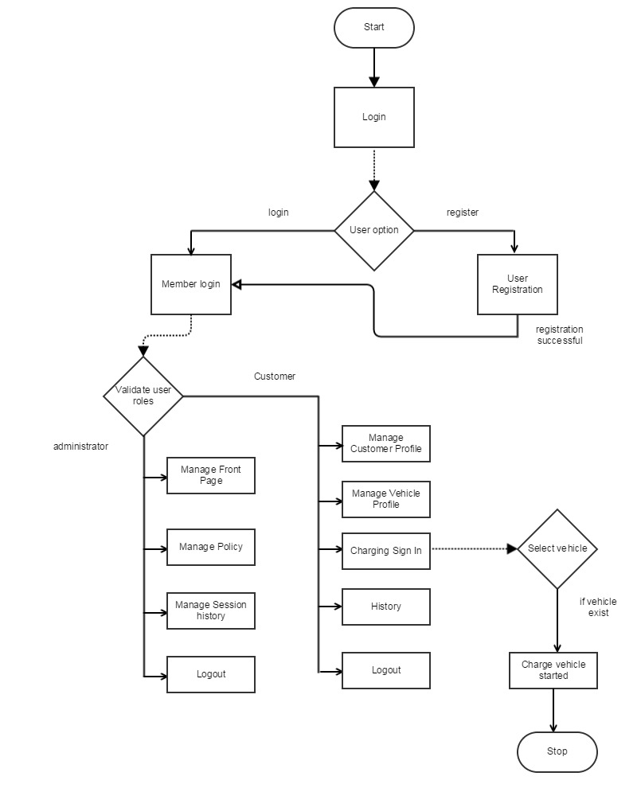
Site Flowchart
The below flowchart depicts the work flow of the web application for both member and admin user.

