Slide 1
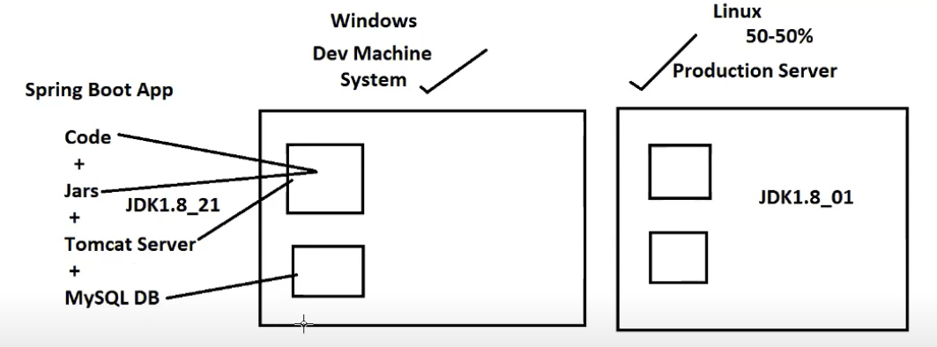
Runtime environment is operating system(OS)/Platform dependent
Softwares required to run our applications are fully OS platform dependent
EX : Java S/w,Tomcat Server,MYSQL etc
Our applications which is running fine in DevMachine (ex : Platform is windows), may or may not work in other platforms(Ex : Linux,Mac..etc)
So solution here is DO NOT RUN APPLICATIONS/SERVICES on DIRECT OS(ex : WINDOWS/LINUX)
Use virtual Platform that supports to run our application/service anywhere with no version or no installer modifications

Slide 2
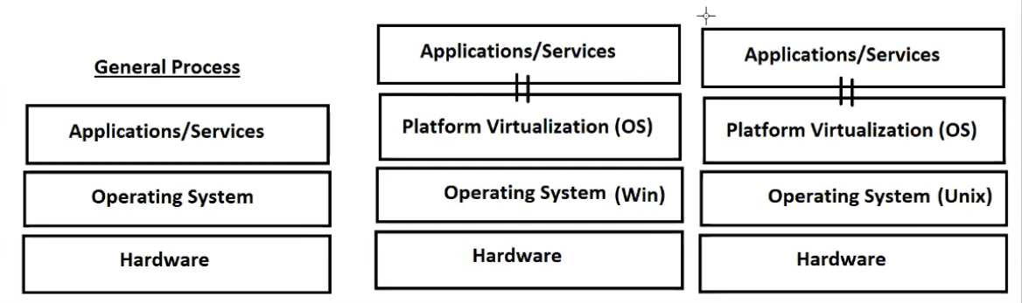
Above virtual platform concepts, if we use then what exactly running in DEV machine will same work in QA,UAT,Production even in cloud also
****DOCKER
Virtual OS
It makes our applications as OS independent

Slide 3
Our application/services must present in Image Format
Image is an executable file in DOCKER OS
Windows -> .exe
Linux -> .sh
Mac
code/Jar + Docerfile -> IMAGE
Tomcat Server -> IMAGE
MySQL -> IMAGE
-> Docker container : executing all the required images in Docker, then one runtime setup is created which is called container.

Slide 4
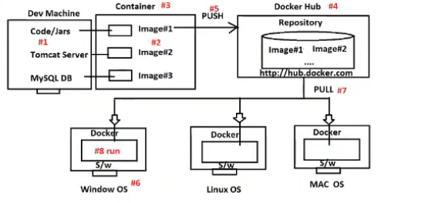
-> once Docker image is created then we are going to place our image inside DockerHub(hub.docker.com) by using PUSH and PULL actions
-> download Docker OS compatible with WINDOWS and install in Windows OS

Slide 5
Steps to follow:
1.Create an account in DockerHub (Register and Login)
https://hub.docker.com
2.Write spring boot application
3.Create Docker File in our application
4.Download & install Docker s/w in our system
5.Start Docker s/w and run docker commands
a. Creating docker image
b. Check other images
c. Run images as container
d. Login to DockerHub
e. PUSH or PULL with DockerHub

Slide 6
Docker commands :
Change location to project folder
Cd <project locations>
2.Create Docker Image
Docker build --help
docker build –f Dockerfile –t <tagName> <location>
docker build –f Dockerfile –t docker-image .
Tag created successfully : <image_name>:<tagVersion>
ex : docker-demo-0.1:v1 3. check existed images
docker image ls
4. ** Run image
docker run –p <masked_port>:<actual_port> image
docker run -p 9090:8080 docker-image
8080 will mask to 9090

