Slide 1
What is cloud ?
Cloud refers to a network or internet. In other word, we can say that cloud is something which is present in remote location.
Can be accessed over public or private networks.
Cloud Computing :
It is type of Internet-based computing that provides shared computer processing resources and data to computers and other devices on demand.
It is a model for enabling ubiquitous, on-demand access to shared pool of configurable computing resources (e.g., computer networks, servers, storage, applications and services) provisioned minimal management effort.
This relies on sharing of resources to achieve coherence and economy of scale, similar to a utility (like the electricity grid over an electricity network.)

Slide 2
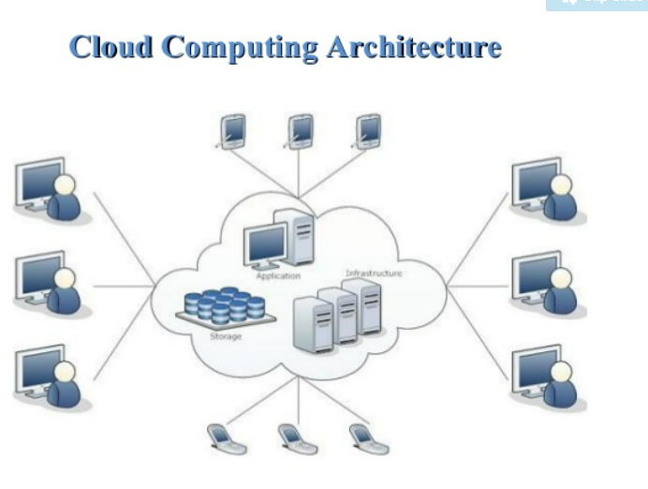

Slide 3
Cloud Characteristics
National Institute of Standards and Technology (NIST) highlights various characteristics that are needed for a service to be regarded as “Cloud”.
On-demand self-service - Sign up and enjoy the services without delays.
Broad network access - Access service through standard platforms (laptop, mobile, desktop, etc.)
Resource pooling - Resources are pooled to multiple customers.
Rapid elasticity - Ability to meet with demand peaks.
Measured Service - Billing is metered and delivered as a utility service.
Working models for cloud computing :
Deployment Models – Type of access to cloud
Four Type of access to cloud – Public,Private,Hybrid,Community
Three unique categories within Cloud Computing:
Software as a Service (SaaS)
Platform as a Service (PaaS)
Infrastructure as a Service (IaaS)

Slide 4
Software as a Service (SaaS)
Capability to run applications on a cloud infrastructure.
Applications are accessible from several client devices via either a thin client interface, like a web browser e.g., web-based email
Interplay between outside world and organization. e.g., email newsletter campaign software
Software for a short term requirement. e.g., collaboration software for particular project
“Vanilla” offerings where the solution is not differentiated.
Consumer does not control or manage the underlying cloud infrastructure, which includes servers, network, operating systems and storage.
SaaS is not suitable in scenarios where the application
processes quick real time data.
has a regulation or legislation that does not allow data being hosted externally.
existing on-premise solution that satisfies all of the requirements of organization.
SaaS Examples :
EMAIL
Google talk
Facebook

Slide 5
Computing platform that permits creating web applications effortlessly, fast, with no complexity of buying or maintaining the infrastructure and software.
Services to develop and test applications, as well as deploy, host and maintain applications in the similar integrated development environment.
Ability to deploy on cloud infrastructure with the help of programming languages, services, libraries, and tools.
Built in scalability of deployed software with failover and load balancing.
Integration with databases and web services through common standards.
PaaS is not suitable in scenarios where the application -
requires to be more portable with respect to where it is hosted.
performance needs customization of the underlying software and hardware.
proprietary approaches or languages would affect the development process.
PaaS Examples :
Database
Windows
.Net/Java
AWS/AZURE

Slide 6
Infrastructure as a Service (IaaS)
Capableness to provide networks, processing, storage, and other fundamental computing resources, and ability to deploy, run arbitrary software that can include operating systems and applications. Here, the consumer is incapable of controlling or managing the underlying cloud infrastructure.
Resources are distributed as a service and enables dynamic scaling
Utility pricing model
Multiple users on one hardware Applicability-
New organizations with less capital could invest in hardware easily
Organizations growing rapidly
Pressure on the organization to restrict capital expenditure and to migrate to operating expenditure
IaaS is not suitable in cases where
strict regulatory compliance is followed
very high level of performance is required.
Iaas examples:
Storage
Load Balancer
Servers
Network

Slide 7
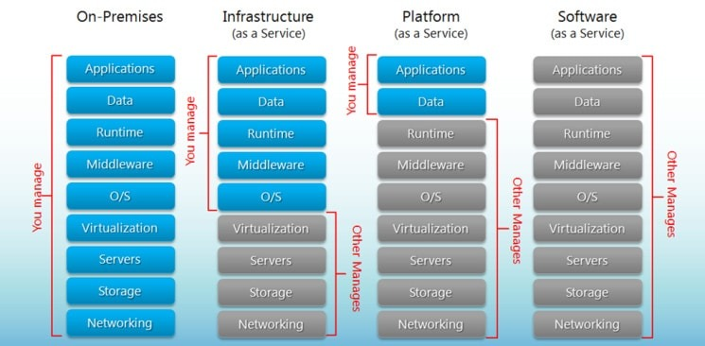

Slide 8
More on Cloud Computing
advantages to moving to the cloud
Variable as opposed to upfront
Fixed cost
Economics of scale can reduce Operating cost
It's easier to match capacity to demand
It allow you to focus on developing and deploying applications instead of the undifferentiated heavy lifting associated with managing an on-premises data center.
It allows you to increase the velocity of your Agile development and allows a global presence right out of the gate.

Slide 9
AWS Cloud - Products
Let us explore about different type of products in AWS.
Compute - AWS provides numerous compute products that allows you to deploy, run, and scale applications as virtual servers, code or containers.
AWS Compute Offerings
Different Compute services offered by AWS.
Amazon EC2 - Virtual Servers in the Cloud
AWS Elastic Beanstalk - Run and Manage Web Apps
Storage - Cloud storage is secure, scalable and reliable component that includes the information used by applications.
Database - AWS provides fully managed NoSQL and relational databases, and in-memory cache to suit your application needs.
Developer Tools - AWS Developer tools is a set of services that are offered to allow developers securely version control and store the source code of applications. Also, it aids to build, test and deploy the application automatically.
Management Tools - Aids you to manage the applications and resources.
Security and Compliance - Allows customers to know the proficient controls at AWS to maintain data protection and security in the cloud.
Messaging - Provides several messaging services and tools with diverse abilities.
Application Services - Offers a plethora of managed services for use with applications such as converting digital media into different formats, including search to your website, and hosting streaming application.

Slide 10
AWS Elastic Beanstalk is an easy-to-use service for deploying and scaling web applications and services developed with Java, .NET, PHP, Node.js, Python, Ruby, Go, and Docker on familiar servers such as Apache, Nginx, Passenger, and IIS.
You can simply upload your code and Elastic Beanstalk automatically handles the deployment, from capacity provisioning, load balancing, auto-scaling to application health monitoring. At the same time, you retain full control over the AWS resources powering your application and can access the underlying resources at any time.
There is no additional charge for Elastic Beanstalk - you pay only for the AWS resources needed to store and run your applications.

