Slide 1
KuberNetes Features
Automatic bin packing
Service discovery & load balancingself healing
Storge orchestration

Slide 2
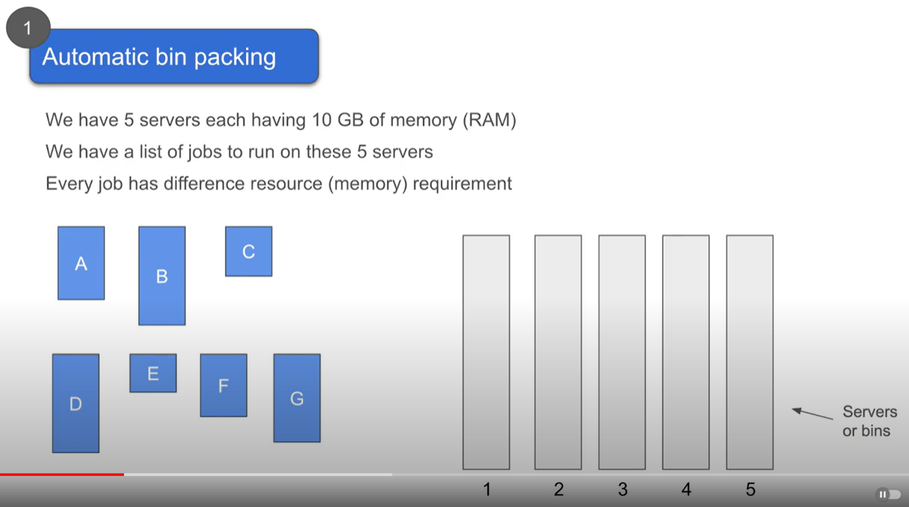

Slide 3
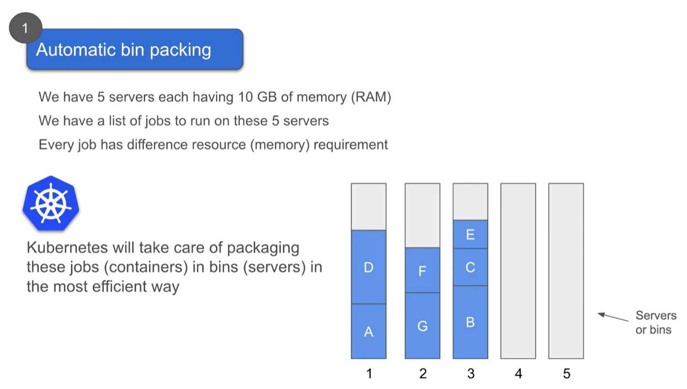

Slide 4
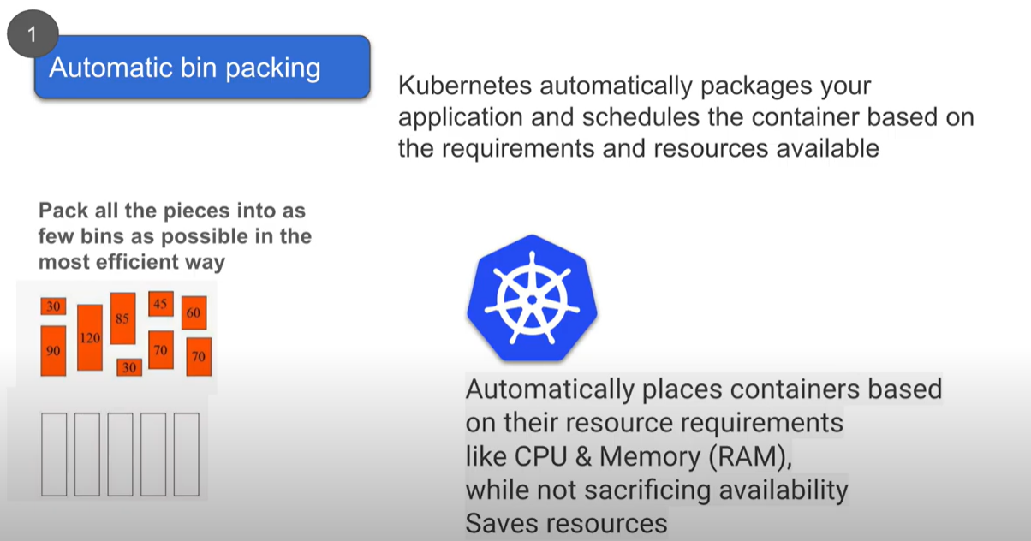

Slide 5
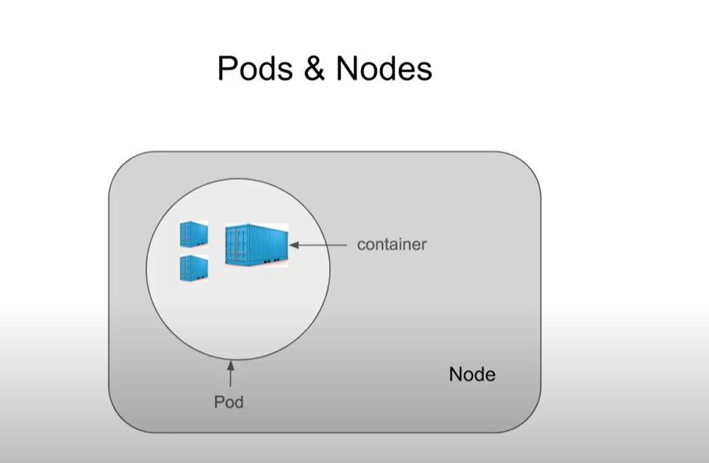
In Kubernetes, we cannot directly interact with the container directly.
Containers are wrapped under a functional unit called as POD.
PODs are housed inside Node, Node can have one or more pods.

Slide 6
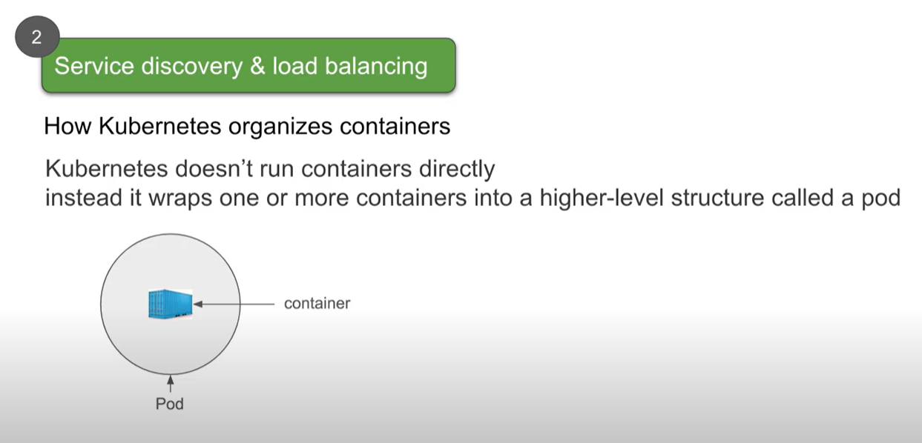

Slide 7
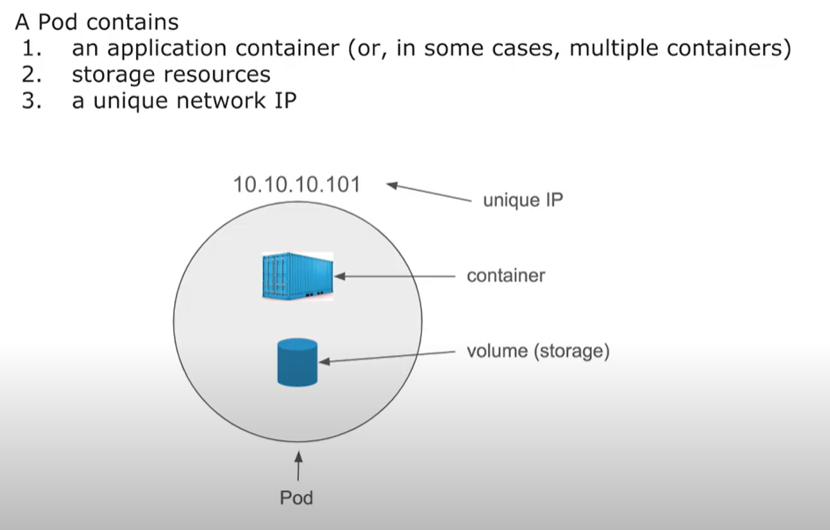

Slide 8
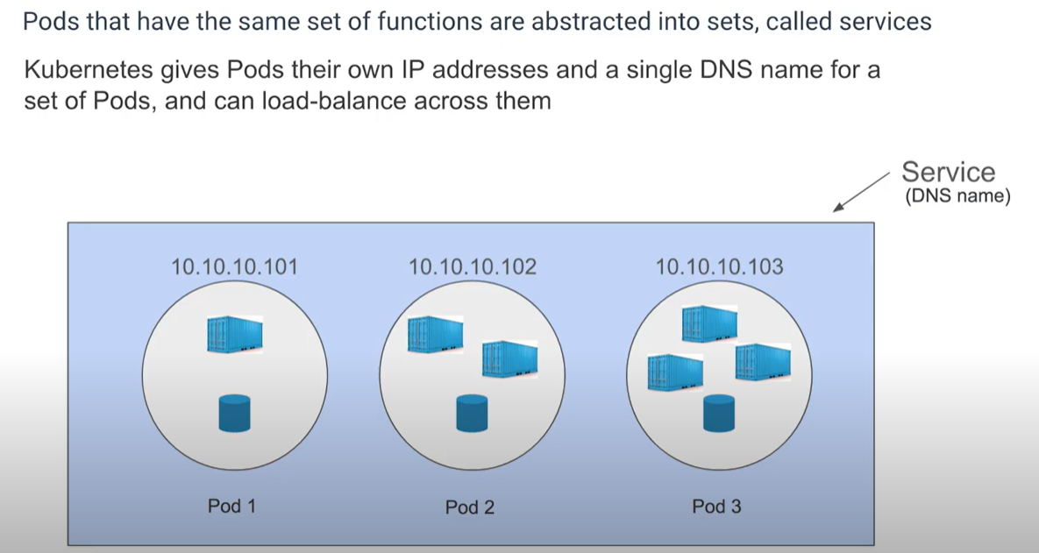

Slide 9
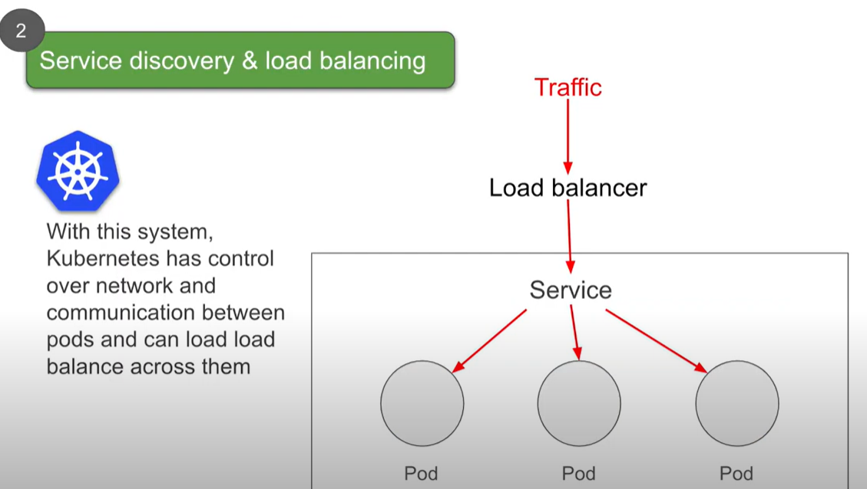

Slide 10
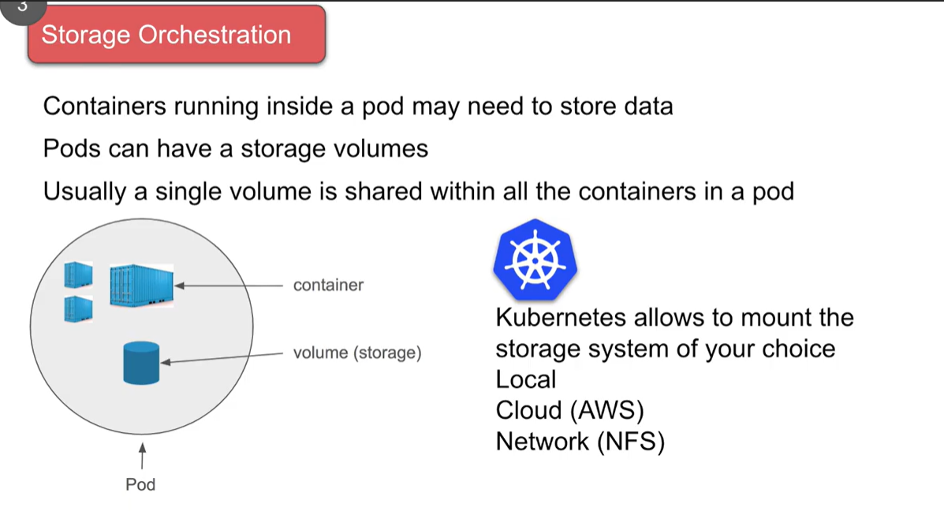

Slide 11
