Slide 1

INTERNSHIP
By
Kadiyala P B Rohit Bharadwaj
1219101313006

Slide 2
Internship Firm Name: KALGUDI DIGITAL PVT LIMITED
Under the esteemed guidance of
Mr. Sreekanth Voleti
(Head of the core)

Slide 3

Our Work
Task-1
I designed a Fertilizer tool and Yield and profit prediction tool which helps the FPOs to train the farmers on cropping pattern they have to follow based on seasonal climate forecast and also how to optimize their resources such as land, fertilizers etc., in order to maximize their profits by careful allocation of land with various crops.
Task-2
Create FPO Knowledge Graphs using Neo4j and CQL

Slide 4
TASK-1

Slide 5

What are FPO’s
Farmer Producer Organizations are based on the idea that farmers, who produce agricultural goods, can organise groups. The Small Farmers' Agribusiness Consortium (SFAC) was established to aid in this process by the Department of Agriculture and Cooperation, Ministry of Agriculture, Government.
It is a group of farmer-producers that supports small farmers by offering end-to-end services that essentially cover every part of farming, from inputs and technical assistance through processing and selling.

Slide 6

IMD(INDIA METEOROLOGICAL DEPARTMENT)
The Ministry of Earth Sciences of the Indian government oversees the India Meteorological Department. It is the main organisation in charge of seismology, meteorological observations, and weather forecasting.
We have taken help of this department to get yield details based on the climate forcast whether it is normal,above normal or below normal.

Slide 7

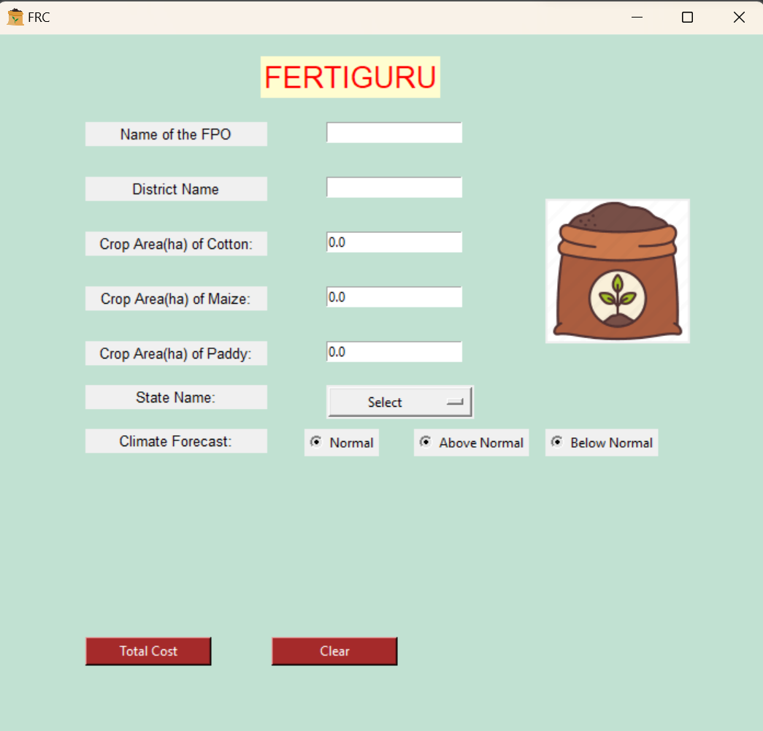
Our Project Front-End

Slide 8

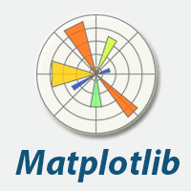


Technologies Used in the Tool
Tkinter
Matplotlib
Pandas
openpyxl

Slide 9
Major Steps in our Project
The programme calculates the fertilizer coating in the first stage using the fertilizer dose recommendations provided by the Agricultural University.Additionally, it determines the overall cost of cultivation per unit area, including the cost of initial field preparation and harvest.
According to the India Meteorological Department's (IMD) seasonal forecast, the tool questions if the seasonal climate would be normal, above normal, or below normal.
Crop models determine crop yields based on climate forecasts and will be sent to the tool.
Predictions from the ANGRAU economic model will be utilised to determine crop out prices.
Finally, the net benefit for each crop will be determined using all the data. Actual recommended area for each crop will be provided as an output using the linear programming and optimization procedure in order to optimise the earnings.

Slide 10
TASK-2

Slide 11

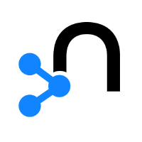
What is Neo4j
Neo4j is a graph database management system developed by Neo4j, Inc. Neo4j delivers the lightning-fast read and write performance you need, while still protecting your data integrity. It is the only enterprise-strength graph database that combines native graph storage, scalable architecture optimized for speed, and ACID compliance to ensure predictability of relationship-based queries.
Neo4j is Created by Emil Eifrem

Slide 12

Use Cases for Neo4j
Realtime Recommendations
Master Data Management
Fraud Detection
Graph Based Search
Network and IT Operations
Identity and Access Management

Slide 13
Graph Database
A graph database stores nodes and relationships instead of tables, or documents
Data is stored just like you might sketch ideas on a whiteboard. Your data is stored without restricting it to a predefined model, allowing a very flexible way of thinking about and using it.
A graph database is a kind of NoSQL database that uses graph structures with nodes, edges, and properties to represent and store information.
General graph databases that can store any graph are distinct from specialized graph databases such as triplestores and network databases.

Slide 14
Knowledge Graph
A knowledge graph, also known as a semantic network, represents a network of real-world entities—i.e. objects, events, situations, or concepts and illustrates the relationship between them.
This information is usually stored in a graph database and visualized as a graph structure, prompting the term knowledge “graph.”
A knowledge graph is made up of three main components: nodes, edges, and labels.

Slide 15
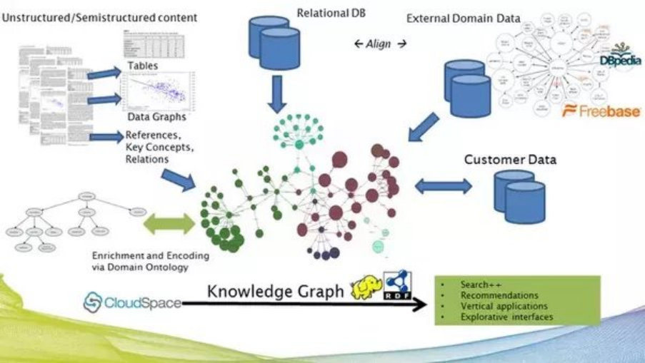

Slide 16
Cypher Query Language (CQL)
CQL stands for Cypher Query Language. Like Oracle Database has query language SQL, Neo4j has CQL as query language.
Neo4j CQL
Is a query language for Neo4j Graph Database.
Is a declarative pattern-matching language.
Follows SQL like syntax.
Syntax is very simple and in human readable format.
Like Oracle SQL
Neo4j CQL has commands to perform Database operations.
Neo4j CQL supports many clauses such as WHERE, ORDER BY, etc., to write very complex queries in an easy manner.
Neo4j CQL supports some functions such as String, Aggregation. In addition to them, it also supports some Relationship Functions.

Slide 17
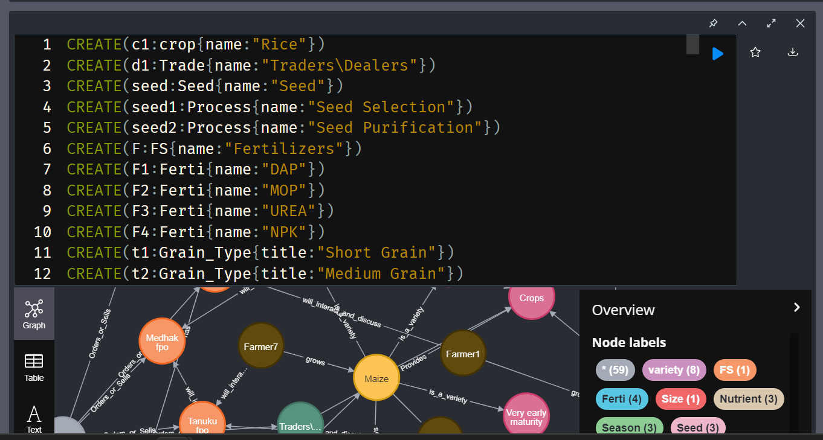

Slide 18
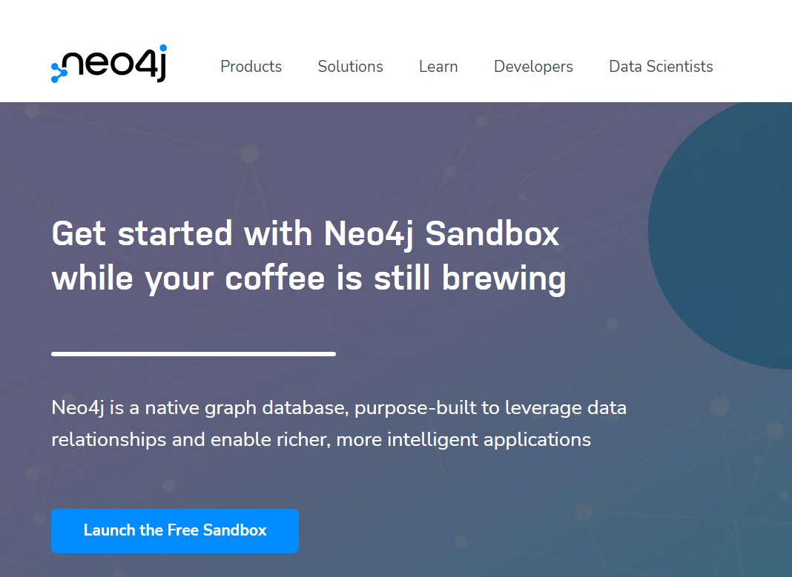
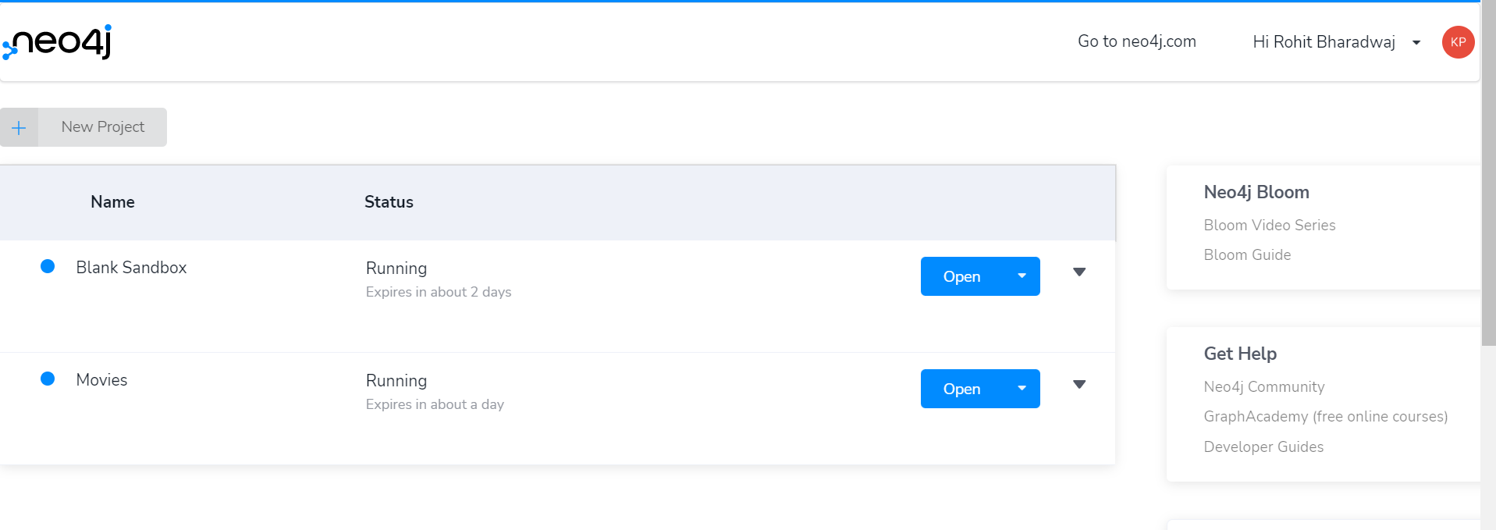
Neo4j Sandbox
The Neo4j sandbox is another way that you can begin development with Neo4j. It is a temporary, cloud-based instance of a Neo4j Server with its associated graph that you can access from any Web browser.
The Sandbox is intended as a temporary environment or for learning about the features of Neo4j as well as specific graph use-cases.

Slide 19
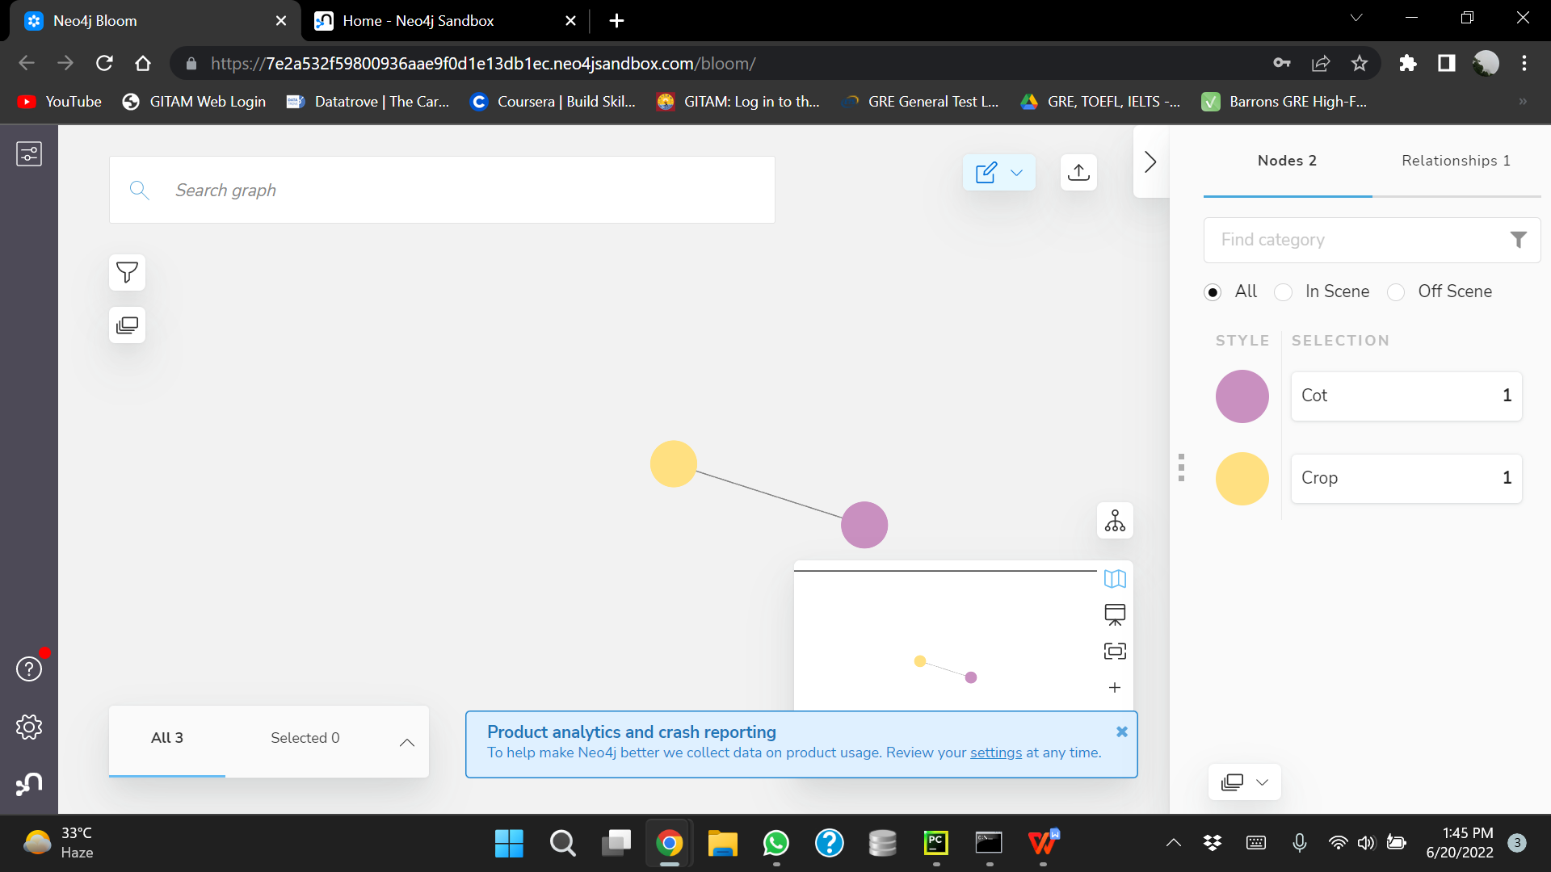

Neo4j Bloom
Neo4j Bloom is a beautiful and expressive data visualization tool to quickly explore and freely interact with Neo4j's graph data platform without any query language or programming.

Slide 20
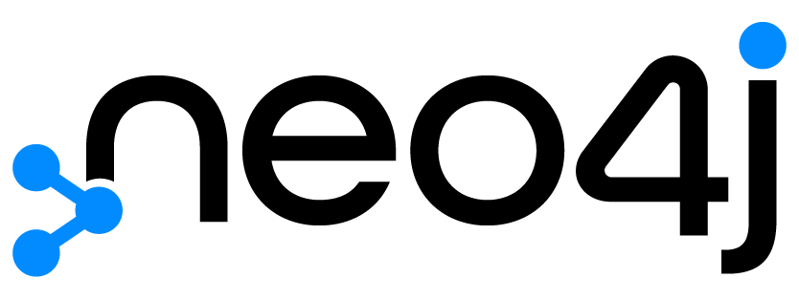

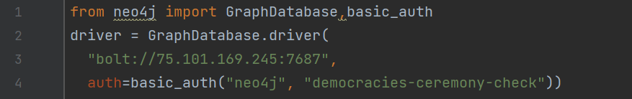
Neo4j and Python
Neo4j provides drivers which allow you to make a connection to the database and develop applications which create, read, update, and delete information from the graph.The Neo4j Python driver is officially supported by Neo4j and connects to the database using the binary protocol.
Making Connection to Neo4j Sandbox using neo4j python driver:

Slide 21





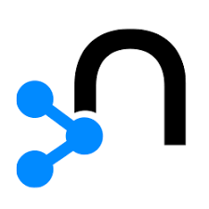
Project Management Tools

Slide 22
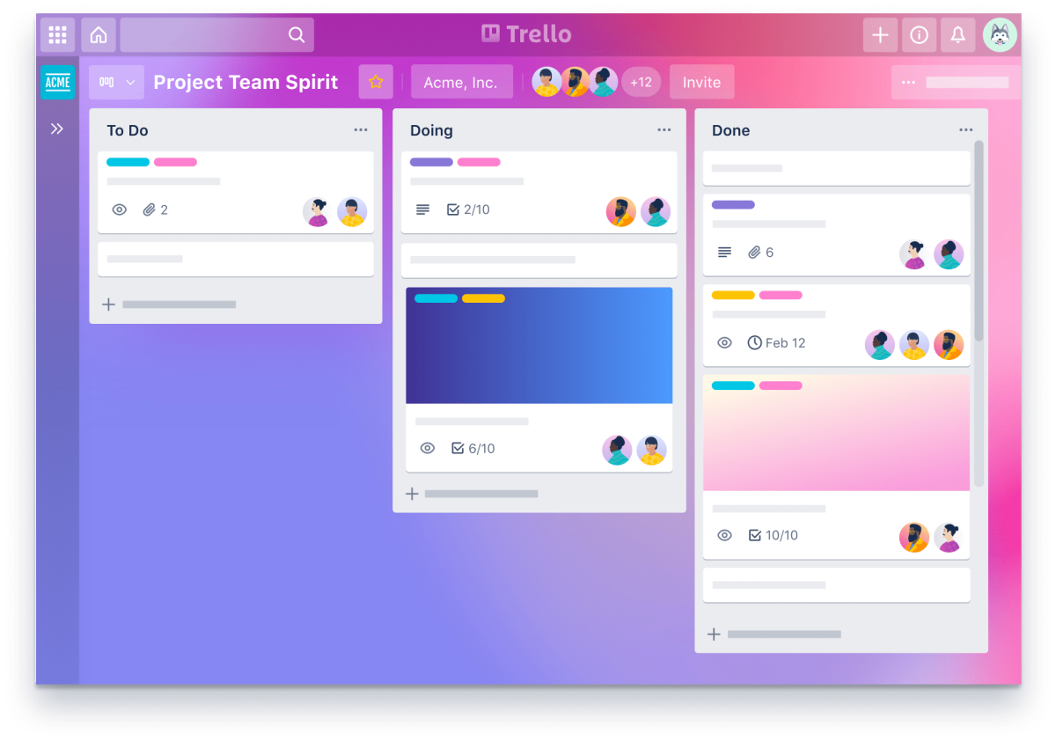

Trello
Trello is a work management tool which makes task organized and easy to complete.It is the visual tool that empowers your team to manage any type of project, workflow, or task tracking. Add files, checklists, or even automation and Customize it all for how your team works best.

Slide 23

Bitbucket
Bitbucket is a Git-based source code repository hosting service owned by Atlassian. Bitbucket Cloud is a Git based code hosting and collaboration tool, built for teams.
Some Features of Bitbucket are:
Collaboration across multiple teams
Ship Quality code
Automate Deployments
Atlassian is the parent company for bitbucket.Bitbucket was created by Jesper Noehr

Slide 24


