Slide 1
WATUMULL INSTITUTE – DEPARTMENT OF COMPUTER ENGINEERING
Group number: 1
Title of Project: Smart Education Bot
Domain: Data Analysis
Student 1: Arman Budhrani – 9
Student 2: Prakash Sewani - 50
Student 3: Bhavesh Thadani - 60
Guide: Prof. Sandeep More

Slide 2
Introduction:
A chatbot is a computer program that simulates human conversation through voice commands or text chats or both.
Use of Chatbots is very popular in a large scale of applications especially in systems that provide an intelligence support to the user.
Our project presents the realization of a prototype of a Chatbot in educational domain.
Our Chatbot also aims to improve communication, increase productivity, and minimize ambiguity from interactions.

Slide 3
Abstract:
A student has to visit various websites in order to complete their assignments, projects, experiments etc. and filter out the content that is needed to be written in the respective papers.
We aim at centralizing the workload of students to a single website (our website) to accomplish these tasks. This will help reduce the stress on students.
Since the 1990s, students per teacher have increased tremendously, this increases the workload on teachers. Doubt solving efficiency is on the decline due to increasing students. This project aims to bring the efficiency up to its standards by helping students along with their teachers individually instead of group discussions.
We understand that more than one answers can be correct for a given question, Our Chatbot is built to handle various queries of students ranging from straight forward answers to long answers.

Slide 4
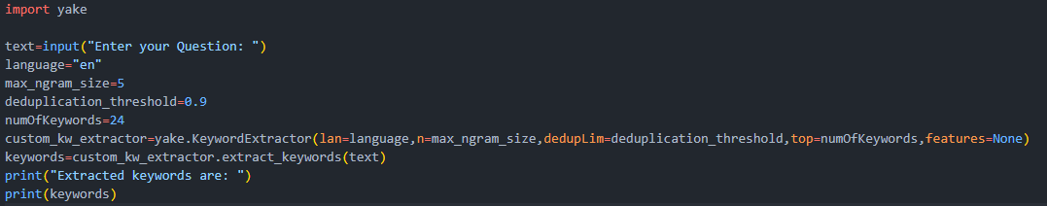
Literature Review
YAKE! Algorithm:
YAKE! stands for Yet Another Keyword Extractor.
YAKE! extracts keywords from a given query without the use of a in-built vocabulary.
YAKE! can also be used for context identification

Slide 5
Literature Review
BERT Algorithm:
BERT stands for Bidirectional Encoder Representations from Transformers.
BERT is a Deep-Learning Model
BERT can read text from both directions, hence Bidirectional.
BERT is trained on the two NLP related tasks:
Masked Language Modeling
Next Sentence Prediction
We utilise the latter, Next Sentence Prediction Model which is a token based algorithm that links two or more words to form sentences using NLP.

Slide 6
Literature Survey:
Survey Existing System
In [1], Farhan M. et al. implemented a web-bot using retrieval based model that a bot that stores the questions and answers it on XML style language i.e., Artificial Intelligence Markup Language (AIML). This bot is trained with a series of questions and answers. When it cannot provide a response to a question, a human user is responsible for responding. This was an interesting approach to an Educational Chatbot as it utilized the essentials of Machine as well as Human together.
In [2], Satu S., Chatbot is called Tutorbot because it is functionality backing of didactics done in e-learning environments. It contains some features as natural language management, presentation of contents, and interaction with search engine. Besides, e-learning platforms work is linked to indispensable services to web service. This project utilizes various Educational Website APIs, search engines and backend data to provide an appropriate answer to the students.

Slide 7
Literature Survey:
In [3], Rana Muhammad tackled traditional rules based chatbots by categorizing user queries into three parts: 1) QA on Structured Data, 2) QA on FAQ data and 3) QA on Unstructured Data. This was achieved by Dialogflow. For QA on Structured Data, he fetched it from a readymade information database into the backend, for QA on FAQ he utilized webscraping to answer similar questions asked on their official University website and for Unstructured Data he applied webscraping to fetch data from various website in terms of ‘Context’ and feed it into BERT Algorithm to find the answers
In [4], Utilizes Latent Dirichlet Allocation Algorithm and Workflow Manager to provide information about the courses offered by the said University using their Knowledge Base consisting of articles, user queries and answers based on the University Website

Slide 8
Limitations
PDF parsing algorithms only work if there is text present in a PDF file, it cannot extract data from images which were merged to form the PDF.
If there are equations in the PDF we need to change the encoding of the PDF Parsing Algorithm to read it properly but in doing so, symbols such as “ ‘ ”, “ ^ ” and other characters are misinterpreted and cause issues while searching for data.
Bert Algorithm requires Context which contains tokens that are less than or equal to 512 only. Anything above will produce an error which will result in a blank answer.

Slide 9
Scope:
We aim to extend our initial scope (i.e. 11th and 12th students) to every university level student by making this Bot a general purpose Education Bot.

Slide 10
Proposed Methodology:
Framework / Algorithm Used:
Python
Flask
NLP
BERT Algorithm
Html, CSS
JavaScript

Slide 11
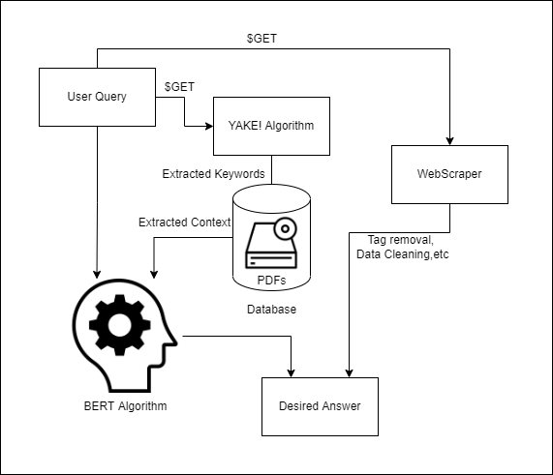
Proposed Methodology:

Slide 12
Proposed Methodology:
Major aspects of our project:
Interface
PDF Parsing Algorithm
Keyword Extraction Algorithm
BERT Algorithm
Web Scraping
Backend Linking
Final Testing

Slide 13
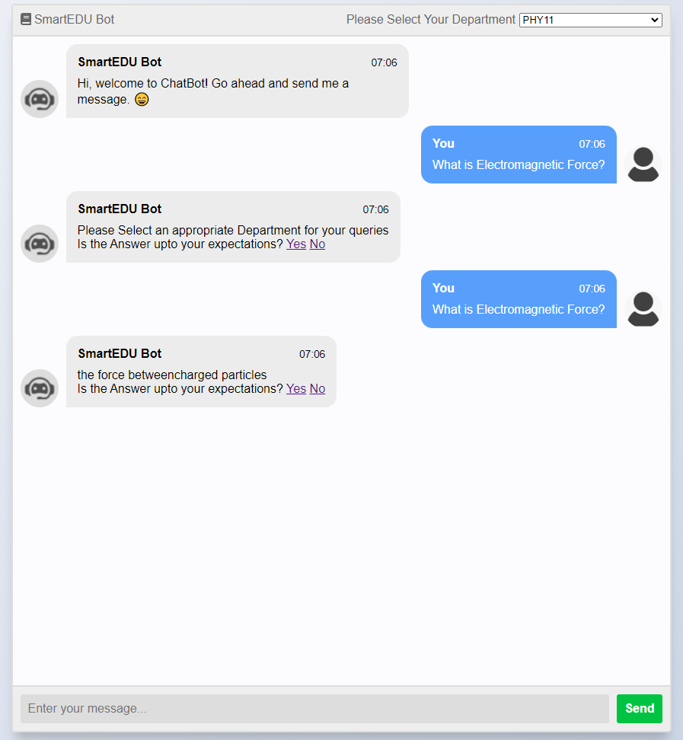
Interface

Slide 14
Implementation
User Query is fetched from the website using $GET method in Flask.
User Query is passed through YAKE! Keyword Extraction Algorithm which extracts the necessary keywords from the Query.
These keywords are then passed through the PDFs to extract the necessary context from the database.

Slide 15
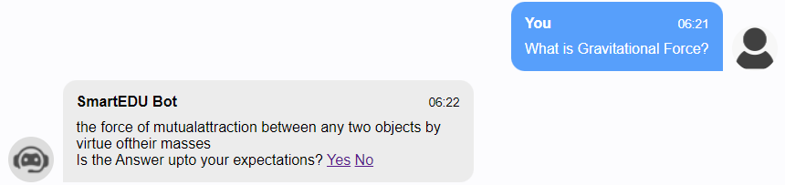
Implementation
Context Extraction yields the following result:
This context this then passed on to the BERT Algorithm along with the user query to return an appropriate answer.

Slide 16
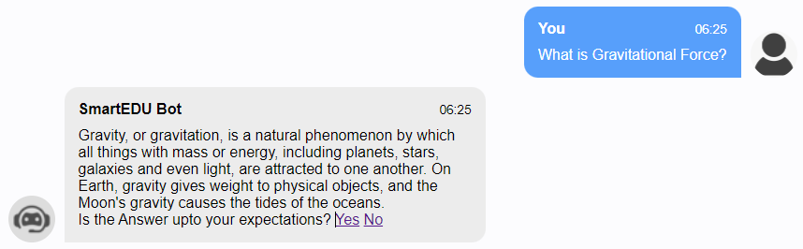
Implementation
If the answer is not upto your expectations you can press the “No” button.
This will automatically revert your previous query to Web Scraping Algorithm which will return the text extracted from top websites

Slide 17
Conclusion:
From the research conducted above we aim towards creating a perfect Smart Student Assistant. We are using advanced data parsing libraries such as PyPDF2 to extract information from various PDFs and send it to our backend. We are also using Wikipedia API and some Educational APIs that shall also provide data to our backend. Concepts of Web Scraping will also help enhance our Backend. By using this Bot, we assure that the student will be able to find both short and brief answers for the asked question.

Slide 18
References:
[1] : M. Farhan, I. M. Munwar, M. Aslam, A. M. Martinez Enriquez, A. Farooq, S. Tanveer, and P. A. Mejia “Automated reply to students’ queries in e-learning environment using Web-BOT,” Eleventh Mexican International Conference on Artificial Intelligence: Advances in Artificial Intelligence and Applications, Special Session - Revised Paper, 2012.
[2] : S. Satu, H. Parvez, and Shamim-AI-Mamun “Review of integrated applications with AIML based chatbot,” First International Conference on Computer and Information Engineering (ICCIE), 2015.
[3] : Rana, Muhammad, “EagleBot: A chatbot based on Multi-Tier Question Answering Systems for Retrieving Answers from Heterogenous Sources Using BERT” (2019). Electronic Theses and Dissertations.
[4] : Anurag Gautam ,Harshit Maheshwari Advisor :Dr. Amitabha Mukherjee, “Question Answering System using PLSA”, Dept. of Computer Science and Engineering IIT-Kanpur ,India
Anjana Tiha, “Intelligent Chatbot using Deep Learning”, UID : U00619942 University of Memphis Spring, 2018
Garcia Brustenga, G., Fuertes-Alpiste, M., Molas-Castells, N. (2018). Briefing paper: “Chatbots in Education.” Barcelona: eLearn Center. Universitat Oberta de Catalunya. ISBN: 978-84-09-03944-9
Eric Hsiao-Kuang Wu, Chun-Han Lin, Yu-Yen Ou, Chen-Zhong Liu, Wei-Kai Wang, Chi-Yun Chao “Advantages and Constraints of a Hybrid Model K-12 E-Learning Assistant Chatbot” Ministry of Science, Taiwan, Grant ID 108-2221-E-008-034.
Chinedu Wilfred Okonkwo, Abejide Ade-Ibijola “Computers and Education: Artificial Intelligence”

