Slide 1


Slide 2
CYSTIC FIBROSIS NEONATAL SCREENING CASE REPORT
Here is where your presentation begins

Slide 3
TABLE OF CONTENTS
01
06
02
03
04
05
About company
Methodology
Abstract
07
Result Analysis
Introduction
08
Conclusion
Flowchart
09
Reference
Algorithm

Slide 4

01
About Company

Slide 5
AiRobosoft Products and Services established in 20 March 2015 in Bengluru. Mr. Syad ased Founder and CEO at AiRbosoft.
AiRobosoft Products and Services formed with the concept of imparting required knowledge to bridge the gap between educational institutions and the industry.
AiRobosoft Products and Services comprises of highly experienced trainers, mentors, educationists and coaches who have been relentlessly providing training for skill and technical development in diverse fields for the past 8 years.
They are proud to offer hands-on technology workshops and seminars for graduates, faculties, job seekers and other professionals. They actively engage in career training, counselling, job placements and consultations.
AiRobosoft Products and Services aims to provide hands on experience about state- of-art knowledge of industry to colleges and universities.

Slide 6
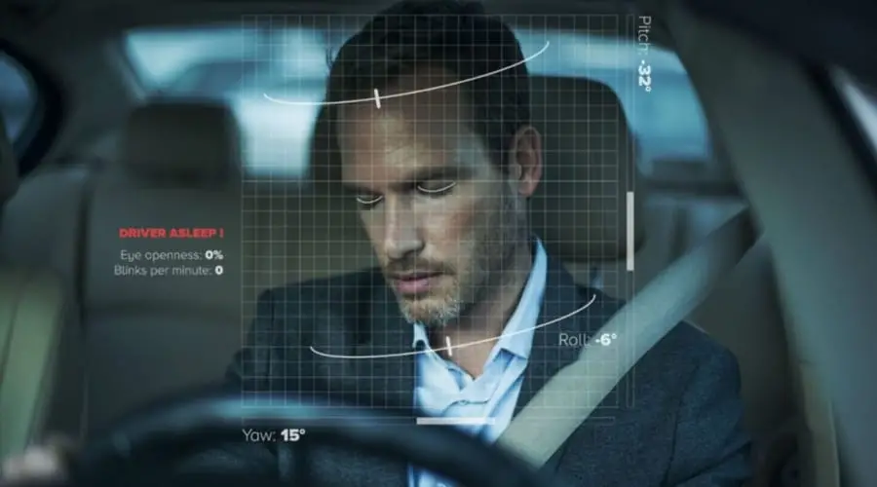
02
ABSTRACT

Slide 7
—It is a difficult problem to make drivers drowsiness detection meet the needs of real time in embedded system; meanwhile, there are still some unsolved problems like drivers’ head tilted and size of eye image not large enough.
This presentation proposes an efficient method to solve these problems for eye state identification of drivers’ drowsiness detection in embedded system which based on image processing techniques.
This method break traditional way of drowsiness detection to make it real time, it utilizes face detection and eye detection to initialize the location of driver’s eyes; after that an object tracking method is used to keep track of the eyes.
finally, we can identify drowsiness state of driver with PERCLOS by identified eye state.

Slide 8
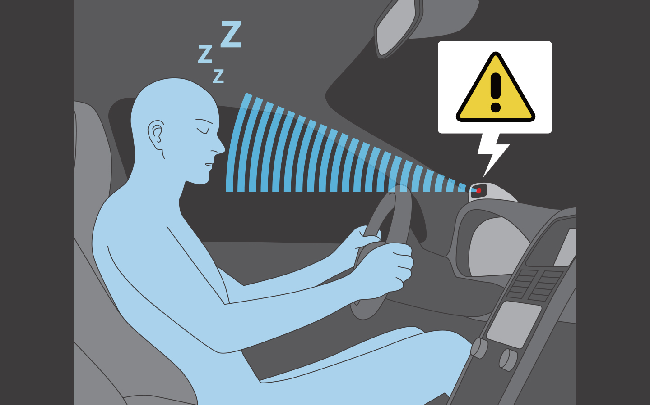
03
Introduction

Slide 9
INTRODUCTION
Driver drowsiness detection is a critical aspect of ensuring road safety. Fatigue and drowsiness can impair a driver's ability to react quickly and make sound decisions, leading to accidents. In this project, we will use Python and PyCharm to create a simple driver drowsiness detection system using computer vision techniques.
This project was made because we were intrigued and we wanted to gain Handson experience with the Machine Learning Project. We are highly interested in anything related to Machine Learning, the independent project provided us with the opportunity to study and reaffirm our passion for this subject. The capacity to generate guesses, forecasts, and offer machines the ability to learn on their own is both powerful and infinite in terms of application possibilities. Machine Learning may be applied in finance, medicine, and virtually any other field. That is why we opted to base our idea on Machine Learning. As a first project, we intended to make it as instructional as possible by tackling each stage of the machine learning process and attempting to comprehend it well.
We have picked Driver’s drowsiness detection identifying problems Many researches have been done on measuring the fatigue degree of drivers’ physiology. After development of decades, researches based on image processing and pattern-recognition technology have been widely adopted.

Slide 10

04
Flow chart

Slide 11
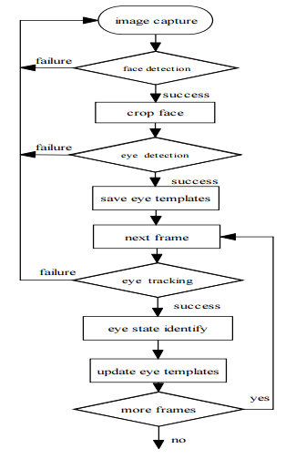

Slide 12
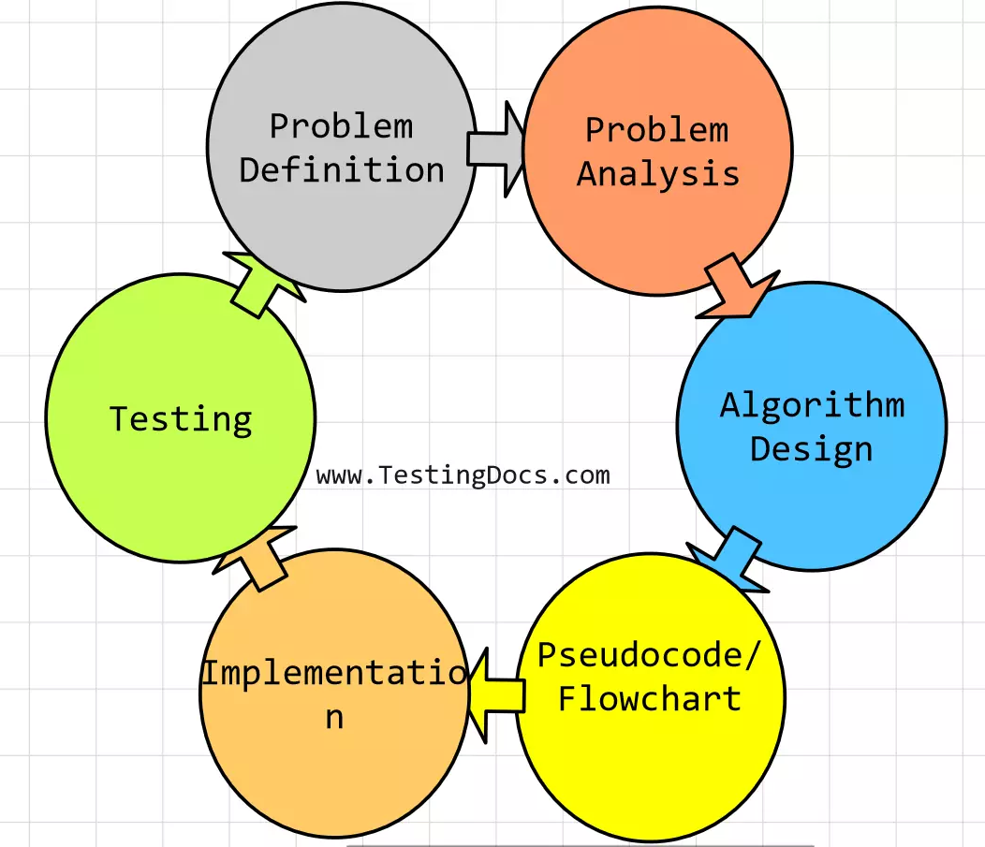
05
Algorithm

Slide 13
Algorithm

Slide 14

06
Methodology

Slide 15
01
Dataset Collection
Describe the dataset used in your project, including the source, size, and format of the data.
Explain how the dataset was annotated, including the labels for alert and drowsy states.
Provide details on any data augmentation techniques applied, such as cropping, resizing, or adding noise
02
Treatment
Discuss how the collected data was preprocessed, such as resizing images, normalizing pixel values, or extracting relevant facial features.
Mention any challenges encountered during preprocessing.

Slide 16
03
Model Architecture
Explain the architecture of the drowsiness detection model, which could be based on convolutional neural networks (CNNs), recurrent neural networks (RNNs), or a combination of both.
Include details about the layers, activation functions, and other hyperparameters used in the model.
04
Training
Describe the training process, including the loss function, optimization algorithm, and the number of epochs.
Discuss the training/validation split and any techniques used for preventing overfitting.

Slide 17
05
Output
Present the results of your drowsiness detection system, including:
Accuracy, precision, recall, and F1-score for alert and drowsy states.
Confusion matrix and other relevant evaluation metrics.
Visualization of the model's performance

Slide 18

07
Result analysis

Slide 19
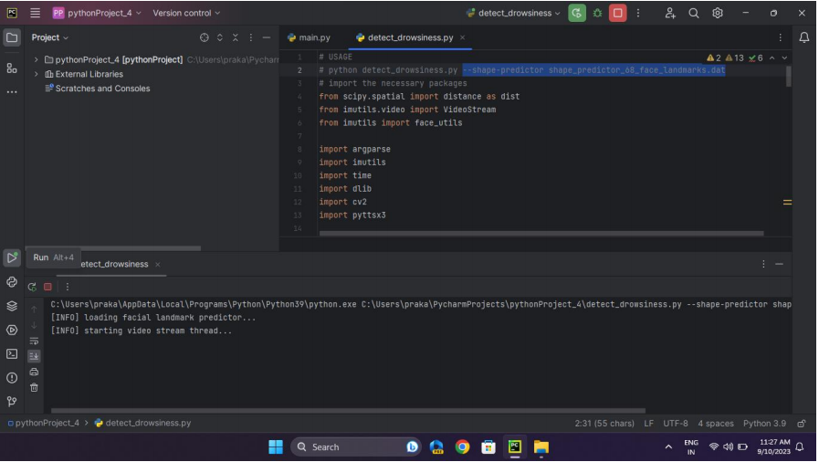
Screenshots
Initialization of the program

Slide 20
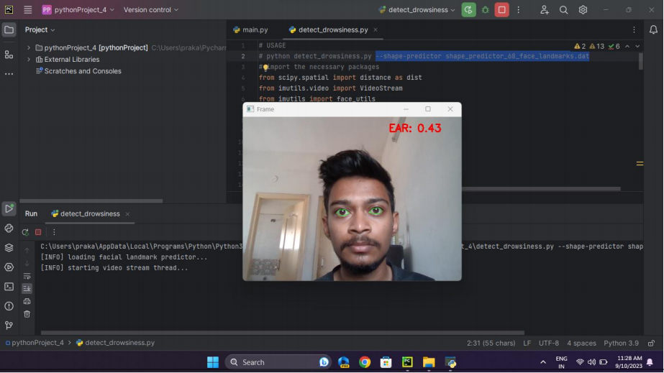
Detection of eye location and identifying the state

Slide 21
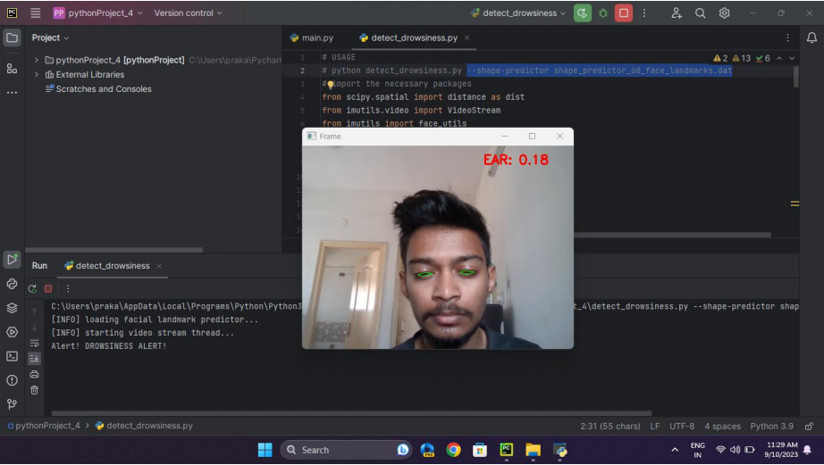
Detection of drowsiness and displaying Drowsiness alert message

Slide 22

08
Conclusion

Slide 23
The Driver Drowsiness Detection system was successfully implemented using Python in PyCharm. The key findings and results of the project are as follows:
Face and Eye Detection: The project effectively used OpenCV and Dlib libraries to detect faces and eyes in real-time from a webcam feed. This step is crucial for tracking driver behavior.
Drowsiness Detection Algorithm: A drowsiness detection algorithm based on eye closure and blinking was implemented. The algorithm monitors eye state and triggers an alert when drowsiness is detected.
Dataset: If applicable, a dataset of driver images with labeled drowsy and non-drowsy states was used for training and testing the model. This dataset provided the necessary ground truth for the system's performance evaluation.
Challenges and Limitations: During the implementation, challenges such as lighting conditions, head movement, and the availability of diverse datasets were encountered. The system may not perform well under extreme lighting conditions or when drivers wear sunglasses.

Slide 24

09
Reference

Slide 25
[1] Perez, C.A.; Palma, A.; Holzmann, C.A.; Pena, C.. Face and eye tracking algorithm based on digital image processing. Systems, Man, and Cybernetics, 2001 IEEE International Conference on Volume 2, 7-10 Oct. 2001 Page(s):1178 - 1183 vol.2.
[2] Tianjian Liu, Shanan Zhu, Eyes detection and tracking based on entropy in particle filter. Control and Automation, 2005. ICCA '05. International Conference on Volume 2, 26-29 June 2005 Page(s):1002 - 1007 Vol. 2
[3] Ito, T., Mita, S., Kozuka, K., Nakano, T., Yamamoto, S.. Driver blink measurement by the motion picture processing and its application to drowsiness detection. Intelligent Transportation Systems, 2002. Proceedings. The IEEE 5th International Conference on 2002 Page(s):168 - 173

Slide 26
Project Video

Slide 27
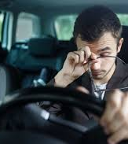
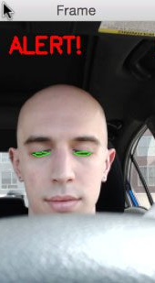
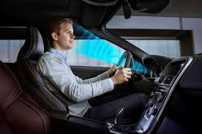
PHOTO SHOWCASE

Slide 28
THANK YOU
Do you have any questions?

