Slide 1
Course, Career & Personal mentorship Chatbot
PRESENTED BY:
SIVA PRAKASH.K
2022179054
MCA (SS)
Project GUIDE:
DR. S. SRIDHAR
(Professor)
IST department
Anna university

Slide 2
Project Domain
Natural language Processing :
Natural Language Processing (NLP) is a subfield of artificial intelligence (AI) and computer science concerned with enabling computers to understand and process human language.
It aims to bridge the gap between the structured nature of computer programs and the unstructured, ambiguous nature of human language.
Recommendation Systems :
Recommendation systems are algorithms and techniques used in information filtering and decision making to suggest items to users.
The primary goal of recommendation systems is to predict the "rating" or "preference" that a user would give to an item.

Slide 3
Problem Statement
Indented to design and develop an AI-driven chatbot system, utilizing speech-to-text and text-to-speech capabilities, for personalized suggestion in job planning, course selection, and professional development.
The system aims to provide intuitive and accessible virtual mentorship through seamless spoken communication, leveraging advanced NLP techniques and deep learning models.
The primary goal is to create an efficient and empathetic virtual mentor capable of offering tailored recommendations and insights, ultimately empowering users to navigate their jobs and educational paths effectively.

Slide 4
Literature Survey
Author | Title | Description | Year
Rajamalli Keerthana R,Fathima, etc | Evaluating the Performance of Various Deep Reinforcement Learning Algorithms for a Conversational Chatbot | The proposed system was created for solving one of the major issues faced in conversational chatbots, relevancy. The solution provided in the proposed system is the use of Deep Reinforcement Learning Technique in order to make the chatbot learn from its mistakes | 2022
Danyal Zaidi, etc. | Artificial Intelligence Based Career Counseling Chatbot: A System for counseling | This chat-bot aims at acting as a career counselor, helping students to decide their career choices anonymously and comfortably with enough information. | 2023
Camilleri, M.A. and Troise, C. | Chatbot Recommender Systems in Tourism: A Systematic Review and a Benefit-Cost Analysis | This research is focused on the utilization of artificially intelligent (AI), customer service chatbots in travel, tourism and hospitality. Rigorous criteria were used to search, screen, extract and synthesize articles on conversational, automated systems. | 2023

Slide 5
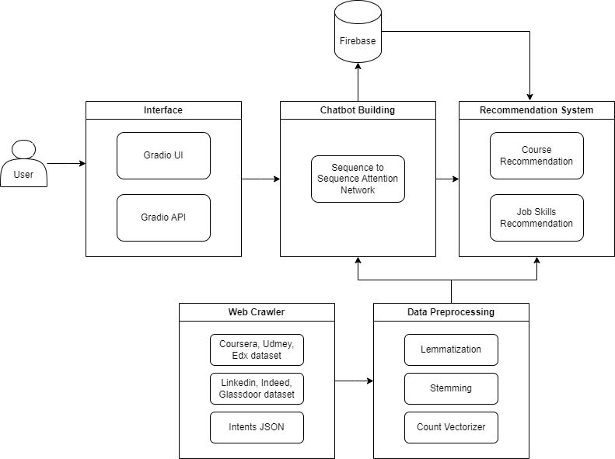

Slide 6
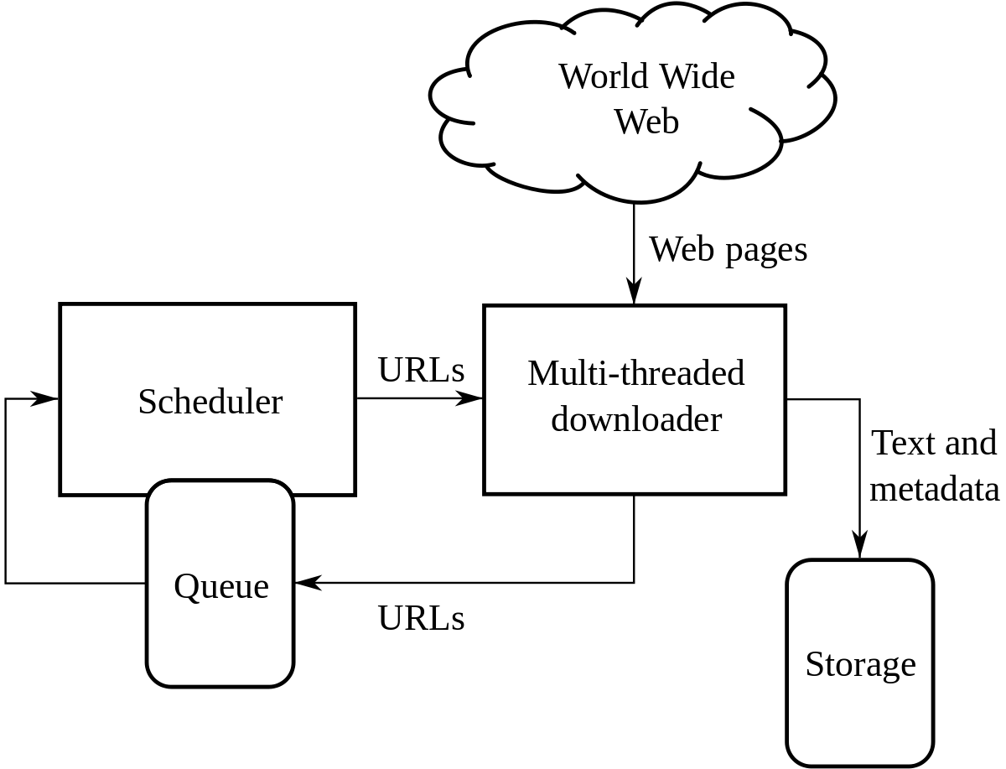
Module Description
Data Collection:
User Profile Data:
Collected data from platforms like Udemy, Coursera, and edX to create user profiles. This data could include:
Courses complete
Skills learned
Ratings and reviews
Job Description Data:
Scrape data from job boards like ZipRecruiter, LinkedIn, and Indeed to collect job descriptions relevant to IT roles. This data could include:
Job titles and descriptions
Required and desired skills
Keywords related to the specific job role

Slide 7
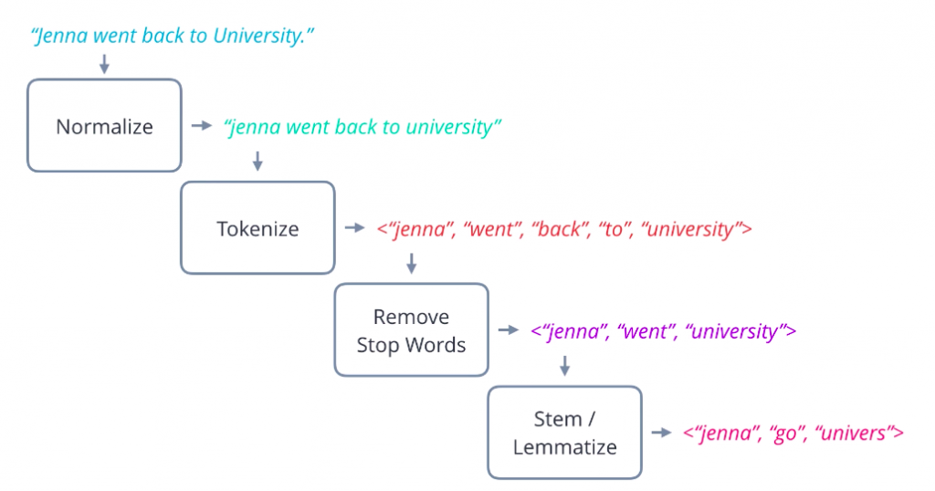
Module Description
Data Preprocessing:
Tokenization: Splitting text into smaller units such as words or subwords. This helps in breaking down the text data into manageable pieces for further processing.
Stopword Removal: Eliminating common words (e.g., "and", "the", "is") that do not contribute much to the meaning of the text. This helps reduce noise in the data.
Stemming and Lemmatization: Reducing words to their base or root form. Stemming chops off prefixes or suffixes, while lemmatization maps words to their dictionary form. This helps in reducing dimensionality and normalizing variations of words.

Slide 8
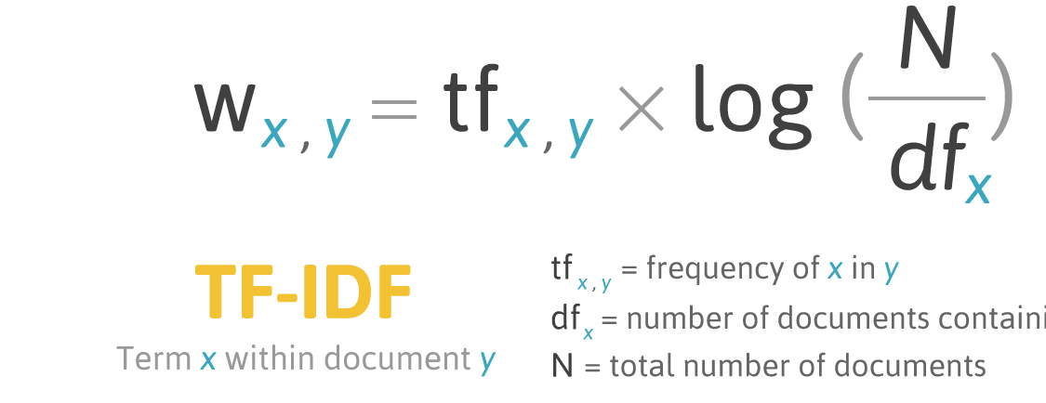
Module Description
Data Preprocessing:
CountVectorizer : CountVectorizer is a technique used in natural language processing for converting a collection of text documents into a matrix of token counts. Each row of the matrix represents a document, and each column represents a unique word in the corpus. The value in each cell indicates the frequency of occurrence of that word in the corresponding document.
TF-IDF:
Term Frequency (TF): This measures the frequency of a term (word) within a document. It indicates how often a particular word occurs in a document relative to the total number of words in that document.
Inverse Document Frequency (IDF): This measures the rarity of a term across the entire corpus. It is calculated as the logarithm of the ratio of the total number of documents in the corpus to the number of documents containing the term.

Slide 9
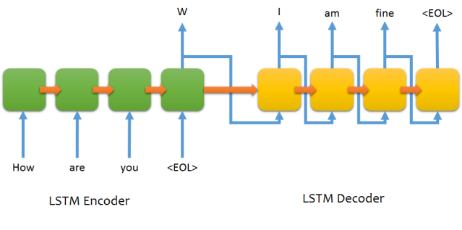
Module Description
Chatbot Building:
Seq2Seq:
Encoder: The input sequence is passed through an encoder RNN (Recurrent Neural Network), typically a variant of LSTM (Long Short-Term Memory) or GRU (Gated Recurrent Unit). The encoder processes the input sequence and produces a fixed-size context vector that represents the entire input sequence.
Decoder: The context vector from the encoder is used as the initial hidden state of the decoder RNN. The decoder generates the output sequence one token at a time. At each step, the decoder receives the previous token as input and produces the next token in the sequence.
Attention Mechanism: In a basic Seq2Seq model, the context vector produced by the encoder is expected to capture all the information from the input sequence. However, this fixed-size representation may not be sufficient, especially for long input sequences.

Slide 10
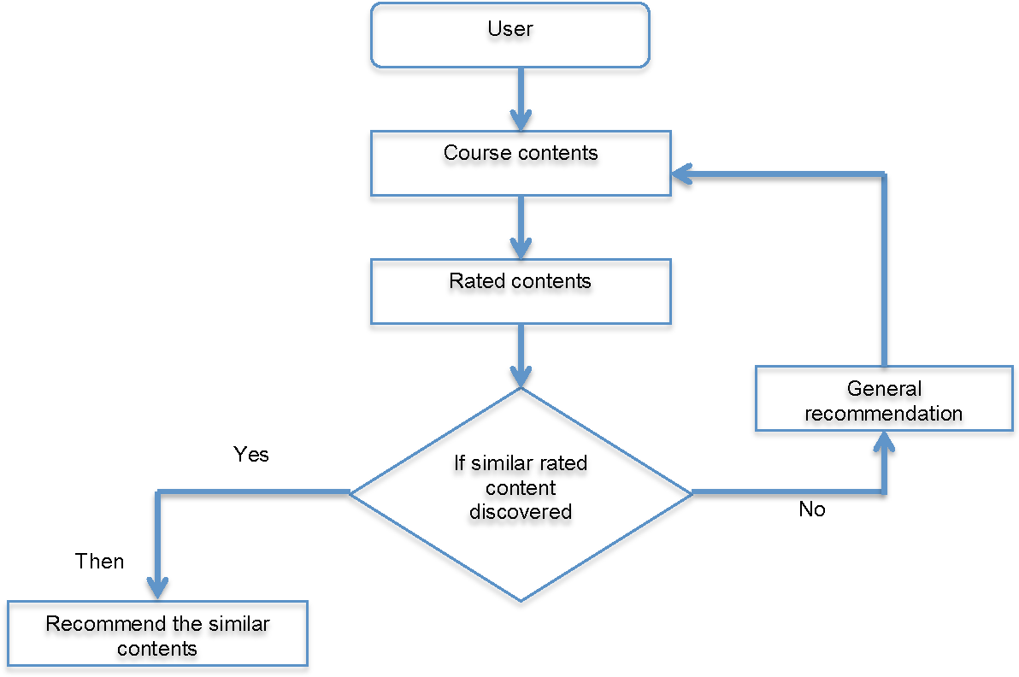
Module Description
Recommendation for Courses and Jobs:
Content-based Filtering:
In this approach, the system identifies similar items to the ones the user has already interacted with and recommends those similar items.
The similarity between items is calculated based on the users who have interacted with both items. Items that are often interacted with by the same users are considered similar.
Once similar items are identified, the system recommends them to the user based on their past interactions with similar items.

Slide 11
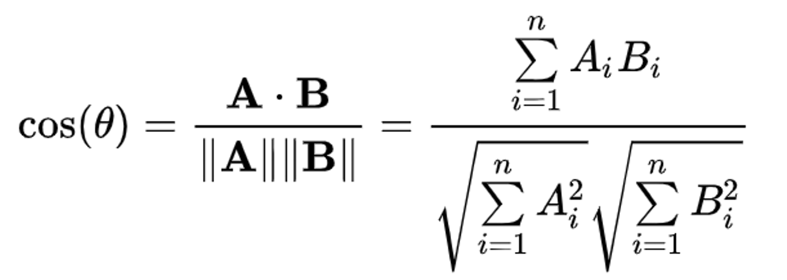
Module Description
Cosine Similarity:
Cosine similarity measures the cosine of the angle between two vectors in a multidimensional space.
It's widely used for text-based recommendation systems where documents or items are represented as vectors of features, such as TF-IDF weights or word embeddings.

Slide 12
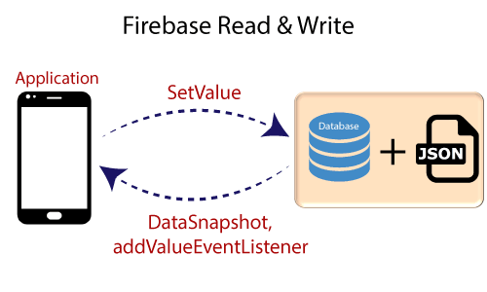
Module Description
Database & Deployment:
Deploy the chatbot model on a web server using Gradio UI, Gradio API for creating APIs.
Integrated Firebase Realtime Database to store chatbot conversations or user data using Firebase SDK to interact with the database from your Python backend.
Implement data synchronization between the chatbot interface and the Firebase database for real-time updates.

Slide 13
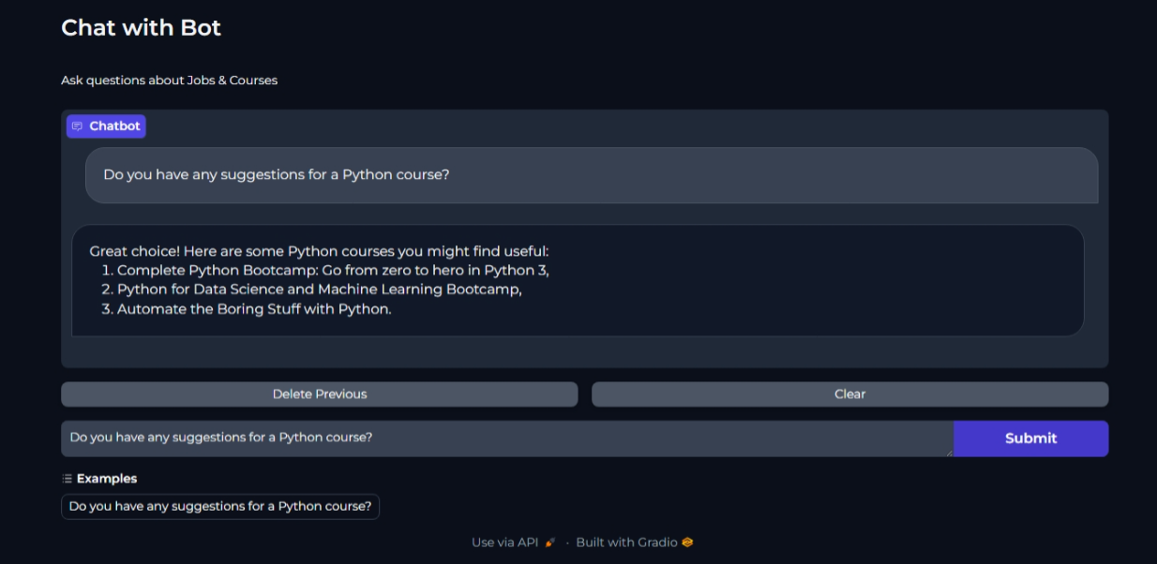
Sample Chatbot

Slide 14
Tools & Technologies
Frontend:
CSS (Cascading Style Sheets): defines the presentation of a web page, including layout, colors, fonts, and animations. It doesn't involve building applications or interactivity.
HTML (HyperText Markup Language): defines the structure and content of a web page. It acts as the foundation for web pages and doesn't handle complex interactions.
Gradio UI: a library specifically designed for building machine learning interfaces. It simplifies creating interfaces for users to interact with your machine learning models. Gradio leverages HTML, CSS, and Javascript under the hood, but provides a higher-level abstraction for building these interfaces.

Slide 15
Tools & Technologies
Backend:
TensorFlow: Core deep learning framework for building, training, and deploying neural network models for tasks like sentiment analysis, topic modeling, text classification, and intent recognition.
Keras: Keras is a high-level API built on top of TensorFlow, it provides Rapid prototyping and experimentation with deep learning models.
SpaCy: Powerful industrial-strength NLP library for text processing, tokenization, named entity recognition (NER), part-of-speech tagging, and dependency parsing, empowering deep understanding of user queries and context.

Slide 16
Tools & Technologies
Environment :
Kaggle Notebooks:
Valuable platform for exploring public datasets relevant to career guidance and personal well-being.
Find pre-processed datasets, benchmark models, and tutorials related to NLP and deep learning.
Use notebooks to share your work, learn from others, and participate in competitions to refine your approach.
Vertex AI:
Vertex AI is a comprehensive platform offered by Google Cloud Platform (GCP) that provides tools and infrastructure to streamline the entire machine learning (ML) development lifecycle, from data processing and model training to deployment and monitoring.

Slide 17
References
Rajamalli Keerthana R,Fathima G,Lilly Florence “Evaluating the Performance of Various Deep Reinforcement Learning Algorithms for a Conversational Chatbot”(2022).
Zaidi, Danyal, et al. “Artificial Intelligence Based Career Counselling Chat Bot a System for Counselling.” Annals of the Romanian Society for Cell Biology, vol. 25, no. 6, 14 June 2021.
“Chatbot Recommender Systems in Tourism: A Systematic Review and a Benefit-Cost Analysis”(2023).

