Slide 1
Map Callback: In this Week, you will learn how to map a callback function onto the elements of an array.
This is a useful tool when dealing with large collections of JSON data.
You can access the starter files from the Introduction and Instructions page.

Slide 2
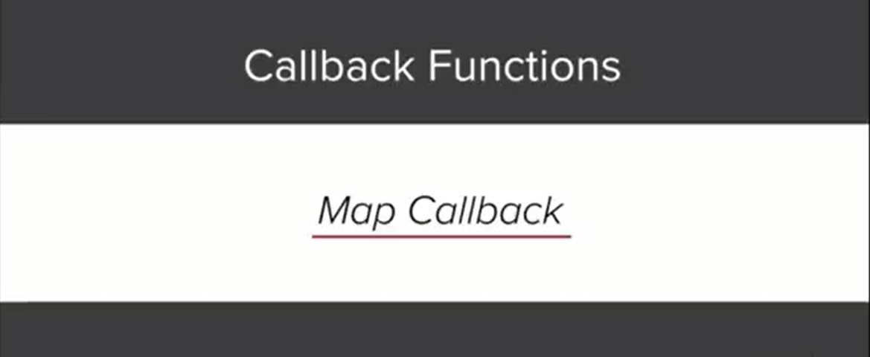

Slide 3


Slide 4
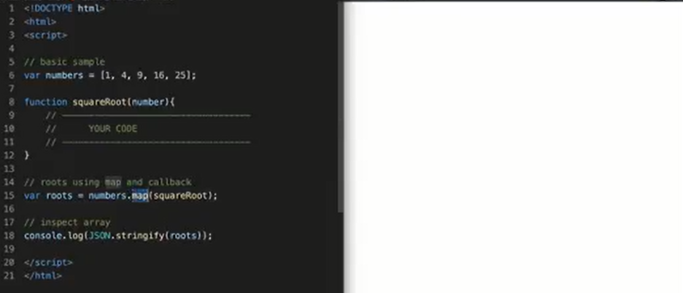
Example: Starter Code
Map a
Function (call back)
on to an Array

Slide 5
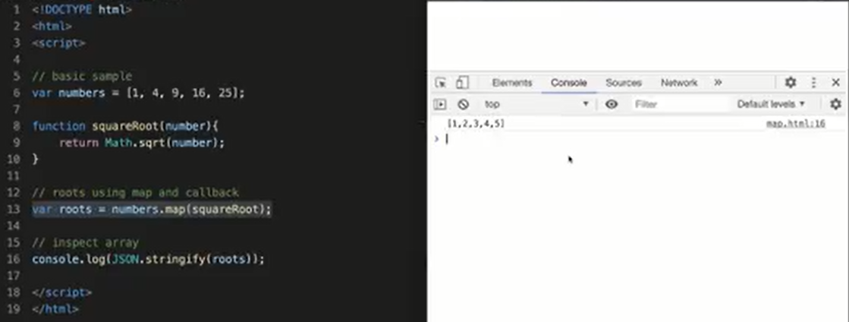

Slide 6
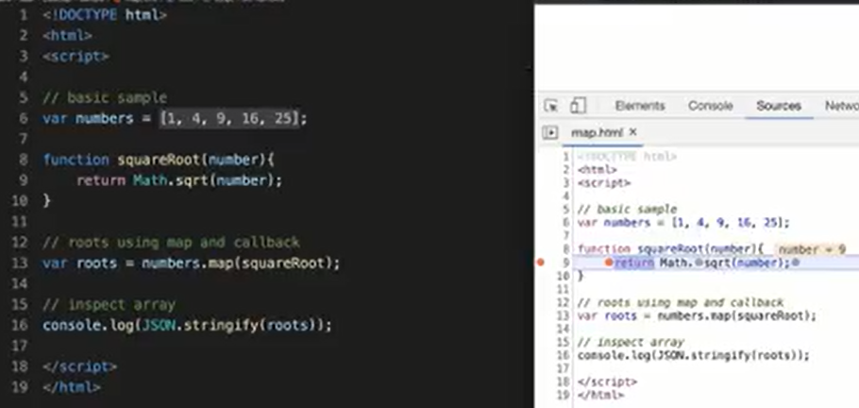

Slide 7
Reduce: The reduce function reduces an array to a single value by leveraging a callback function.
Try coding out this example on your own machine and viewing it in the console to see how it works.
You can download the starter files from the Introduction and Instructions page.

Slide 8
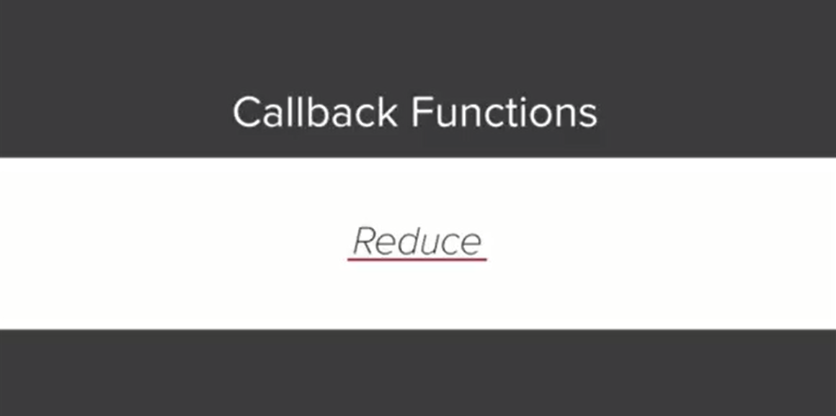

Slide 9
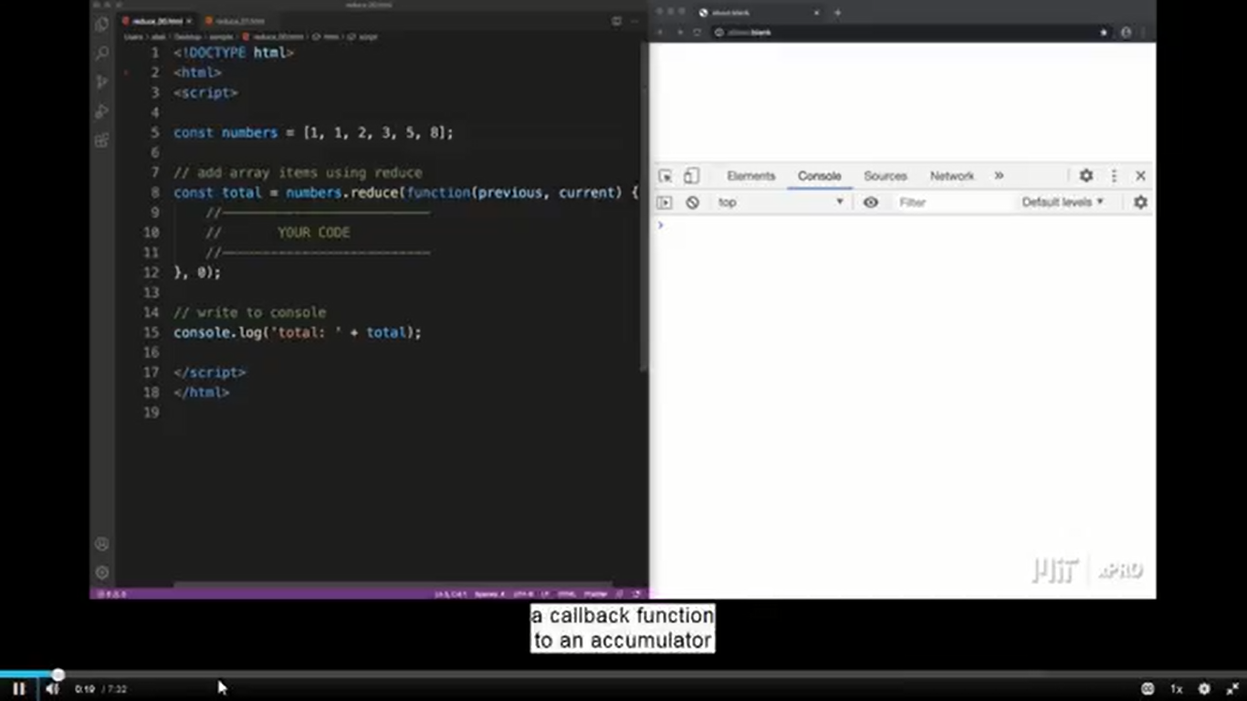
Example: Starter Code
Reduce a
Function (call back)
on to an Array

Slide 10
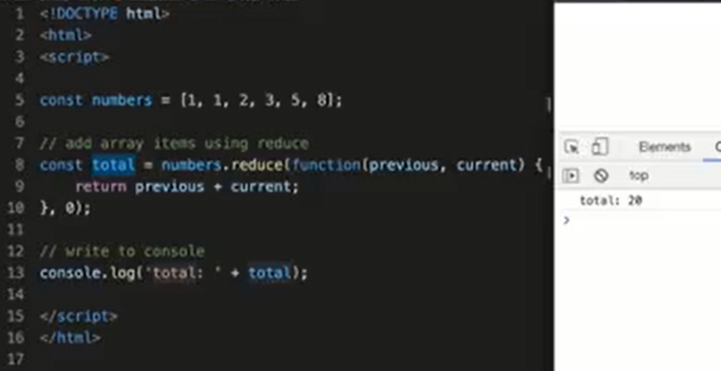

Slide 11
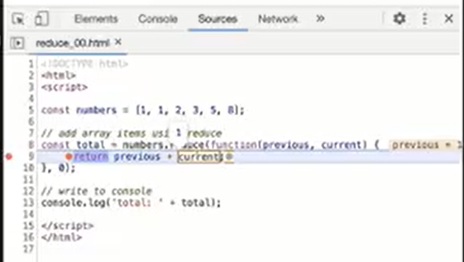

Slide 12
Exercise : Reduce Callback

Slide 13
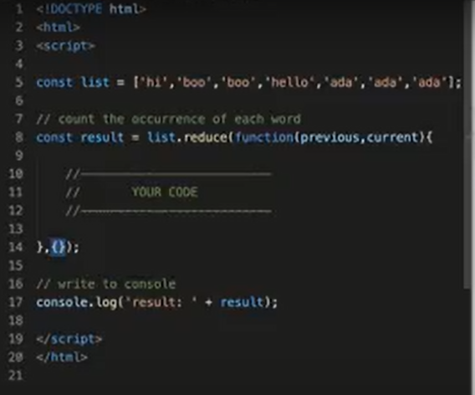

Slide 14
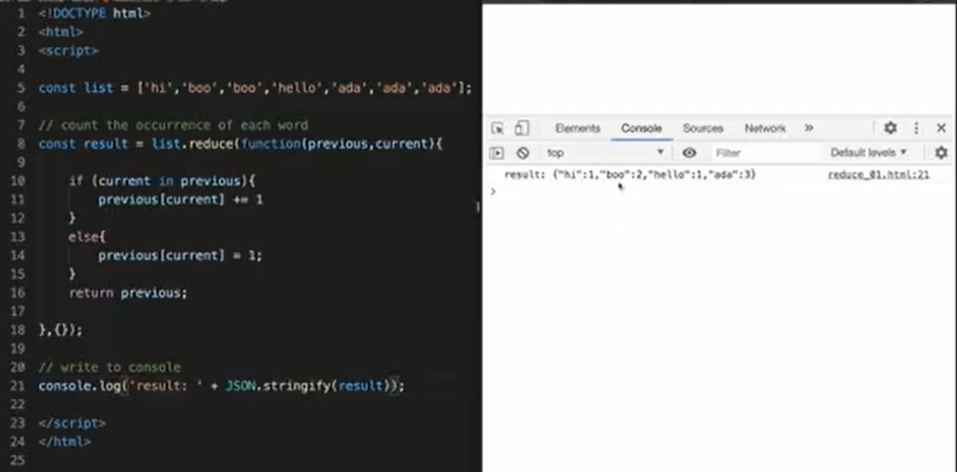

Slide 15
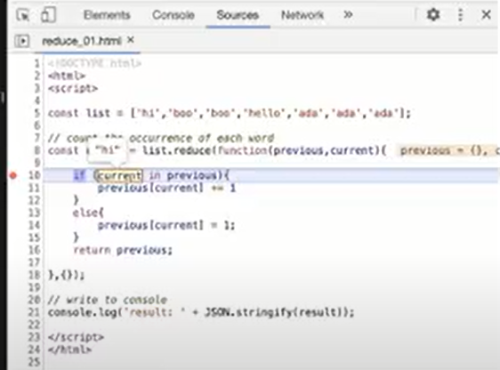

Slide 16
Complete coding activity related to
Map and Reduce call back functions,
Upload the solutions to the GitHub.

