Slide 1
🏨 HOTEL BOOKING ANALYSIS
Comprehensive Business Intelligence Report
30,000 Hotel Bookings | 10 US Cities | 2024–2025
Key Observations • Root Cause Analysis • Business Recommendations
Analysis Date: June 2026

Slide 2
Executive Summary
At-a-glance key performance indicators across 30,000 hotel bookings
30,000
20.23%
$28,191
27.9%
Total Bookings
Overall Cancel Rate
Web Channel Value
Travel Agent Cancel
2024–2025
6,070 cancelled bookings
Highest avg booking value
Highest cancellation rate
21,672
~4 nights
May
16.0%
Confirmed Bookings
Avg Stay Length
Peak Month
Deluxe Cancel Rate
72.2% of all bookings
Consistent across all tiers
2,910 bookings
Lowest cancellation room
This report analyses 30,000 hotel bookings across 10 major US cities (2024–2025), covering three booking channels, three room types, and hotels rated 2–5 stars. The dataset reveals a 20.23% overall cancellation rate, with Travel Agents driving the highest cancellation (27.9%) while the Web channel delivers the best booking quality (17.6% cancel, $28,191 avg value). Seasonal peaks occur in April–June (summer + weddings); August–September show elevated cancellations (10–11%). Five-star properties carry slightly higher cancellation risk (21.3%) due to price sensitivity, while Deluxe rooms show the strongest guest commitment (16.0%). Recommendations focus on deposit policies, direct-booking loyalty programmes, and dynamic pricing to improve profitability and retention.

Slide 3
Key Observations – Trends & Patterns (1/2)
Booking channel dominance, seasonal demand cycles, and their interaction with value
📡 Trend 1: Channel Performance Divergence
📅 Trend 2: Seasonal Demand Swings
The three booking channels show dramatically different economics: • Web Channel (50% share): Highest avg value ($28,191) + lowest cancellation (17.6%) → Customers research thoroughly before committing. • Mobile App (40% share): Mid-range value ($21,351), 21.6% cancel rate. → Impulse/deal-driven bookings via push notifications. • Travel Agents (10% share): $24,454 avg value, but 27.9% cancellation. → Agents hold multiple options, leading to high attrition. Key takeaway: The Web channel is the most valuable segment — 37% lower cancellation than Travel Agents, 32% higher average booking value than Mobile.
Monthly booking volumes and cancellation rates move inversely: • Peak bookings (Apr–Jun): 2,221–2,910/month. Cancellation rate is remarkably low (0.4–0.6%) — guests are committed to planned trips. • Post-summer surge (Aug–Sep): Volumes drop to ~1,864–1,920 but cancellation rates spike to 10–11% — last-minute plan collapses. • Winter months (Jan–Feb): Moderate volumes (1,742–1,959), low-mid cancellation (7–8%) — post-holiday, deliberate bookings. • Average booking value is relatively stable ($24K–$27K year-round), suggesting price is not the main driver of seasonal variation — traveller intent and external factors (school calendars, weather) are the primary levers.

Slide 4
Key Observations – Trends & Patterns (2/2)
Room type commitment levels, star rating nuances, and cancellation behaviour
🛏️ Trend 3: Room Type & Commitment Levels
⭐ Trend 4: Star Rating & Cancellation Nuance
• Standard (55.2% of bookings): Cancellation rate 23.3% — budget guests have more alternatives; lower switching cost drives higher attrition. • Deluxe (34.9%): Cancellation rate 16.0% — strongest commitment; guests are willing to pay more and see through their plans. • Suite (9.9%): Cancellation rate 18.0% — premium but moderate.
• 2-Star: 19.8% cancel — lowest among all ratings; budget guests less likely to have premium alternatives to switch to. • 3-Star: 20.2% | 4-Star: 20.0% — near-identical, mid-market stable. • 5-Star: 21.3% — highest; luxury price sensitivity and broader high-end alternatives increase cancellation risk. • Average stay (~4 nights) is consistent across all star ratings.
📊 Cancellation Behaviour at a Glance
Segment
Volume
Cancel Rate
Avg Value
Key Driver
Web Channel
15,001
17.6%
$28,191
High intent, direct research
Mobile App
12,009
21.6%
$21,351
Impulse booking, easy cancellation
Travel Agent
2,990
27.9%
$24,454
Speculative holds, no deposit
Standard Room
16,552
23.3%
$25,147
Low switching cost for budget guests
Deluxe Room
10,478
16.0%
$25,005
Higher commitment, curated choice
5-Star Property
4,511
21.3%
$25,117
Price sensitivity, luxury alternatives

Slide 5
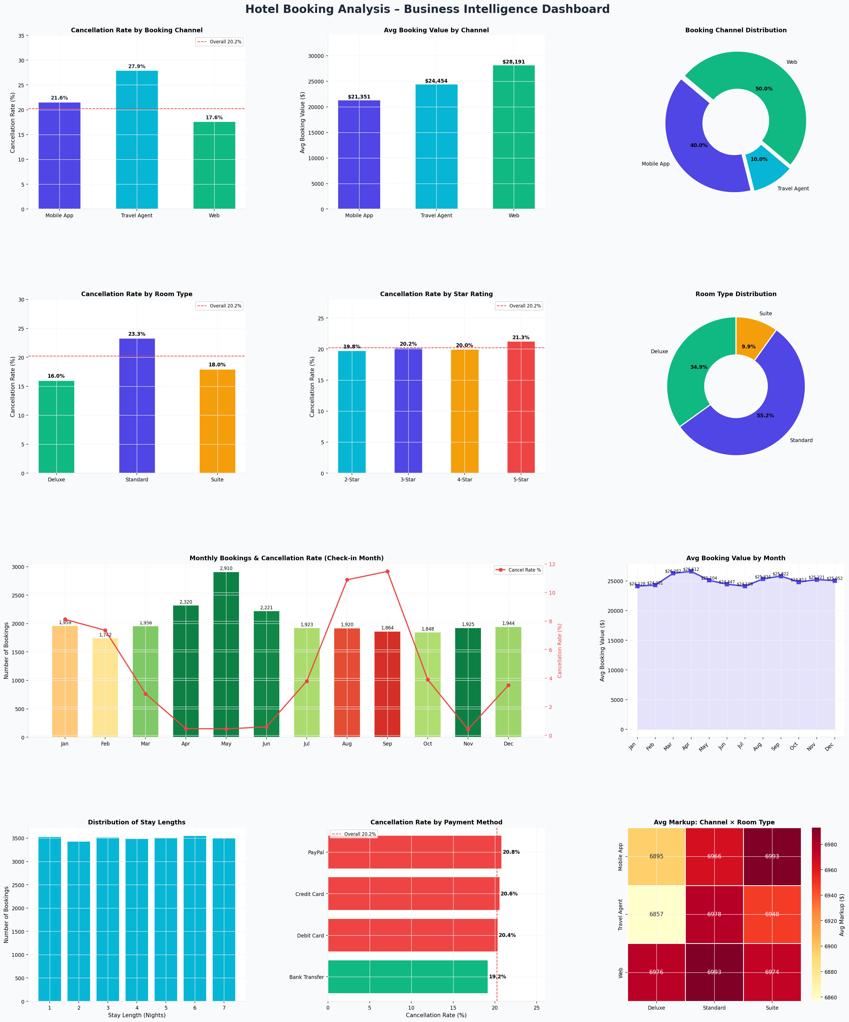
Data Visualizations
Cancellation rates, booking values, seasonal trends, and stay-length distribution

Slide 6
Root Cause Analysis
Why do cancellations, channel gaps, and seasonal patterns occur?
🚫 Cancellation Drivers
📡 Channel Performance Gap
📅 Seasonal & Temporal Factors
▸ Travel Agents (27.9%): Speculative multi-property holds with no deposit risk; corporate flexible cancellation policies incentivise last-minute changes.
▸ Standard Rooms (23.3%): Budget guests face lower switching costs — identical or cheaper options are always available; no loyalty lock-in.
▸ 5-Star Properties (21.3%): High absolute price amplifies sensitivity to any change in travel plans; abundance of luxury competitors in top US cities.
▸ Aug–Sep spike (10–11%): Post-summer plan collapses driven by school calendars, budget exhaustion, and weather uncertainty.
▸ Web superiority: Direct booking = high intentionality. Customers compare, research, and decide deliberately — 'booker's commitment' is highest.
▸ Mobile App underperformance: Push-notification flash deals attract price-sensitive, impulsive bookers who cancel when better prices emerge.
▸ Travel Agent structurally weak: Agents are paid per booking, not per stay. No financial penalty for cancellations means zero deterrent to over-booking.
▸ Avg markup is similar across channels (~$6,930–$6,985), so revenue loss from Travel Agent cancellations is not offset by higher margins.
▸ Apr–Jun peak: Summer vacation planning + US wedding season creates committed forward bookings; cancellation rate drops to <1% — these guests are locked in.
▸ Aug–Sep trough: School year restart, family budget exhaustion, and weather shifts cause last-minute trip abandonment — a structural, recurring pattern.
▸ Stable stay length (~4 nights) across ALL star ratings suggests trip purpose (not property tier) drives duration — segment marketing accordingly.
▸ Avg booking value stable year-round ($24K–$27K): Seasonality affects volume and commitment, not willingness-to-pay per booking.

Slide 7
Business Recommendations – Reduce Cancellations
Targeted policies to cut the 20.23% cancellation rate by 15–20%
🏢 Travel Agent Channel (Priority 1 – Immediate)
✔ Require 25% non-refundable deposit for all agent-originated bookings.
✔ Implement agent performance scorecards — completion rate < 75% triggers commission tier demotion.
✔ 'Verified Booking' protocol: agents must provide customer contact for confirmation call within 48 hrs.
✔ Offer agents a 'completion bonus' ($50/booking) to incentivise follow-through over cancellations.
✔ Expected impact: 8–12% reduction in Travel Agent cancellations.
🛏️ Standard Room Segment (Priority 2 – 4 Weeks)
✔ 'Flex-Date Credits': instead of cancelling, guests receive a 6-month credit — reduces refunds.
✔ Complimentary room upgrade (Standard → Deluxe) when guest accepts date change instead of cancellation.
✔ Trip insurance upsell at checkout: 'Cancel for Any Reason' at 3% of booking value.
✔ Send 48-hr pre-arrival reminder with value-add (restaurant coupon) to reinforce commitment.
✔ Expected impact: 5–7% reduction in Standard room cancellations.
📅 Seasonal Intervention (Priority 3 – Before Aug/Sep)
✔ For bookings with check-in in Aug–Sep, offer early 'lock-in incentive' (free breakfast if not cancelled).
✔ Stricter cancellation windows during Aug–Sep: non-refundable 14 days before check-in vs 3 days year-round.
✔ Mobile App: Proactive 'Trip Confirmation' push at T-30 days to confirm travel plans.
✔ Cross-sell travel insurance via Mobile App channel specifically for high-cancel months.

Slide 8
Business Recommendations – Profitability & Repeat Bookings
Strategies to increase direct revenue, customer lifetime value, and retention
📲 Direct Booking Loyalty Programme
📈 Revenue Per Booking Optimisation
✔ Launch 'Book Direct Rewards': 10% instant discount + loyalty points for Web channel bookings.
✔ Points earn: 1 point per $10 spent; 500 points = 1 free night (drives repeat stays).
✔ Exclusive perks for direct bookers: late checkout, free WiFi, F&B credit ($25).
✔ Run 'Book Direct' awareness campaign across email + social media targeting past guests.
✔ Upsell Deluxe/Suite at check-in for Standard room guests (targeted via Mobile App).
✔ Bundle packages: Room + Breakfast ($15 add-on), Room + Airport Transfer, Room + Spa.
✔ Minimum-stay upsell: 'Book 3 nights, save 12%' for stays that would otherwise be 1–2 nights.
✔ Target repeat guests with higher-tier room offers based on their last stay preferences.
🔄 Post-Stay Retention
🏢 Channel Revenue Mix
✔ Personalised rebooking offer within 24 hours of checkout: 15% off same property.
✔ Birthday/anniversary recognition: room upgrade offer 30 days before special dates.
✔ Milestone loyalty rewards: 3rd stay (room upgrade), 5th stay (free night), 10th (VIP status).
✔ NPS survey post-stay; high-score guests get referral programme invitation.
✔ Shift 5% of Travel Agent share to Web channel (saves cancellation losses + increases avg value).
✔ Reduce OTA dependency by investing in Web channel SEO and PPC campaigns.
✔ For Mobile App: shift from deal-focused to experience-focused marketing to raise avg value.
✔ Track channel contribution margin, not just revenue — factor in cancellation cost.

Slide 9
Business Recommendations – Pricing, Promotions & Channel Strategy
Optimise revenue yield through dynamic pricing and segment-specific promotions
🌐 Web Channel
📱 Mobile App
🤝 Travel Agents
Premium positioning & exclusivity. • Price parity + exclusive perks (late checkout, F&B credit) • 'Best Rate Guarantee' to prevent OTA leakage • Enhanced UX: one-click rebooking for returning guests • Retargeting ads for cart-abandoned users
Flash sales & last-minute deals. • 18-hour flash sales via push notifications (mobile-exclusive) • Progressive discount: book within 1hr → extra 5% off • Gamified check-in streaks and app-only loyalty points • AI-driven 'Best Deals Near You' personalisation
Volume-based commission reform. • Tiered commissions: 8% (base), 12% (50+/month), 15% (100+/month) • Commission tied to stay completion, not just booking • Quarterly agent performance review and ranking • Co-marketing budget for top-performing agents
🎯 Seasonal Promotions
⚙️ Dynamic Pricing Engine
• Apr–Jun (Peak): 'Early Bird Summer' — 15% off for 60+ day advance bookings. Minimum 2-night stay requirement to maximise occupancy yield. • Aug–Sep (High Cancel): 'Trip Protection Bundle' — book with trip insurance; offer 'rebook, don't cancel' credits valid 9 months. • Feb (Slow): 'Valentines & Beyond' — couples packages, extended stay promo (stay 4 nights, 5th free) to stimulate demand. • Oct–Dec (Steady): 'Holiday Countdown' early access for loyalty members.
• Real-time rate adjustment based on 30/60/90-day occupancy forecasts. • Competitor rate benchmarking: auto-match or undercut by ≤3% when occupancy is below 70% with 30+ days to check-in. • Last-minute pricing (< 7 days): Mobile App exclusive discounts (up to 20%) to fill unsold inventory without devaluing brand on main channels. • Peak period floor prices: Set minimum rates during Apr–Jun to protect revenue when demand is inelastic. • Room-type-specific pricing: Deluxe/Suite premium to reflect lower cancellation risk and higher perceived value.

Slide 10
Implementation Roadmap & Expected Impact
Phased execution plan with measurable KPI targets
Phase 1
Phase 2
Phase 3
Phase 4
Immediate (0–4 Weeks)
Short-term (1–3 Months)
Mid-term (3–6 Months)
Long-term (6–12 Months)
✔ Agent deposit requirement (25% non-refundable)
✔ Book Direct Rewards loyalty programme launch
✔ Dynamic pricing engine deployment
✔ Full loyalty milestone reward system
✔ Post-stay email campaign launch
✔ Mobile App flash sale system (18-hr windows)
✔ Bundle package creation (room + add-ons)
✔ Agent commission tier restructure complete
✔ 'Flex-Date Credits' for Standard room cancellations
✔ Agent performance scorecard system
✔ Mobile App personalisation (AI recommendations)
✔ Competitor benchmarking + automated repricing
✔ Aug/Sep trip insurance upsell activation
✔ Early-bird summer packages (Apr–Jun)
✔ NPS + referral programme rollout
✔ Cross-channel analytics dashboard
EXPECTED IMPACT AFTER FULL IMPLEMENTATION
15–20%
10–15%
8–12%
25%
Reduction in Overall Cancellation Rate
Increase in Direct (Web) Bookings
Improvement in Avg Booking Value
Increase in Repeat Customer Rate

Slide 11
Conclusion & Next Steps
This analysis of 30,000 hotel bookings across 10 US cities reveals a clear strategic opportunity: The 20.23% cancellation rate — costing millions in lost revenue and operational disruption — is largely driven by structural weaknesses in the Travel Agent channel (27.9%), low-commitment Standard room bookings (23.3%), and a recurring August–September cancellation spike (10–11%). The Web channel, despite commanding only 50% of bookings, is the gold standard: lowest cancellation (17.6%), highest booking value ($28,191), and strongest guest commitment. Growing this channel is the single highest-ROI action. The four-phase roadmap — from immediate agent deposit policies to long-term dynamic pricing — provides a structured path to 15–20% cancellation reduction, 10–15% direct booking growth, and a 25% repeat customer rate.
Immediate Next Step: Implement Travel Agent deposit requirement and Book Direct Rewards programme
Hotel Booking Analysis | 30,000 Bookings | June 2026

