Slide 1
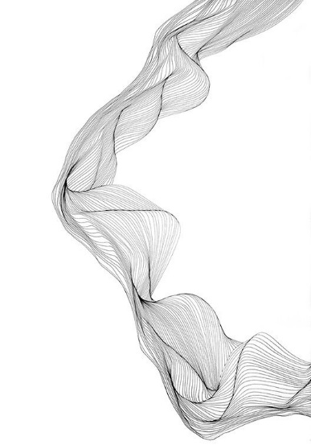
Real Time Visual Crime Analysis
Public Safety
Team Pixel
Prakhar Bhartiya
PES-EC CSE

Slide 2
CONTENTS
01
Problem Statement
02
Proposed Solution
03
Work Flow Model
04
Technologies & Framework
05
Sample Results

Slide 3
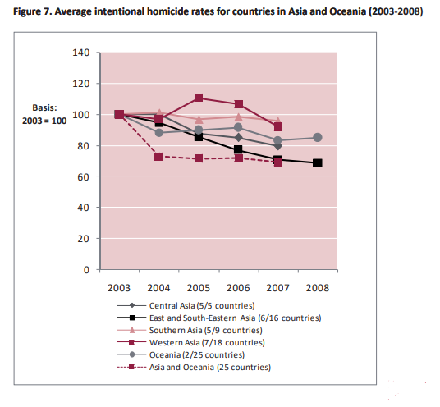
Problem Statement
Intoduction:
“When a man is denied the right to live the life he believes in, he has no choice but to become an outlaw.”
Crime rate in past decade has been increased in megacities mutliplefolds.Most common attack list according to United Nations Office on Drugs and Crime (UNODC) are:
1.Public Assault
2.Street Theft/Automobile Theft
3.Rape
4.Kidnapping
Major crime occur in daylight at crowed place in daylight under surveillance.Passive method such as police patrolling,rescue force,surveilliance are slow-paced solution and often ineffictive.
Survelliance can be used to monitor all major city areas for crime detection but a manual human intervened monitoring forge it into unreliable method.
Source: UNODC

Slide 4
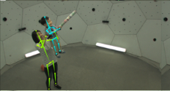
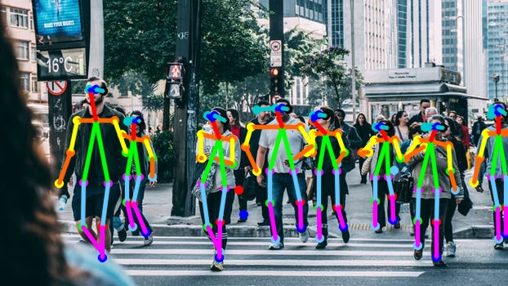
Proposed solution
Survelliance camera provide an appreciable amount of raw image data that can be utilised for building an effective real time crime detection model.Resulting an safe public ecosystem.
Our solution model is based on detection of human 2D pose mapping(including hand,finger and body) interaction combined with deep learning for classification of public interaction with crime potential. Assaults,theft ,road accidents are some common crime sector which will be most effected by our solution.Our research is based on a research paper “Realtime Multi-Person 2D Pose Estimation using Part Affinity Fields” proposed by Robotics Institute department, Carnegie Mellon University.Paper provide a method that efficiently detect the 2D pose of multiple people in an image.
Raw frames from surveillance camera are fed to 2D Pose estimation alogrithm.Deep learning model trained on dataset(includes the 2D human pose variation in crime scenes such as assault,theft,road accidents) are used to classify real time pre-processed survelliance camera frame.Difference in features from real time data and trained data are used to measure confidence level of classification.

Slide 5
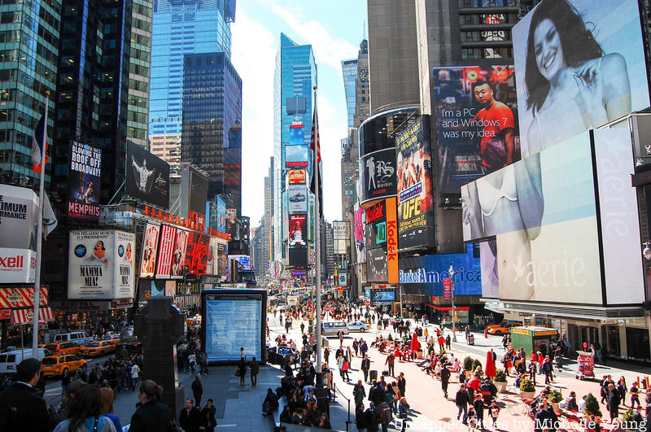
Survelliance Camera
Work Flow Model
Deep Learning Model
Realtime Multi-Person 2D Pose Estimation Algorithm
Classification Results
Classification result can be used to lock face tracking on culprict.

Slide 6
Technologies & Framework
OpenCV - python
OpenPose
Tensorflow (tf =1.14)
Keras
NEC Bigdata Solutions(Solution area:Enhancing information control to prevent crime and fraud)
Public Safety and Biometric (NEC Solutions)
Libraries(Python : argparse,dill,fire,matplotlib,numba,psutil,requests,scikit-image,scipy,slidingwindow,tqdm)
Nvidia GPU Support(CUDA,CudNN Toolkit support)

Slide 7
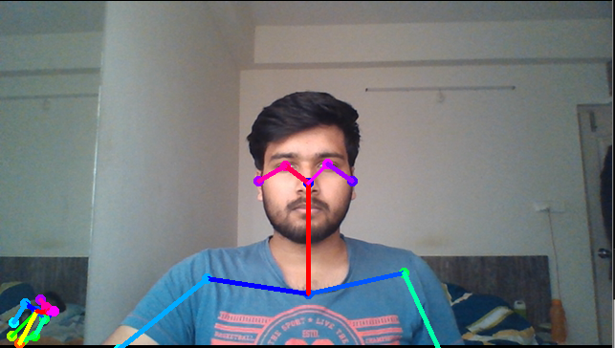
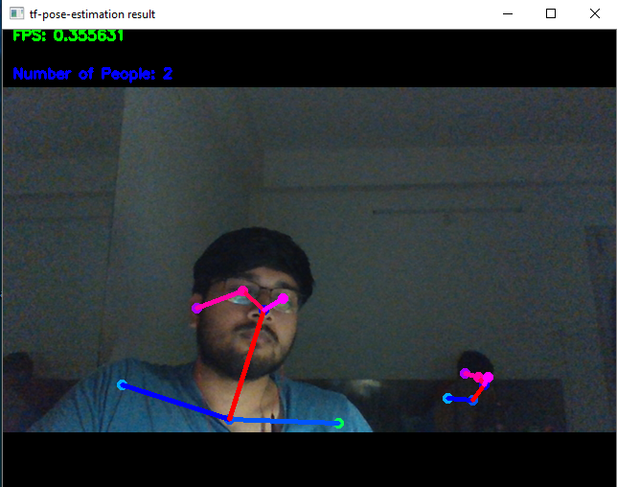
Sample Results
Daylight
Low Light
Detected 2D pose even in very low light environment
Hardware used:
Webcam = 640×480 (0.307MP)
CPU = (Intel i5)
GPU = (Notebook 1050ti)

Slide 8
Thank You
References:
Research Paper:
https://arxiv.org/pdf/1611.08050.pdf
https://arxiv.org/pdf/1901.03798.pdf
GitHub Repo:
https://github.com/CMU-Perceptual-Computing-Lab/openpose
Reference Video(Concept understanding):
https://youtu.be/F84jaIR5Uxc

