Slide 1
Web and Mobile Application Development
Web Services
CS 275
Material created by:
David Augenblick, Bill Mongan, Dan Ziegler, Samantha Bewley, and Matt Burlick
7/11/18
Drexel University - CS275

Slide 2
Obtaining Data
When we looked at Ajax we saw how to get data from an external source
  Pretty cool!
Ultimately in the course we’ll look at two ways to get data for our sites:
  Get the response from a web service which might give us nicely formatted data to use (JSON?)
  Get the data from a server and/or database (we’ll do this later once we introduce servers and databases).
7/11/18
Drexel University - CS275

Slide 3
Web Services
The example we just did with AJAX was an example of using a web services
Web services provide a safe and easy way to request data from a different domain.
Remember our Ajax call to get JSON from
Here’s the full JSON response
{
"userId": 1,
"id": 1,
"title": "sunt aut facere repellat provident occaecati excepturi optio reprehenderit",
"body": "quia et suscipit\nsuscipit recusandae consequuntur expedita et cum\nreprehenderit molestiae ut ut quas totam\nnostrum rerum est autem sunt rem eveniet architecto"
}
7/11/18
Drexel University - CS275
Drexel University - CS275

Slide 4

Weather Web Service Example
Let’s do a more interesting example of using a web service
  We’re going to get weather information and use it to populate our website.
Drexel University - CS275

Slide 5
Weather Web Service Call
Let’s use the Open Weather Map web service to obtain the current temperature.
The API can be found at
You’ll first need to create an account
Then you’ll need to “buy” a free key at
Drexel University - CS275

Slide 6
Weather Web Service Call
The “Documentation” link is on this page
The “current conditions” call is
https://api.openweathermap.org/data/2.5/weather?zip={zip code}&appid={your key}
Where
      YOUR KEY is your wunderground key
      ZIPCODE is the zipecode for which to get the current conditions
Drexel University - CS275

Slide 7
Example: Weather
Following that URL, the API will give us a JSON response that looks something like below
{"coord":{"lon":-122.09,"lat":37.39},
"weather":[{"id":500,"main":"Rain","description":"light rain","icon":"10d"}],
"base":"stations",
"main":{"temp":280.44,"pressure":1017,"humidity":61,"temp_min":279.15,"temp_max":281.15},
"visibility":12874,
"wind":{"speed":8.2,"deg":340,"gust":11.3},
"clouds":{"all":1},
"dt":1519061700,
"sys":{"type":1,"id":392,"message":0.0027,"country":"US","sunrise":1519051894,"sunset":1519091585},
"id":0,
"name":"Mountain View",
"cod":200}
7/11/18
Drexel University - CS275

Slide 8
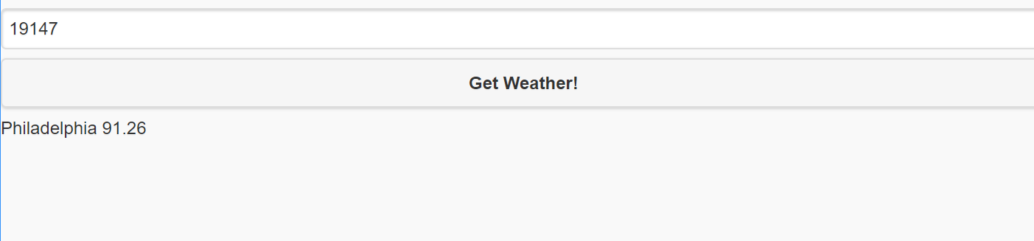
Weather Example
Ahh now we can finally do some cool stuff!
Let's make a webpage that has
  A text box
  A button
  An empty div
When the user clicks the button
  Construct an HTTP request based on the content of the text box
  Send that request asynchronously via an AJAX
  When the request comes back, populate the div based on what came back!
NOTE: Before sending the request we should probably to some regular expression checking to make sure there’s a valid ZIP in the textbox. But that’s not the focus so we’ll omit that.
7/11/18
Drexel University - CS275

Slide 9
Weather Example
First let’s create the HTML content
<html>
<head>
<script src="http://ajax.googleapis.com/ajax/libs/jquery/2.1.1/jquery.min.js"></script>
<script src="http://ajax.googleapis.com/ajax/libs/jquerymobile/1.4.5/jquery.mobile.min.js">
</script>
<link type="text/css" rel="stylesheet“ href="http://ajax.googleapis.com/ajax/libs/jquerymobile/1.4.5/jquery.mobile.min.css"/>
<meta name="viewport" content="width=device-width, initial-scale=1">
<script>
function requestWeather(){
//todo (next slide)
}
</script>
</head>
<body>
<input type=text id="zipcode" placeholder="Enter desired zip code here"/>
<input type=button onclick="requestWeather()" value="Get Weather!"/><div id=current></div>
</body>
</html>
7/11/18
Drexel University - CS275

Slide 10
Weather Example
Now let’s implement that requestWeather function
  Note: It’s probably not best to hard-code in your API key (others can see/get it). But for security JS can’t read from a file. So we could either
    Have the user enter theirs in an other input field (probably a pain)
    Have our server do the processing and store our key there
      We’ll do this once we get to server-side processing.
    But for now we’ll hard-code it ☹
7/11/18
Drexel University - CS275

Slide 11
Weather Example
<script>
function requestWeather(){
var zip = $("#zipcode");
var code = ‘YOURCODE’;
var URL = "https://api.openweathermap.org/data/2.5/weather?zip=" + zip.val() + "&appid=" + code+"&units=imperial";
$.ajax({
type: "GET",
url : URL,
dataType : "jsonp",
success : function(msg){
var json = msg;
if(json.cod=200){
var city = json.name;
var temp = json.main.temp;
document.getElementById("current").innerHTML=city+" " + temp + “F”;
}
else
document.getElementById("current").innerHTML="ERROR";
},
error: function(jgXHR, textStatus,errorThrown){
alert("Error: " + textStatus + " " + errorThrown);
}
});
}
</script>
7/11/18
Drexel University - CS275

