Slide 1
L1 Normalisation

Slide 2
Problem
Selecting critical features to be used in a Machine Learning Model
Mostly hand-selected by developers
Relative importance of these attributes is unknown
Overfitting

Slide 3
Problem: Overfitting
//Needs a separate slide, because it’s an important issue
“The production of an analysis which corresponds too closely or exactly to a particular set of data, and may therefore fail to fir additional data or predict future observations reliably.”
“An overfitted model is a statistical model that contains more parameters than can be justified by the data.”

Slide 4
A Way to fix it: Regularisation
Adding information
Artificially discourages complex equations and solutions.
The most common types of regularisation are L2 and L1 Norm.
The core idea remains the same, the only difference comes in the way one adds a penalty system in the loss function.
We bias the values of data towards lower bounds, by adding a penalty term.

Slide 5
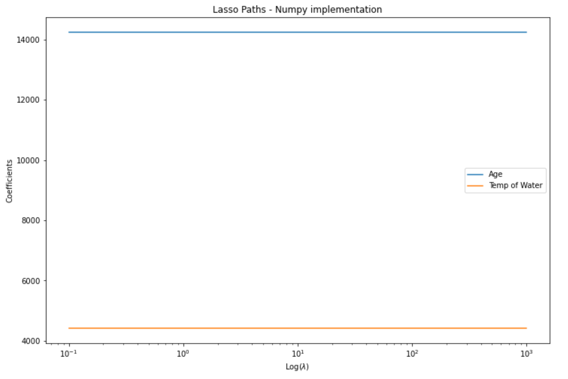
solution
This tells us that the ‘Age’ attribute is more significant to the model than ‘Temp of Water’

