Slide 1
Experiment -1
Introduction to Hadoop Ecosystem tools

Slide 2
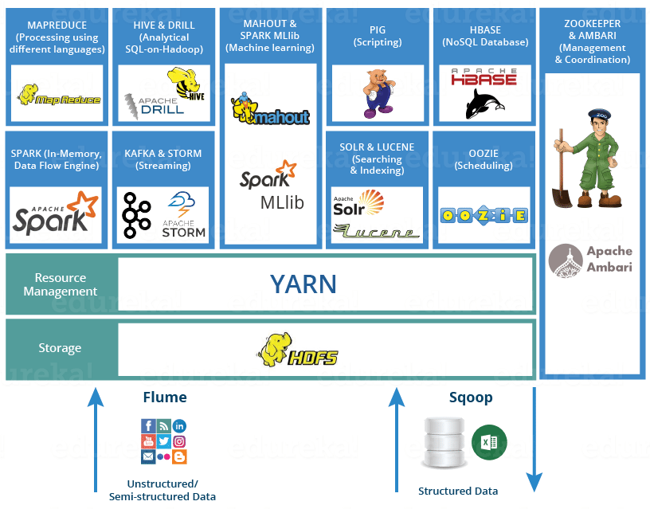
Hadoop Ecosystem

Slide 3
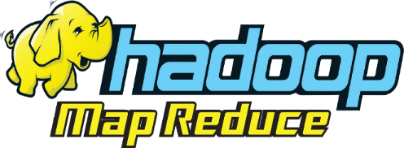
MAPREDUCE
Mapreduce is the core component of processing in a Hadoop Ecosystem as it provides the logic of processing.
MapReduce is a software framework which helps in writing applications that processes large data sets using distributed and parallel algorithms inside Hadoop environment.
In a MapReduce program, Map() and Reduce() are two functions.
The Map function performs actions like filtering, grouping and sorting.
While Reduce function aggregates and summarizes the result produced by map function.
The result generated by the Map function is a key value pair (K, V) which acts as the input for Reduce function.

Slide 4

YARN
YARN is the brain of your Hadoop Ecosystem.
It performs all your processing activities by allocating resources and scheduling tasks.
It has two major components, i.e. ResourceManager and NodeManager.
  ResourceManager is the main node in the processing department.
  It receives the processing requests, and then passes the parts of requests to corresponding NodeManagers accordingly, where the actual processing takes place.

Slide 5
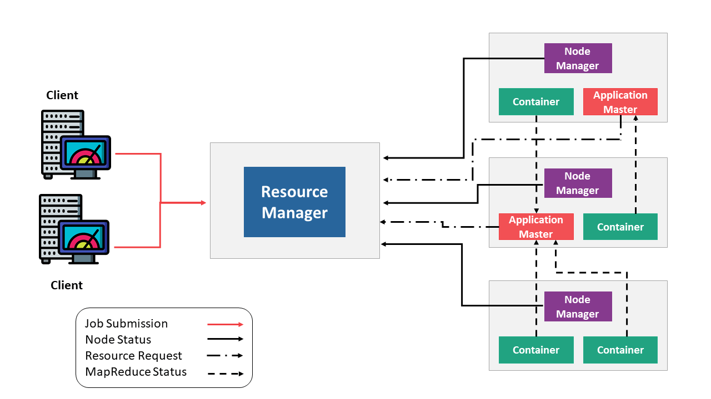
HADOOP YARN ARCHITECTURE

Slide 6

PIG
PIG was initially developed by Yahoo.
PIG tool has two parts: Pig Latin, the language and the pig runtime, for the execution environment.
Pig latin language contains SQL type of command structure.
The compiler internally converts pig latin to MapReduce.
It produces a sequential set of MapReduce jobs.
It gives you a platform for building data flow for ETL (Extract, Transform and Load), processing and analyzing huge data sets.
The process of extracting data from different source systems and bringing it into the data warehouse is commonly called ETL.

Slide 7
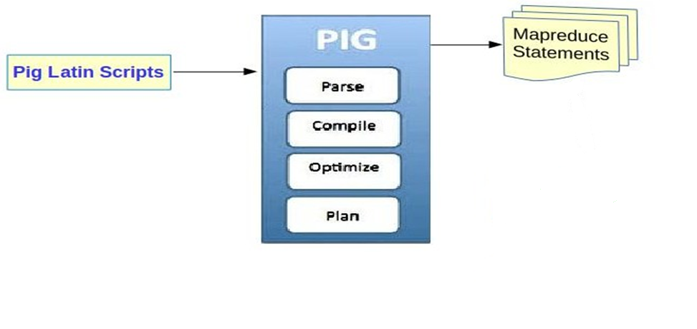
HADOOP PIG ARCHITECTURE

Slide 8
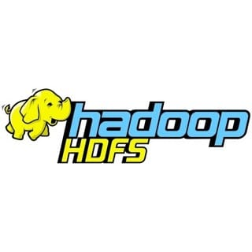
Hadoop Distributed File System
The Hadoop Distributed File System (HDFS) is the primary data storage system used by Hadoop applications.
HDFS is used to store different types of large data sets (i.e. structured, unstructured and semi structured data).
It helps us in storing our data across various clusters and maintaining the log file about the stored data (metadata).

Slide 9

APACHE HIVE
Facebook created HIVE for people who are fluent with SQL.
Basically, HIVE is a data warehousing component which performs reading, writing and managing large data sets in a distributed environment using SQL-like interface.
HIVE + SQL = HQL
The query language of Hive is called Hive Query Language(HQL), which is very similar like SQL.
It has 2 basic components: Hive Command Line and JDBC/ODBC driver.
The Hive Command line interface is used to execute HQL commands.
While, Java Database Connectivity (JDBC) and Object Database Connectivity (ODBC) is used to establish connection from data storage(HDFS)

Slide 10
Secondly, Hive is highly scalable. As, it can serve both the purposes, i.e. large data set processing and real time data processing.
It supports all primitive data types and predefined functions of SQL.

Slide 11
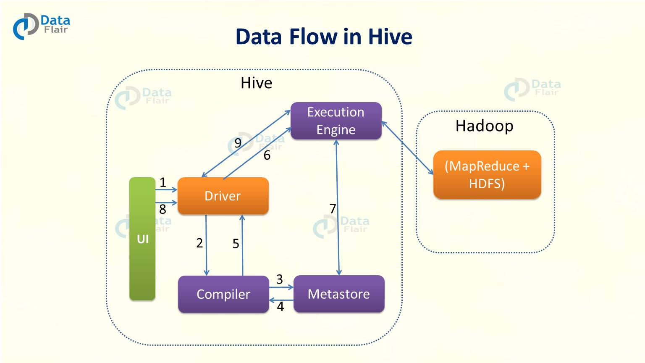

Slide 12

Mahout
Mahout performs the following operations like collaborative filtering, clustering and classification, frequent item set missing.
Collaborative filtering: Mahout mines user behaviors, their patterns and their characteristics and based on that it predicts and make recommendations to the users. The typical use case is E-commerce website.
Clustering: It organizes a similar group of data together like articles can contain blogs, news, research papers etc.

Slide 13
Classification: It means classifying and categorizing data into various sub-departments like articles can be categorized into blogs, news, essay, research papers.
Frequent item set missing: Here Mahout checks, which objects are likely to be appearing together and make suggestions, if they are missing. For example, cell phone and cover are brought together in general. So, if you search for a cell phone, it will also recommend you the cover and cases.

Slide 14
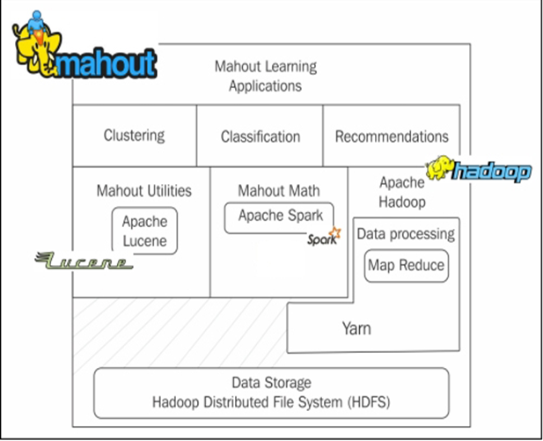

Slide 15

APACHE SPARK
Apache Spark is a framework is used real time data analytics in a distributed computing environment.
The Spark coding's are written in Scala and was originally developed at the University of California, Berkeley.
It executes in-memory computations to increase speed of data processing over Map-Reduce.
It is 100x faster than Hadoop for large scale data processing by exploiting in-memory computations and other optimizations.
Therefore, it requires high processing power than Map-Reduce.

Slide 16
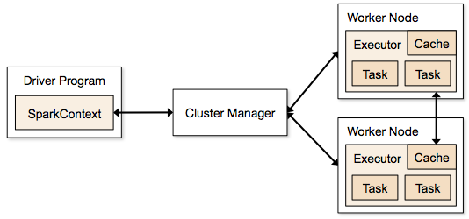
Working of Spark Architecture

Slide 17

APACHE HBASE
HBase is an open source, non-relational distributed database.
In other words, it is a NoSQL database.
It supports all types of data and that is why, it’s capable of handling anything and everything inside a Hadoop ecosystem.
It is modelled after Google’s BigTable, which is a distributed storage system designed to cope up with large data sets.

Slide 18
The HBase was designed to run on top of HDFS and provides BigTable like capabilities.
The HBase is written in Java, whereas HBase applications can be written in REST, Avro and Thrift APIs.

Slide 19
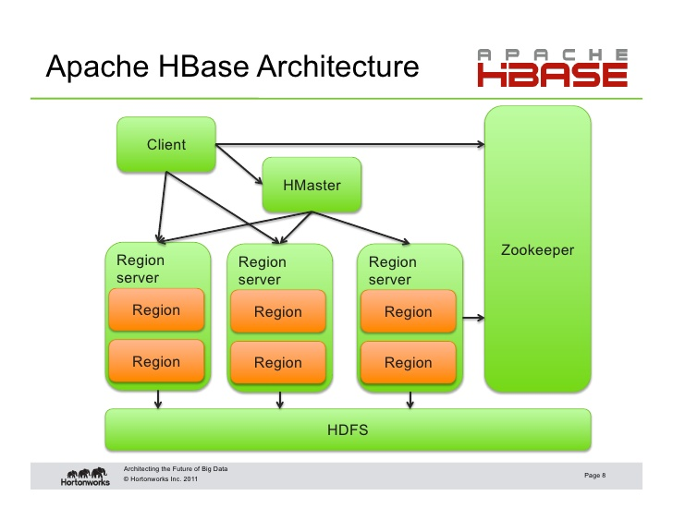

Slide 20
The HBase Architecture:
-1. Consists of servers in a Master-Slave relationship. Master node is called HMaster and the multiple Region Servers(Slaves)(collection of column families) are called HRegionServer. Each Region Server contains multiple Regions – HRegions.
-2. Data is stored in Tables which are stored in Regions(collection of column families). When a Table becomes too big, the Table is partitioned into multiple Regions.
-3. Each Region Server contains a Write-Ahead Log (called HLog) and multiple Regions. Each Region in turn is made up of a MemStore and multiple StoreFiles (HFile). The data lives in these StoreFiles in the form of Column Families . The MemStore holds in-memory modifications to the Store (data).
-4. A system table called .META - keeps the mapping of Regions to Region Server. The clients read the required Region information from the .META table and directly communicate with the appropriate Region Server.

Slide 21
The HBase Architecture:
-1. Consists of servers in a Master-Slave relationship. Master node is called HMaster and the multiple Region Servers(Slaves) are called HRegionServer. Each Region Server contains multiple Regions – HRegions.
-2. Data is stored in Tables which are stored in Regions. When a Table becomes too big, the Table is partitioned into multiple Regions.
-3. Each Region Server contains a Write-Ahead Log (called HLog) and multiple Regions. Each Region in turn is made up of a MemStore and multiple StoreFiles (HFile). The data lives in these StoreFiles in the form of Column Families . The MemStore holds in-memory modifications to the Store (data).
-4. A system table called .META - keeps the mapping of Regions to Region Server. The clients read the required Region information from the .META table and directly communicate with the appropriate Region Server.

Slide 22
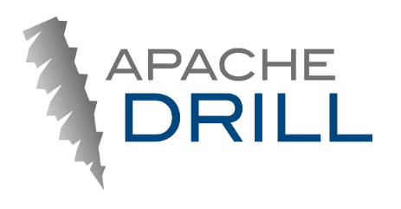
APACHE DRILL
As the name suggests, Apache Drill is used to drill into any kind of data.
It’s an open source application which works with distributed environment to analyze large data sets.
It supports different kinds NoSQL databases and file systems, which is a powerful feature of Drill.
For example: Azure Blob Storage, Google Cloud Storage, HBase, MongoDB, MapReduce-FS, Amazon S3, Swift, NAS and local files.

Slide 23
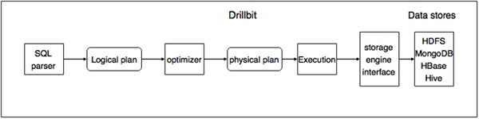
WORKING OF APACHE DRILL

Slide 24

APACHE ZOOKEEPER
Apache Zookeeper is the coordinator of any Hadoop job which includes a combination of various tools in a Hadoop Ecosystem.
Apache Zookeeper coordinates with various services in a distributed environment.
Before Zookeeper, it was very difficult and time consuming to coordinate between different tools in Hadoop Ecosystem.
The services earlier had many problems with interactions like common configuration while synchronizing data.

Slide 25
Even if the services are configured, changes in the configurations of the services make it complex and difficult to handle.
Grouping and naming of tools was also a time-consuming factor.
Due to the above problems, Zookeeper was introduced.
It saves a lot of time by performing synchronization, configuration maintenance, grouping and naming.

Slide 26
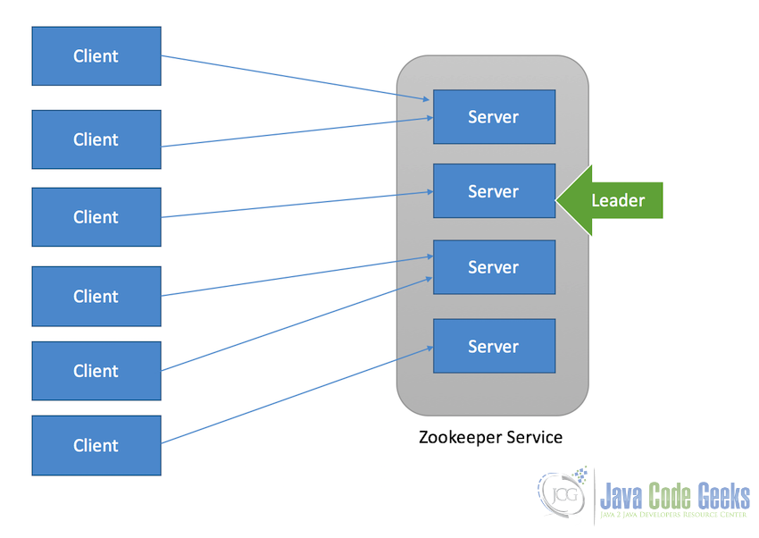

Slide 27

APACHE OOZIE
Apache Oozie as a clock and alarm service inside Hadoop Ecosystem.
For Apache jobs, Oozie has been just like a scheduler.
It schedules Hadoop jobs and binds them together as one logical work.
There are two kinds of Oozie jobs:
Oozie workflow: These are sequential set of actions to be executed. You can assume it as a relay race. Where each athlete waits for the last one to complete his part.

Slide 28
Oozie Coordinator: These are the Oozie jobs which are triggered when the data is made available to it.
Think of this as the response-stimuli system in our body.
In the same manner as we respond to an external stimulus, an Oozie coordinator responds to the availability of data and it rests otherwise.

Slide 29
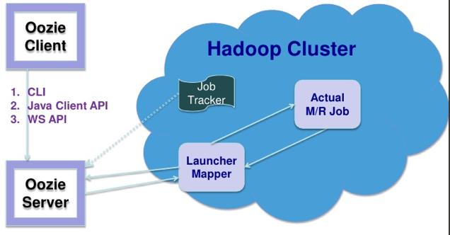
WORKING OF APACHE OOZIE

Slide 30

APACHE SQOOP
Sqoop imports data from external sources into related Hadoop ecosystem components like HDFS, Hbase or Hive.
It also exports data from Hadoop to other external sources.
Sqoop works with relational databases such as teradata, Netezza, oracle, MySQL.

Slide 31
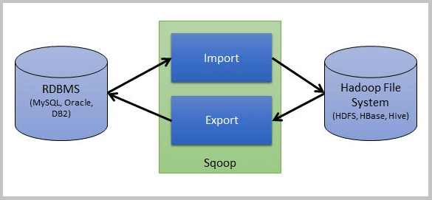
WORKING OF APACHE SQOOP

Slide 32

APACHE FLUME
Feeding data is an important part of our Hadoop Ecosystem.
The Flume is a tool which helps in feeding unstructured and semi-structured data into HDFS.
It gives us a solution which is reliable and distributed.
It helps us in collecting, aggregating and moving large amount of data sets.
It helps us to consume online streaming data from various sources like network traffic, social media, email messages, log files etc. in HDFS.

Slide 33
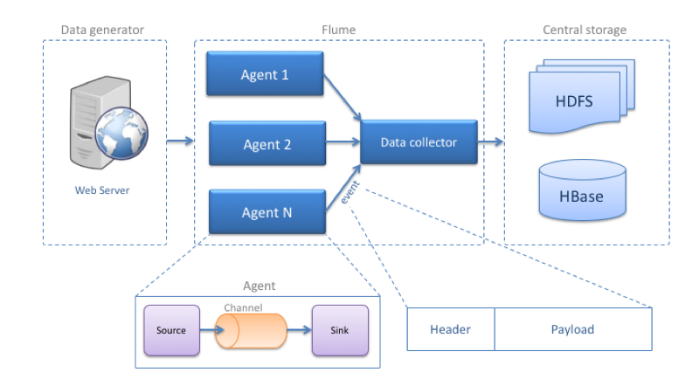
WORKING OF APACHE FLUME

Slide 34
APACHE SOLR & LUCENE
Apache Solr and Apache Lucene are the two services which are used for searching and indexing in Hadoop Ecosystem.
Apache Lucene is based on Java, which also helps in spell checking.
If Apache Lucene is the engine, Apache Solr is the car built around it.
Solr is a complete application built around Lucene.
It uses the Lucene Java search library as a core for search and full indexing.
Indexing is a way to optimize performance of a database by minimizing the number of disk accesses required when a query is processed.

Slide 35
APACHE AMBARI
Ambari is an Apache Software Foundation Project which aims at making Hadoop ecosystem more manageable.
It includes software for provisioning, managing and monitoring Apache Hadoop clusters.
Hadoop cluster provisioning:
  It gives us step by step process for installing Hadoop services across a number of hosts.
  It also handles configuration of Hadoop services over a cluster.
Hadoop cluster management:
  It provides a central management service for starting, stopping and re-configuring Hadoop services across the cluster.

Slide 36
Hadoop cluster monitoring: For monitoring health status, Ambari provides us a dashboard.
The Amber Alert framework is an alerting service which notifies the user, whenever the attention is needed. For example, if a node goes down or low disk space on a node, etc.

Slide 37
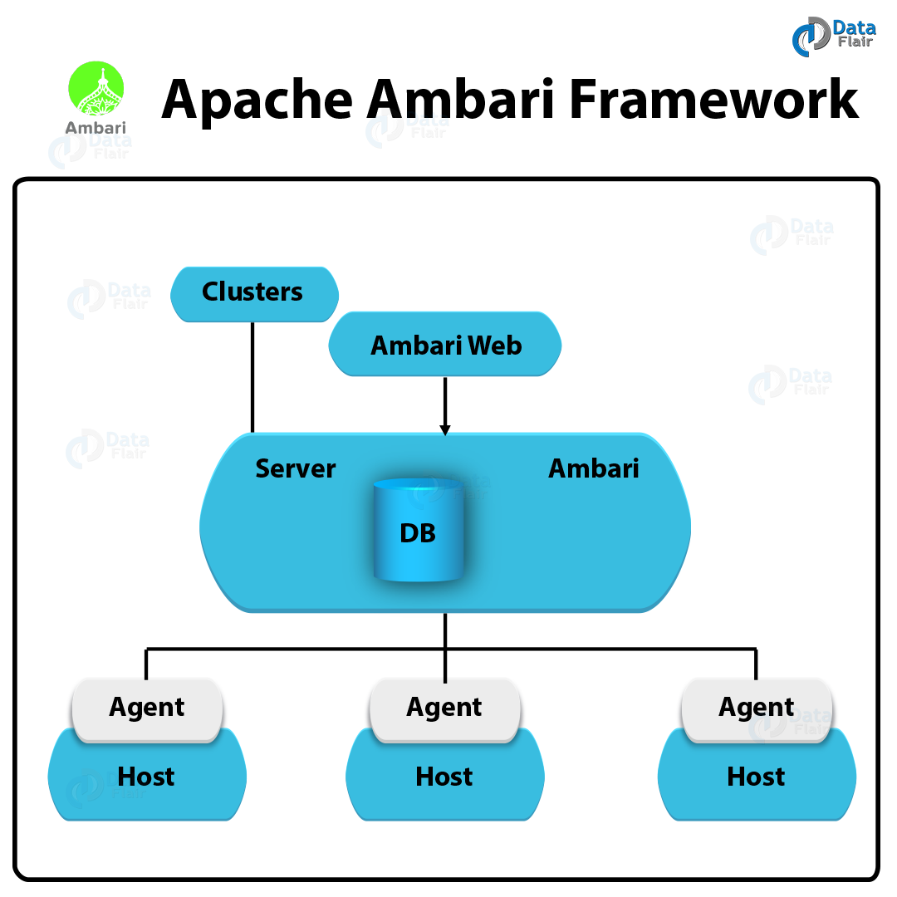

Slide 38


