Slide 1
Experiment -3
Installation of Hadoop Single Node Cluster

Slide 2
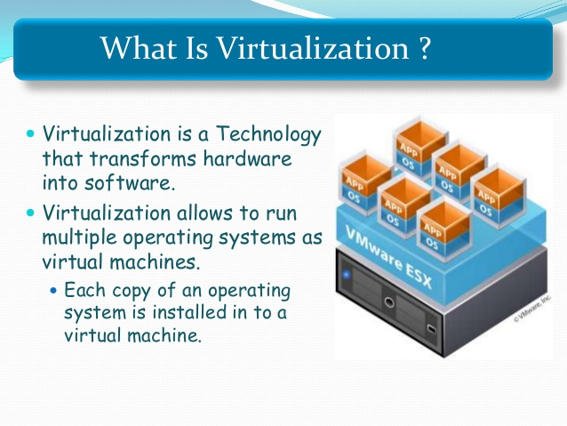

Slide 3
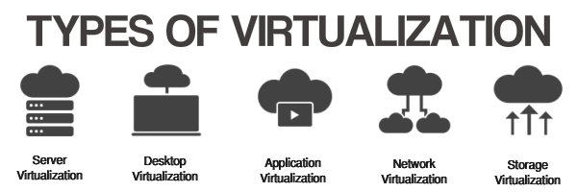

Slide 4


Slide 5
Infrastructure-as-a-service (IaaS)
With IaaS, you rent IT infrastructure—servers and virtual machines (VMs), storage, networks, operating systems—from a cloud provider on a pay-as-you-go basis.
Platform as a service (PaaS)
Platform-as-a-service (PaaS) that supply an on-demand environment for developing, testing, delivering and managing software applications.
PaaS is designed to make it easier for developers to quickly create web or mobile apps, without worrying about setting up or managing the underlying infrastructure of servers, storage, network and databases needed for development.

Slide 6
Software as a service (SaaS)
Software-as-a-service (SaaS) is a services for delivering software applications over the Internet, on demand and typically on a subscription basis.
With SaaS, cloud providers host and manage the software application and underlying infrastructure and handle any maintenance, like software upgrades.

Slide 7

VMware Workstation
VMware Workstation is a hosted hypervisor that runs on x64 versions of Windows and Linux operating systems.
It enables users to set up virtual machines on a single physical machine, and use them simultaneously along with the actual machine.

Slide 8
REQUIREMENTS
A Laptop or Desktop with 32 or 64 bit with window (Linux operating system when using VM )
Minimum of 2 Gb ram
Minimum of 100 gb hard disk
Minimum VGA is required

Slide 9
Installing of Hadoop Single Node Cluster Configuration.
Downloading the software Required
Untar the software
Bashrc configurations
Hadoop Configuration File
Share public key to localhost
Formatting the name node
Starting Hadoop Daemons
Checking the working hadoop Daemons

Slide 10
STEP-1
SOFTWARES REQUIRED
Hadoop 1.2.0-bin.tar.gz
Jdk 7u67-linux-i586.tar.gz
Link for JDK http://www.oracle.com/technetwork/java/javase/downloads/index.html
Link of Hadoop : http://mirror.fibergrid.in/apache/hadoop/common/hadoop-1.2.0/

Slide 11
STEP-2
Untar the software
Open the terminal window
Type the command : cd Desktop
Type ls command
tar –zxvf jdk-7u67-linux-i586.tar.gz
tar –zxvf hadoop-1.2.0-bin.tar.gz

Slide 12
Step 3
Bashrc configurations
Open the terminal type the command
sudo gedit ~/.bashrc
export JAVA_HOME=/home/user/Desktop/jdk1.7.0_67
export PATH=$PATH:$JAVA_HOME/bin
export HADOOP_HOME=/home/user/Desktop/hadoop-1.2.0
export PATH=$PATH:$HADOOP_HOME/bin
Open new terminal and check for java version and Hadoop version.

Slide 13
Step-4
Hadoop Configuration Files
1. Core-site.xml
(Configuration setting for hadoop core, such as I/O setting that are common to HDFS and Mapreduce)
2.Hdfs-Site.xml
(Configuration setting for HDFS daemons the name node, Secondary name node and data node and Replication factor as well)

Slide 14
3. Mapred-site.xml
(configuration setting for MapReduce daemons: the job tracker and the task tracker)
4. Hadoop-Env_sh
(Environment variables that are used in the scripts to run Hadoop)

Slide 15
Open the new terminal window
Go to the hadoop folder
cd Desktop
cd Hadoop (Press tab) for path
cd conf
Type ls
All the above mentioned files are listed

Slide 16
Go to terminal and type
sudo gedit core-site.xml
<configuration>
<property>
<name>fs.default.name</name>
<value>hdfs://localhost:9000</value>
</property>
</configuration>
Ip address :127.0.0.0 , 198.1.27.0
Port no: 80,

Slide 17
Go to terminal and type
sudo gedit hdfs-site.xml
<configuration>
<property>
<name>dfs.replication</name>
<value>1</value>
<name>dfs.name.dir</name>
<value>/home/user/Desktop/hadoop-1.2.0/name/data</value>
</property>
</configuration>

Slide 18
Go to terminal and type
sudo gedit mapred-site.xml
<configuration>
<property>
<name>mapred.job.tracker</name>
<value>hdfs://localhost:9001</value>
</property>
</configuration>

Slide 19
Go to terminal and type
sudo gedit hadoop-env.sh
export JAVA_HOME=/home/user/Desktop/jdk1.7.0_67

Slide 20
STEP-5
SSh Configuration
sudo apt-get install ssh
ssh-keygen -t rsa -P ""
Sharing the public key with host
ssh-copy-id –i ~/.ssh/id_rsa.pub user@ubuntuvm and check
ssh localhost (It should not ask password)

Slide 21
STEP 6
Formatting the Name Node
$ hadoop namenode –format
format a new distributed file system
Process creates an empty file system for creating the storage directories

Slide 22
STEP-7&8
Starting Hadoop Daemons
Open the terminal window and type
$ start-all.sh
and type
$ jps

Slide 23
user@ubuntuvm:~$ start-all.sh
Warning: $HADOOP_HOME is deprecated.
starting namenode, logging to /home/user/Downloads/hadoop-1.2.0/libexec/../logs/hadoop-user-namenode-ubuntuvm.out
localhost: datanode running as process 2978.
localhost: secondarynamenode running as process 3123.
jobtracker running as process 3204.
localhost: tasktracker running as process 3342.
user@ubuntuvm:~$ jps
4020 Jps
3342 TaskTracker
3204 JobTracker
3123 SecondaryNameNode
3606 NameNode
2978 DataNode

Slide 24


