Slide 1
Graph-Guided Prompt Learning
Structural Extensions to Context Optimization (CoOp)
Prakhar Mittal · Divyansh Jha · Ishan Raha
Department of Computer Science, BITS Pilani
CE+GLoss Hybrid
Graph Laplacian Reg.
Graph Label Smoothing
Graph Context Diffusion

Slide 2
Method Overview
Image Batch
Image Embeddings
Concat Node
Graph + LPA
CE + GLoss
Frozen CLIP
Image Encoder
f_img ∈ R^d
(normalized)
z_i = [f_img ; α·f_prompt]
(α = 1.0)
Gaussian kernel
Label Propagation
λ_CE·L_CE + λ_G·L_GLOSS
(0.2 / 0.8)
▶
▶
▶
▶
f_prompt = mean(ctx)
Prompt Learner (ctx)
[V]₁[V]₂…[V]₁₆[CLASS]
16 learnable tokens (ONLY params updated)
Key Insight: Graph nodes use LEARNED PROMPT VECTORS (not class labels) → no label leakage in semi-supervised graph

Slide 3
CE + GLoss Hybrid
𝓛 = λ_CE · 𝓛_CE + λ_G · 𝓛_GLOSS
λ_CE = 0.2 λ_G = 0.8 (optimal empirically on Caltech-101)
1
2
3
Split Batch
Build Graph
Label Propagation
γ = 0.9 of batch
→ labeled nodes
(10% unlabeled)
→
W_ij = exp(−||z_i−z_j||² / 2σ²)
σ = dataset-specific
Symmetric norm: D^{-½} W D^{-½}
→
Ŷ_u = (I − T_uu)⁻¹ T_ul Y_l
CE loss on propagated
predictions for unlabeled

Slide 4
Few-Shot Classification Results
Dataset | 4-shot CE | 4-shot CE+GLOSS | 16-shot CE | 16-shot CE+GLOSS
Caltech101 | 89.3 | 91.0 ▲+1.7 | 91.8 | 92.1 ▲+0.3
DTD | 51.9 | 53.7 ▲+1.8 | 63.3 | 63.6 ▲+0.3
FGVC Aircraft | 23.0 | 20.9 ▼−2.1 | 33.4 | —
Oxford Flowers | 85.1 | 84.1 ▼−1.0 | 94.5 | 93.5 ▼−1.0
Oxford Pets | 88.5 | 88.9 ▲+0.4 | 87.9 | 89.9 ▲+2.0
UCF101 | 68.6 | 68.1 ▼−0.5 | 77.3 | 78.0 ▲+0.7
3/6 datasets improve at 4-shot · 4/6 datasets improve at 16-shot · Best gain: +2.0% (Oxford Pets 16-shot)

Slide 5
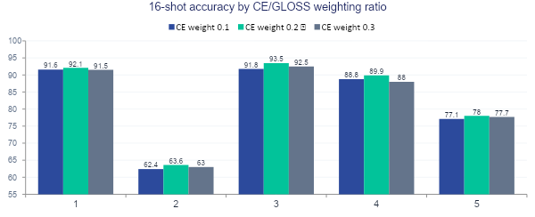
Ablation: CE / GLoss Weighting
0.2 / 0.8 is consistently optimal — too much GLoss (0.1 CE) weakens discrimination; too much CE (0.3) loses graph structure

Slide 6
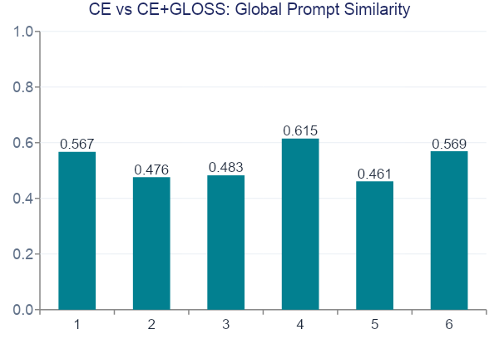
Prompt Representation Analysis
Similarity range: 0.46–0.62
CE+GLOSS converges to a genuinely different optimum — not just a small perturbation
FGVC lowest (0.46)
Strongest graph influence on fine-grained tasks — prompts diverge most
Oxford Pets highest (0.62)
Well-separated classes → both methods converge to a working solution
Graph-guided optimization does not merely regularize — it encourages alternative prompt representations at different local optima

Slide 7
When Does Graph Guidance Help?
✓ Graph Guidance HELPS
✗ Graph Guidance HURTS
Caltech101
FGVC Aircraft
Well-separated semantic classes
→ graph reinforces structure
Fine-grained categories
→ over-smoothing blurs boundaries
Oxford Pets
Oxford Flowers
Distinct breed categories
→ +2.0% at 16-shot
High visual similarity
at 16-shot → coupled neighbors
DTD
Texture clusters benefit
from graph smoothing

