Slide 1
Study Sessions
Group 2

Slide 2
Study Sessions
Group Members:
Naren Inukoti
Prakhar Garg
Elizabeth Haynes

Slide 3
Study Sessions
Application Description:
Study Sessions is an app that will allow students to create and join study sessions on campus by enabling them to easily reserve spaces, coordinate studying times, and share study materials for the same class. Working together increases time efficiency when searching for solutions to a problem, and creates a more solid personal understanding of materials. Spend more time studying and less time planning with Study Sessions.

Slide 4
Study Sessions
Target Audience:
Our target audience is college students who wish to connect with their peers in the same class to study for an exam or work on assignments.

Slide 5
Study Sessions
Application Functionality:
Signup & Login
Newsfeed & Filtering
Create/Join Study Sessions
View/Upload Study Materials
Discussion Board
Change Profile Settings
Subscribe to Classes
View Class History

Slide 6
Study Sessions
Application Challenges Experienced:
Attempting to create a live chat using the Parse backend
Attempting to display/change UT’s actual reserved and open rooms data
Creating a very community driven app requires a heavy use of a backend and database queries
Complicated storyboard
Navigation Controllers and Page View Controller creates a giant Stack
Setting up Parse

Slide 7
Study Sessions
Group Member Contributions:
Naren Inukoti
View/Upload Files
Discussion Board
Create Study Sessions screen
Elizabeth Haynes
View/add/remove a class
View historic study sessions per class
Prakhar Garg
Set up Parse Backend
Home Screen
Personal Settings screen

Slide 8
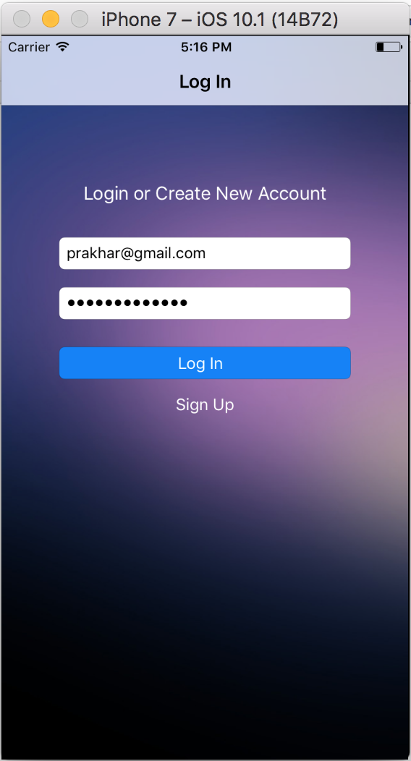
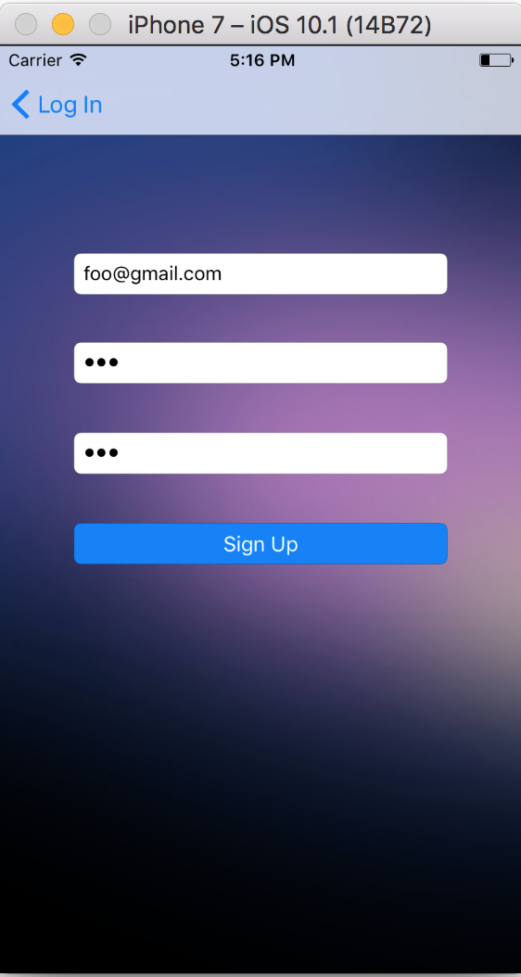
Study Sessions
Launch Screen -
Login Workflow
Enter email & password
Sign Up Workflow
Enter email, password, re-enter password
Email Uniqueness assertion
Password encryption

Slide 9
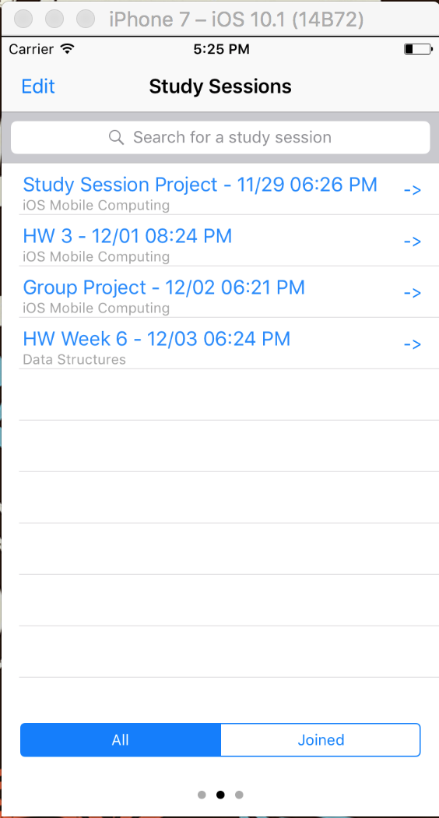
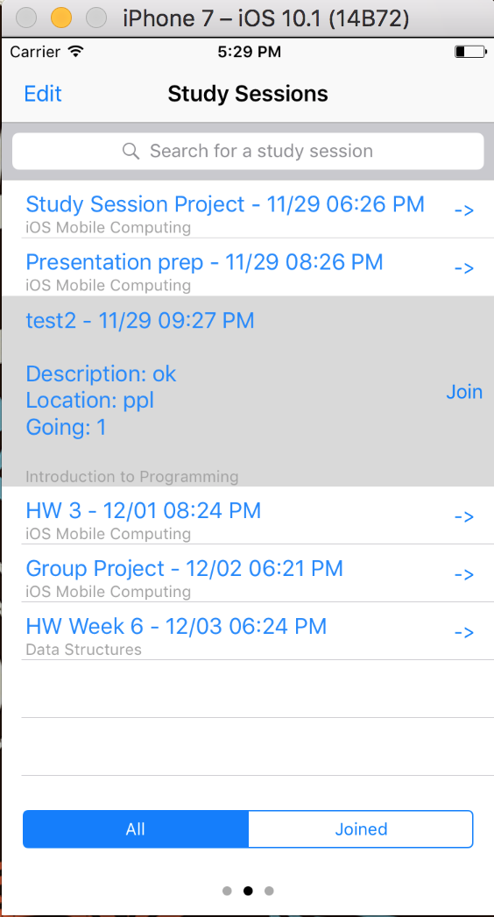
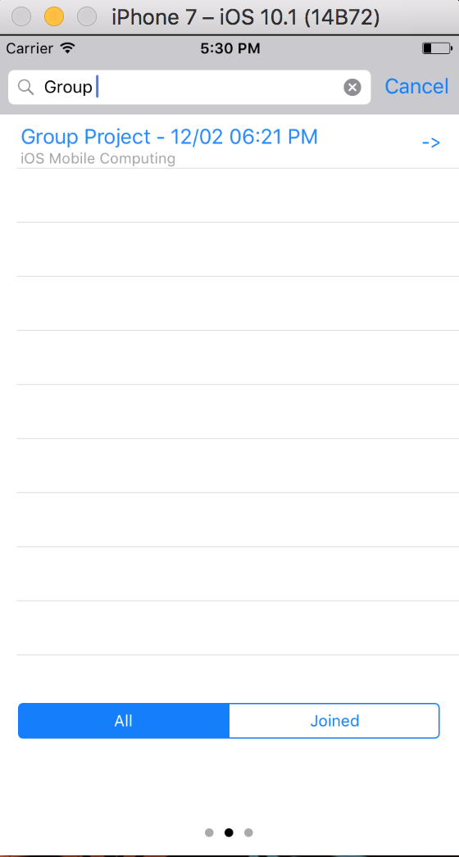
Study Sessions
Home Screen
Study Session Description
Filtered Search

Slide 10
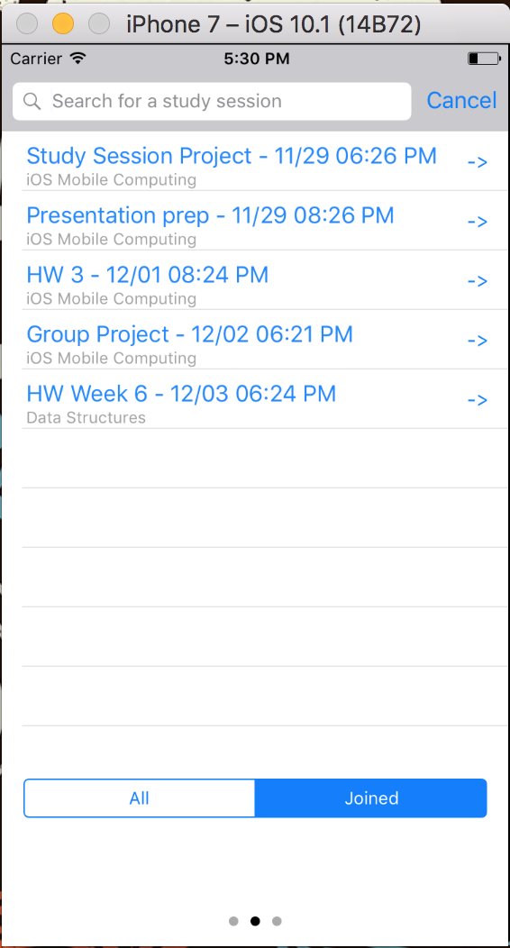
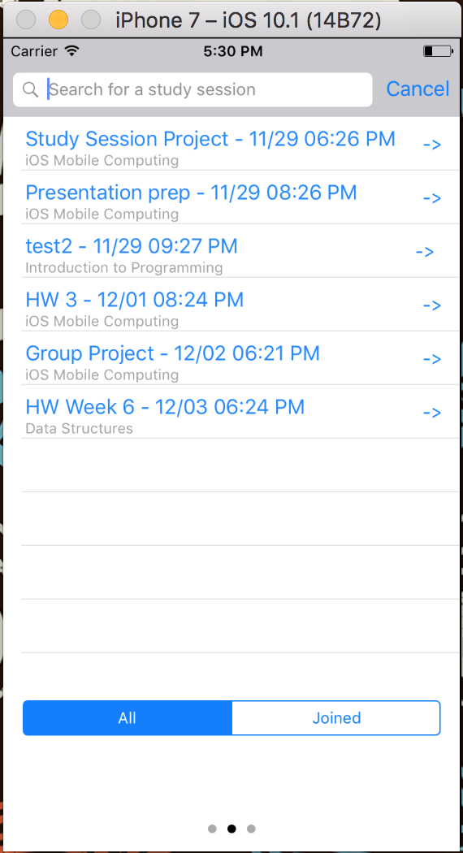
Study Sessions
All Tab Filter - Displays all current and future Study Session for the classes you are subscribed to in chronological order.
Joined Tab Filter - Displays only current and future Study Sessions which you have joined.

Slide 11
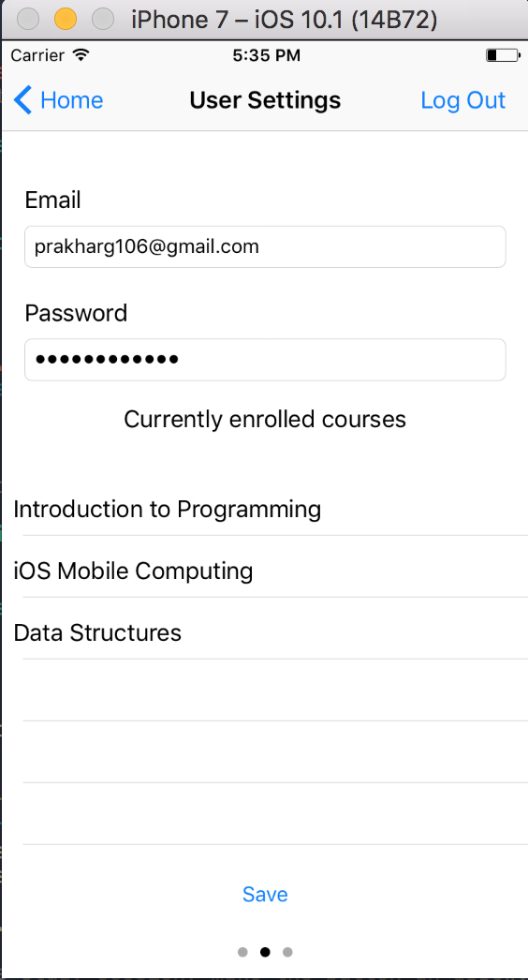
Study Sessions
Change User Settings
Change email & password
View currently enrolled courses

Slide 12
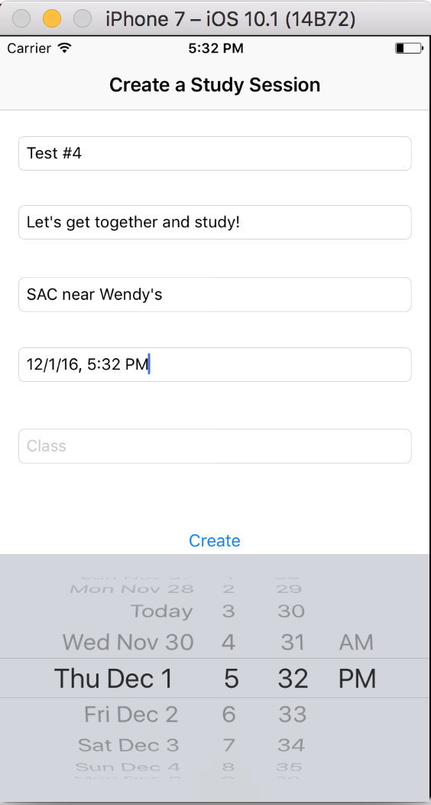
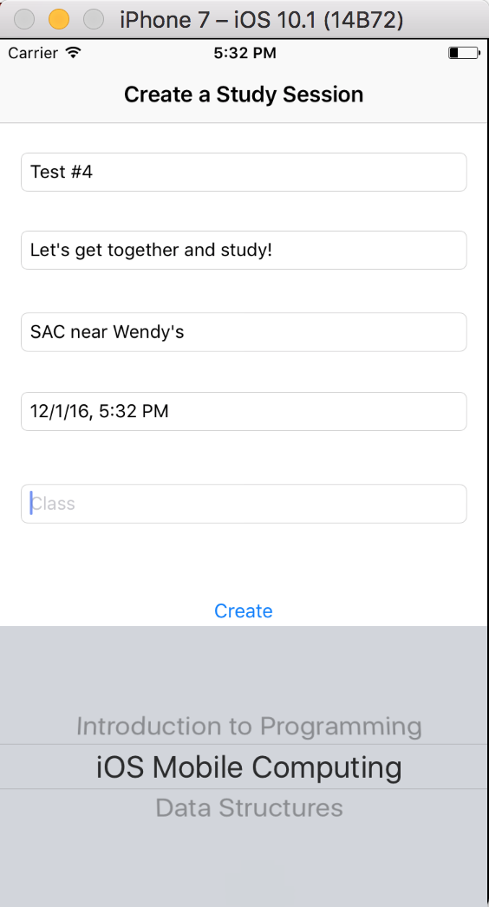
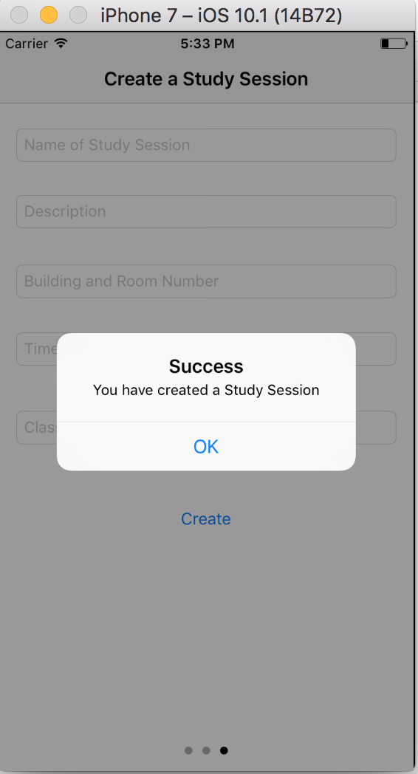
Study Sessions
Create a Study Session Workflow
Name of Study Session
Description
Building and Room Number
Time
Clas

Slide 13
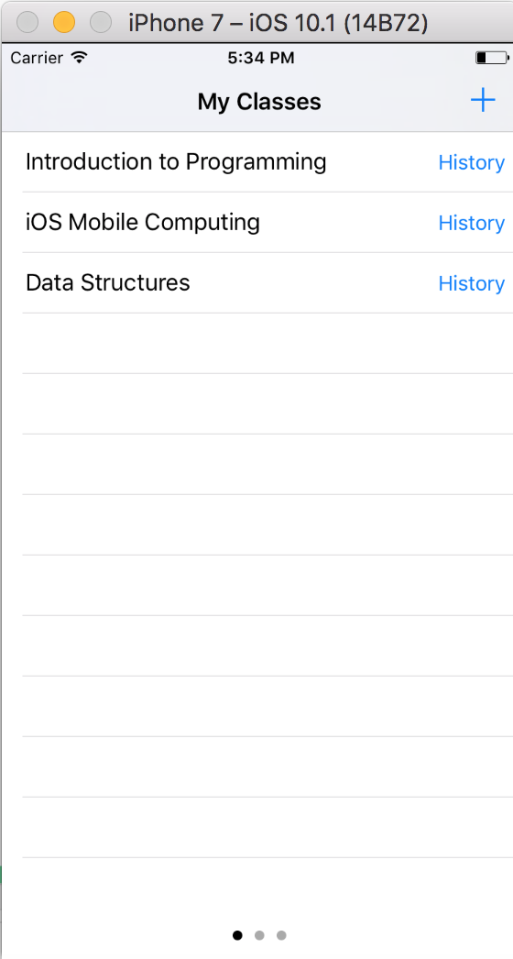
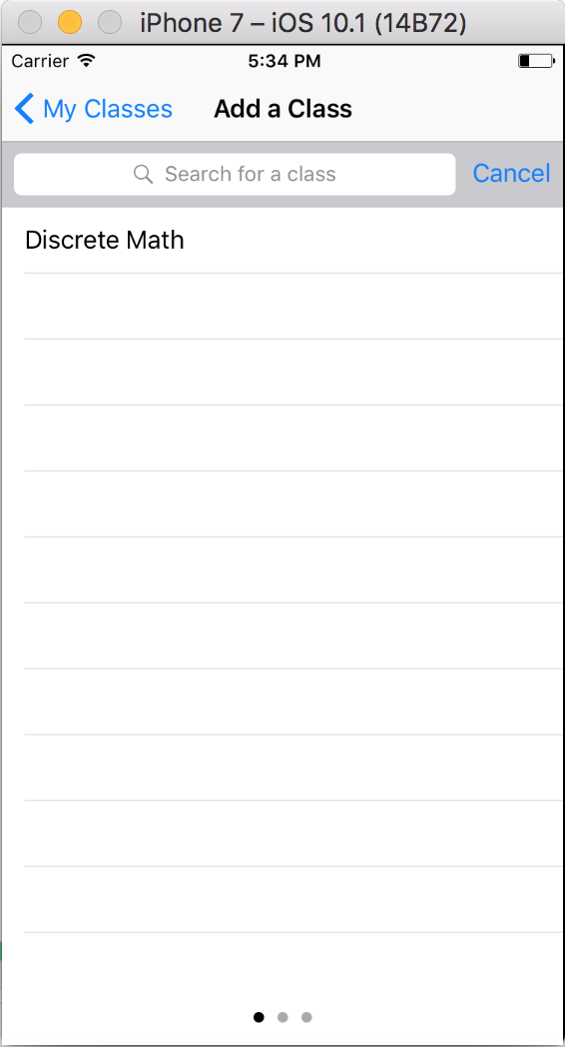
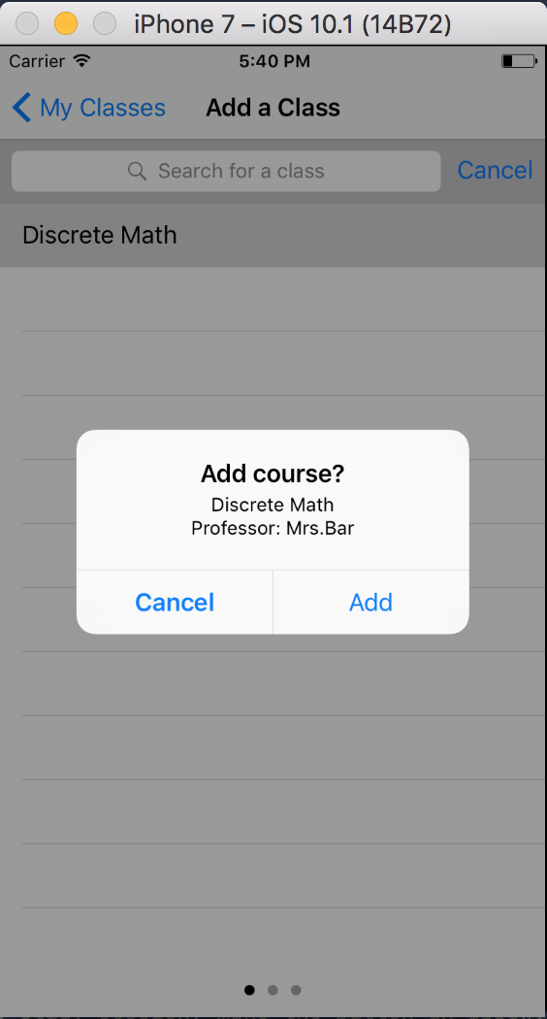
Study Sessions
My Classes Screen -
Adding Classes Workflow
Click ‘+’ to show list of available classes
Click on the class and confirm to add it.

Slide 14
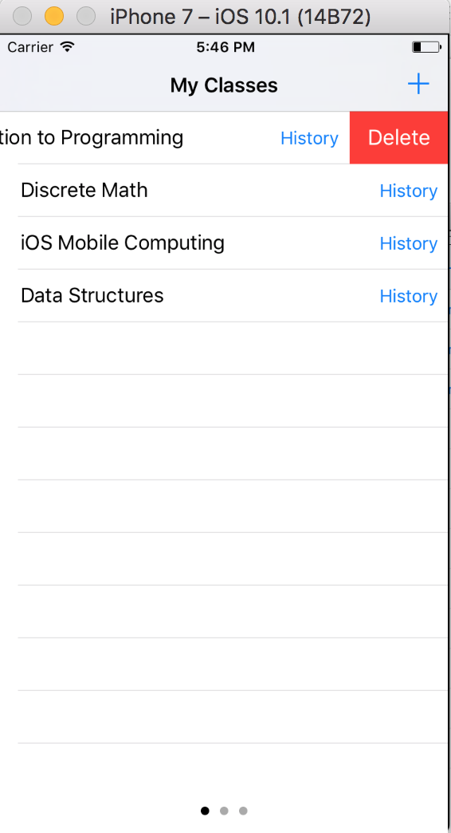
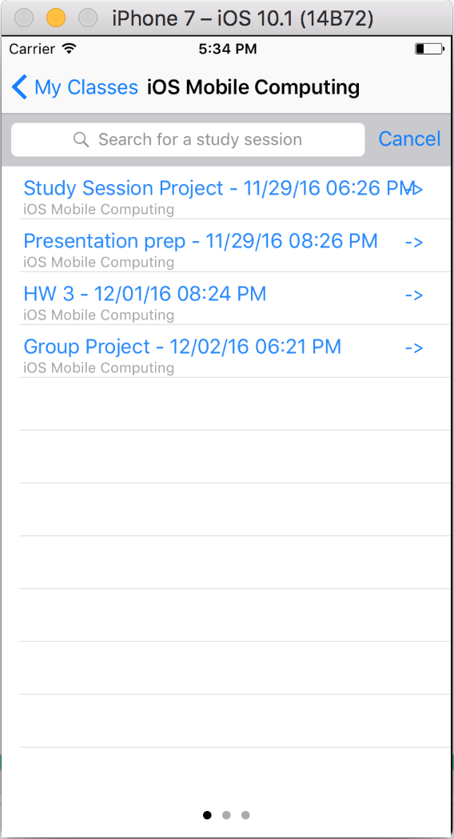
Study Sessions
My Classes Screen -
Deleting a Class
Swipe from left to right on a class to delete
Viewing all past Study Sessions of a class
Click on the ‘History’ button of a class

Slide 15
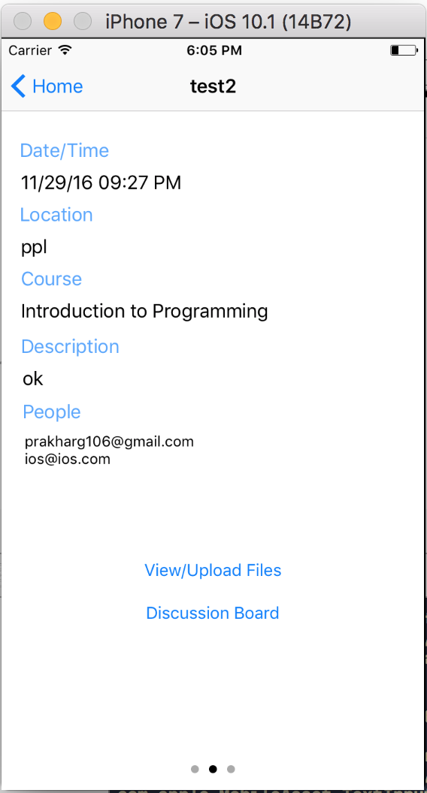
Study Sessions
Study Session Description
Date/Time
Location
Course
Description
People
View/Upload Files
Discussion Board - Students post questions that others can respond/reply to. Similar to Piazza.

Slide 16
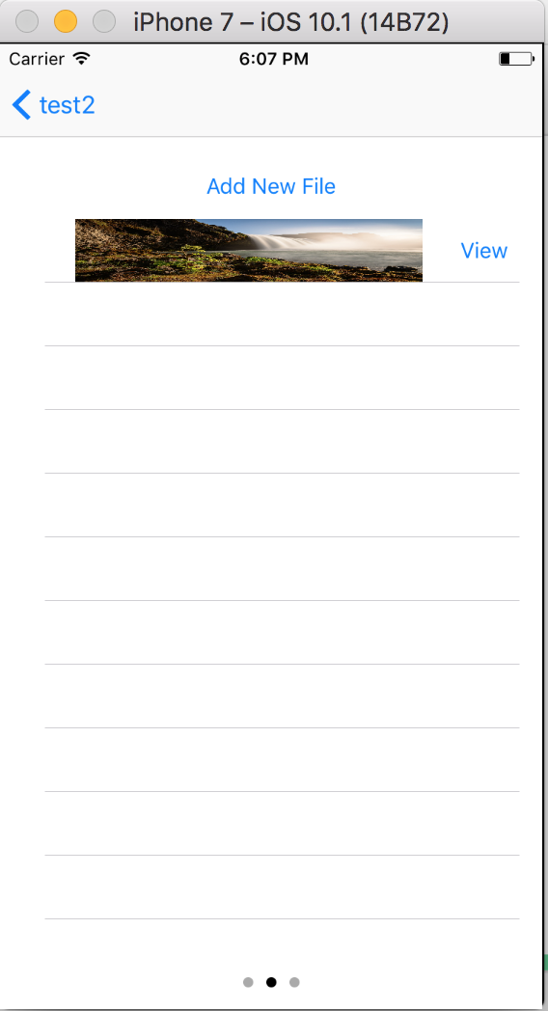
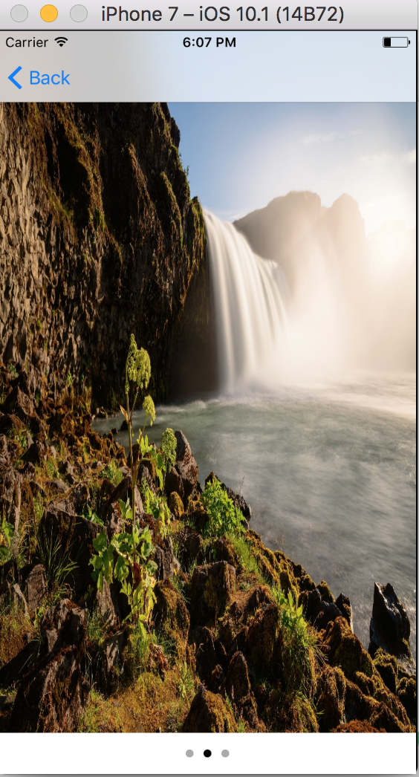
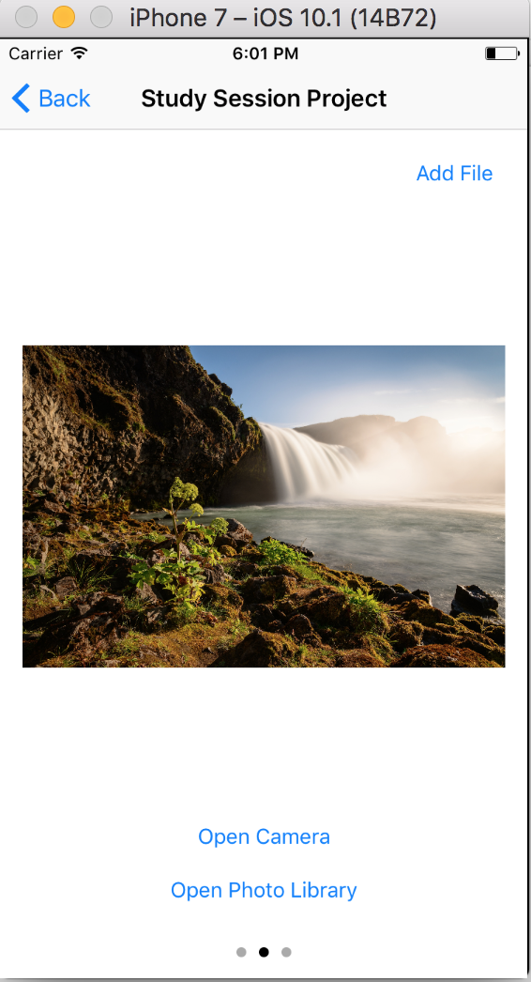
Study Sessions
View all files uploaded by students part of this study session
View a single file up close
Upload a file through phone camera or photo library

Slide 17
Study Sessions
Questions & Answers

