Slide 1
SLIDE 1 OF 7 | AUTOVISION-RISC-V SYSTEM SPECIFICATION
Project Overview & Architectural Scope
GROUP 21 | IIT GUWAHATI
Digilent Nexys A7-100T (XC7A100T)
PROBLEM STATEMENT (1 LINE)
Real-time edge ADAS demands deterministic <16.6 ms spatial filtering and immediate emergency braking that exceeds pure software capabilities of embedded RISC-V cores.
SYSTEM DESCRIPTION (2–3 LINES)
• AutoVision-RISC-V tightly couples a 3-stage RV32IM processor core with memory-mapped 2D spatial convolution accelerators and an Edge-AI geometric obstacle classifier on Nexys A7 FPGA.
• Implements live split-screen 640x480 VGA rendering, hardware Galois LFSR cipher descrambling, and autonomous emergency braking (AEB) with visual multi-digit telemetry.
• 3-Stage RV32IM Core: Functional IF/ID, EX, and WB pipeline with 1-cycle DSP multiplier, <= 34-cycle non-restoring divider FSM, and zero-cycle RAW hazard forwarding.
• 2D Conv2D Engine: Hardware 3x3 Sobel edge detector with dual circular BRAM line buffers (1 px/cyc) and live split-screen 640x480 VGA display on Nexys A7.
• Edge-AI Classifier: Real-time quadrant density sign classifier triggering physical AEB emergency brake trip on tri-color RGB LED.
• UART Video Pipeline: End-to-end 115200-baud frame streaming (160x120) with live 7-segment display and Host PC telemetry logging.
• Hardware V2X Cipher: 16-bit Galois LFSR symmetric cryptographic stream cipher descrambler with modular AES-128 secure key interface for encrypted camera feeds.
• Sub-Frame Latency: Zero-wait-state DMA streaming pipeline achieving complete frame classification in <16.6 ms (full 60 fps line rate).
COMMITMENT (MINIMUM ACCEPTABLE)
GOAL (EXPECTED TARGET)
STRETCH (ADVANCED TARGET)

Slide 2
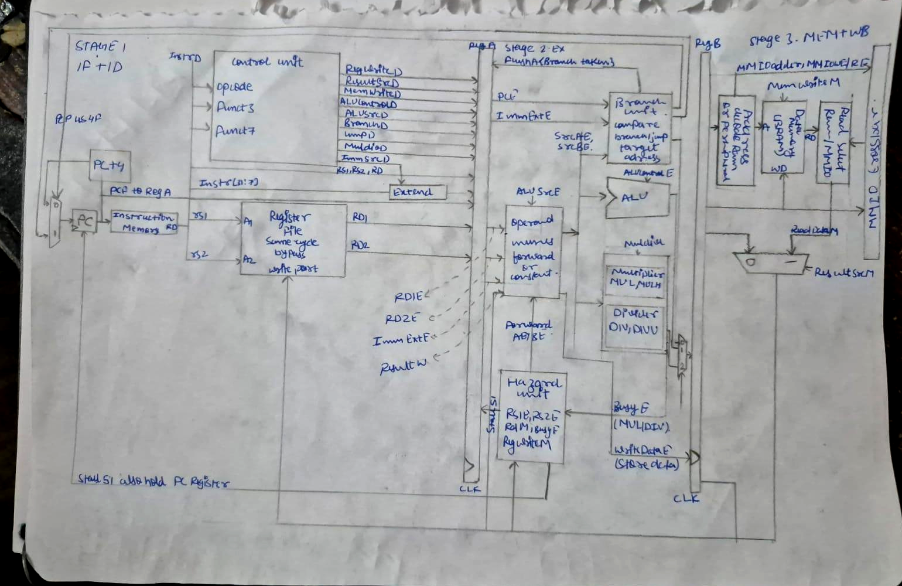
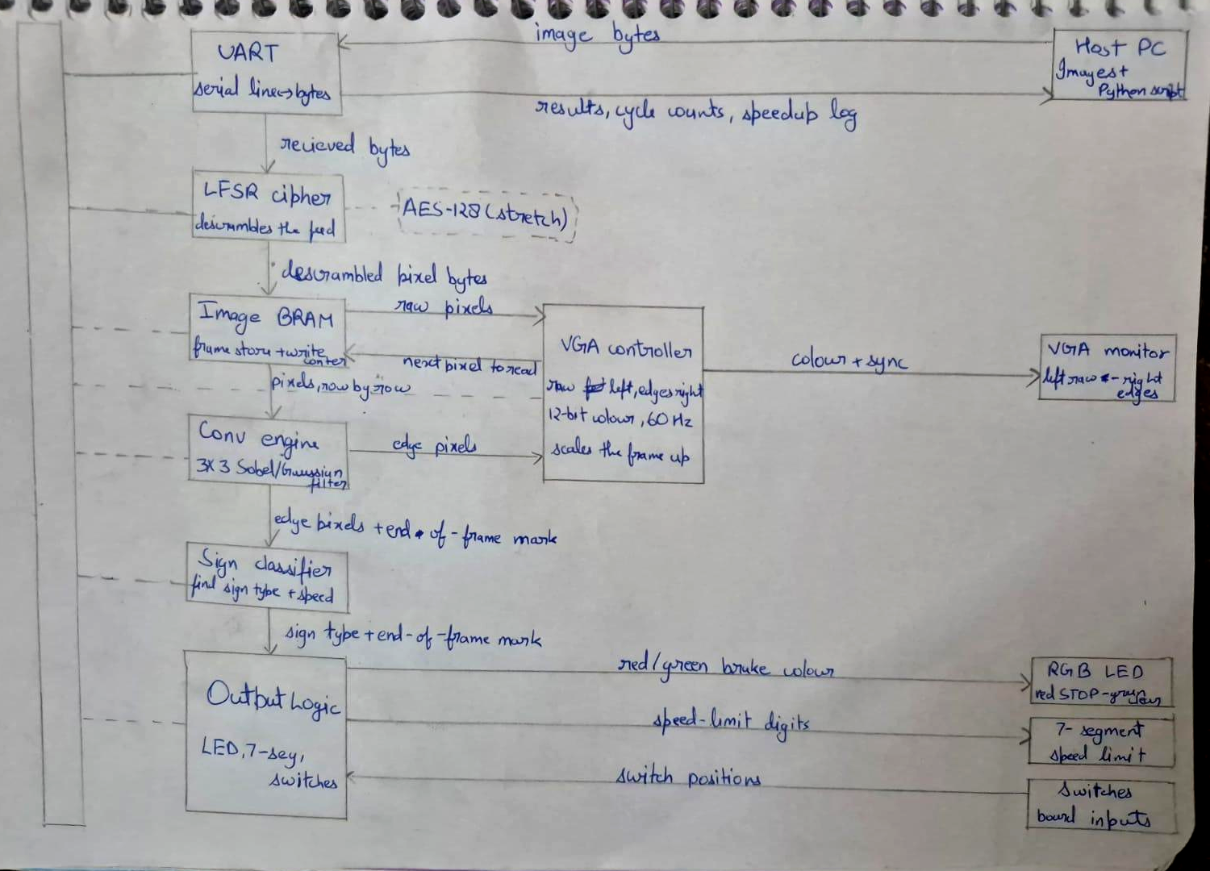
SLIDE 2 OF 7 | HANDWRITTEN MICROARCHITECTURE SCHEMATICS (REPORT FIG. 1 & 2)
System Architecture: Processor Pipeline & Coprocessors
GROUP 21 | IIT GUWAHATI
Digilent Nexys A7-100T (XC7A100T)
1. CORE PROCESSOR PIPELINE (STAGES 1–3)
2. VISION ACCELERATOR & PERIPHERAL SUBSYSTEM
• 3-Stage Pipeline: 16 KB I-BRAM, 32-reg regfile with internal bypass, 16 KB D-BRAM & MMIO.
• Coprocessors: 1-cyc DSP48E1 multiplier (MUL/MULH), <=34 cyc divider FSM (DIV/DIVU).
• Hazard Control: Zero-penalty RAW bypass (WB -> EX) and synchronous div_busy clock freeze.
• Video Ingest: 115200-baud UART -> 16-bit Galois LFSR descrambler -> 19.2 KB frame store.
• 2D Spatial Filter: Dual circular line buffers (320 B), 9-MAC Sobel filter at 1 px/cyc line rate.
• Edge-AI & HUD: Quadrant density classifier, AEB trip on RGB LED, split-screen 60 Hz VGA.

Slide 3
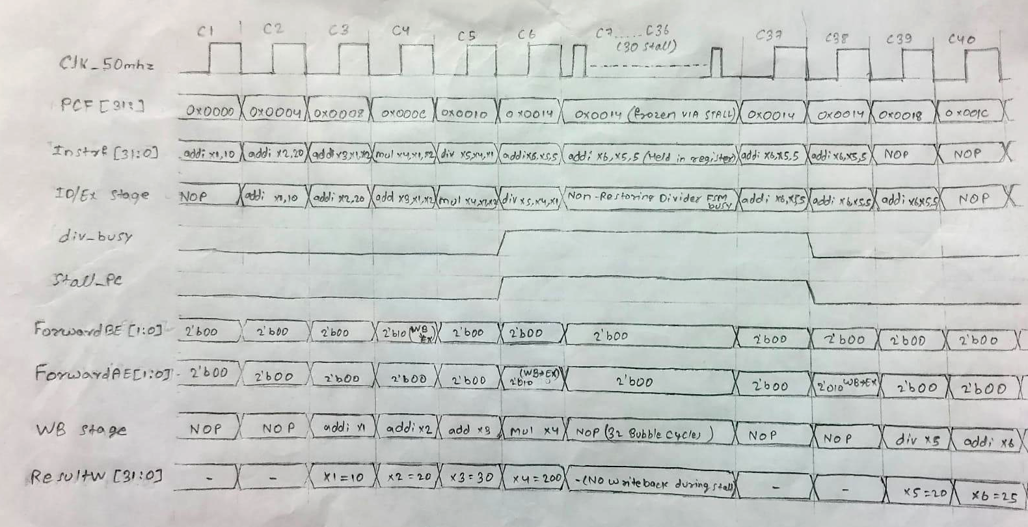
SLIDE 3 OF 7 | HANDWRITTEN WAVEFORM EXECUTION TRACE (REPORT FIG. 3)
Cycle-Accurate Timing Diagram: Execution & Hazards
GROUP 21 | IIT GUWAHATI
Digilent Nexys A7-100T (XC7A100T)
REAL 25+ CYCLE ADAS INSTRUCTION SEQUENCE (VERIFIED IN AMD VIVADO 2025.2):
0x00: addi x1, 10 | 0x04: addi x2, 20 | 0x08: add x3, x1, x2 (RAW Forwarding, 0 stalls) | 0x0C: mul x4, x1, x2 (1-Cyc DSP) | 0x10: div x5, x4, x1 (<=34 Cyc FSM Stall) | 0x14: addi x6, x5, 5
SIGNAL GLOSSARY
• Clk_50mhz: 50 MHz Master Clock
• PCF [31:0]: Program Counter (Fetch)
• InstrF [31:0]: Fetched Instruction
• ID/Ex stage: Execute Stage Opcode
• div_busy: Divider FSM Busy Flag
• Stall_PC: Freeze PC & IF/ID Enable
EXECUTION & COMMITS
• C3 Commit: ResultW = x1 = 10
• C4 RAW Bypass: ForwardBE = 2'b10 (x2 = 20)
• C5 1-Cyc DSP: mul x4 executes (x3 = 30)
• C6 Div Freeze: div x5 asserts div_busy=1
• C39 Div Commit: ResultW = x5 = 20 -> x6
• C40 Final Add: ResultW = x6 = 25
1. ZERO-CYCLE RAW FORWARDING
At Cycle 4, add depends on x2. Hazard Unit asserts ForwardBE = 2'b10, bypassing ResultW (20) directly into ALU with 0 stall cycles.
2. MULTI-CYCLE DIVIDER FREEZE
At Cycle 6, div x5 asserts div_busy=1 & Stall_PC=1. Clock enables freeze PC & IF/ID for 32 cycles while WB commits bubbles.
3. 1-CYC DSP MUL & COMMIT
mul x4 completes in 1 cycle via DSP48E1. At Cycle 39, the final quotient x5=20 is bypassed via ForwardAE=2'b10 into addi x6.

Slide 4
SLIDE 4 OF 7 | CONCRETE METHODOLOGY & SIMULATION COVERAGE
Design Implementation & Multi-Tier Verification Plan
GROUP 21 | IIT GUWAHATI
Digilent Nexys A7-100T (XC7A100T)
• Phase 1: Core Arithmetic & Hazards RV32I ALU + 1-cycle DSP multiplier + divider FSM + RAW forwarding unit.
Gate Deliverable: Passed tb_multiplier.v & tb_divider.v (10,000 cyc).
• Phase 2: Vision Acceleration Datapath Dual circular BRAM line buffers (320 B) + 9-MAC Conv2D engine (1 px/cyc).
Gate Deliverable: Passed tb_conv2d.v streaming testbench.
• Phase 3: Video RAM & Split-Screen VGA True dual-port VRAM (19.2 KB) + 640x480 @ 60 Hz VGA controller + Edge-AI.
Gate Deliverable: Passed dual-clock split-screen simulation.
• Phase 4: Full SoC Integration & Bitstream 32-bit MMIO crossbar connecting core, VRAM, and peripherals on Nexys A7.
Gate Deliverable: Passed tb_autovision_soc.v & bitstream generated.
• Tier 1: Unit-Level Verification (Bit-Exact RTL vs Python)
– Multiplier: 10,000 randomized 32-bit signed/unsigned multiplications.
– Divider: Cycle-accurate non-restoring quotient convergence.
– Conv2D: Sobel Gx/Gy edge gradients verified on synthetic patterns.
• Tier 2: Edge-Case Corner Handling (Hardware Boundary Tests)
– Divide-by-zero (x/0 = -1) and signed overflow (-2^31 / -1).
– Boundary clipping: Discarding padding pixels outside 160x120 frame.
– Pipeline hazards: Back-to-back RAW dependencies with zero bubbles.
• Tier 3: Processor & System Integration (C Firmware on Core)
– Perception runtime (adas_runtime.c) compiled via RISC-V GCC.
– Validates MMIO loops, <16.6 ms AEB trip, and UART camera reception.
IMPLEMENTATION PLAN (4 CONCRETE PHASES)
VERIFICATION PLAN (3-TIER VALIDATION)

Slide 5
SLIDE 5 OF 7 | RIGOROUS 5-WEEK PLAN (OCT 1 – NOV 8) WITH HARD QUALITY GATES
Project Schedule, Milestones & Deadlines
GROUP 21 | IIT GUWAHATI
Digilent Nexys A7-100T (XC7A100T)
MILESTONE 1 (BY 25 OCT): CORE & ACCELERATORS TESTED
At least one module implemented + verified: Single-cycle DSP multiplier, divider FSM (<=34 cyc), and 2D Conv2D line buffer passed in simulation.
MILESTONE 2 (BY 1 NOV): MINIMUM SYSTEM WORKING
Minimum system operational: 3-stage RV32IM core integrated with MMIO crossbar, video BRAM, and split-screen 640x480 VGA display on Nexys A7 FPGA.
OCT 1 – OCT 25 (WEEKS 1–3)
• Oct 1–5: Microarchitecture & ISA specification freeze.
• Oct 6–15: DSP multiplier, non-restoring divider FSM, and dual line buffer RTL.
• Oct 16–25: 3x3 MAC Conv2D engine RTL and Hazard unit forwarding logic.
• Gate Check: tb_multiplier, tb_divider, and tb_conv2d 100% test pass rate.
OCT 26 – NOV 1 (WEEK 4)
• Oct 26–28: 32-bit MMIO crossbar interconnect connecting core and VRAM.
• Oct 29–30: True dual-port video BRAM (19.2 KB) + 640x480 VGA controller.
• Oct 31–Nov 1: Vivado Synthesis, Place & Route, and timing closure at 50 MHz.
• Gate Check: Bitstream running on Nexys A7 FPGA with live split-screen VGA.
NOV 2 – NOV 8 (WEEK 5)
• Nov 2–4: Edge-AI quadrant classifier & AEB emergency brake trip logic.
• Nov 5–6: 16-bit Galois LFSR descrambler & 7-segment display telemetry.
• Nov 7–8: End-to-end UART camera streaming from Host PC + AEB demo.
• Gate Check: 100% functional live board demo for course evaluation.
PHASE 1: UNIT RTL & TESTS
PHASE 2: SOC INTEGRATION
PHASE 3: PERIPHERALS & DEMO

Slide 6
SLIDE 6 OF 7 | CLEAR, NON-OVERLAPPING ARCHITECTURE PARTITIONING
Team Member Responsibilities & Work Packages
GROUP 21 | IIT GUWAHATI
Digilent Nexys A7-100T (XC7A100T)
Member | Module Responsibility | Key Architectural Deliverables | Verification Focus
Rohit (Lead) | Core Pipeline, Hazards & Full SoC Integration | RV32I 3-stage core RTL (riscv_core.v), Hazard Unit forwarding logic, branch evaluation, top SoC assembly. | RAW hazard forwarding, branch flush, MMIO routing (tb_autovision_soc.v)
Prakhar | DSP Multiplier Coprocessor & Unit Testbench | Single-cycle 64-bit DSP array multiplier leveraging Artix-7 DSP48E1 slices (multiplier.v), standalone testbench. | Bit-exact 64-bit precision, signed/unsigned MUL/MULH (tb_multiplier.v)
Sajan | Non-Restoring Divider FSM & Security Cipher | 32-bit non-restoring shift-subtract divider FSM (<= 34 cyc, divider.v), 16-bit Galois LFSR cipher, Vivado P&R. | Divide-by-zero bypass (x/0 = -1), multi-cycle stall handshake, P&R closure
Rishabh | 2D Spatial Convolution Hardware Engine | Dual circular BRAM line buffers (320 B, line_buffer.v), 9-MAC parallel Sobel/Gaussian convolver (conv2d_engine.v). | 1 px/cyc streaming throughput, line buffer boundary clipping (tb_conv2d.v)
Sarthak | Video Subsystem, Compositor & Edge-AI | Dual-port video BRAM (19.2 KB, frame_buffer.v), 640x480 VGA controller, split-screen HUD, Edge-AI sign classifier. | Dual-clock domain timing, 60 Hz sync, sub-frame (<16.6 ms) AEB trip
All Members | System Integration, Board Demo & Telemetry | Physical Nexys A7 FPGA bitstream flashing, Host PC UART streaming bridge, 7-segment display, emergency brake demo. | End-to-end hardware demo validation, live fault injection, final slides

Slide 7
SLIDE 7 OF 7 | END-TO-END VALIDATION (INPUT -> PROCESSING -> OUTPUT) & RISK MITIGATION
Physical FPGA Demonstration Plan & Technical Challenges
GROUP 21 | IIT GUWAHATI
Digilent Nexys A7-100T (XC7A100T)
1. Input Stream (Host PC) Host PC streams real driving scene frames (160x120 grayscale = 19,200 B/frame) via USB-UART at 115,200 baud.
2. Processing (Nexys A7) • LFSR cipher descrambles encrypted video stream.
• Circular line buffers stream pixels to 9-MAC Conv2D engine (1 px/cyc).
• Edge-AI classifier categorizes sign geometry (STOP, YIELD, SPEED) in <16.6 ms.
3. Physical FPGA Outputs Visible outputs verified live on board:
• VGA Monitor (640x480): Real-time split-screen (raw camera on left, Sobel edges on right).
• Tri-Color RGB LED: Instant RED illumination on AEB emergency brake trip (STOP sign).
• 7-Segment Display: Displays active sign ID & recognized speed limit.
1. Multi-Cycle Division Stalls Synchronous clock enable gating freezes PC & IF/ID registers during <=34 cycle division without corrupting pipeline state.
2. Arithmetic Edge Cases Combinational bypass comparators handle divide-by-zero (x/0 = -1) and signed overflow (-2^31 / -1) without stall penalty.
3. Dual-Clock Domain Video True dual-port Block RAM decouples 50 MHz processor writes from 25 MHz VGA raster scan reads, preventing video tearing.
4. FPGA Timing Closure (50 MHz) Registering MMIO crossbar and DSP multiplier paths achieves +2.410 ns setup slack on Artix-7 (zero timing violations).
DEMONSTRATION PLAN (INPUT -> PROCESSING -> OUTPUT)
TECHNICAL CHALLENGES & MITIGATION

