Slide 1
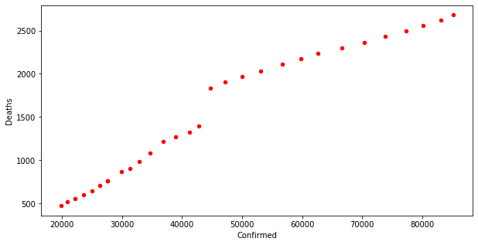
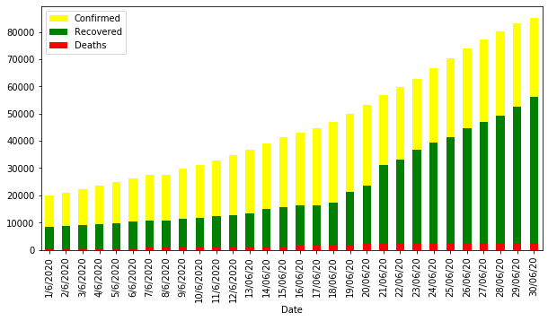
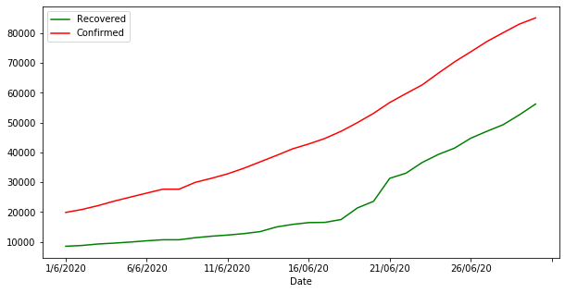
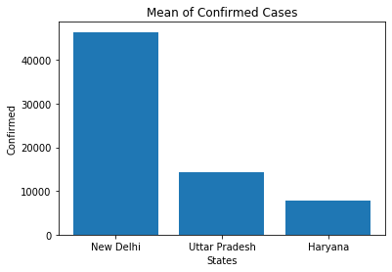
Delhi’s COVID19 Statistics
Delhi’s COVID19 Statistics
Neighbouring states of Delhi
Delhi’s COVID19 Statistics

