Slide 1

Transport For London (TFL) Cycling Usage Stats Dataset Analysis & Expansion Strategy
Key Findings & Data-Driven Recommendations

Slide 2
Table of Contents
Business Challenge and Objective of this Analysis – Slide 3
Exploratory Data Analysis and Visualizations – Slides 4 - 7
Potential Data Science Use Cases – Slide 8
Selected Use Case & Prototype Model -Bike Demand Forecasting Model – Slides 9-11
Business Recommendations for Short-Term Rental Cycle Expansion in London – Slide 12
APPENDIX – Slides 13 - 17
* Please visit Appendix section of this presentation to view more Exploratory Data Analysis and Visualizations performed.

Slide 3
Business Challenge and Objective of this Analysis
Business Challenge
One of our clients is considering expanding their business into short term rental-cycles. Before investing, they would like to understand how people in London use cycling services in order to develop their strategy. We have been asked to look at existing biking usage patterns to help them with this. From the initial meeting, they suggested that they were interested in what kinds of usage they might expect to see, what profile of customers they might have, as well as operational concerns such as reliability and supply chain management.
Objective of this Analysis
The objective of this analysis is to provide insights into cycling usage patterns in London to help a client determine the feasibility of expanding into the short-term rental cycle business. After the initial client meeting, we’d like to get back to them with an initial response as well as some suggestions for how they can use data to make their expansion a success. Using the TFL cycling dataset usage-stats12 data from 2021 to 2023:
Perform exploratory analysis on the dataset
Identify possible data science use cases with the data
Select a use case and prototype a simple model that demonstrates the application of data science to this business
Make two recommendations for the client

Slide 4
Exploratory Data Analysis and Visualizations

Slide 5
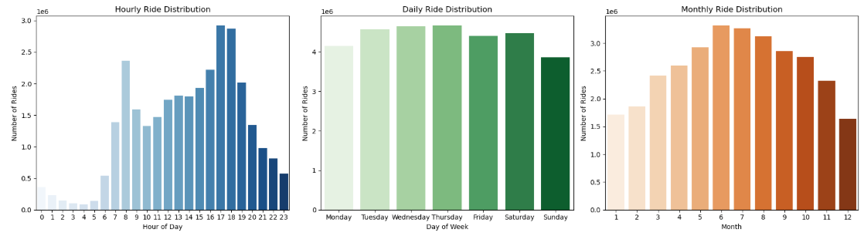
1. 🚴‍♂️ Ride Frequency Analysis - Exploratory Data Analysis (EDA)
Peak Usage Trends: Identified high-traffic hours & days (weekends vs. weekdays).
Hourly Trends
📌 Use Case: Identify peak hours for demand.
Observation: Ride usage is lowest during late night hours and peaks around 8 AM (morning rush) and 5-7 PM (evening commute).
Daily Trends
📌 Use Case: Understand how usage changes by day of the week.
Observation: Weekdays have relatively consistent usage, with slight dips on Monday & Sunday. Weekend usage remains high, likely due to leisure activities.
Monthly Trends
📌 Use Case: Identify seasonal variations in ride demand.
Observation: Peak usage occurs during summer months (June - August), while winter months (December - February) show a decline, indicating a seasonal effect.

Slide 6
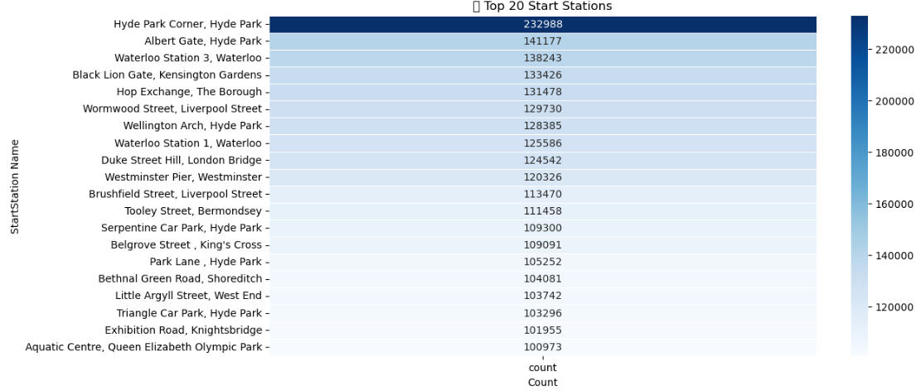
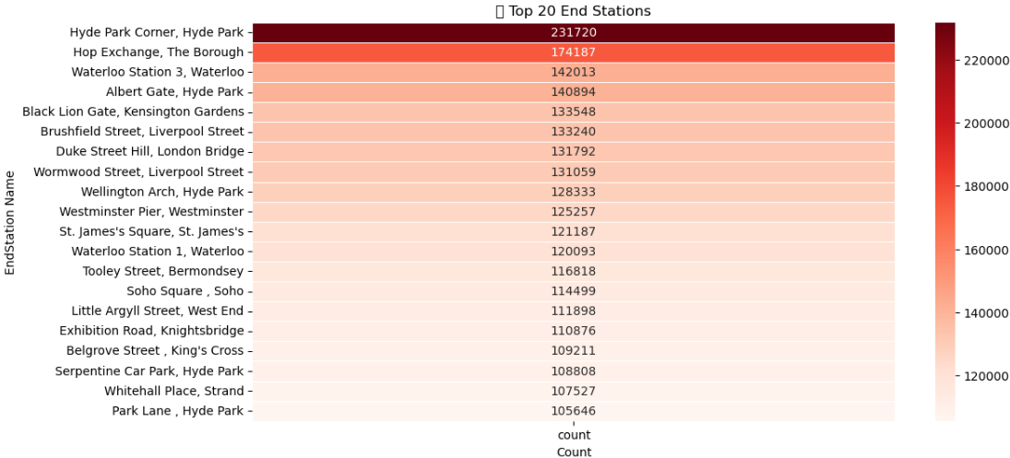
2. 🚴‍♂️ Heatmap of Station Activity - Exploratory Data Analysis (EDA)
📌 Use Case: Identify popular departure locations for better station stocking.
📌 Use Case: Optimize bike redistribution by analyzing where most trips end.
Top 20 Start Stations
Observation: Hyde Park Corner, Hyde Park is the most popular starting location, likely due to high tourist activity.
Top 20 End Stations
Observation: Hyde Park Corner, Hyde Park is also the most common endpoint, indicating frequent short loops or round trips.

Slide 7
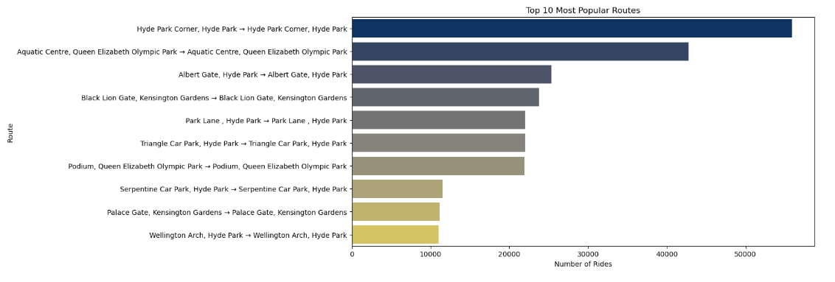
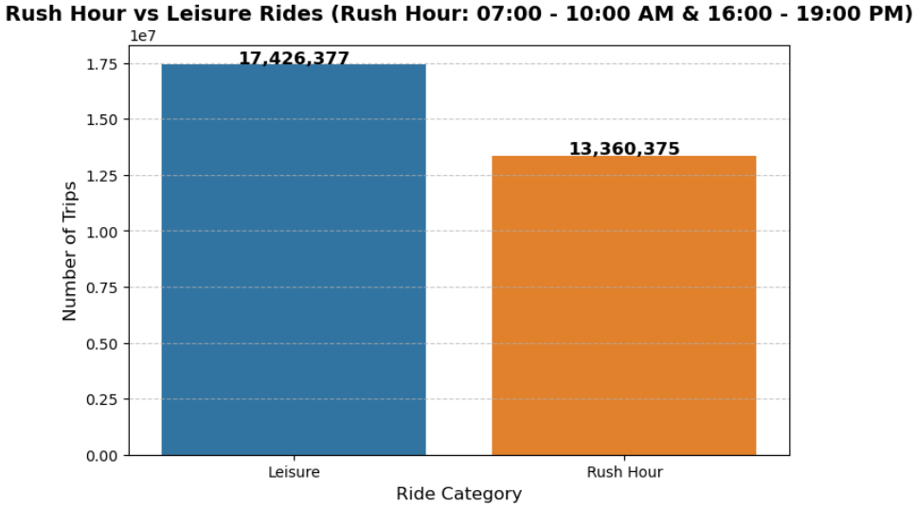
3. 🚴‍♂️ Popular Routes Analysis
4. 🚴‍♂️ Rush Hour vs Leisure Rides
📌 Use Case: Identify frequently traveled routes to improve bike redistribution and infrastructure planning.
📌 Use Case: Helps city planners and bike-sharing companies optimize bike availability during peak and off-peak hours.
Top 10 Most Popular Routes
Observation: The most popular routes are short, looped trips within parks, such as Hyde Park Corner, Hyde Park → Hyde Park Corner, Hyde Park and Aquatic Centre, Queen Elizabeth Olympic Park → Aquatic Centre, Queen Elizabeth Olympic Park. This suggests a mix of recreational riders and tourists using the service.
Defining Rush Hour: For defining Rush Hour, we need to consider common commuting patterns. In most cities, rush hour typically falls within:
🔹 Morning Rush Hour: 07:00 - 10:00 AM (people commuting to work)
🔹 Evening Rush Hour: 16:00 - 19:00 PM (people returning from work)
So, a ride is classified as Rush Hour if: The Start Time falls within 07:00 - 10:00 AM or 16:00 - 19:00 PM. All other trips are classified as Leisure Rides.
Observation: More rides occur outside rush hours, indicating that leisure rides dominate over commuter rides.

Slide 8
Potential Data Science Use Cases
Bike Demand Forecasting helps predict peak and future bike demand times, to optimize fleet allocation and improve service reliability, ensuring better resource allocation and bike availability.
Features used: Start Time (timestamp) and Demand Count (historical bike usage).
Approach: Time-series forecasting using models like LSTM, XGBoost, Prophet, and SARIMA to predict demand for the next 180 days.
Business impact: Enhances operational efficiency, reduces costs, improves user experience, and supports data-driven decision-making for city planning.
Bike Availability Optimization ensures an even distribution of bikes across stations, preventing shortages in high-demand areas and excess bikes in low-use stations.
Features used: Start and end station IDs, total trip duration, day of the week, and historical ride trends.
Approach: Machine learning models classify stations based on demand patterns, and optimization algorithms recommend bike rebalancing strategies.
Business impact: Lower operational costs, increased user satisfaction, and higher bike utilization rates.
Customer Segmentation helps categorize users based on their ride behaviors, enabling personalized marketing and engagement strategies.
Features used: Rental ID, start station ID, end station ID, total duration, day of the week, and month.
Approach: K-means clustering segments users based on trip frequency, duration, and ride patterns, identifying groups like commuters, tourists, and occasional riders.
Business impact: Targeted promotions, improved user experience, and higher retention rates.
Trip Duration Prediction estimates how long a ride will take, improving estimated time of arrival (ETA) accuracy and optimizing station rebalancing.
Features used: Start station ID, end station ID, start time, day of the week, and total duration.
Approach: Regression models like Random Forest or XGBoost predict trip duration based on historical ride data.
Business impact: More accurate ETAs, improved user experience, and better trip planning.
Optimal Station Placement identifies strategic locations for new bike stations to maximize accessibility and revenue.
Features used: Total trip count per station, trip durations, popular routes, and peak usage trends.
Approach: Cluster analysis distinguishes underutilized and overutilized stations, identifying areas with high unmet demand for potential expansion.
Business impact: Better station placement, increased ridership, and optimized expansion planning.
Anomaly Detection in Bike Usage helps identify suspicious activities such as bike theft, misuse, or fraudulent rentals.
Features used: Rental ID, bike ID, start and end times, trip duration, and station usage patterns.
Approach: Anomaly detection algorithms flag unusual ride durations, station movements, or repeated trips that deviate from normal usage patterns.
Business impact: Reduced fraud, increased security, and better enforcement of bike-sharing policies.

Slide 9
Selected Use Case & Prototype Model - Bike Demand Forecasting Model

Slide 10

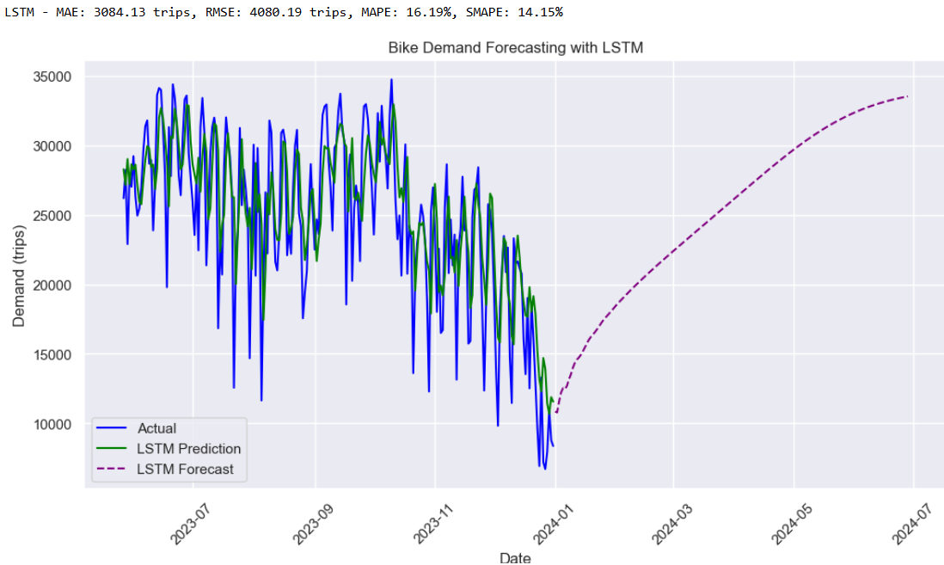
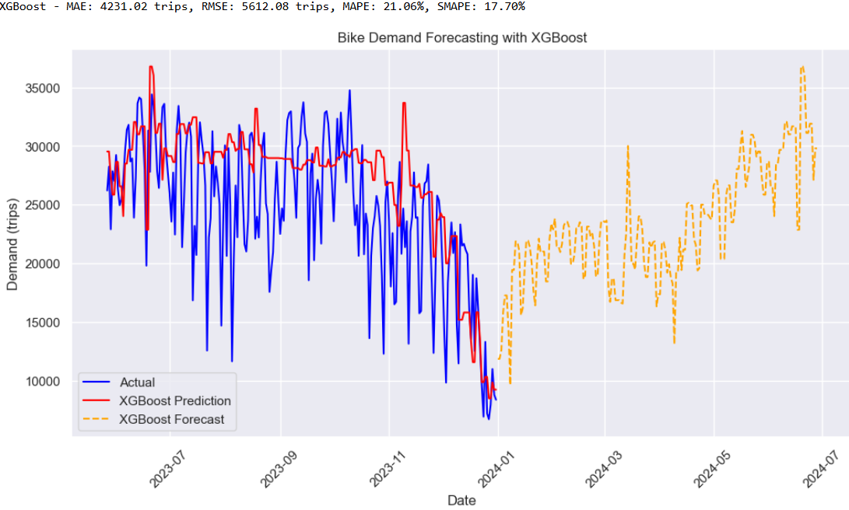
1.) LSTM and XGBoost Models - Bike Demand Forecasting
📌 Use Case: The Bike Demand Forecasting Model helps city planners, bike-sharing companies, and policymakers predict future bike demand over time. By leveraging forecasting models, we can identify seasonal trends, short-term fluctuations, and long-term demand patterns. This enables optimized bike distribution, efficient fleet management, infrastructure planning, and improved customer experience, ultimately promoting sustainable urban mobility. 🚲📊
LSTM is better for long-term forecasting as it provides a smoother trend, learns seasonality well, and has lower error metrics (MAE: 3084, RMSE: 4080, MAPE: 16.19%, SMAPE: 14.15%). It is more stable for predicting demand over six months.
XGBoost is better for short-term forecasting as it captures fluctuations effectively but has higher errors (MAE: 4231, RMSE: 5612, MAPE: 21.06%, SMAPE: 17.70%) and produces a more irregular long-term forecast. Suitable for short-term demand variations.
Hence, in conclusion LSTM has demonstrated the best performance in predicting bike demand. It has the lowest error metrics, capturing seasonality and trends more effectively than XGBoost. Given its superior accuracy, LSTM shall be used for future demand forecasting.

Slide 11
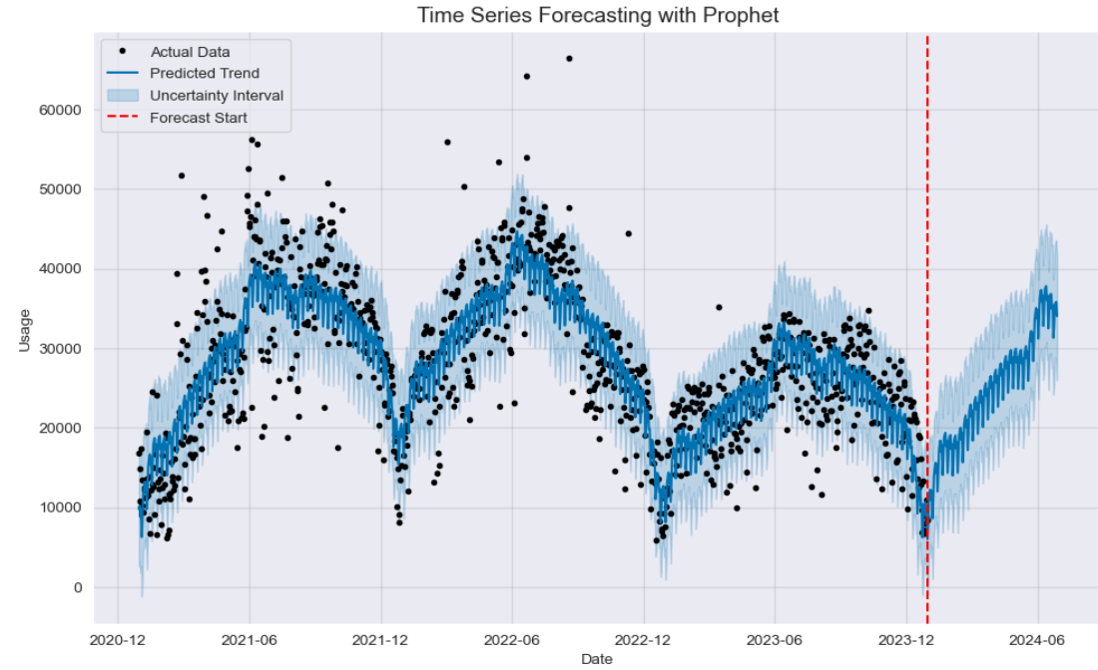
2.) Prophet Model - Bike Demand Forecasting
Why Use Prophet for Forecasting?
Prophet, developed by Facebook, is a robust model designed for business forecasting applications. Prophet was chosen because it excels at capturing seasonal patterns and long-term trends in time-series data. Unlike traditional models, which struggle with complex fluctuations, Prophet can automatically detect:
🗓 Weekly, monthly, and yearly cycles
📈 Long-term trend variations
📉 Outlier handling and missing data adaptability
This makes it highly effective for bike demand forecasting, where ridership varies due to commuting patterns.
Prophet RMSE: 5603.70
Prophet MAE: 4177.56
Prophet MAPE: 17.98%
Prophet SMAPE: 16.48%
Why No Train-Test Split?
Unlike traditional machine learning models, Prophet does not require an explicit train-test split because it treats the entire dataset as historical data to learn from. The model fits all available data and forecasts future points based on learned patterns.
✅ Instead of fitting on a portion and testing on the rest, Prophet makes future projections based on past trends. ✅ This makes Prophet naturally suited for time series forecasting without the need for a separate validation set.
Pattern Detection and Prophet Model Strengths
One of Prophet’s major advantages is its ability to smoothly model trends while handling irregularities. Key observations from the forecast:
🔹 The black dots (actual data) exhibit clear seasonal demand patterns. 🔹 The blue line (Predicted Trend) closely follows fluctuations, capturing annual demand peaks and dips. 🔹 The blue shaded region represents uncertainty intervals - wider regions indicate more variability in predictions. 🔹 The red dashed line marks the start of the forecast, meaning everything to the right is Prophet’s prediction for the next 6 months.
💡 Prophet's forecast suggests a steady increase in bike demand post-winter, with peaks expected in summer, aligning with past trends

Slide 12
Business Recommendations for Short-Term Rental Cycle Expansion in London
1.) Seasonal Fleet Optimization & Dynamic Pricing Strategy
The forecasting analysis highlights strong seasonal patterns in bike demand, with peaks during summer and lower demand in winter.
Recommendation: The client should increase fleet availability during peak months (spring and summer) and reduce surplus inventory in winter to optimize operational costs.
Additionally, implementing dynamic pricing (higher rates during peak hours/seasons and discounts in off-peak times) can help balance demand and improve profitability. Offer discounts or promotions during off-peak hours to balance demand. Launching incentive programs during off-peak hours can encourage more balanced usage, reducing congestion and improving overall system efficiency.
2.) Targeted Marketing & Expansion Based on High-Demand Zones
The forecasting models indicate short-term fluctuations and long-term growth trends, suggesting that bike demand is influenced by commuter habits and leisure cycling patterns.
Recommendation: The client should target high-demand areas (high-traffic locations such as business districts, universities, and tourist hotspots) for bike station placement.
A segmented marketing approach should be adopted, focusing on commuters during weekdays and leisure cyclists on weekends, using promotional strategies tailored to each group to maximize engagement and usage.

Slide 13
APPENDIX

Slide 14
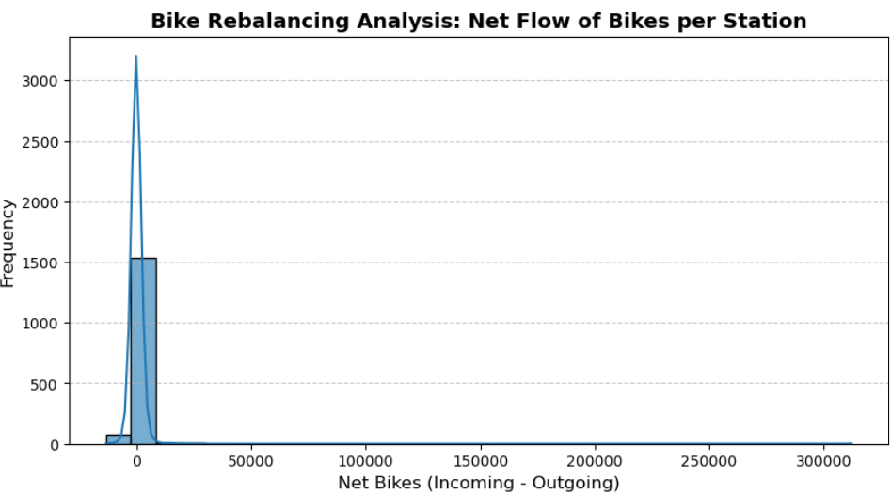
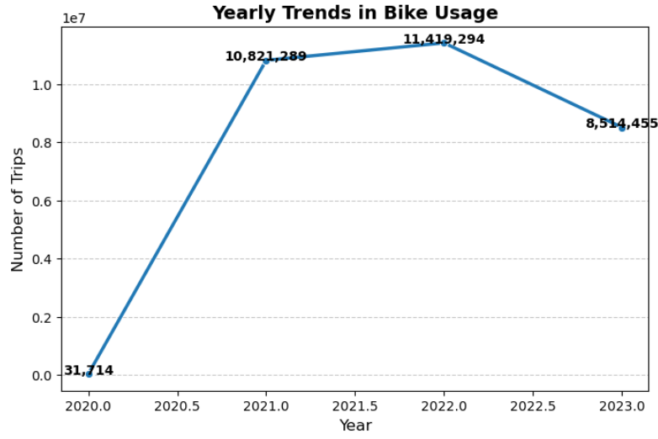
5. 🚴‍♂️ Bike Rebalancing Analysis (Histogram + KDE Plot)
6. 🚴‍♂️ Yearly Trends in Bike Usage (Line Chart)
📌 Use Case: Analyzes station imbalances to optimize bike distribution strategies. This histogram identifies station imbalances, showing where more bikes arrive than leave. It helps optimize station locations and distribution.
📌 Use Case: Helps understand growth or decline in bike usage over the years. This chart helps track bike usage trends over the years, identifying growth, seasonal drops, or changes due to external factors like policy changes or weather conditions.
Observation: Most stations have small net bike flow, but some experience high positive/negative fluctuations, requiring manual rebalancing.
Observation: Bike usage peaked in 2022 but declined in 2023, possibly due to external factors like weather, policy changes, or competition.

Slide 15
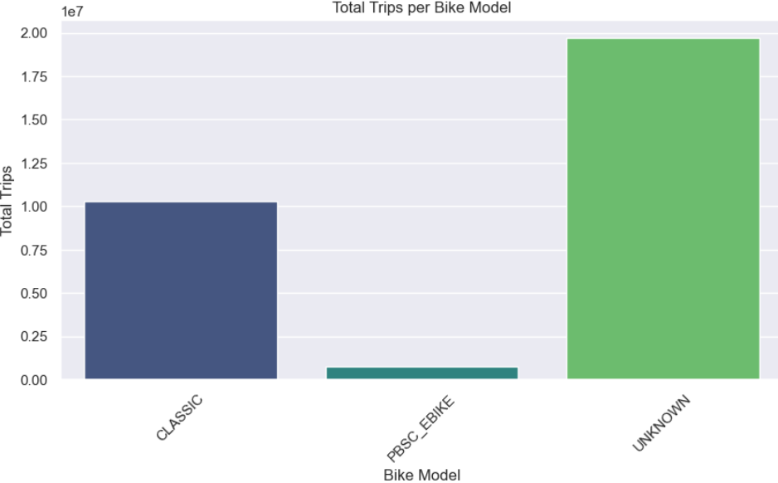
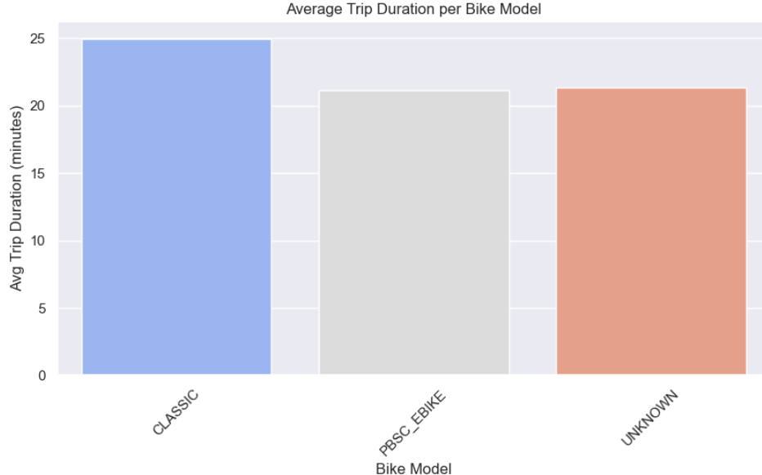
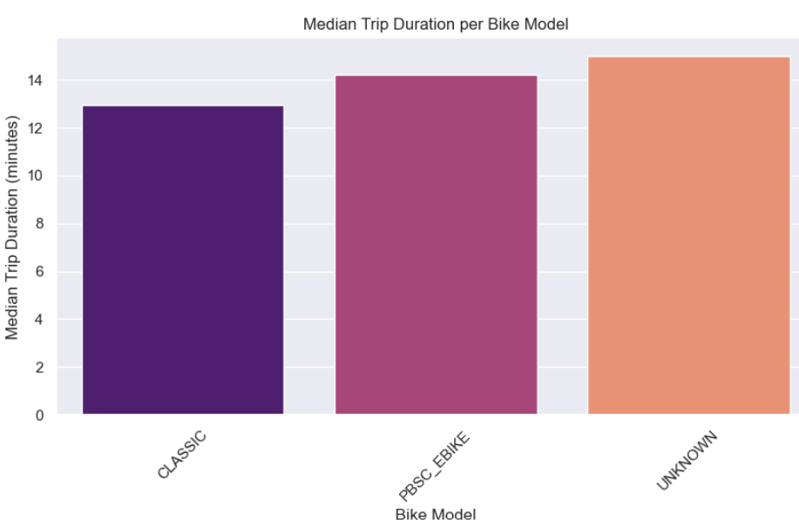
7.🚴‍♂️ Bike Model Performance Analysis - Exploratory Data Analysis (EDA)
📌 Use Case: Understanding which bike model performs best in terms of trip duration and frequency to optimize bike allocation, identify maintenance needs, and improve user experience.
📊 Total Trips per Bike Model
Use Case: Identifies the most frequently used bike model, helping in fleet management and maintenance planning.
Observation: UNKNOWN bikes dominate usage, possibly due to missing data on bike models. Classic bikes are still widely used, while PBSC_EBIKE might need more promotion or better accessibility.
⏳ Average Trip Duration per Bike Model
Use Case: Evaluates user satisfaction and efficiency of bike models based on trip duration.
Observation: "Classic" bikes are used for longer trips, which could mean they are preferred for leisure or longer commutes. "PBSC_EBIKE" trips might be shorter because they assist with pedaling, making trips faster.
⏱ Median Trip Duration per Bike Model
Use Case: Prevents skewed insights from extreme trip durations, ensuring a fair performance comparison.
Observation: Since median duration is less affected by outliers, this suggests PBSC_EBIKE and UNKNOWN models are used for more consistent trip lengths, while CLASSIC bikes may have more variation in trip duration.

Slide 16
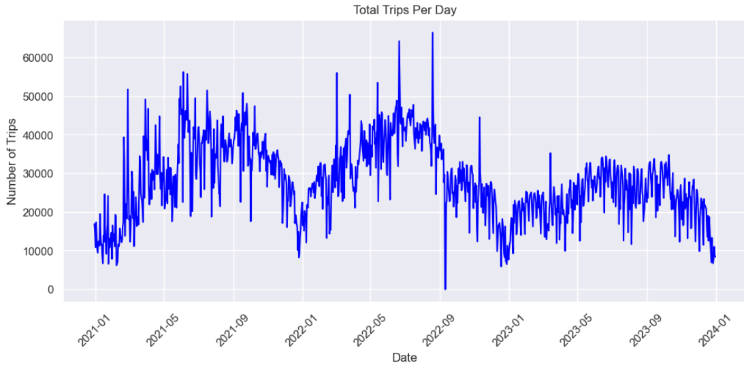
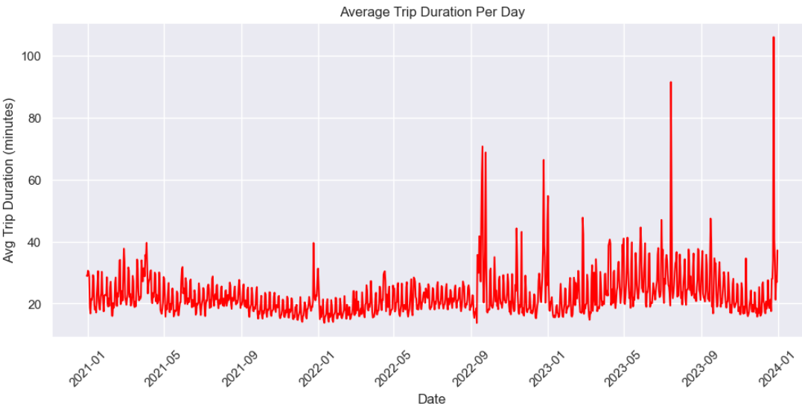
8. 🚴‍♂️ Total Trips Per Day - Exploratory Data Analysis (EDA)
9. 🚴‍♂️ Average Trip Duration Per Day - Exploratory Data Analysis (EDA)
Observations:
There is a clear seasonality in the data, with some periodic rises and falls.
There is a sharp drop in trips in certain places (possibly due to events like holidays, lockdowns, or weather conditions).
There is a downward trend in the later period (2023 onwards), suggesting a decline in total trips.
Observations:
Most of the time, the average trip duration is relatively stable.
There are extreme spikes in trip duration at certain points—this could be due to outliers, anomalies, or specific events (such as system errors, weather disruptions, or special occasions).
The spikes seem to be irregular but happen every few months.

Slide 17
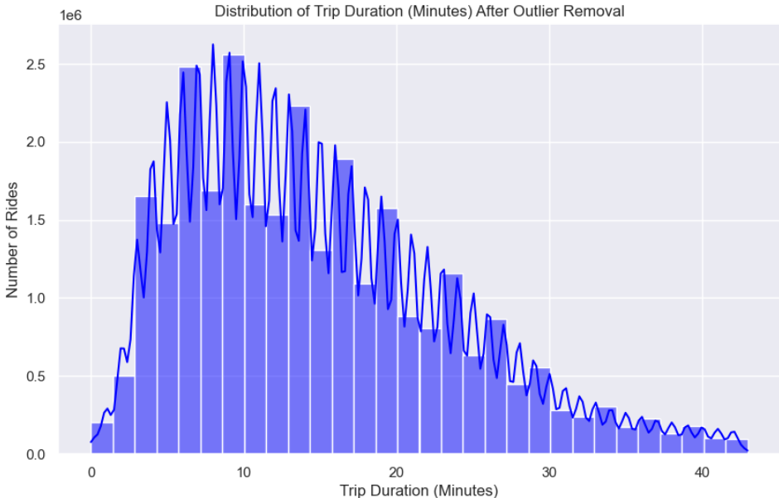
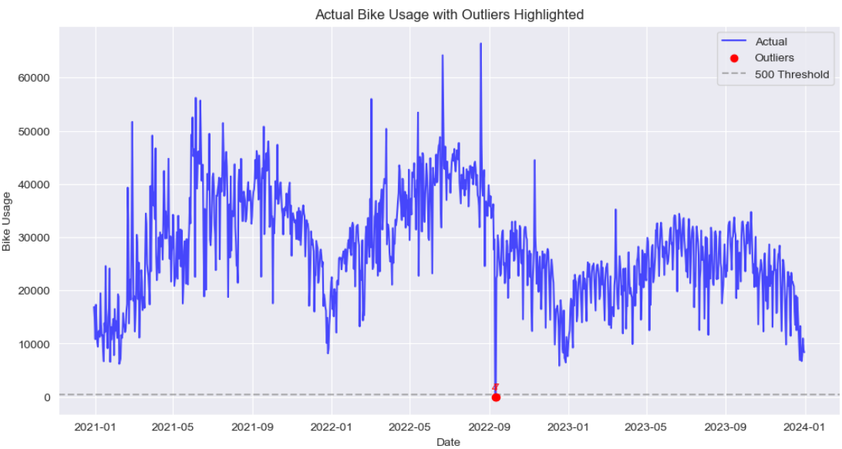
10.🚴‍♂️ Distribution of Trip Duration (Minutes) After Outlier Removal
11.🚴‍♂️ Outlier Detection in Bike Demand Data
📌 Use Case: To analyze the distribution of trip durations after filtering out extreme short and long outliers. This helps in understanding the typical trip duration patterns and improving service efficiency..
📌 Use Case: Detect anomalies in bike demand data to identify unusual usage patterns, optimize fleet management, and improve service reliability.
Observations
The majority of trips fall within the 0–40-minute range, with the peak occurring between 5-15 minutes.
The distribution shows a right-skewed pattern, indicating that shorter trips are more common than longer ones.
Removing outliers has provided a clearer view of trip duration trends, which was would have been distorted due to extreme values.
There is a gradual decline in the number of trips as duration increases, suggesting that most users prefer shorter trips.
Observations
Most data points are within expected demand levels, with a strong seasonal pattern.
Only a few outliers were detected, indicating a relatively clean dataset.
There are 2 outliers containing very low bike usage demand at the following dates –
10th Sept, 2022 (Usage Demand 4) and 11th Sept,2022 (Usage Demand: 7)
Outliers (red points) appear near the lower threshold (500 trips), suggesting occasional extreme drops in demand.
The demand exhibits cyclical trends, with peaks in warmer months and dips in colder months.

Slide 18
THANK YOU !

