Slide 1
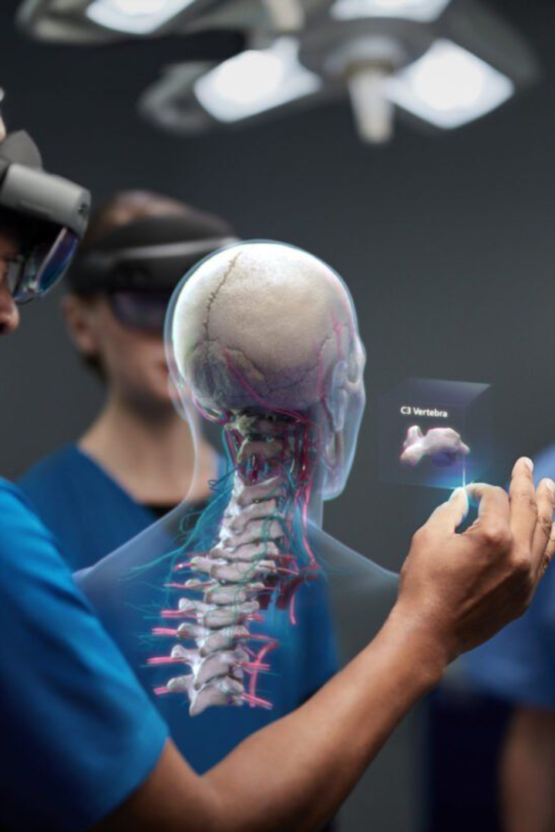
Introduction to
AI Fitness and Wellness System
We have created an AI Fitness and Wellness System that gives you real time feedback for posture correction, nutrition planning and your personal trainer at your home for maintaining health and fitness goals.

Slide 2


Level of Innovation
Revolutionizing the Fitness Industry
Unique System Capabilities
Our AI technology is reshaping the fitness industry, providing data-driven insights and customized plans to optimize workout routines and enhance overall wellness.
Explore the unique features and capabilities of our AI Fitness and Wellness System, bringing state-of-the-art solutions to the fingertips of our users.

Slide 3
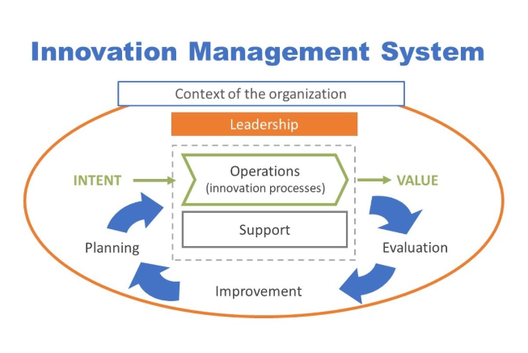
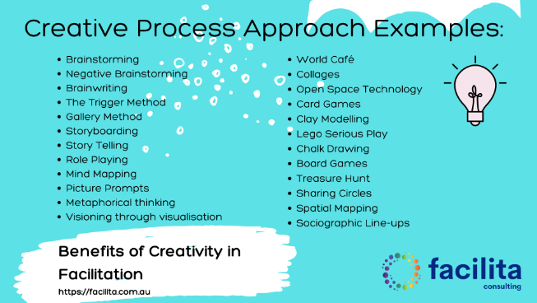
Originality
Standout System
Creative Approaches
Discover how our system distinguishes itself from existing fitness and wellness solutions, offering forward-thinking innovations and groundbreaking features.
Explore the creative and novel approaches that have been integrated into our project, setting it apart as a truly original and impactful system.

Slide 4


Realistic Capability
Practicality and Feasibility
Success Stories
We demonstrate the practicality and feasibility of our system through rigorous testing and real-world application, ensuring its effectiveness and reliability.
Explore the case studies and success stories that showcase the real-world effectiveness and capabilities of our AI Fitness and Wellness System.

Slide 5
Why Choose Our AI Powered Fitness and Wellness System?
Our AI Powered Fitness and Wellness System stands out from the rest due to its unique features and benefits which adds value:
Personalized Recommendations: Our advanced AI algorithms analyze your data and provide tailored recommendations to optimize your fitness journey.
Real-time Tracking: Stay informed about your progress with real-time tracking of key fitness metrics, including steps, calories burned, and heart rate.
Customizable Workout Plans: Our system offers personalized workout plans that are designed to suit your fitness level, goals, and preferences.
Interactive Virtual Trainers: Get guidance and motivation from our interactive virtual trainers who will lead you through engaging and effective workout sessions.
Data Visualization: Visualize your progress through intuitive charts and graphs, helping you identify trends and areas for improvement.
Community and Support: Connect with a vibrant community of fitness enthusiasts, share your achievements, and get support from like-minded individuals.
With our AI Powered Fitness and Wellness System, you can unlock your full potential and take your fitness and well-being to new heights.

