Slide 1

Investment Data Analysis Project
By:-Prakhar Raj Singh Bakshi

Slide 2
Objective:-
1.Understand and summarize key statistics in the dataset.
2.Analyze and visualize gender-based differences in investment preferences.
3.Analyze the relationship between savings objectives and Investment choices.
4.Analyze Investment durations and monitoring frequencies
5.Analyze and visualize the reasons for investment
6.Analyze the sources from which individuals gather investment information
7.Create a dashboard incorporating all insights.
8.Conclusion

Slide 3
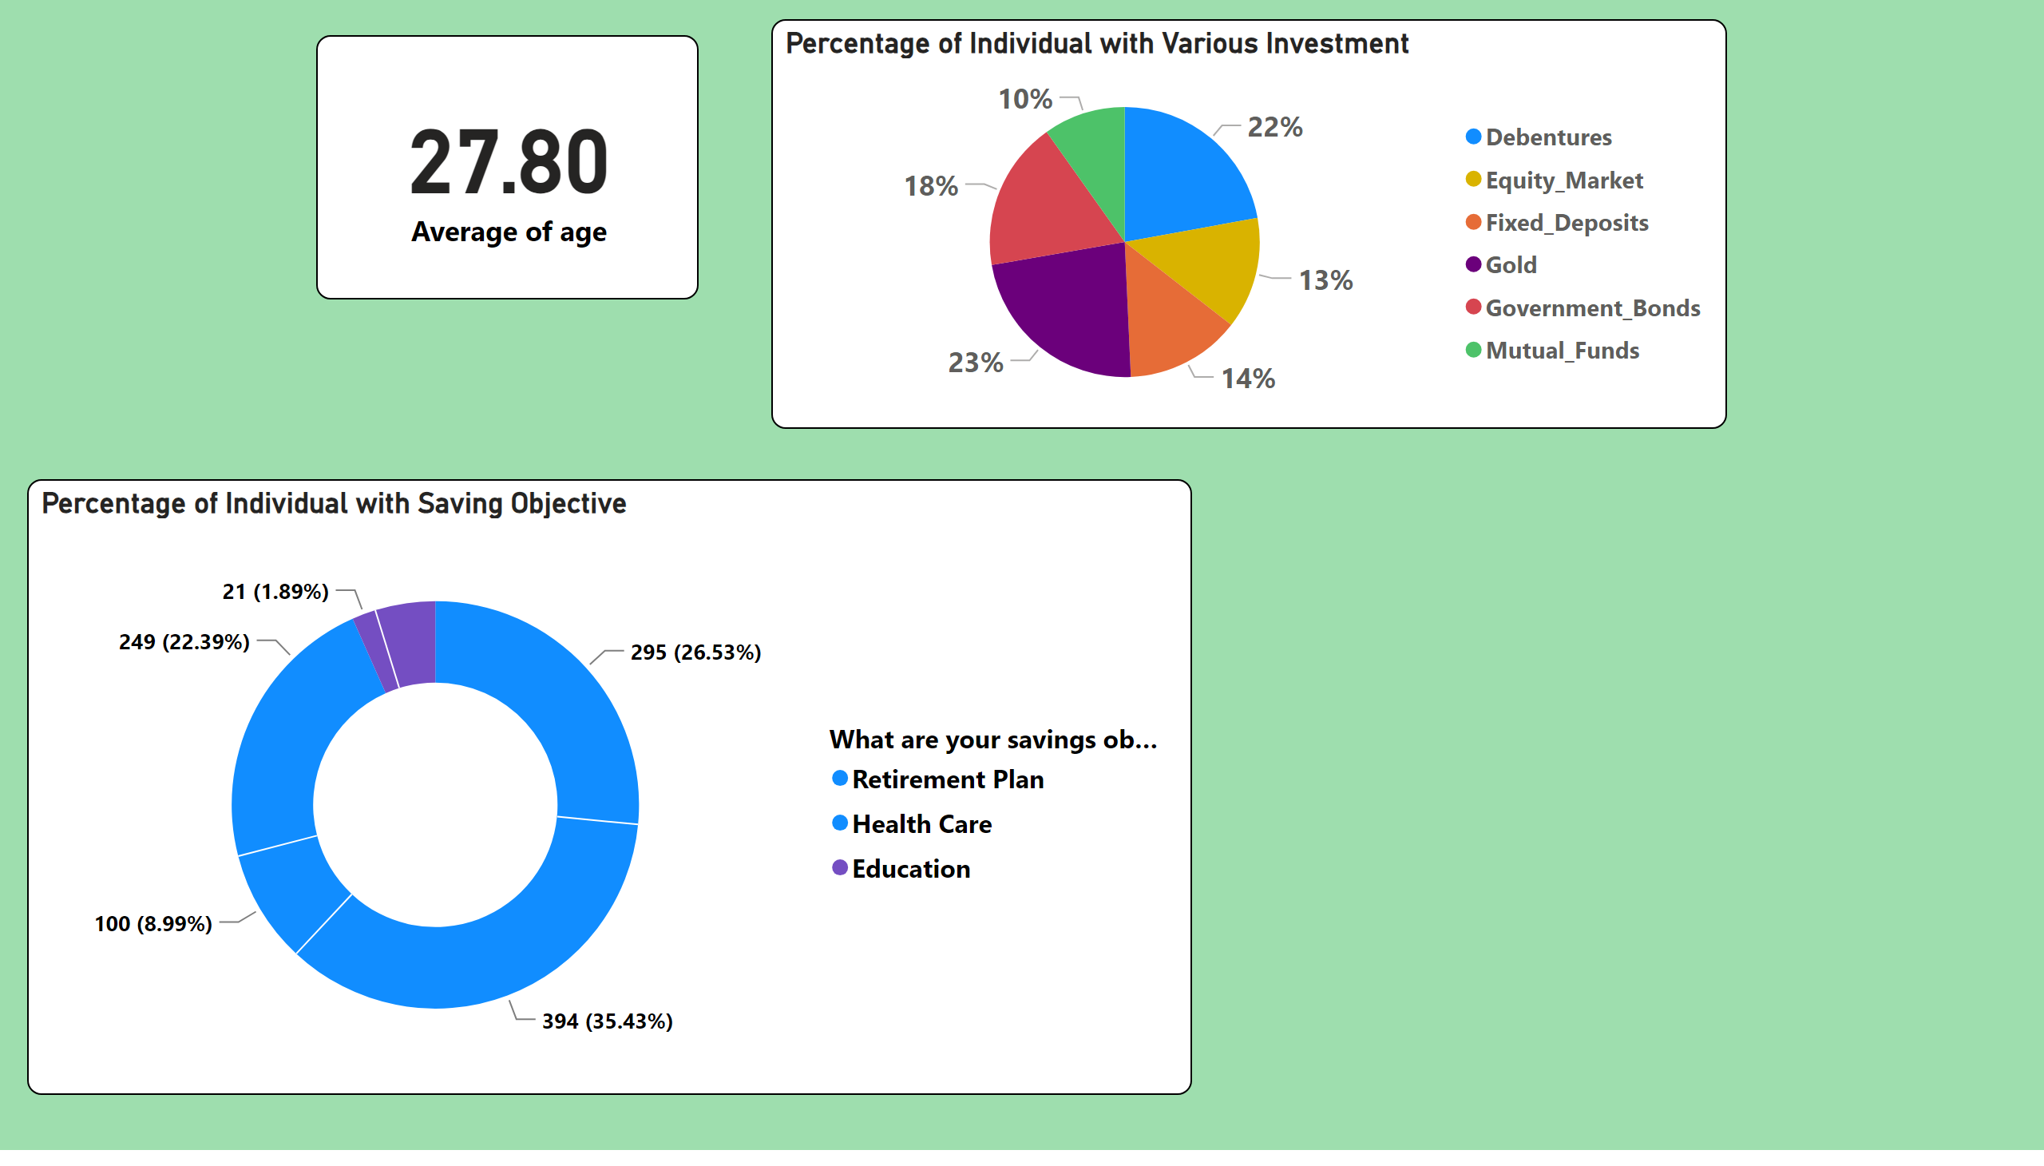
Data Exploration and Summary
In this Analysis Individuals more Invested in Gold and less Investment in the mutual Funds and Equity Market.
Individuals main purpose for saving on Retirement plan. Also, both men and women have less saving education Objectives.
Notes:
Percentage of Individual with Saving Objective
No alt text provided
card
No alt text provided
Percentage of Individual with Various Investment
No alt text provided

Slide 4
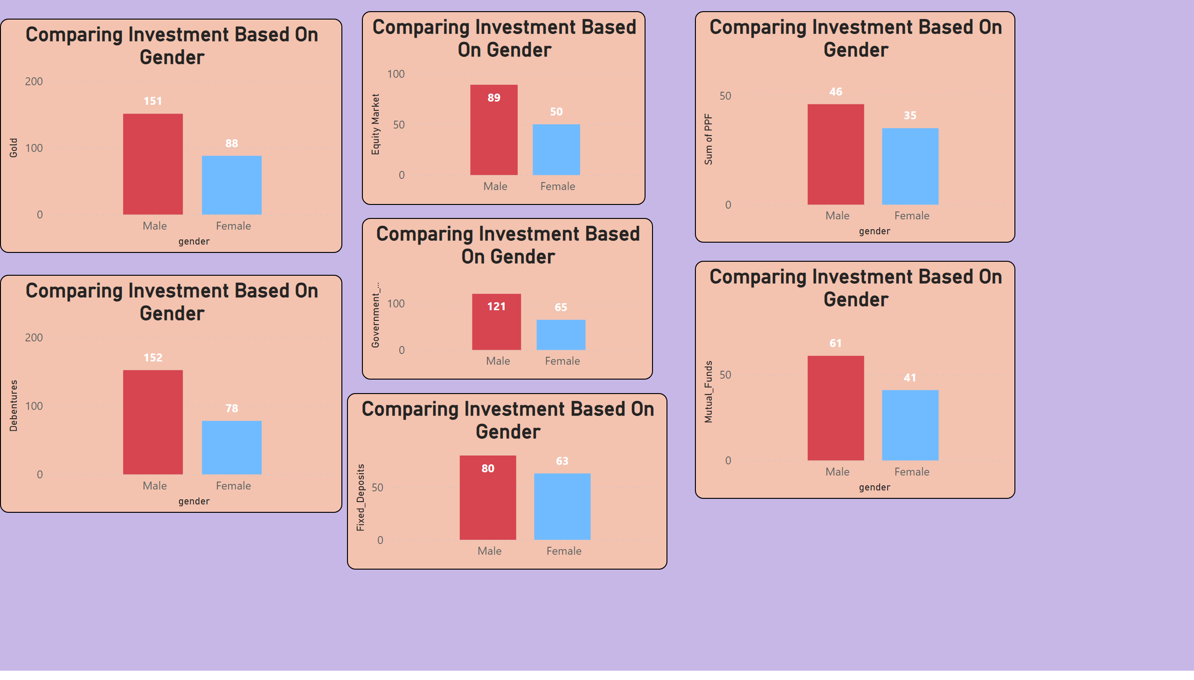
Gender Based Analysis
Gender Based Analysis
Notes:
Comparing Investment Based On Gender
No alt text provided
Comparing Investment Based On Gender
No alt text provided
Comparing Investment Based On Gender
No alt text provided
Comparing Investment Based On Gender
No alt text provided
Comparing Investment Based On Gender
No alt text provided
Comparing Investment Based On Gender
No alt text provided
Comparing Investment Based On Gender
No alt text provided

Slide 5
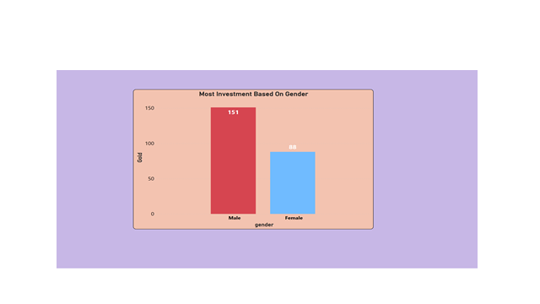
Most Investment Based On Gender
Male People are more invested in Debentures and the Gold total sum is 303.Also,Male people have less investment in PPF total sum is 46..
Female People are more interested in investing in Gold total sum is 88. And they are less invested in PPF.
Both men and females have less investment in PPF, the total sum is 81.

Slide 6
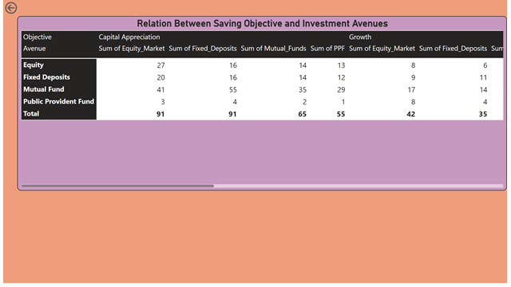
Gender Based Analysis
In Capital Appreciation saving objectives fixed deposit and Equity market Avenues are higher.
Growth saving objective equity market avenues are preferred over other avenues.
Income Saving objective fixed deposit avenues highly recommended.
Individuals preferred Equity and fixed deposit avenues in terms of saving objectives. In which the fixed deposit total sum is 143 higher than the equity market.
Notes:
Comparing Investment Based On Gender
No alt text provided
Comparing Investment Based On Gender
No alt text provided
Comparing Investment Based On Gender
No alt text provided
Comparing Investment Based On Gender
No alt text provided
Comparing Investment Based On Gender
No alt text provided
Comparing Investment Based On Gender
No alt text provided
Comparing Investment Based On Gender
No alt text provided

Slide 7
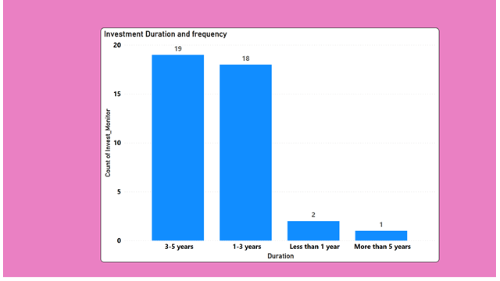
Investment Duration and Frequency
Individuals are more invested in the duration of 3-5 years which investment monitoring is higher than other duration periods.
Also , Individuals are less interested in investing in a duration of more than 5 years.

Slide 8
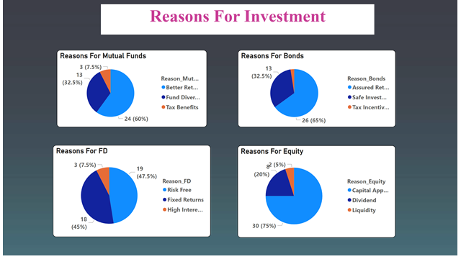

Slide 9
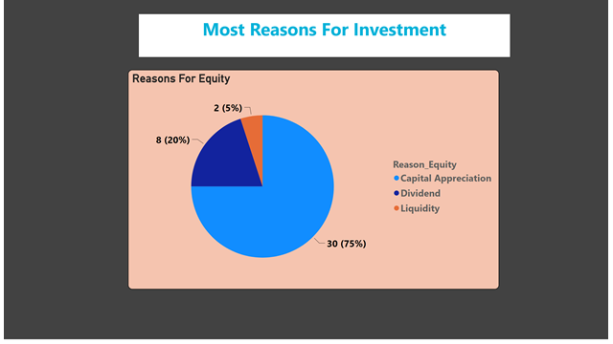
We have four Reasons for investment Mutual Funds, Bonds, Fixed Deposit, equity.
Reasons for equity investment is more in demand than other investments.
In reasons for equity investment capital appreciation is a higher percentage of 75% than the rest of the investment. Liquidity in reasons for equity investment is less in demand 5%.

Slide 10
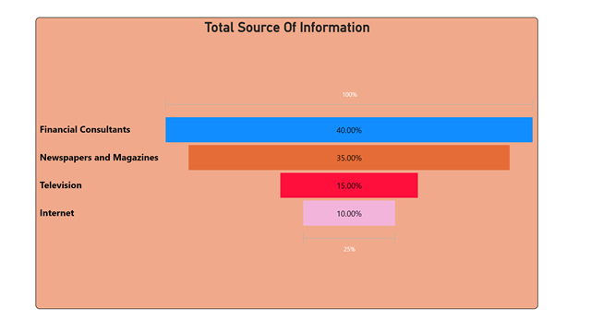
We have four sources of informations financial consultant,Newspapers and magazines,Television,Internet.
In this visualization, we analyze, the financial consultants source of information commonly relied upon by investors. Gathering information through the internet is less relied on by investors.

Slide 11
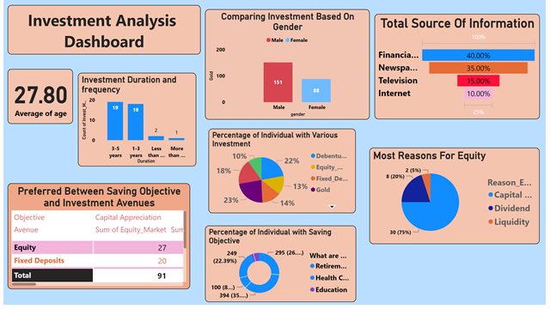

Slide 12
Conclusion:-
Investment companies need to more focus on education saving objectives so that customers are more focused on children’s education.
Also, the company should create more attractive offers in bonds, and mutual funds so that more and more people invest in mutual funds, bonds, FD, PPF.
Companies have to give a small duration of investment services ,so customers interested in investing in short term duration.
Company should give information about investment on the internet and television with the help of this person easily reach out to investment information.

Slide 13
Thank You

