Slide 1
3. REQUIRMENT ANALYSIS
Requirement Analysis is an important phase in the software development process. In this phase, the requirements of the users and the system are carefully identified and analyzed. The main objective of requirement analysis is to understand what the system should do and how it should perform its functions.
For the DarshanEase project, requirement analysis helps in identifying the needs of devotees and temple management. The system must provide an easy way for users to book darshan slots, view temple information, and manage their bookings. It also helps in improving crowd management in temples.
The requirements of the system are divided into functional requirements and non-functional requirements.
3.1 Functional Requirements
Functional requirements describe the main functions that the system must perform.
1. User Registration and Login The system must allow users to create an account by providing basic information such as name, email, and password. After registration, users should be able to log in to the system securely.

Slide 2
2. Temple Information The system should provide detailed information about temples, including temple name, location, description, and available darshan timings.
3. Darshan Slot Booking Users should be able to select a temple, choose an available date and time slot, and book their darshan online.
4. Booking Confirmation After successful booking, the system should generate a confirmation message or ticket for the user.
5. Admin Management The admin should be able to add or update temple details, manage darshan slots, and view booking records.
3.2 Non-Functional Requirements
Non-functional requirements describe the quality and performance of the system.
1. Usability The system should have a simple and user-friendly interface so that users can easily navigate and book darshan slots.
2. Performance The system should respond quickly and handle multiple users at the same time without slowing down.
3. Security User data such as login credentials and booking information must be stored securely.
4. Reliability The system should work consistently without errors or failures.
5. Scalability The system should be able to handle an increasing number of users in the future.

Slide 3
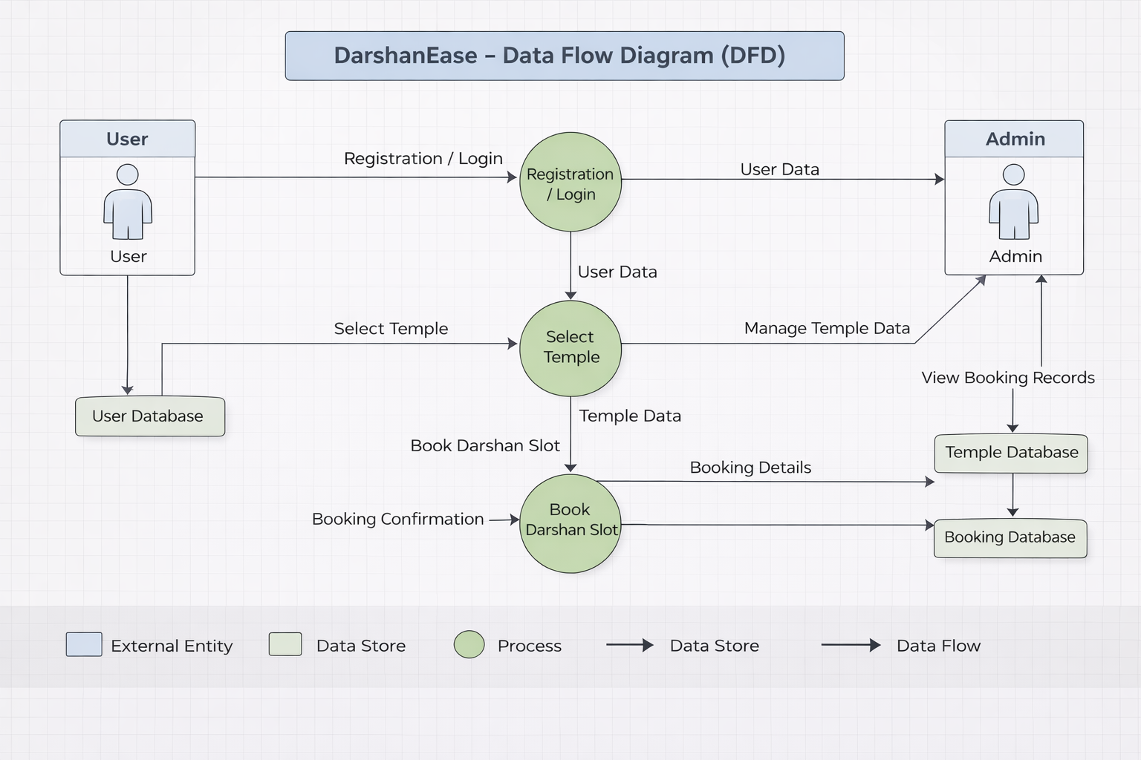
3.3 Data Flow Diagram (DFD)

Slide 4
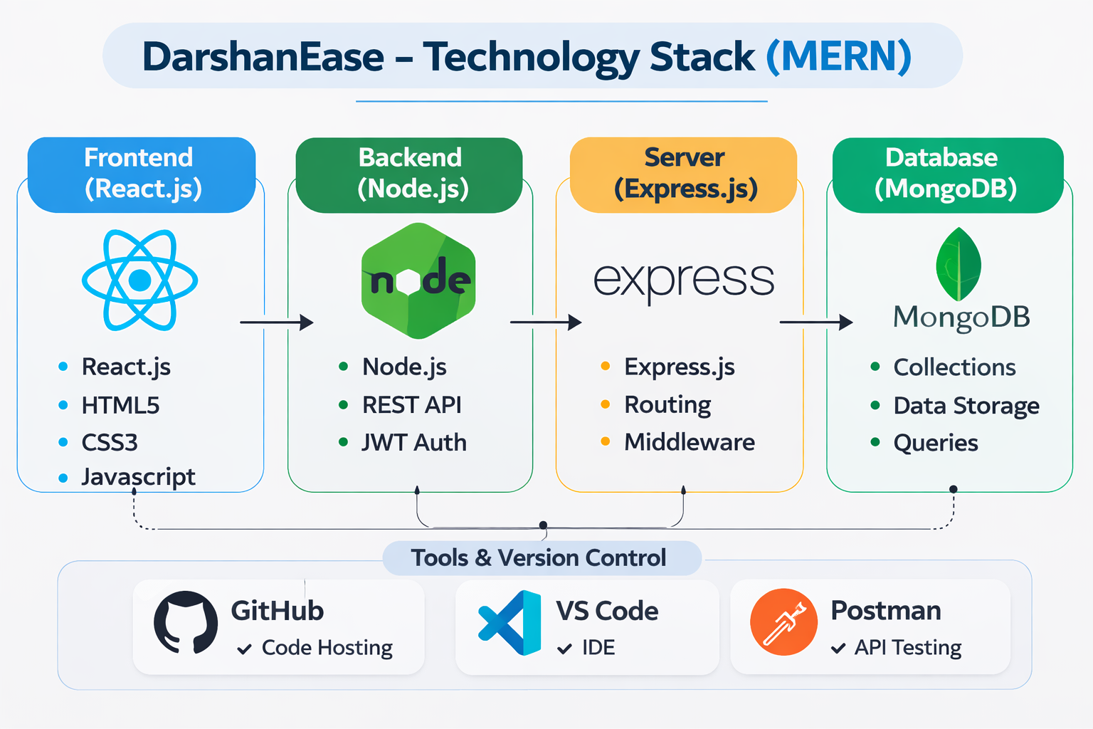
3.4 TECHNOLOGY STACK

