Slide 1
4. PROJECT DESIGN
Project design is an important phase in the development of the Darshan Ease system. In this phase, the overall structure of the system is planned and designed. The project design defines how the different components of the system interact with each other. It includes system architecture, user interface design, and database design. The main goal of this phase is to create an efficient and scalable system that provides a smooth experience for users.
The Darshan Ease system is designed using the MERN stack, which includes MongoDB, Express.js, React.js, and Node.js. This architecture helps in developing a fast, scalable, and secure web application.
4.1 Problem–Solution Fit
The Darshan Ease system is designed to solve the problem of long waiting queues and poor crowd management in temples. Many devotees face difficulty while visiting temples due to overcrowding and lack of proper scheduling.
The proposed system provides an online platform where users can book their darshan slots in advance. This helps reduce waiting time and ensures better crowd management. The system allows devotees to select temples, choose time slots, and confirm their bookings easily. This solution improves the overall temple visit experience.
4.2 Proposed Solution
The proposed solution is a web-based application that allows users to book darshan slots online. The system provides a simple and user-friendly interface where devotees can view temple information and book available slots.
The application uses React.js for the frontend to create an interactive user interface. The backend is developed using Node.js and Express.js, which handle server requests and application logic. MongoDB is used as the database to store user details, temple information, and booking records.

Slide 2
4.3 System Architecture
The DarshanEase system follows a three-tier architecture consisting of the following layers:
1. Presentation Layer (Frontend)
This layer is responsible for the user interface. It allows users to interact with the system through web pages. The frontend is developed using React.js, HTML, CSS, and JavaScript.
2. Application Layer (Backend)
This layer handles the business logic of the system. It processes user requests, manages booking operations, and communicates with the database. The backend is developed using Node.js and Express.js.
3. Data Layer (Database)
This layer stores all the data required for the system. It includes user information, temple details, and booking records. The database used in the system is MongoDB, which provides flexible and scalable data storage.
4.4 User Interface Design
The user interface of the Darshan Ease system is designed to be simple and easy to use. The application includes different pages such as the home page, temple listing page, booking page, and confirmation page. The interface allows users to easily navigate through the system and complete the booking process without difficulty.

Slide 3
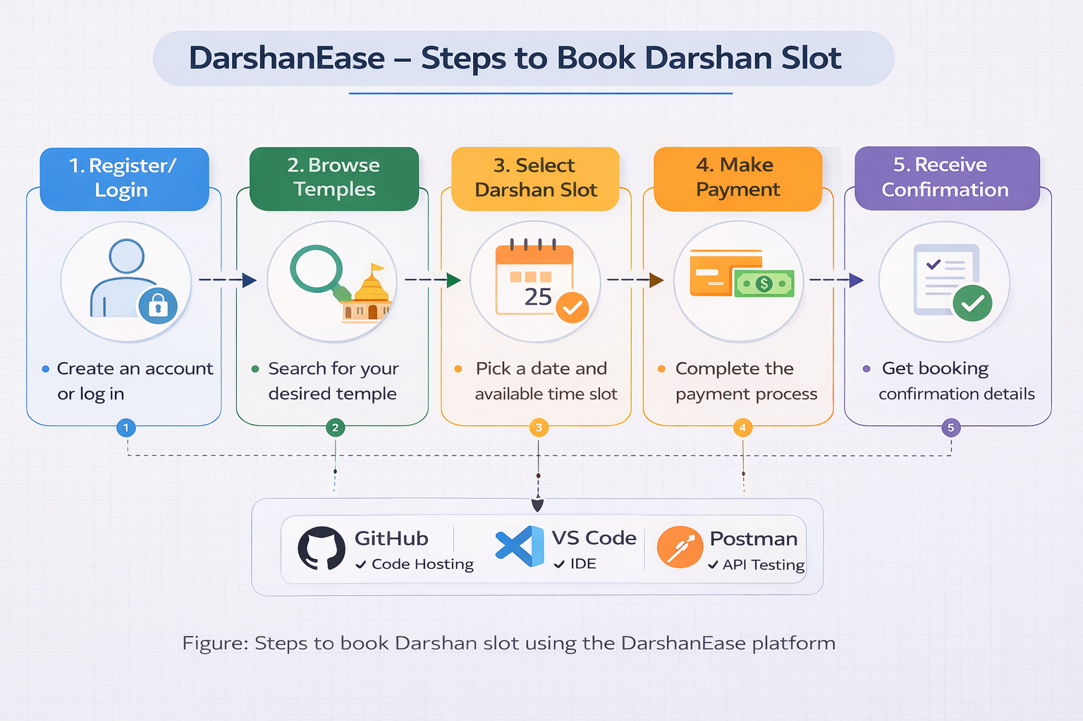
4.5 Database Design
The database is designed to store and manage all the information related to users, temples, and bookings. MongoDB is used as the database because it provides flexible data storage and high performance.
The main collections used in the database are:
Users Collection – stores user details such as name, email, and password
Temples Collection – stores information about temples and available darshan slots
Bookings Collection – stores booking details including date, time slot, and user information

