Slide 1
5. PROJECT PLANNING AND SCHEDULING
Project planning and scheduling are essential activities in software development. They help in organizing the development process, managing resources, and completing the project within the specified time. Proper planning ensures that each stage of the project is completed systematically and efficiently.
For the DarshanEase Online Temple Booking System, the project is divided into multiple phases such as requirement analysis, system design, development, testing, and deployment. Each phase has specific tasks and timelines that guide the development process.
The project schedule helps the team monitor progress and ensures that all tasks are completed according to the planned timeline.
5.1 Project Planning
Project planning involves defining the project goals, identifying required resources, and organizing tasks for development.
The main objectives of the DarshanEase project are:
To develop an online platform for temple darshan slot booking
To reduce waiting time for devotees
To manage temple crowd efficiently
To provide a simple and user-friendly interface
The project planning process includes:
Requirement Analysis
System Design
Development using MERN Stack
Testing and debugging
Deployment and maintenance
These steps help in completing the project in an organized and structured manner.

Slide 2
5.2 Project Scheduling
For the development of the DarshanEase Online Temple Booking System, the project is divided into several phases. Each phase focuses on a specific activity required to build the system. Proper scheduling helps the development team organize tasks and complete the project within the planned timeline.
The scheduling process allows the team to monitor progress, manage development activities, and ensure that every stage of the project is completed efficiently. Each phase of the project is completed in sequence so that the system can be developed in a structured and systematic manner.
Project Scheduling Phases
1. Requirement Analysis
In this phase, the requirements of the system are collected and analyzed. The objective is to understand the needs of users and identify the features required for the DarshanEase system.
2. System Design
During this phase, the structure of the system is designed. It includes system architecture design, database design, and user interface design.
3. Frontend Development
The frontend of the system is developed using React.js, HTML, CSS, and JavaScript. This phase focuses on creating user interfaces such as login pages, temple listing pages, booking pages, and confirmation pages.

Slide 3
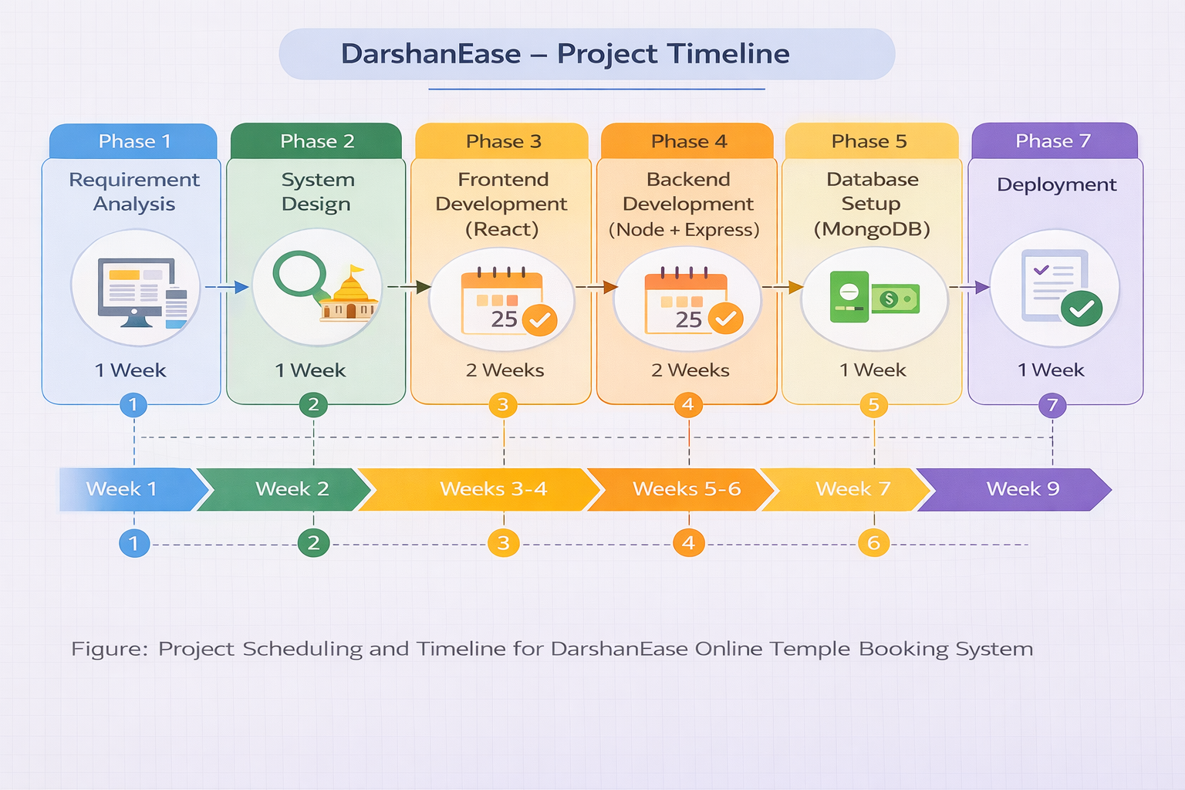
4. Backend Development
In this phase, server-side logic and APIs are developed using Node.js and Express.js. The backend handles user requests, authentication, and communication with the database.
5. Database Development
The database is created using MongoDB to store user details, temple information, and booking records.
6. Testing and Debugging
Testing is performed to identify errors and ensure that all features of the system work properly.
7. Deployment
In the final phase, the system is deployed on a server so that users can access the application online.

