Slide 1
PREDICTIVE ANALYTICS COURSE PROJECT
Complete 12-slide final review
GraphPulse
Graph-based predictive and prescriptive analytics for cross-border power grids
Team
Prakki Krishna Karthik · 23BCE1294
Vasudev · 23BCE1496
Shubham Bhuyan · 23BCE1809
Data → Cleaning → Features → Forecasting → Evaluation → Graph reasoning → Scenario simulation → Recommendation
Faculty: Pattabiraman V
Course: Predictive Analytics
Research model surfaced: Fusion GRU
Graph model benchmarked: DCRNN
Operational replay baseline: Persistence
Final review deck | October 2026
Notes:
Introduce the project as one auditable pipeline. Make the model distinction explicit: Fusion GRU is the research winner on the saved holdout, DCRNN is the graph benchmark, and Persistence remains the lightweight operational replay baseline.

Slide 2
1. PROBLEM
Problem definition and project objectives
Cross-border flow is a network problem, not a single-line problem. A local change can affect neighbouring countries and the routes available for recovery.
PREDICTIVE QUESTION
PRESCRIPTIVE QUESTION
What is likely to happen in the next hour?
What can we test when a link becomes stressed?
Use recent load and net-flow history, global network context, and graph centrality to forecast next-hour net flow.
Reduce a selected transfer, search connected alternate paths, check headroom and loss, and report the trade-off for human review.
PROJECT OBJECTIVES
01 Build a canonical 12-node / 24-link graph from two supplied CSVs.
02 Compare transparent baselines, Fusion GRU, and DCRNN using chronological evaluation.
03 Add explainable graph-stress screening and recommendation-only rerouting.
GRIDPULSE / PREDICTIVE ANALYTICS
02
Notes:
Prediction estimates the next-hour condition. Prescription tests an action. The project never claims automatic switching or dispatch control.

Slide 3
2. DATA
Data, cleaning, features, and graph construction
315,598
1,262,592
12
24
11
dynamic country records
directional flow records
country nodes
canonical links
selected features
Source | One row represents | Important variables | System role
dynamic_with_flows.csv | One country at one hour | Load, net flow, imbalance, residual, weather, renewables | Node signals + forecast features
power_flow.csv | One directional interconnector | Datetime, source, target, power_flow_mw | Edge direction + rerouting
Processed manifest | Canonical graph definition | Nodes, edges, aliases, quality flags | Data contract + API metadata
Results folder | One evaluation artifact | Metrics, curves, matrices, graphs | Evidence for decisions
PROCESSING CONTRACT
Parse UTC → validate missing/duplicate/gap records → canonicalize aliases → align hourly histories → select 11 explainable features → chronological split → training-only scaling.
11 features = local flow, load, imbalance, residual + global flow/load/imbalance/residual + degree, closeness, betweenness centrality.
GRIDPULSE / PREDICTIVE ANALYTICS
03
Notes:
Explain that the raw data is larger than the model tensor. The deliberate 11-feature contract keeps the experiment auditable and prevents irrelevant columns from becoming hidden model inputs.

Slide 4
3. FORECASTING
Forecasting models and experimental design
OPERATIONAL BASELINE
RESEARCH MODEL
GRAPH RESEARCH MODEL
Persistence
ŷₜ₊₁ = yₜ
Fusion GRU
local + global + centrality → GRU → flow
DCRNN
forward/reverse diffusion → recurrent update
Fast and transparent. Kept for replay and comparison.
24-hour lookback; hidden size 32; research winner by RMSE.
12 nodes jointly; 2 diffusion steps; hidden size 24.
Lookback: 24 hours
Chronological holdout: final 168 hours
Scaling: x′ = (x − μtrain) / σtrain
No random shuffle crosses the time boundary. Model selection uses pooled RMSE; classification uses Normal / Warning / Critical labels.
GRIDPULSE / PREDICTIVE ANALYTICS
04
Notes:
Persistence is not persistent storage. It is a valid forecasting baseline. Fusion GRU and DCRNN are the advanced research experiments trained with the same leakage-safe target and holdout.

Slide 5
4. GRAPH MODEL
DCRNN: diffusion before recurrence
DCRNN preserves the country axis. At every hour, neighbouring information is diffused through the graph before a GRU-style update produces the next flow.
TENSOR AND DIFFUSION
SIMPLE A → B → C EXAMPLE
X ∈ Rᴮ×²⁴×¹²×¹¹
Xₜ ∈ Rᴮ×¹²×¹¹
Hₜ₋₁ ∈ Rᴮ×¹²×²⁴
Supports: Xₜ, A_fXₜ, A_f²Xₜ, A_rXₜ, A_r²Xₜ
A: high flow → B: neighbour → C: two-hop
zₜ, rₜ = σ(Θg *D [Xₜ, Hₜ₋₁])
Ĉₜ = tanh(Θc *D [Xₜ, rₜ ⊙ Hₜ₋₁])
Hₜ = zₜ ⊙ Hₜ₋₁ + (1 − zₜ) ⊙ Ĉₜ
A_f and A_r are row-normalized forward/reverse transitions. Two steps expose one-hop and two-hop context.
The gates decide how much old memory and new graph-informed information to keep.
Fusion GRU: 570.5 MW RMSE · DCRNN: 634.0 MW RMSE · DCRNN is slower because graph diffusion adds computation.
GRIDPULSE / PREDICTIVE ANALYTICS
05
Notes:
Use the A–B–C example for a non-specialist audience. DCRNN is valuable because it tests the graph hypothesis, but topology alone does not guarantee improvement when the graph lacks complete electrical information.

Slide 6

5. RESULTS
Model comparison: evidence before complexity
SAVED HOLDOUT RESULTS
Fusion GRU
RMSE 570.5 MW · MAE 400.3 MW
F1 85.6% · 34.7 ms
Persistence
RMSE 580.3 MW · MAE 375.8 MW
F1 81.2% · 0.45 ms
DCRNN
RMSE 634.0 MW · MAE 436.2 MW
F1 83.8% · 63.6 ms
MAE = (1/n) Σ|y − ŷ|
RMSE = √[(1/n) Σ(y − ŷ)²]
GRIDPULSE / PREDICTIVE ANALYTICS
06
Notes:
Fusion GRU is the research winner by RMSE, while Persistence has lower MAE and much lower inference time. This is why the interface distinguishes research model from operational baseline rather than hiding the baseline.

Slide 7


6. EVALUATION
Training behaviour and generalization
FUSION GRU TRAINING EVIDENCE
DCRNN TRAINING EVIDENCE
Training loss and macro-F1 are tracked across epochs. The validation curves show whether the model continues to generalize.
DCRNN uses the same target and chronological protocol but keeps the node axis and applies diffusion at each recurrent update.
GRIDPULSE / PREDICTIVE ANALYTICS
07
Notes:
Do not claim that a falling training curve alone proves production readiness. The important evidence is the shared chronological holdout and the comparison of validation/test metrics.

Slide 8

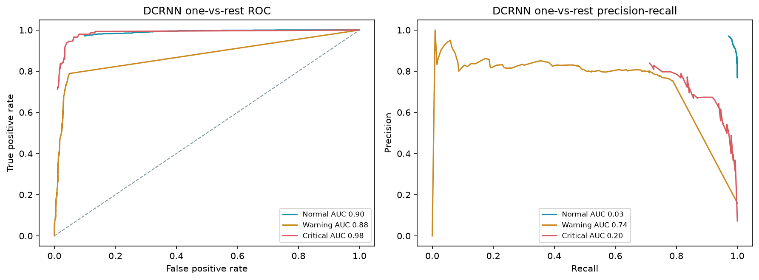

7. EVALUATION
Classification, thresholding, and error analysis
FUSION GRU CONFUSION MATRIX
FUSION GRU ROC AND PRECISION–RECALL
Actual \ Pred. | Normal | Warning | Critical
Normal | 1490 | 58 | 0
Warning | 37 | 260 | 25
Critical | 0 | 27 | 119
Rows = actual class; columns = predicted class. Off-diagonal cells show misses and false alarms.
Fusion GRU
DCRNN
QUALITATIVE ERROR DISTRIBUTION
Thresholds are not random: Warning and Critical are absolute net-flow magnitudes at the 75th and 90th training quantiles. Critical events are rarer, so F1, recall, ROC-AUC, and Precision–Recall complement accuracy.
GRIDPULSE / PREDICTIVE ANALYTICS
08
Notes:
Explain why accuracy alone is insufficient. A model can look accurate by predicting Normal frequently, while missing Warning or Critical cases. The saved confusion matrix exposes those errors.

Slide 9


8. EXPLAINABILITY
Feature interpretation and representation
PERMUTATION / ABLATION IMPORTANCE
T-SNE HIDDEN-STATE PROJECTION
The feature catalogue combines local time series, global network context, and static graph centrality.
Similar learned states should appear closer in the projected representation; overlap highlights difficult cases.
Interpretation principle: a model result is stronger when the audience can see which inputs, classes, and network structures shaped it.
GRIDPULSE / PREDICTIVE ANALYTICS
09
Notes:
Feature importance is evidence of sensitivity, not proof of causality. t-SNE is a visual diagnostic, not a performance metric.

Slide 10
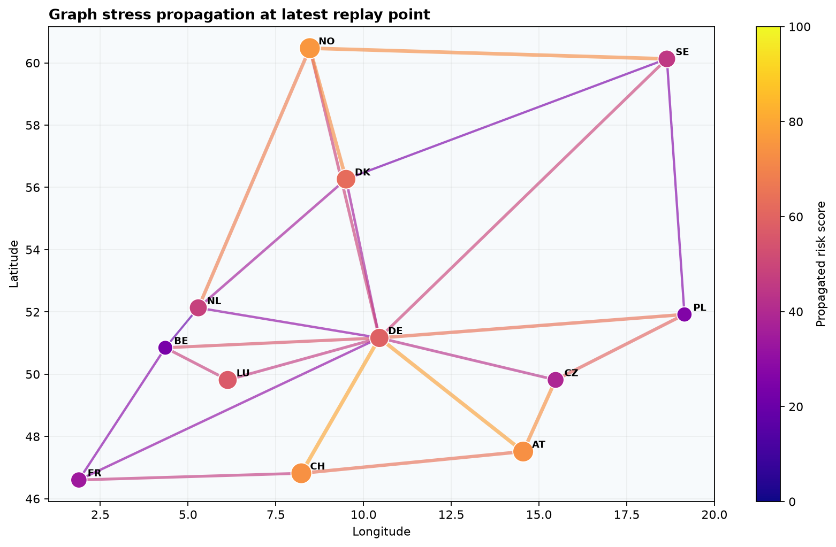
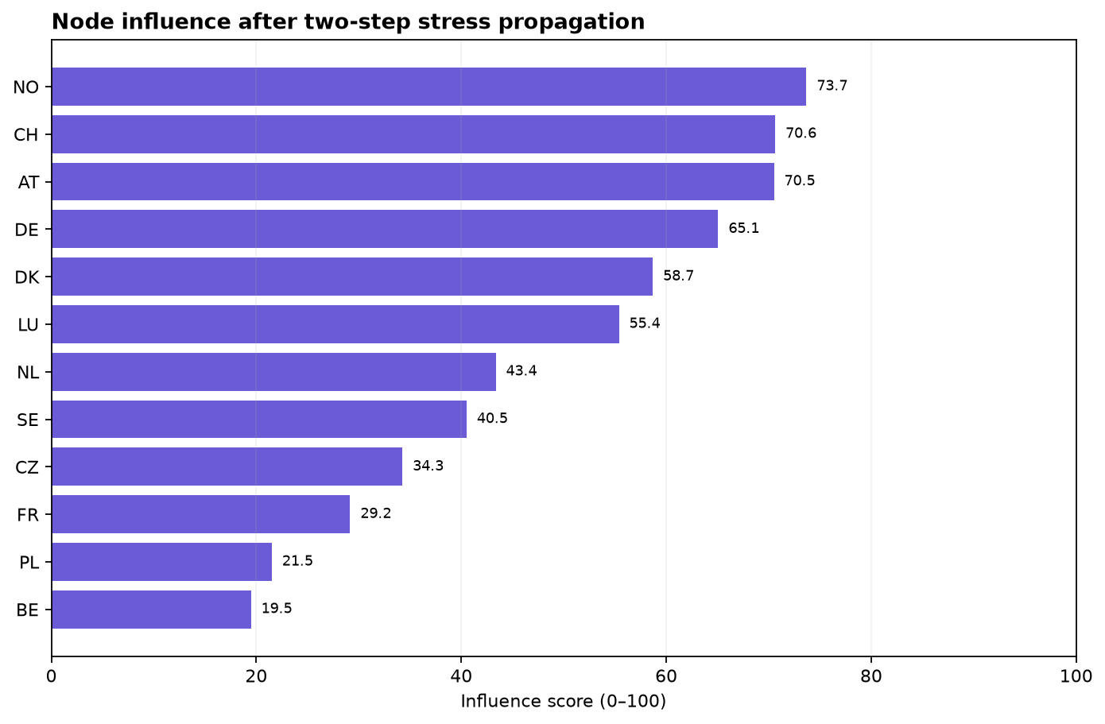
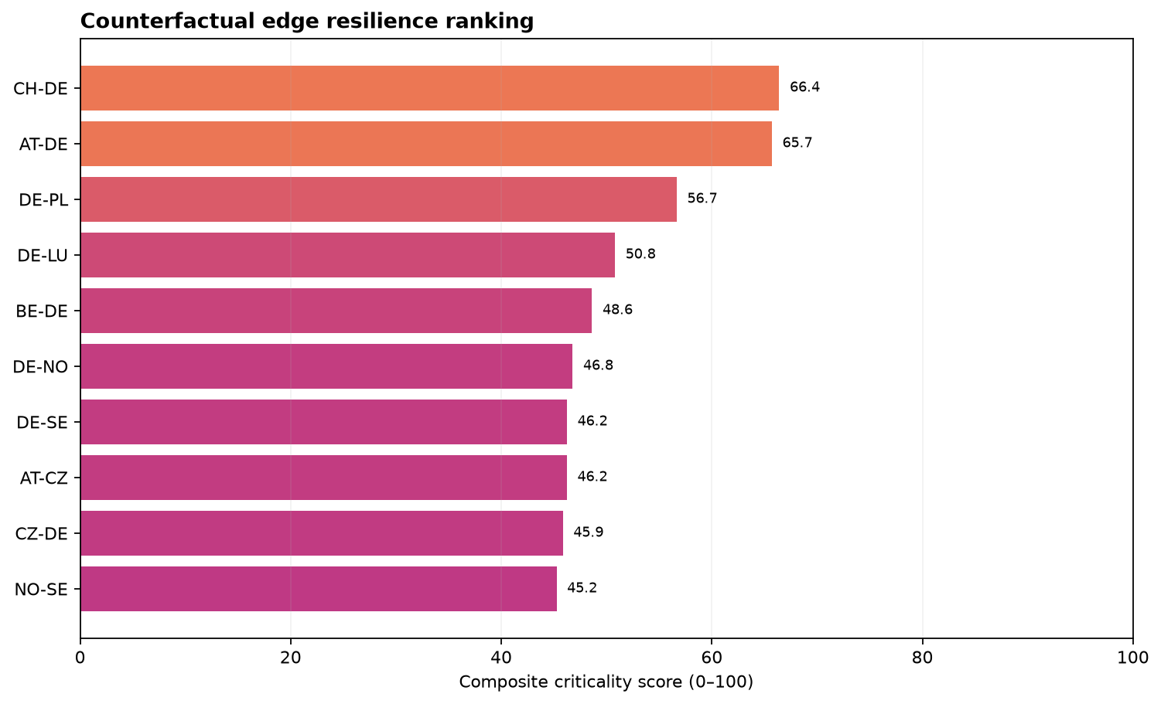
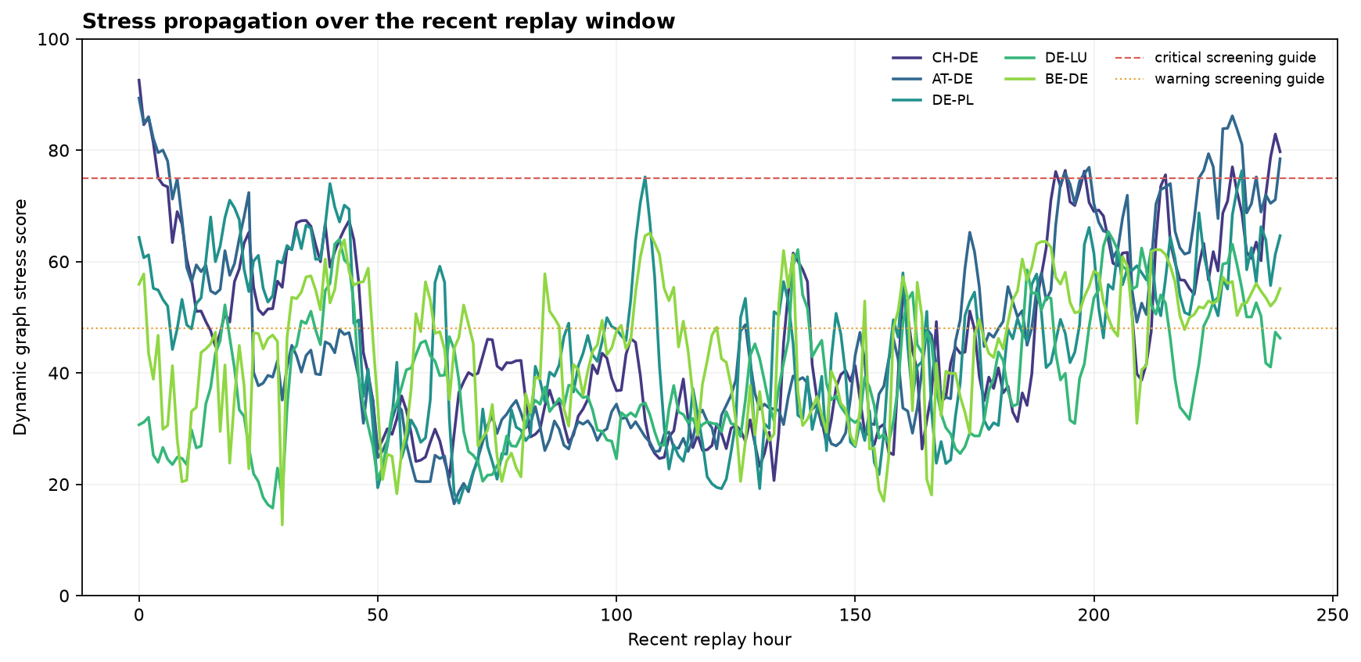
9. GRAPH INTELLIGENCE
Graph reasoning: stress propagation and resilience
NODE STRESS AFTER TWO-STEP PROPAGATION
NODE INFLUENCE RANKING
COUNTERFACTUAL EDGE-REMOVAL RANKING
STRESS OVER RECENT REPLAY HOURS
Dynamic stress = 0.45 utilization + 0.25 endpoint risk + 0.20 propagated risk + 0.10 loss proxy. Criticality also includes betweenness and the topology impact of removing an edge.
GRIDPULSE / PREDICTIVE ANALYTICS
10
Notes:
These are transparent graph-screening artifacts. They explain influence and resilience, but they are not N-1 certification or AC power-flow validation.

Slide 11
10. PRESCRIPTION
Physics lens, scenario simulation, and rerouting
DISTANCE-BASED LOSS PROXY
WHAT-IF REROUTING ALGORITHM
R = ρL/A
S = |P|/pf
I = S/(√3V)
P_loss = 3I²R
1 Select a stressed edge
2 Move a chosen share of transfer
3 Remove the edge temporarily
4 Search connected alternate paths
5 Reject insufficient headroom / critical links
6 Score distance, utilization, loss, and risk
7 Report route, bottlenecks, and loss delta
Haversine centroid distance
ρ = 1.68 × 10⁻⁸ Ωm
A = 2,000 mm²
V = 400 kV · pf = 0.95
Recommendation only: the planner does not switch equipment or dispatch generation.
Proxy only: replace assumptions with surveyed line geometry and engineering ratings before operational use.
Example: CH–DE → CH–AT–DE; 25% moved; best-effort review because proxy loss increases.
GRIDPULSE / PREDICTIVE ANALYTICS
11
Notes:
The prescription layer is a constrained what-if search. A route can relieve a stressed link while increasing estimated loss, so the UI exposes the trade-off rather than hiding it.

Slide 12
11. INTEGRATION
Interface, findings, limitations, and conclusion
HOW THE BROWSER RECEIVES THE EVIDENCE
WHAT THE PROJECT CONTRIBUTES
Processed CSV artifacts
↓
Python pipeline + graph analysis
↓
server.py REST + SSE replay
↓
HTML + SVG + JavaScript
↓
topology + forecast + graph + reroute
01 Auditable predictive + prescriptive workflow
02 Fusion GRU and DCRNN compared on the same holdout
03 Explicit DCRNN diffusion and graph-risk evidence
04 Explainable feature, error, and resilience views
05 Rerouting with visible headroom and loss guardrails
Fusion GRU is the research model; Persistence is the operational baseline. Moving particles show historical replay, not live SCADA telemetry.
Next: connect verified telemetry, thermal ratings, AC power flow, and N-1 validation.
Final takeaway: Fusion GRU is the research winner; Persistence remains a transparent baseline; DCRNN tests the graph hypothesis; the system recommends evidence for human review, not automatic operation.
GRIDPULSE / PREDICTIVE ANALYTICS
12
Notes:
Close by stating the honest model hierarchy and the system limitation. Complexity is demonstrated through the trained Fusion GRU, DCRNN diffusion, evaluation evidence, and graph-prescriptive layer—not by hiding the baseline.

