Slide 1
PREDICTIVE ANALYTICS COURSE PROJECT
A complete, auditable workflow from raw hourly records to an explainable rerouting scenario
GraphPulse
Graph-based predictive and prescriptive analytics for cross-border power grids
Team
Prakki Krishna Karthik · 23BCE1294
Vasudev · 23BCE1496
Shubham Bhuyan · 23BCE1809
Data → Cleaning → Features → Forecasting → Evaluation → Graph reasoning → Scenario simulation → Recommendation
Faculty: Pattabiraman V
Course: Predictive Analytics
Final review deck | October 2026
01
Notes:
Opening: introduce the operational question. The project predicts the next-hour state of a cross-border network, explains which nodes and edges are under pressure, and tests a possible alternate route. Team members: Prakki Krishna Karthik, Vasudev, and Shubham Bhuyan. Faculty: Pattabiraman V.

Slide 2
1. CONTEXT
Problem definition and project objectives
Cross-border flow is a network problem, not a single-line problem. A local change can affect neighbouring countries and the routes available for recovery.
PREDICTIVE QUESTION
PRESCRIPTIVE QUESTION
What is likely to happen in the next hour?
What can we test when a link becomes stressed?
Forecast country net flow and load from recent time-series behaviour, global network context, and graph centrality.
Remove a selected share of transfer, search connected alternate paths, check headroom and stress, and report the loss trade-off.
Course alignment
Data preprocessing · time-series forecasting · regression metrics · classification metrics · class imbalance · model comparison · decision support
GRIDPULSE / PREDICTIVE ANALYTICS
02
Notes:
Explain the distinction: predictive analytics estimates the future; prescriptive analytics evaluates an action. The project deliberately stops at recommendation because it lacks engineering-grade operating constraints.

Slide 3
2. DATA
Dataset profile and signals
315,598
1,262,592
12
24
960
dynamic country records
directional flow records
country nodes
canonical interconnectors
recent points retained for replay
Source | One row represents | Important variables | Role in the system
dynamic_with_flows.csv | One country at one hour | Load, net_flow, imbalance, residual, weather, renewables, coordinates, centrality | Node signals and forecasting features
power_flow.csv | One directional interconnector record | datetime, source, target, power_flow_mw | Edge history, direction, utilization, rerouting
Processed manifest | One canonical graph definition | Nodes, edges, aliases, quality flags, assumptions | Data contract and API metadata
Research results | One evaluation artifact | Metrics, curves, confusion matrix, graphs | Evidence for model and graph decisions
The raw files contain more variables than the current experiment uses. The model keeps a deliberate 11-feature set so each prediction remains explainable.
GRIDPULSE / PREDICTIVE ANALYTICS
03
Notes:
Source: docs/VALIDATION_REPORT.md, data/processed/manifest.json, and the two supplied CSV headers. Emphasize that the project preserves the broader dataset but selects an explainable feature set for the benchmark.

Slide 4
3. PIPELINE
End-to-end predictive and prescriptive workflow
Every downstream decision is traceable to a specific transformation of the original records.
01
02
03
04
05
06
07
08
Data
→
Cleaning
→
Features
→
Forecasting
→
Evaluation
→
Graph reasoning
→
Scenario
→
Recommendation
Two CSV sources
UTC, aliases, gaps
11 model inputs
Next-hour flow
Error + classes
Stress + criticality
Move selected MW
Route with guardrails
Decision boundary
The model predicts. The graph layer explains. The scenario planner tests. The interface recommends. The system never dispatches the real grid automatically.
GRIDPULSE / PREDICTIVE ANALYTICS
04
Notes:
Walk through the workflow slowly. This slide is the presentation backbone. Each later slide expands one block, so the audience can always locate the current method in the full pipeline.

Slide 5
4. CLEANING
Data cleaning and canonicalization
WHAT THE PIPELINE CHECKS
01 Convert timestamps into ordered UTC time points.
QUALITY RESULTS
02 Parse numeric values and count missing cells before safe defaults.
0
0
03 Check duplicate country–timestamp and edge–timestamp keys.
dynamic missing cells
power-flow missing cells
04 Normalize aliases such as DE-AT → AT-DE and NL_NO → NL-NO.
0
38
05 Retain timestamp gaps as quality evidence instead of hiding them.
duplicate composite keys
country timestamp-gap hours
Why canonicalization matters
Without it, the same physical interconnector could appear as multiple graph edges. The model would then learn a false topology and the rerouting planner could send flow through a duplicate line.
GRIDPULSE / PREDICTIVE ANALYTICS
05
Notes:
Source: docs/VALIDATION_REPORT.md and data/processed/manifest.json. Explain that cleaning is part of the scientific contribution because labels and gaps affect graph structure and downstream decisions.

Slide 6
5. GRAPH FOUNDATION
Graph construction and distance-based loss proxy
The graph uses countries as nodes and canonical interconnectors as edges. Coordinates add a transparent distance and loss lens.
ELECTRICAL PROXY
VISIBLE ASSUMPTIONS
R = ρL / A
Voltage
400 kV
Power factor
0.95
S = |P| / PF
I = S / (√3 V)
P_loss = 3I²R
Resistivity
1.68 × 10⁻⁸ Ω·m
Cross-section
2,000 mm²
Distance
Haversine centroid distance
Capacity
95th percentile observed flow
L comes from Haversine centroid distance. ρ and A stay constant in the scenario model.
Interpretation: this is a scenario proxy for comparing alternatives, not an engineering-grade line study.
GRIDPULSE / PREDICTIVE ANALYTICS
06
Notes:
Source: backend/physics.py and data/processed/manifest.json. Make the limitation explicit: the data lacks surveyed route geometry, conductor parameters, actual voltage, and thermal ratings.

Slide 7
6. FEATURES
Feature extraction for next-hour prediction
The model receives a compact, explainable representation of each country and its network context.
LOCAL TIME SERIES
GLOBAL NETWORK CONTEXT
STATIC GRAPH CONTEXT
1 Local net flow
2 Local load
3 Flow imbalance
4 Load residual
5 Mean net flow
6 Mean load
7 Mean absolute imbalance
8 Mean absolute residual
9 Degree centrality
10 Closeness centrality
11 Betweenness centrality
Target: next-hour country net flow
X_t = [local signals, global signals, graph signals] over the previous 24 hours
GRIDPULSE / PREDICTIVE ANALYTICS
07
Notes:
Source: results/feature_catalog.json and backend/experiments.py. Explain that the raw dataset includes weather, renewables, and calendar features, while the benchmark keeps these 11 inputs for a controlled and interpretable comparison.

Slide 8
7. TIME SERIES SETUP
Target construction and chronological validation
ONE TRAINING EXAMPLE
24-hour lookback
t−23
t−19
t−15
t−11
t−7
t−3
t
→
target t+1
No random shuffle
Training
Earlier observations
The split preserves time order so the model never sees future behaviour while learning the past.
Validation
Next 168 hours
Test
Final 168 hours
Scaling uses training statistics only: x′ = (x − μ_train) / σ_train
GRIDPULSE / PREDICTIVE ANALYTICS
08
Notes:
Source: results/run_metadata.json and backend/experiments.py. Mention the 24-hour lookback, 168-hour validation and test horizons, and training-only standardization as the leakage controls.

Slide 9
8. FORECASTING
Forecasting models and their roles
Persistence
ŷₜ₊₁ = yₜ
Transparent baseline. The next hour equals the current hour.
24h moving average
ŷₜ₊₁ = mean(yₜ₋₂₃…yₜ)
Smooths noise but reacts slowly to sudden changes.
Linear trend
y = β₀ + β₁t
Projects a recent slope inside a bounded window.
Seasonal naive
ŷₜ₊₁ = yₜ₋₂₃
Reuses the same hour from the previous day.
The selected live forecast model is Persistence because it has the lowest pooled RMSE among the classical models. The research layer separately benchmarks Fusion GRU and DCRNN.
GRIDPULSE / PREDICTIVE ANALYTICS
09
Notes:
Source: data/processed/model_metrics.json and results/model_comparison.json. Clarify that persistence is a forecasting method, not persistent storage. Keeping it as the operational baseline prevents the project from assuming that a complex model must be better.

Slide 10
9. RESEARCH MODELS
Fusion GRU and DCRNN architecture
FUSION GRU
DCRNN
Country sequence
All 12 countries together
local + global + centrality
↓
24-hour GRU
↓
LayerNorm + linear head
↓
next-hour net flow
node features at t
↓
forward + reverse graph diffusion
↓
recurrent graph update
↓
next-hour flow for every node
Hidden size: 32
2 diffusion steps · hidden size: 24
DCRNN tests whether neighbouring-country information improves forecasting. It does not solve AC power-flow equations.
GRIDPULSE / PREDICTIVE ANALYTICS
10
Notes:
Source: results/run_metadata.json and backend/experiments.py. Explain the difference in simple terms: Fusion GRU processes a country sequence with global context; DCRNN exchanges information through the graph at every recurrent step.

Slide 11
10. DCRNN METHOD
DCRNN internals: diffusion before recurrence
DCRNN keeps the node axis intact. At every hour, it diffuses information through the 12-country graph before applying a GRU-style update.
INPUT AND HIDDEN STATE
TWO-WAY DIFFUSION
RECURRENT GRAPH UPDATE
X ∈ Rᴮ×²⁴×¹²×¹¹
At one hour:
Xₜ ∈ Rᴮ×¹²×¹¹
Hₜ₋₁ ∈ Rᴮ×¹²×²⁴
Joined channels = 11 + 24 = 35
A_f and A_r are row-normalized transitions with self-loops.
zₜ, rₜ = σ(Θg *D [Xₜ, Hₜ₋₁])
Ĉₜ = tanh(Θc *D [Xₜ, rₜ ⊙ Hₜ₋₁])
Hₜ = zₜ ⊙ Hₜ₋₁ + (1 − zₜ) ⊙ Ĉₜ
ŷₜ₊₁ = Linear(LayerNorm(Hₜ))
Supports used by the convolution:
Xₜ
A_f Xₜ
A_f² Xₜ
A_r Xₜ
A_r² Xₜ
B = batch size · 24 = lookback · 12 = countries · 11 = features
*D means diffusion convolution. The gates decide how much old memory and new graph-informed information to keep.
GRIDPULSE / PREDICTIVE ANALYTICS
11
Notes:
Source: backend/experiments.py, especially DiffusionGraphConv, DCRNNCell, and DCRNN. The saved run uses input shape 150 × 24 × 12 × 11, hidden size 24, two diffusion steps, and forward/reverse row-normalized transitions.

Slide 12
11. DCRNN METHOD
DCRNN worked example: how a neighbour affects a forecast
Imagine three connected countries. The same mechanism runs on all 12 countries in the actual experiment.
ONE SIMPLIFIED GRAPH STEP
SAVED RESEARCH COMPARISON
Metric | Fusion GRU | DCRNN
RMSE | 570.5 MW | 634.0 MW
MAE | 400.3 MW | 436.2 MW
F1 | 85.6% | 83.8%
Inference | 34.7 ms | 63.6 ms
A
high flow
→
B
neighbor
→
C
2-hop
A_f B and A_r B carry one-hop information. Applying them again carries a two-hop signal. The recurrent gates then decide whether that neighbour signal should change the hidden state.
Interpretation
DCRNN is valuable because it tests the graph hypothesis. It lags here because topology is incomplete electrical information, neighbour signals can add noise, and the benchmark has limited engineering labels.
GRIDPULSE / PREDICTIVE ANALYTICS
12
Notes:
Source: results/model_comparison.json, results/dcrnn_analysis.json, and results/run_metadata.json. Use the three-node illustration only as a teaching example. The actual model processes 12 countries jointly and predicts the next net flow for every node.

Slide 13
12. EVALUATION
Evaluation strategy and equations
REGRESSION EVALUATION
STRESS-CLASS EVALUATION
MAE = (1/n) Σ |y − ŷ|
RMSE = √[(1/n) Σ (y − ŷ)²]
MAPE = (100/n) Σ |(y − ŷ) / y|
Precision = TP / (TP + FP)
Recall = TP / (TP + FN)
F1 = 2PR / (P + R)
The model converts continuous flow into Normal, Warning, and Critical classes using training-data thresholds. This exposes missed warnings, not only average MW error.
RMSE drives model selection. MAPE is included for completeness but becomes unstable when net flow is near zero or changes sign.
Evaluation includes regression metrics, confusion matrices, training curves, ROC/PR curves, feature importance, t-SNE representations, and error examples.
GRIDPULSE / PREDICTIVE ANALYTICS
13
Notes:
Source: results/model_comparison.json, results/confusion_matrix.json, and backend/experiments.py. Explain why accuracy alone is insufficient when Normal cases outnumber Warning and Critical cases.

Slide 14

13. RESULTS
Model comparison: Fusion GRU leads the research benchmark
FINDINGS
Fusion GRU
RMSE 570.5 MW
F1 85.6%
It improves RMSE over Persistence in the saved research holdout, but the improvement is modest.
DCRNN
RMSE 634.0 MW
F1 83.8%
Graph context did not automatically improve this dataset. That is a result, not a failure of the experiment.
GRIDPULSE / PREDICTIVE ANALYTICS
14
Notes:
Source: results/figures/model_comparison.png and results/model_comparison.json. The saved comparison includes Persistence, moving average, linear trend, seasonal naive, Fusion GRU, and DCRNN. The chart is embedded directly from the results folder.

Slide 15


14. RESULTS
Training behaviour and overfitting checks
Fusion GRU
DCRNN
Read the gap between training and validation: a growing gap suggests overfitting; both curves flattening at high error suggests underfitting or weak signal.
GRIDPULSE / PREDICTIVE ANALYTICS
15
Notes:
Source: results/figures/training_curves.png and results/figures/dcrnn_training_curves.png. These are the saved experiment figures. Do not confuse them with the classical baseline validation curve in data/processed/model_metrics.json.

Slide 16

15. RESULTS
Classification evidence: confusion matrix and ROC/PR
FUSION GRU CONFUSION MATRIX
Actual \ Predicted | Normal | Warning | Critical
Normal | 1490 | 58 | 0
Warning | 37 | 260 | 25
Critical | 0 | 27 | 119
Rows are actual classes. Columns are predicted classes. Off-diagonal cells expose missed warnings and false alarms.
ROC evaluates separability across thresholds. Precision–Recall is more informative when Critical cases are less frequent.
GRIDPULSE / PREDICTIVE ANALYTICS
16
Notes:
Source: results/fusion_gru_confusion_matrix.json and results/figures/roc_pr_curves.png. The confusion matrix is rebuilt as an editable table from the saved JSON because no confusion-matrix image exists in results/figures.

Slide 17
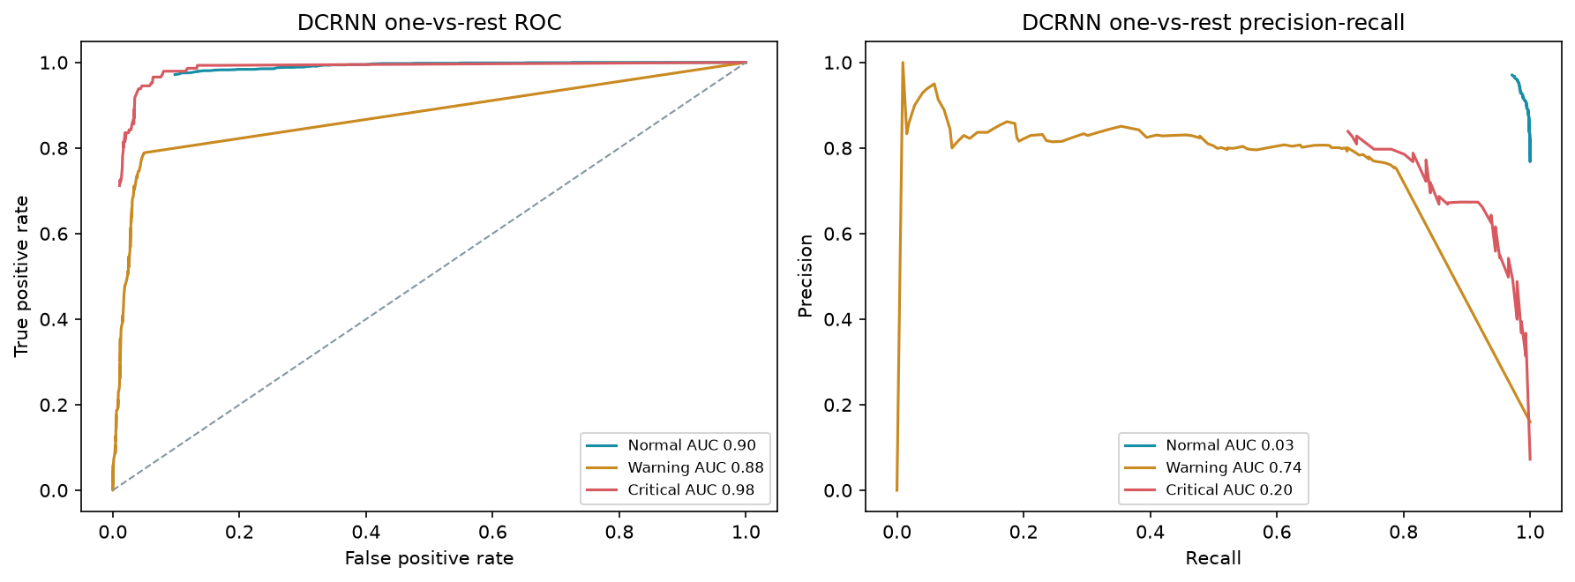
16. RESULTS
DCRNN classification evidence and interpretation
WHY THE GRAPH MODEL LAGS
01 Topology is a country graph, not a complete electrical model.
02 The graph may spread noisy neighbour information.
03 The dataset has limited verified engineering labels.
04 DCRNN is slower: 63.6 ms versus Fusion GRU at 34.7 ms.
05 The result prevents an unsupported claim that graph models always win.
DCRNN still matters because it tests the graph hypothesis under the same lookback, split, scaling, and test horizon.
GRIDPULSE / PREDICTIVE ANALYTICS
17
Notes:
Source: results/figures/dcrnn_roc_pr_curves.png, results/dcrnn_analysis.json, and results/model_comparison.json. The comparison is intentionally honest: DCRNN is implemented and measured, but topology alone does not guarantee improvement.

Slide 18


17. EXPLAINABILITY
Feature contribution and learned representations
Permutation importance asks: how much does validation MAE increase when one feature is shuffled? t-SNE asks: do similar hidden states form visible operating clusters?
GRIDPULSE / PREDICTIVE ANALYTICS
18
Notes:
Source: results/figures/feature_importance.png, results/figures/tsne_projection.png, results/feature_importance.json, and results/embedding_projection.json. Explain that feature importance supports model interpretation but does not prove causality.

Slide 19

18. RESULTS
Error analysis: where predictions fail
WHAT TO INSPECT
01 Large absolute errors around flow reversals.
02 Near-zero actual values make MAPE unstable.
03 Critical cases are harder because they are less frequent.
04 Timestamp gaps can weaken a local history window.
05 A low average error can still hide a missed warning.
The saved error-analysis JSON also records representative successes and failures for qualitative review.
GRIDPULSE / PREDICTIVE ANALYTICS
19
Notes:
Source: results/figures/error_distribution.png and results/error_analysis.json. Connect the error distribution to the metric choice: RMSE and F1 are more useful than MAPE alone for signed flows.

Slide 20
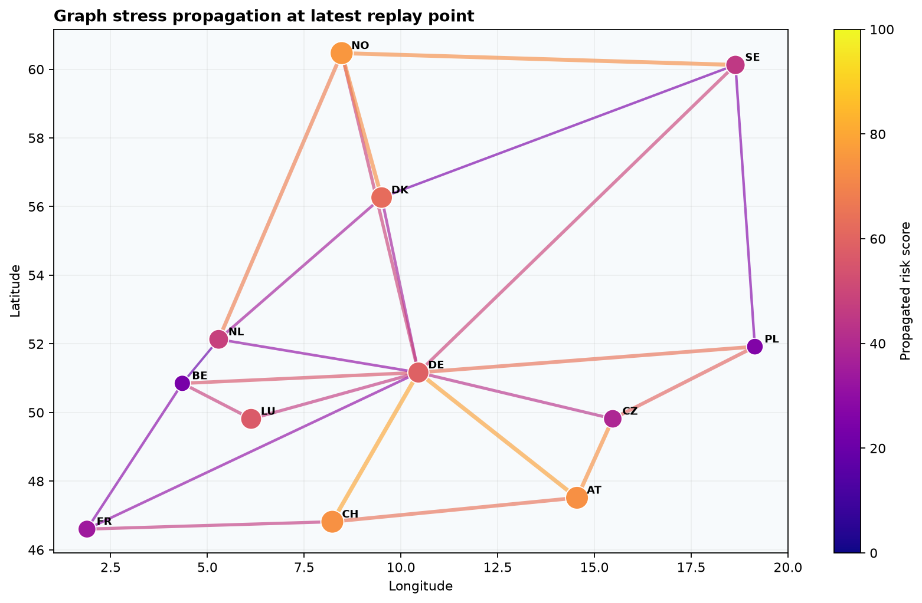
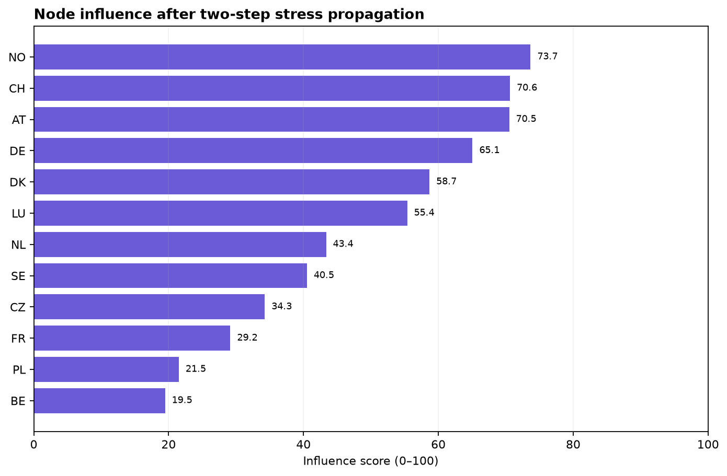
19. GRAPH REASONING
Graph intelligence: stress propagation and node influence
Two-step propagation combines local node risk with utilization-weighted neighbouring risk. Influence also includes graph centrality, so a bridge node can matter even before it becomes the most loaded node.
GRIDPULSE / PREDICTIVE ANALYTICS
20
Notes:
Source: results/figures/graph_stress_propagation.png and results/figures/graph_node_influence.png. The graph analysis is a transparent screening layer, not an AC power-flow or N-1 security calculation.

Slide 21
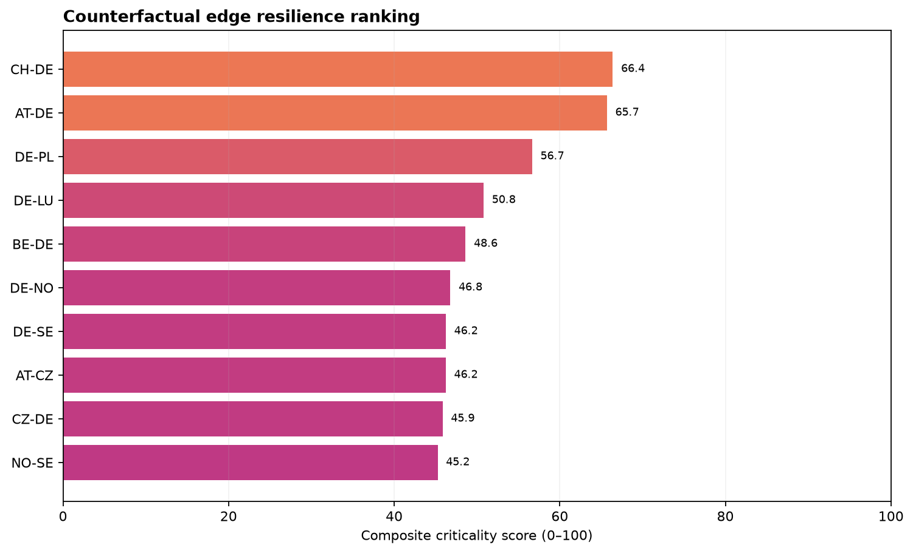
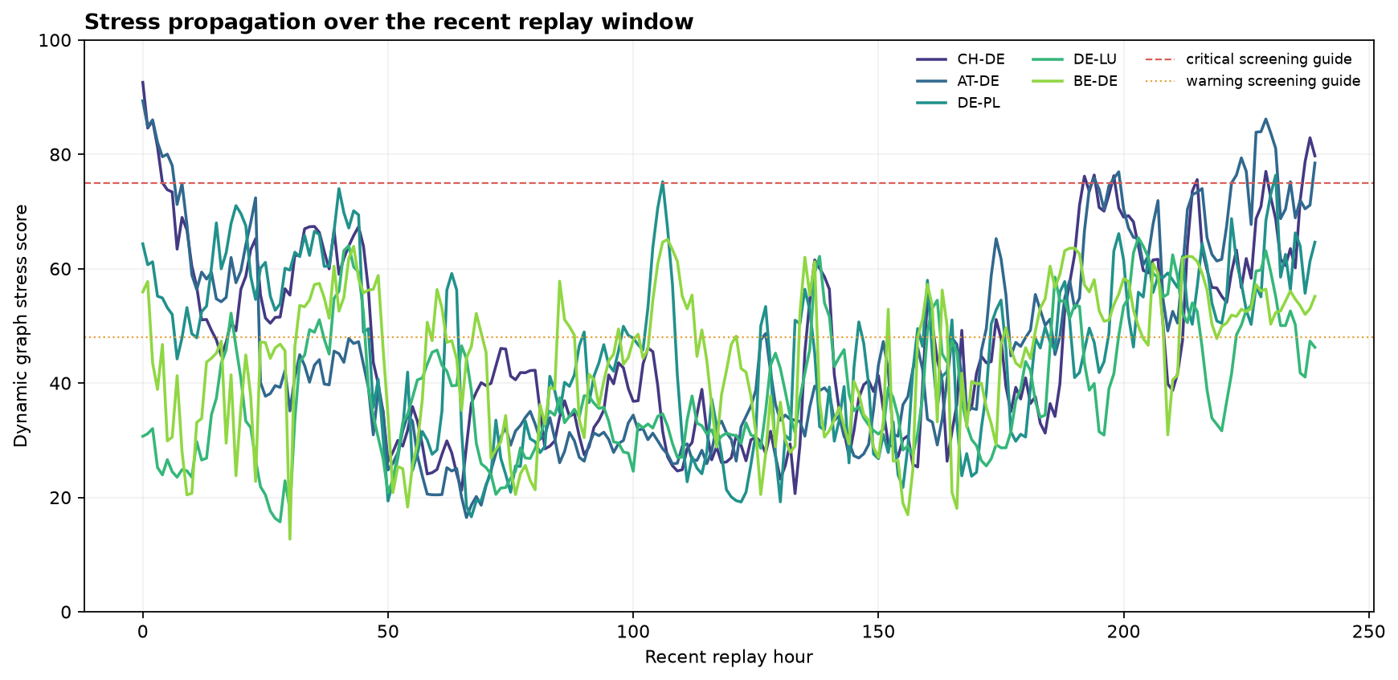
20. GRAPH REASONING
Edge resilience and stress over time
Criticality is more than current loading: it combines dynamic stress, edge betweenness, disconnected pairs after removal, and increased shortest-path length.
GRIDPULSE / PREDICTIVE ANALYTICS
21
Notes:
Source: results/figures/graph_resilience_ranking.png and results/figures/graph_stress_timeline.png. Explain that the ranking asks what the topology loses if an edge disappears, while the timeline shows how dynamic stress changes through replay.

Slide 22
21. SCENARIO SIMULATION
Prescriptive routing: how the alternate path is chosen
1
Choose edge
2
Move MW
3
Remove edge
Select a stressed interconnector.
Set a hypothetical reduction, capped at 60%.
Search between the same endpoints.
4
Check guardrails
5
Score paths
6
Compare
Reject low-headroom or Critical links.
Penalize distance, utilization, loss, and risk.
Show route, bottleneck, and loss delta.
Path cost
Warning links receive a 1.35× penalty. Critical links receive a 4× penalty during soft scoring. Strict search first requires enough proxy headroom.
Costₑ = Lₑ × (1 + 2.2Uₑ + 6Loss%ₑ)
The result is a recommendation-only scenario. It never dispatches generation or switches a real line.
GRIDPULSE / PREDICTIVE ANALYTICS
22
Notes:
Source: backend/routing.py and docs/USER_MANUAL.md. Explain the order: strict feasible path first, best-effort path only if strict search fails, and explicit bottlenecks when the route needs engineering review.

Slide 23
22. RECOMMENDATION
Scenario result and system integration
EXAMPLE REPLAY SCENARIO
HOW THE BROWSER RECEIVES IT
Selected link: CH–DE
Current flow: 1,414.75 MW
Scenario reduction: 25%
Moved transfer: 353.69 MW
Candidate route: CH → AT → DE
Python pipeline
↓
processed JSON artifacts
↓
server.py REST + SSE
↓
HTML + CSS + SVG + JavaScript
↓
topology + forecast + graph + reroute
Status: BEST EFFORT · REVIEW
Baseline proxy loss: 204.25 MW
Rerouted proxy loss: 241.24 MW
Loss change: +37.00 MW
Normal cyan particles stay muted. The selected reroute appears above the graph in purple with amber moving particles, keeping the decision path visible.
A route with higher proxy loss can still be useful for relieving a stressed link, but the UI shows the trade-off instead of hiding it.
GRIDPULSE / PREDICTIVE ANALYTICS
23
Notes:
Source: live /api/route-plan example, backend/server.py, backend/routing.py, frontend/app.js, and frontend/styles.css. Explain that the exact numbers can change with the replay cursor, while the decision procedure remains the same.

Slide 24
23. CONCLUSION
Findings, novelty, limitations, and next step
WHAT THE PROJECT PROVES
PROJECT NOVELTY
WHAT MUST IMPROVE
01 A messy cross-border dataset can become a canonical graph.
01 One auditable workflow joins predictive and prescriptive analysis.
01 Replace proxy capacity with verified thermal ratings.
02 Chronological validation protects the forecast comparison.
02 Data quality, physical assumptions, and graph risk stay visible.
02 Add surveyed line geometry and actual electrical parameters.
03 A simple baseline can beat a complex model on a real dataset.
03 Stress propagation and counterfactual resilience add graph evidence.
03 Calibrate thresholds using engineering events or quantiles.
04 Graph reasoning can explain node influence and edge resilience.
04 Connect the replay API to SCADA, Kafka, or MQTT telemetry.
04 The dashboard explains what the model can and cannot claim.
05 Rerouting can be tested with visible guardrails and loss trade-offs.
05 Validate recommendations with AC power flow and N-1 studies.
Final takeaway: the model produces evidence for human review, not an automatic operating command.
GRIDPULSE / PREDICTIVE ANALYTICS
24
Notes:
Closing: return to the original question. The project connects data quality, predictive modelling, graph reasoning, and route simulation in one traceable workflow. The main contribution is the auditable integration and honest handling of missing engineering information.

