Slide 1
PREDICTIVE ANALYTICS COURSE PROJECT
Project Review 1
GridPulse
PROJECT TEAM
Graph-based predictive and prescriptive analytics for cross-border power grid flows
Prakki Krishna Karthik | 23BCE1294
Vasudev | 23BCE1496
Shubham Bhuyan | 23BCE1809
COURSE AND FACULTY
Project Review 1
Problem, data, methodology, and system design
Predictive Analytics
Faculty: Pattabiraman V
Review 1 establishes the problem, data contract, model plan, and implementation boundary.
01
Notes:
Opening: introduce the project as a predictive analytics course project. Review 1 covers the foundation. The later reviews will cover trained-model evidence and prescriptive graph decisions.

Slide 2
1. PROJECT CONTEXT
Problem definition and project scope
Electricity does not move through one isolated line. A change at one country can change neighbouring flows and the alternatives available during stress.
PREDICTIVE QUESTION
PRESCRIPTIVE QUESTION
What is likely to happen in the next hour?
What action can we test when a link is stressed?
Estimate next-hour country net flow from recent history, demand signals, shared network context, and graph centrality.
Reduce a selected transfer in a scenario, search alternate paths, check headroom and proxy loss, and present the trade-off for human review.
The project scope ends at explainable decision support. It does not control a real transmission grid.
GRIDPULSE / PROJECT REVIEW 1
02
Notes:
Make the predictive and prescriptive distinction clear. The forecast estimates a future value. The routing module tests a hypothetical intervention and reports consequences. The dashboard recommends; an operator would still need verified engineering constraints.

Slide 3
2. MOTIVATION
Why this project needs both time series and graph analysis
A single model family does not answer every question in the project. The design combines complementary views of the same network.
Approach | What it captures | Why this project adds another layer
Classical time-series baseline | Recent history and seasonality | Useful comparator, but it does not see neighbouring nodes or alternate paths.
Fusion GRU | Recent local and global signals | Learns nonlinear temporal patterns while keeping the input features inspectable.
DCRNN | Temporal behaviour plus graph diffusion | Tests whether neighbouring countries improve the forecast through learned spatial propagation.
Rule-based routing screen | Feasible alternate-path scenarios | Explains the action and trade-off, but it does not replace power-flow certification.
Project contribution
One traceable workflow connects data quality, forecasting, graph stress reasoning, and scenario recommendations. Each layer exposes its inputs and limitations.
GRIDPULSE / PROJECT REVIEW 1
03
Notes:
This slide explains the project gap in original wording. The point is not to claim that one method is universally best. The project tests temporal and graph-aware models under the same chronological evaluation and then uses a separate transparent scenario layer for routing.

Slide 4
3. DATA
Dataset profile and graph ingredients
315,598
1,262,592
12
24
960
country-hour records
directional flow records
country nodes
canonical links
recent hourly points retained
Source | One row represents | Main fields | System role
dynamic_with_flows.csv | One country at one hour | Load, net flow, imbalance, residual, weather, renewables, coordinates, centrality | Node signals and forecast features
power_flow.csv | One directional interconnector record | Timestamp, source, target, power flow in MW | Edge history and routing context
Processed graph manifest | One canonical graph definition | Nodes, edges, aliases, quality flags, assumptions | Data contract used by the API
Research result files | One evaluation artifact | Metrics, curves, confusion matrices, graph plots | Evidence for later reviews
Coverage: hourly records from 1 January 2022 to 31 December 2024. The current replay keeps the latest 960 hours for a compact, reproducible dashboard view.
GRIDPULSE / PROJECT REVIEW 1
04
Notes:
Source: results/dataset_profile.json. The dynamic source contains 37 columns and the power-flow source contains 5 columns. Review 1 introduces the raw data contract; model results are intentionally reserved for Review 2.

Slide 5
4. DATA PREPARATION
Preprocessing turns raw files into a safe experiment
01
Parse
04
Align
Read both CSV files and convert timestamps to UTC.
Join node signals and edge history on the common hourly timeline.
02
Validate
05
Scale
Check missing cells, duplicate keys, country codes, and hourly gaps.
Fit means and standard deviations only on the training window.
03
Canonicalize
06
Split
Map aliases to a stable endpoint pair such as CH-DE.
Keep validation and test periods later in time. Do not shuffle across the boundary.
Training-only scaling
x_scaled = (x − μ_train) / σ_train
The same training statistics are applied to validation, test, and live replay inputs.
GRIDPULSE / PROJECT REVIEW 1
05
Notes:
Source: results/preprocessing_summary.json. Explain why the chronological split matters: using future values while scaling or randomly shuffling would make the evaluation look better than the real forecasting situation.

Slide 6
5. FEATURE DESIGN
Feature extraction keeps the forecast explainable
The experiment uses 11 features per country and hour. They fall into three groups so the model has local evidence, system context, and graph structure.
LOCAL TIME SERIES
NETWORK CONTEXT
STATIC GRAPH
Net flow
Actual load
Flow imbalance
Load residual
Mean net flow across countries
Mean load
Mean imbalance
Mean load residual
Degree centrality
Closeness centrality
Betweenness centrality
What is happening at the country now?
What pressure is shared across the system?
Where does this country sit in the network?
The tensor shape is 12 countries × 960 hours × 11 features. The target is next-hour net flow.
GRIDPULSE / PROJECT REVIEW 1
06
Notes:
Source: results/feature_catalog.json. Give one simple example: if German load rises while nearby countries also show pressure, the model sees both the local signal and the network context. Centrality does not prove physical causation; it gives the model a stable connectivity descriptor.

Slide 7
6. GRAPH REPRESENTATION
Graph construction and distance-based loss proxy
GRAPH DEFINITION
LOSS ESTIMATE USED IN SCENARIOS
Nodes represent countries.
Edges represent canonical cross-border interconnectors.
Coordinates support distance and centrality features.
Directional flow history keeps source and target visible.
R = ρL / A
S = |P| / pf
I = S / (√3 V)
P_loss = 3I²R
The graph has 12 nodes and 24 canonical links. The same graph supports forecasting features, stress propagation, resilience ranking, and route search.
L comes from the Haversine distance between country-centroid coordinates. The project uses fixed assumptions for voltage, power factor, resistivity, and conductor area.
This is a screening proxy, not an engineering-grade thermal or AC power-flow calculation.
GRIDPULSE / PROJECT REVIEW 1
07
Notes:
Source: results/dataset_profile.json and the engineering limitations recorded by the pipeline. Explain the purpose of the proxy: compare candidate scenarios consistently. Do not present it as a certified line-loss calculation because actual conductor, route, voltage, and thermal data are missing.

Slide 8
7. FORECASTING SETUP
Model plan and chronological experiment design
BASELINES
FUSION GRU
DCRNN
Persistence
24-hour moving average
Linear trend
Seasonal naive
A recurrent model reads the last 24 hourly steps. It fuses local and global features, then estimates the next-hour net flow.
A graph recurrent model diffuses information through forward and reverse graph transitions while it processes time.
These provide reference points before judging the learned models.
The checkpoint is trained in PyTorch and loaded by the live API.
It tests whether neighbouring countries improve the next-hour forecast.
24-hour lookback | 600 train hours | 168 validation hours | 168 test hours | chronological order
GRIDPULSE / PROJECT REVIEW 1
08
Notes:
Source: results/preprocessing_summary.json and results/run_metadata.json. The current split is 600:168:168 hours, or 25:7:7 in time duration. The models use a 24-hour input window. Review 2 will present loss curves and model metrics.

Slide 9
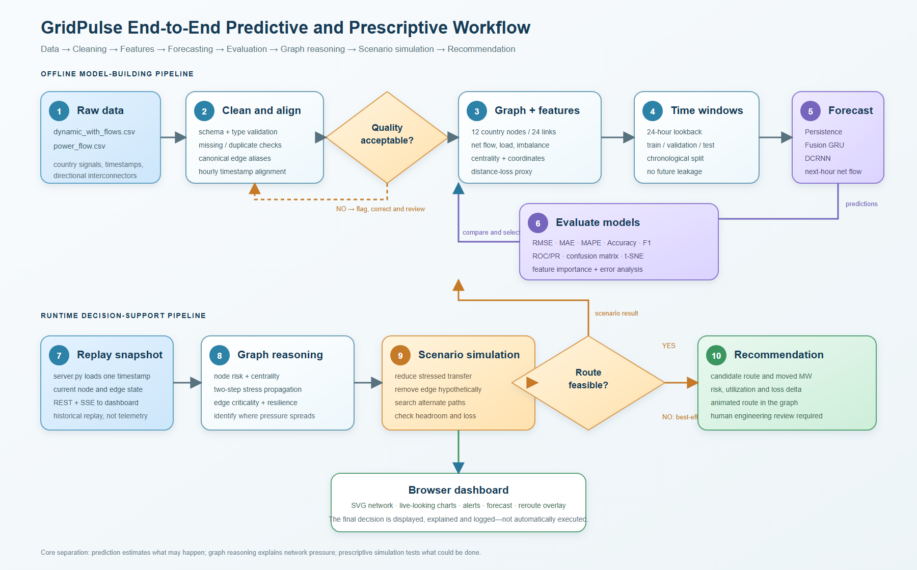
8. IMPLEMENTATION DESIGN
System architecture from CSV files to browser decisions
The implementation keeps data preparation, model inference, graph reasoning, and presentation separate so each result can be inspected.
IMPLEMENTED COMPONENTS
01
Pipeline
Parses, validates, aligns, and writes processed JSON artifacts.
02
Experiments
Trains Fusion GRU and DCRNN checkpoints and saves evaluation files.
03
API
Serves metrics, forecasts, graph status, and route-plan scenarios.
The browser displays evidence from the API. It does not retrain models in the interface.
GRIDPULSE / PROJECT REVIEW 1
09
Notes:
Source: results/figures/end_to_end_workflow_architecture.png and the current backend/frontend implementation. Explain this as the system design, not just a slide diagram: the model artifacts are trained offline, the API loads them for inference, and the browser visualizes the returned values.

Slide 10
9. REVIEW PLAN
Review 1 outcome and the remaining project reviews
REVIEW 1 FOUNDATION
REVIEW 2 MODEL EVIDENCE
REVIEW 3 DECISION LAYER
Problem and scope
Dataset contract
Quality checks
Feature tensor
Graph and loss assumptions
Model plan
System architecture
Training curves
Validation strategy
Confusion matrix
ROC and precision-recall
Model comparison
DCRNN analysis
Error analysis
Stress propagation
Edge resilience
Loss comparison
Alternate-path search
Dashboard integration
Limitations
Final conclusions
Review 1 takeaway: the project has a defined data contract, a reproducible forecasting setup, and a clear boundary between learned prediction and explainable scenario analysis.
GRIDPULSE / PROJECT REVIEW 1
10
Notes:
Close by showing that Review 1 has a concrete outcome. The project is not only an interface idea; it now has a defined dataset, preprocessing contract, feature tensor, graph representation, model plan, and end-to-end architecture. Reviews 2 and 3 will add empirical evidence and decisions.

