Slide 1
PREDICTIVE ANALYTICS COURSE PROJECT
Project Review 3
GridPulse
PROJECT TEAM
Graph-based predictive and prescriptive analytics for cross-border power grid flows
Prakki Krishna Karthik | 23BCE1294
Vasudev | 23BCE1496
Shubham Bhuyan | 23BCE1809
COURSE AND FACULTY
Project Review 3
Graph intelligence and prescriptive routing
Predictive Analytics
Faculty: Pattabiraman V
Review 3 turns forecasts into an auditable graph decision.
01
Notes:
Opening: Reviews 1 and 2 established the data, models, and evaluation evidence. This review explains the graph intelligence layer and the recommendation workflow that follows a forecast.

Slide 2
1. GRAPH INTELLIGENCE
From a forecast to a network decision
A country can look safe in isolation while its neighbouring links are losing headroom. The graph layer makes that dependency visible.
Forecast
Propagate stress
Test removal
1
Fusion GRU or DCRNN estimates next-hour net flow for each country.
2
Risk is shared across adjacent nodes using the canonical 12-node topology.
3
Each edge is removed in a counterfactual check to measure structural impact.
WHAT THIS ADDS TO PREDICTIVE ANALYTICS
Prediction answers: What is likely next hour?
Graph reasoning answers: Where can that pressure travel, which link is influential, and what happens if we reduce a stressed transfer?
The output is a ranked, explainable screening result. It does not replace a power-system operator or an AC load-flow study.
Inputs: observed flows, forecasted stress, node connectivity, proxy loss, edge history
GRIDPULSE / PROJECT REVIEW 3
02
Notes:
Explain the hand-off from Review 2. The learned forecast supplies a likely next-hour condition. The graph layer then asks how local stress can affect neighbouring countries and whether the network still has alternate routes.

Slide 3
2. STRESS PROPAGATION METHOD
How stress is propagated through the graph
STEP 1: LINK STRESS
STEP 2: EDGE CRITICALITY
sₑ = 0.45uₑ + 0.25rₑ + 0.20pₑ + 0.10ℓₑ
cₑ = 0.55sₑ + 0.25bₑ + 0.15dₑ + 0.05hₑ
uₑ utilization of the link
rₑ endpoint risk
pₑ risk propagated from neighbouring nodes
ℓₑ loss proxy
bₑ edge betweenness
dₑ disconnected-pair rate after removal
hₑ average hop increase after removal
The weights make utilization the strongest signal, while still preserving endpoint and neighbourhood context.
Two checks are combined: dynamic pressure now, and structural importance if the edge disappears.
Important scope: these are screening proxies, not AC power flow, thermal limits, voltage stability, or N-1 certification.
GRIDPULSE / PROJECT REVIEW 3
03
Notes:
The formulas are implemented in the saved graph stress analysis. Stress is normalized before the weighted combination. Criticality adds topology evidence from counterfactual edge removal. The result is designed to be inspectable, not to pretend that the project has utility-grade engineering data.

Slide 4
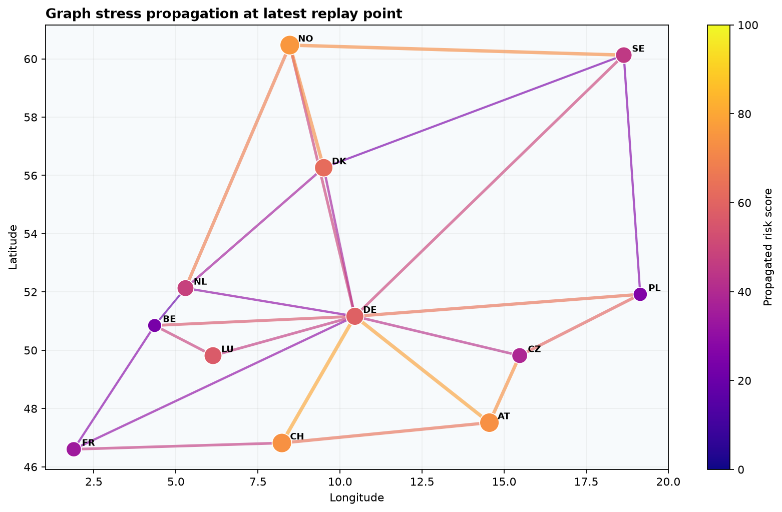
3. GRAPH STRESS RESULTS
Latest replay: where pressure concentrates
LATEST SCREENING SNAPSHOT
NO · 73.68
top node influence score
CH-DE · 66.4
top critical edge score
NO
75.58
propagated node risk
CH
73.86
propagated node risk
The graph does not only highlight the largest flow. It also highlights the node or edge whose position makes the network more sensitive.
GRIDPULSE / PROJECT REVIEW 3
04
Notes:
Source: results/figures/graph_stress_propagation.png and results/graph_stress_analysis.json. The latest saved snapshot ranks NO as the most influential node at 73.68 and CH-DE as the most critical edge at 66.4. These numbers are screening scores on a 0 to 100 scale, not megawatts or a physical thermal rating.

Slide 5
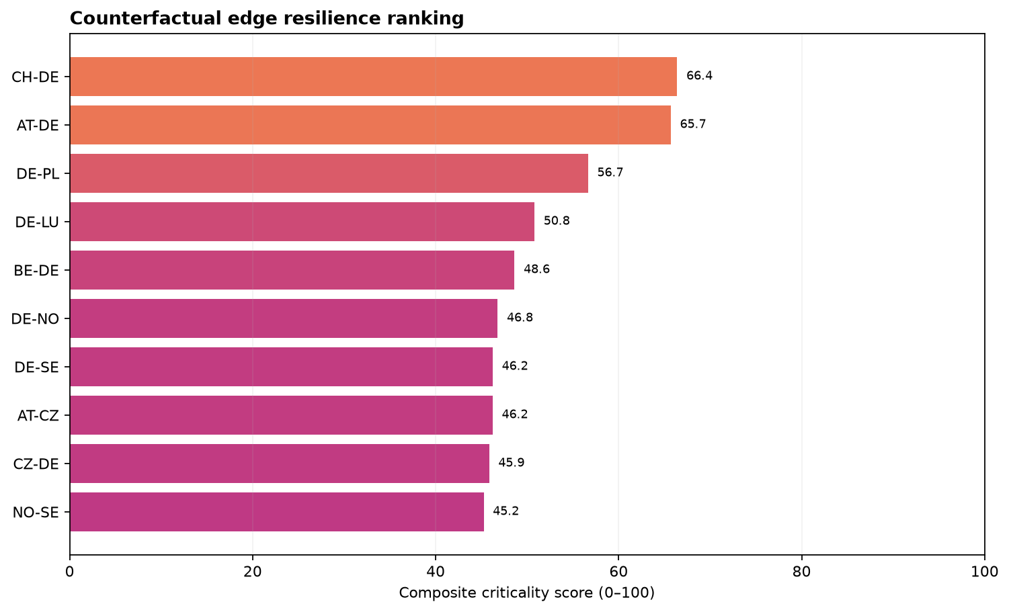
4. COUNTERFACTUAL ANALYSIS
Edge resilience: what changes when a link is removed
TOP REMOVAL CHECKS
CH-DE
66.4
2 alternate shortest paths
AT-DE
65.7
2 alternate shortest paths
DE-PL
56.66
2 alternate shortest paths
DE-LU
50.8
1 alternate shortest path
No top-ranked removal disconnects a country pair in this snapshot. A high score means reduced structural slack or longer recovery paths.
Betweenness + disconnection count + hop increase are recalculated for each counterfactual edge removal.
GRIDPULSE / PROJECT REVIEW 3
05
Notes:
Source: results/figures/graph_resilience_ranking.png and results/graph_resilience_ranking.csv. Clarify that resilience is not binary. The network can remain connected while a key link removal makes alternate paths longer or more expensive.

Slide 6
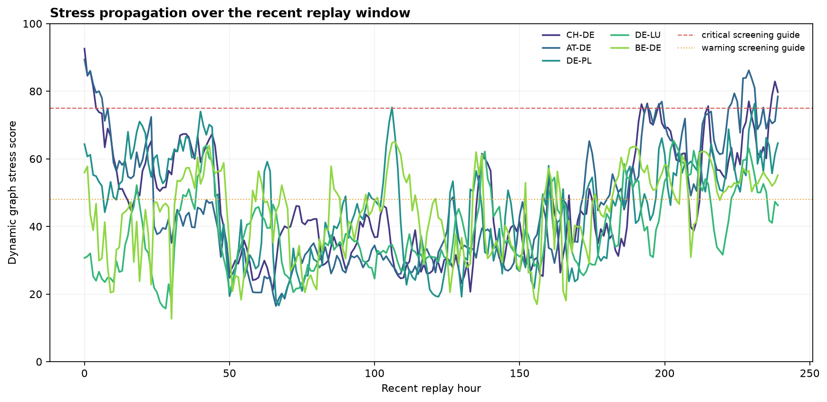
5. TIME-VARYING GRAPH ANALYSIS
Risk moves with the replay, not just with the topology
CH-DE PEAK WINDOW
16 Dec 2024
01:00 UTC
97.10
dynamic stress
75.95
criticality
The same edge can move from warning to a higher screening state as observed transfer and endpoint risk change.
GRIDPULSE / PROJECT REVIEW 3
06
Notes:
Source: results/figures/graph_stress_timeline.png and results/graph_stress_analysis.json. The CH-DE series peaks at 97.10 dynamic stress and 75.95 criticality at 16 Dec 2024 01:00 UTC. This is why the dashboard shows a replay cursor and changing values instead of one static graph.

Slide 7
6. RECOMMENDATION LOGIC
How prescriptive routing is chosen
Select
Search
Guard
1
Choose a stressed link and a reduction percentage, capped at 60%.
2
Find a connected path between the same endpoints, first requiring proxy headroom.
3
Avoid Critical links in the strict search and record any bottlenecks.
PATH COST
DECISION STATUS
Costₑ = Lₑ × (1 + 2.2Uₑ + 6Loss%ₑ)
ROUTE FOUND
All guardrails pass.
BEST EFFORT
Lₑ distance proxy
Uₑ current utilization
Loss%ₑ distance-based loss proxy
A physical path exists, but headroom or risk guardrails need review.
NO ALTERNATE PATH
The API returns a recommendation and a trade-off. It does not dispatch power automatically.
GRIDPULSE / PROJECT REVIEW 3
07
Notes:
The route planner in backend/routing.py uses Dijkstra-style path search. It first tries strict constraints: enough proxy headroom and no Critical links. If that fails, it returns the best physical path with bottlenecks, clearly labelling the result as best effort for human review.

Slide 8
7. WHAT-IF SIMULATION
Scenario example: relieving CH-DE has a visible trade-off
The planner tests a 25% reduction on CH-DE, then compares the original proxy loss with the candidate alternate route.
1,414.75 MW
353.69 MW
CH to AT to DE
BEST EFFORT
selected transfer
flow moved at 25%
candidate route
review status
LOSS COMPARISON
HOW TO INTERPRET IT
Baseline proxy loss
204.25 MW
The scenario reduces pressure on the selected edge, but the alternate path is longer or more stressed, so the proxy loss increases.
Rerouted proxy loss
241.24 MW
That is not a failed prediction. It is the cost of the proposed recovery and the reason an operator must review the recommendation.
Loss delta
+37.00 MW
Recommendation only. Validate with engineering limits and an N-1 study before operational use.
GRIDPULSE / PROJECT REVIEW 3
08
Notes:
This saved scenario illustrates the project’s prescriptive behaviour. A route can relieve the selected transfer but add distance-based proxy loss. The system presents that trade-off rather than hiding it. The values shown are the project’s stored scenario example.

Slide 9
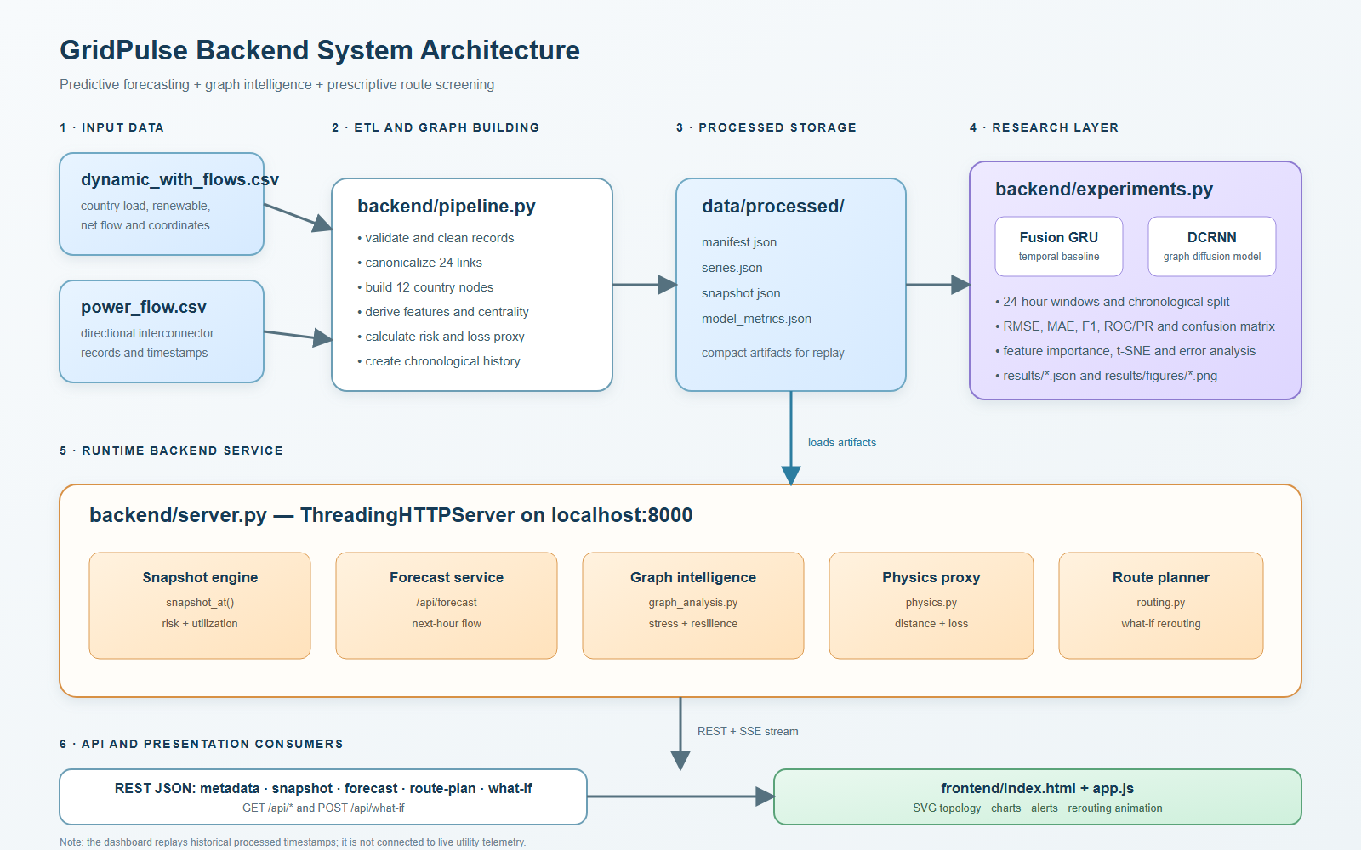
8. SYSTEM INTEGRATION
How the decision layer reaches the interface
RUNTIME PATH
Replay snapshot
A
server.py serves the selected timestamp and topology.
Forecast
B
saved Fusion GRU or DCRNN checkpoint supplies next-hour values.
Recommend
C
routing.py returns a route, status, and loss trade-off.
The browser redraws the SVG network and overlays the recommendation. Live-style replay is API-backed, but it is not SCADA telemetry.
GRIDPULSE / PROJECT REVIEW 3
09
Notes:
Source: results/figures/backend_system_architecture.png. Explain the interfaces: the Python API exposes topology, forecast, graph analysis, and route-plan endpoints. The frontend requests those results and redraws the graph, metrics, and route overlay. The current project uses replay data rather than a live utility feed.

Slide 10
9. FINDINGS AND NEXT STEPS
What Review 3 establishes
PROJECT CONTRIBUTION
CURRENT LIMITATIONS
NEXT ENGINEERING STEP
Forecast → graph explanation → counterfactual test → recommendation
• Proxy distance and loss
• No measured thermal or voltage limits
• No AC load-flow or N-1 certification
• Route is a recommendation, not dispatch
• Replay data, not live SCADA
Connect verified line parameters and telemetry, then validate each scenario with AC load flow, thermal limits, voltage stability, uncertainty calibration, and an N-1 study.
The novelty is the auditable chain. A learned forecast is connected to stress propagation and a loss-aware route scenario with visible guardrails.
Final takeaway
The model predicts. The graph explains. The scenario planner tests. The operator decides.
Review 3 takeaway: graph reasoning turns a next-hour forecast into a transparent decision-support workflow.
GRIDPULSE / PROJECT REVIEW 3
10
Notes:
Closing: The project is intentionally transparent about what the ML model does and what the graph layer does. The learned model forecasts the next hour. The graph analysis identifies sensitive nodes and edges. The route planner tests a what-if. The result is a recommendation for review, not an automatic operational action.

