Slide 1
SMART BUILDING AI AGENT
Problem Statement ID - 1
Theme: Smart Building AI
PS Category: Software
EnergyPlus + Agentic AI
Closed-loop HVAC optimization

Slide 2
AUTONOMOUS BUILDING OPTIMIZATION
Problem: Building controls are often rigid and do not adapt to changing conditions.
Solution: An AI agent reads EnergyPlus performance data, evaluates HVAC opportunities, and proposes safe setpoint changes.
Innovation: Physics-based simulation supplies measurable feedback, while a local open-source LLM selects tools and recommends actions.
Outcome: Every change is simulated again before energy and comfort impact are reported.

Slide 3
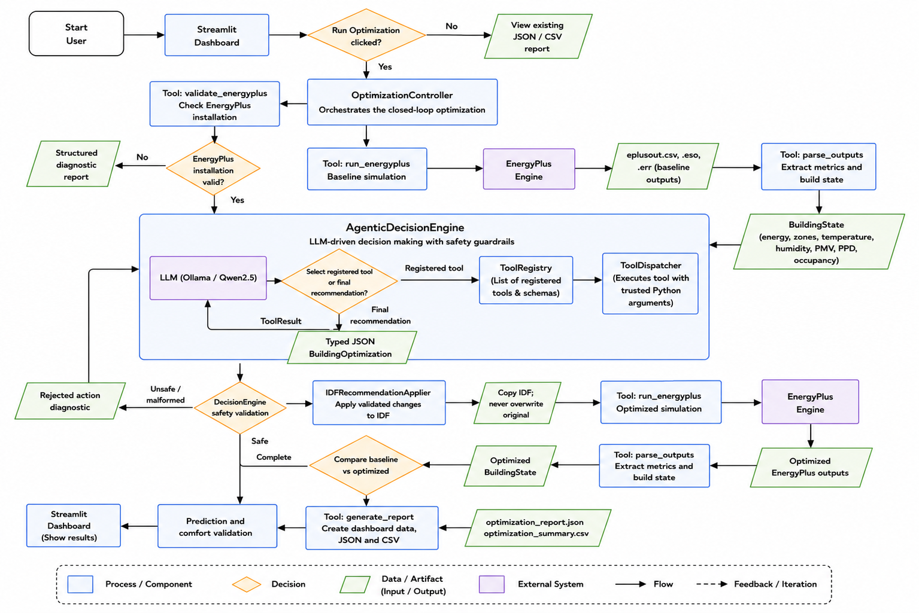
TECHNICAL APPROACH
Stack: Python, EnergyPlus, Ollama/Qwen2.5, Streamlit, Plotly, Pandas.
Baseline -> BuildingState -> LLM tool selection -> safety validation.
Copy IDF -> optimized EnergyPlus run -> measured comparison.
Tools: validate, run, parse, apply, compare, report.
Outputs: JSON/CSV reports and dashboard views.
Original IDF is never overwritten.

Slide 4
FEASIBILITY AND VIABILITY
Verified: Official EnergyPlus office model; baseline and optimized runs exit code 0.
Measured: 129.19B -> 126.30B; 2.24% reduction; 2 recommendations.
Comfort: Degraded in this run; the tradeoff is shown explicitly.
Risks: LLM schema, long context, and IDF mappings.
Mitigation: JSON mode, retry, tools, trusted paths, safety validation, and logs.

Slide 5
ARTIFACTS
Working prototype:
Streamlit dashboard: live progress, charts, and downloads
EnergyPlus runner + CSV/ESO/ERR/END parser
Custom tools: registry, dispatcher, ToolCall/ToolResult
Safety validation on copied IDFs; original preserved
Outputs: JSON/CSV reports and official IDF + weather input

Slide 6
RESEARCH AND REFERENCES
1. Zhang et al. (2019) – Building HVAC Scheduling Using Reinforcement Learning
Summary: Demonstrates EnergyPlus-based reinforcement learning for optimizing HVAC schedules while reducing energy consumption and maintaining occupant comfort.
2. Liu et al. (2026) – Balancing Comfort and Cost via Large Language Models
Summary: Introduces an LLM-powered multi-agent framework that intelligently manages HVAC systems by balancing energy efficiency with thermal comfort.
3. He & Jazizadeh (2025) – Context-aware LLM-based AI Agents for Smart Buildings
Summary: Presents context-aware AI agents that use large language models for autonomous building energy management and decision-making.
4. U.S. DOE – EnergyPlus™ Engineering Reference
Summary: Provides the validated simulation engine used for modeling building energy consumption, HVAC performance, and occupant comfort.

