Slide 1
Energy-Efficient Robust Beamforming for Satellite Downlink
Formulating a new maximization problem on our satellite downlink system

Slide 2
Motivation: Why Energy Efficiency?
Real satellites have limited onboard power (solar/battery) and amplifier heat budgets
Maximizing raw data rate alone always pushes transmit power to its full budget, regardless of the marginal rate that extra power actually buys
The real question is different:
not “how much rate can we get,” but “how much rate do we get per watt actually spent”
This calls for a new optimization problem — built on the same satellite system our earlier work already established

Slide 3
Motivation: Why a Learning-Based Approach?
Classic (“conventional”) precoders — e.g. MMSE, robust SLNR — work by solving a math formula by hand, derived specifically for one objective and one error assumption
Our new objective (rate per watt) combined with realistic channel-knowledge errors makes that hand-derived math extremely hard — in general, provably intractable
Instead of deriving a new formula from scratch, we let an agent learn a good strategy directly from repeated trial and error — a Reinforcement Learning (RL) approach
This is also flexible: the same learning approach adapts automatically to different antenna counts, user counts, or error levels — no new math derivation needed each time

Slide 4
What Is Soft Actor-Critic (SAC)?
Reinforcement Learning in one line: an agent tries something, sees a “reward” for how well it worked, and gradually adjusts to do better — automated trial and error
Two neural networks work together:
Actor — proposes a precoding strategy (what signal weights to transmit); the decision-maker
Critic — judges how good that strategy turned out to be; a coach scoring each attempt, guiding the Actor's next try
“Soft” = the agent is deliberately kept a little unpredictable/exploratory, so it keeps searching for a better strategy instead of settling early on a mediocre one
Why it fits us: our precoding weights are continuous-valued, not a small fixed menu of choices — and the Actor/Critic never need to know the math form of the objective in advance, only a reward number after each attempt

Slide 5
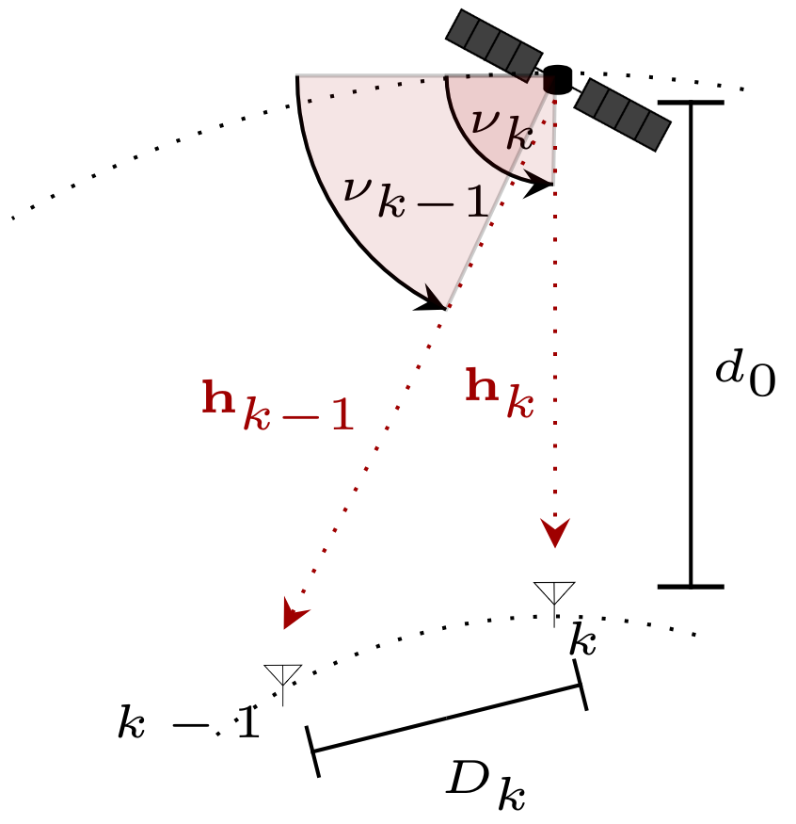
System Model
Single LEO satellite, Uniform Linear Array (ULA), N = 16 antennas
K = 3 single-antenna ground users
Satellite altitude d₀ = 600 km | Sat. gain G_Sat = 20 dBi | User gain G_Usr = 0 dBi
Carrier wavelength λ = 15 cm (f = 2 GHz) | Inter-antenna spacing dₙ = 3λ/2 ≈ 22.5 cm
Noise power σₙ² ≈ 6×10⁻¹³ W | Transmit power budget P = 100 W
Same LoS channel model and CSIT error model (AoD error + large-scale fading) established in our earlier work — the baseline system this new problem is built on

Slide 6
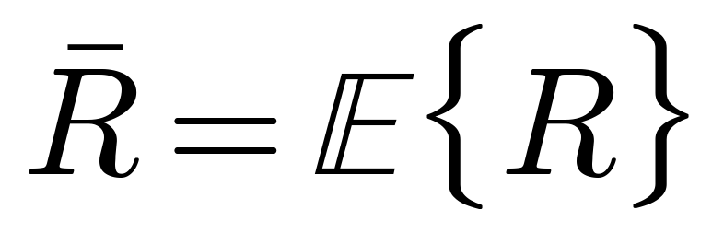
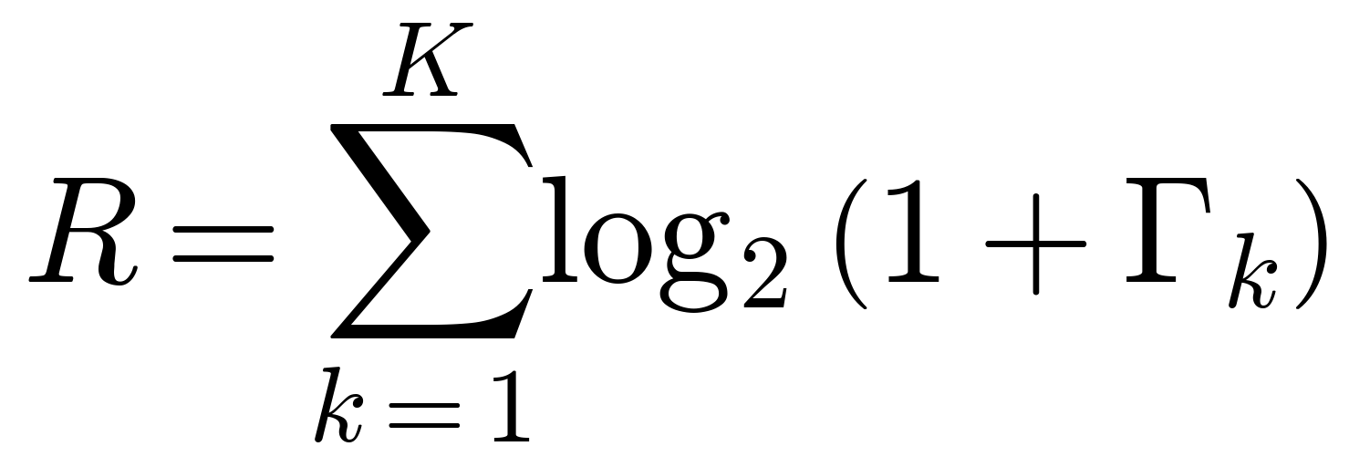
Baseline: Maximize Sum Rate
Our earlier work on this system established the following objective:
where the instantaneous sum rate over all K users is:
subject to a total radiated power budget P
The precoder (MMSE, robust SLNR, or our earlier learned SAC precoder) rescales its output to land exactly on this power budget
Under this rate-only objective, using more transmit power is never worse — so the optimum always saturates the full power budget
This is the baseline we now build a new problem on top of

Slide 7
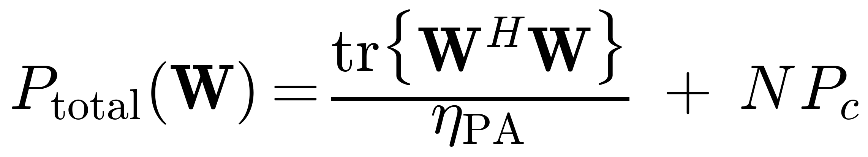
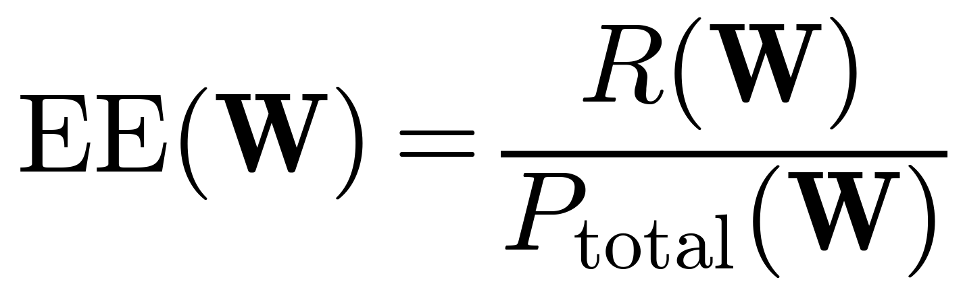
Our New Objective: Energy Efficiency
We add an electrical power consumption model on top of the baseline system:
our values: η_PA = 0.60 (amplifier efficiency), P_c = 1.0 W/antenna × N=16 → 16 W static draw
and formulate a new maximization problem — Energy Efficiency:
same power budget P = 100 W as the baseline
Precoder now only rescales DOWN when over budget (“clip-only”), instead of always normalizing exactly to the boundary — this lets the policy choose to use less than the full budget when that is more efficient

Slide 8
How We Solve It: SAC in Practice
Each simulation step, in a loop:
channel estimate → Actor network → proposed precoding matrix W → reward → store & learn
Rate-over-power is a ratio, awkward for RL to optimize directly — Dinkelbach's transform turns it into a subtraction, folded directly into the reward:
λ updated online, as a running average over a 5,000-step window
Actor and Critic: 4 fully-connected layers of 512 units each, with batch normalization between layers to keep training stable
Trained with batch size 1024, drawing from a replay buffer of 100,000 past experiences, Adam optimizer
Trained separately at 3 CSIT error levels: Δε = 0.0, 0.025, 0.05 — 13,000 episodes × 1,000 steps ≈ 13M simulation steps per checkpoint

Slide 9
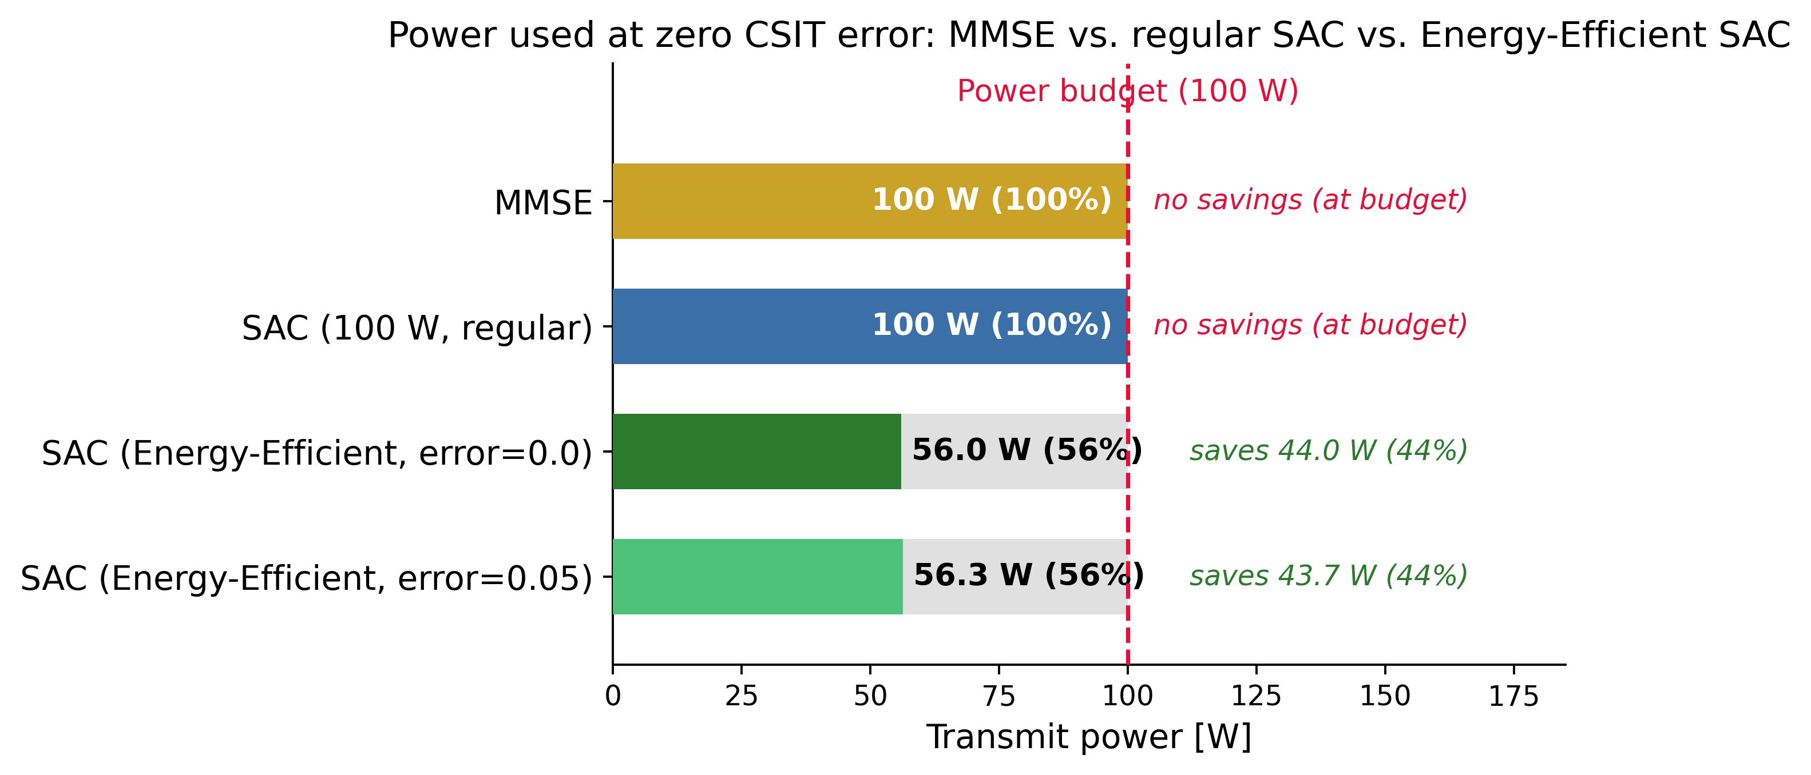
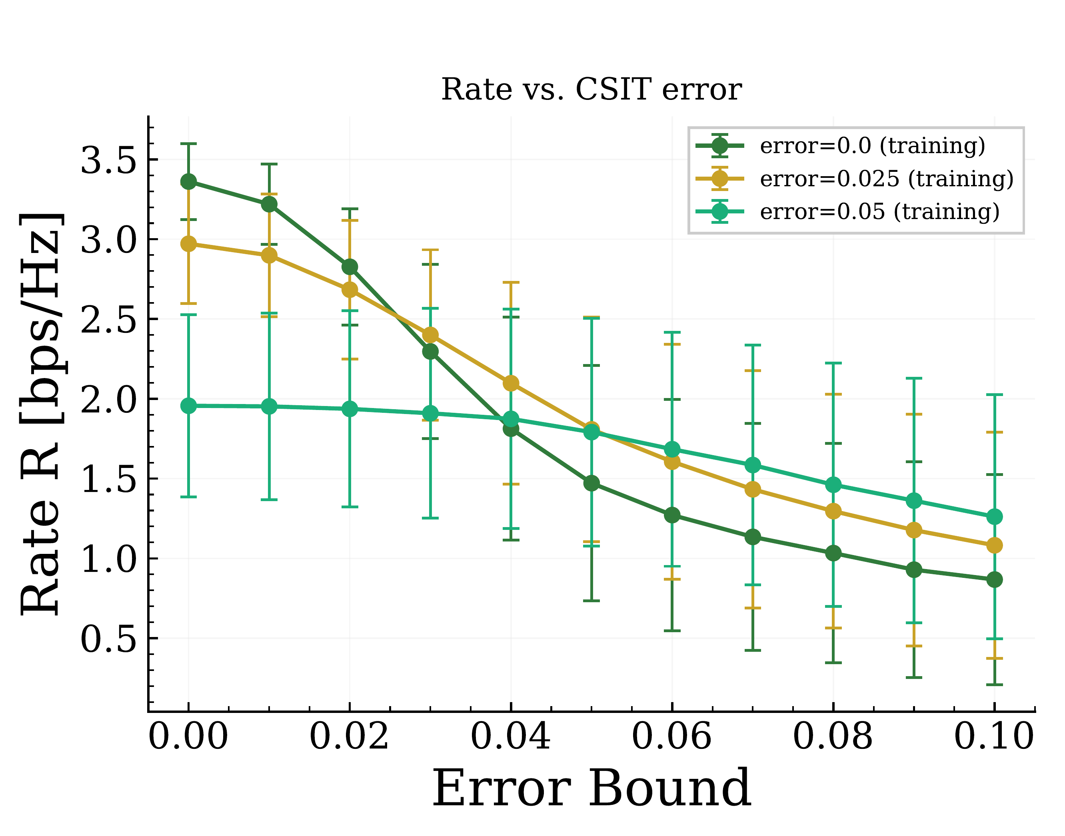
Results: Power Savings and Robustness
MMSE and the regular (100 W) SAC checkpoint always spend the full power budget; our Energy-Efficient checkpoints do not — and stay robust as CSIT error grows:
MMSE and regular SAC always transmit at the full 100 W budget. Our Energy-Efficient SAC checkpoints use only ~56-59 W (41-44% saved).
The checkpoint trained at higher CSIT error degrades more gracefully and overtakes the others as error grows — clean crossovers around error ≈ 0.03–0.07.

Slide 10
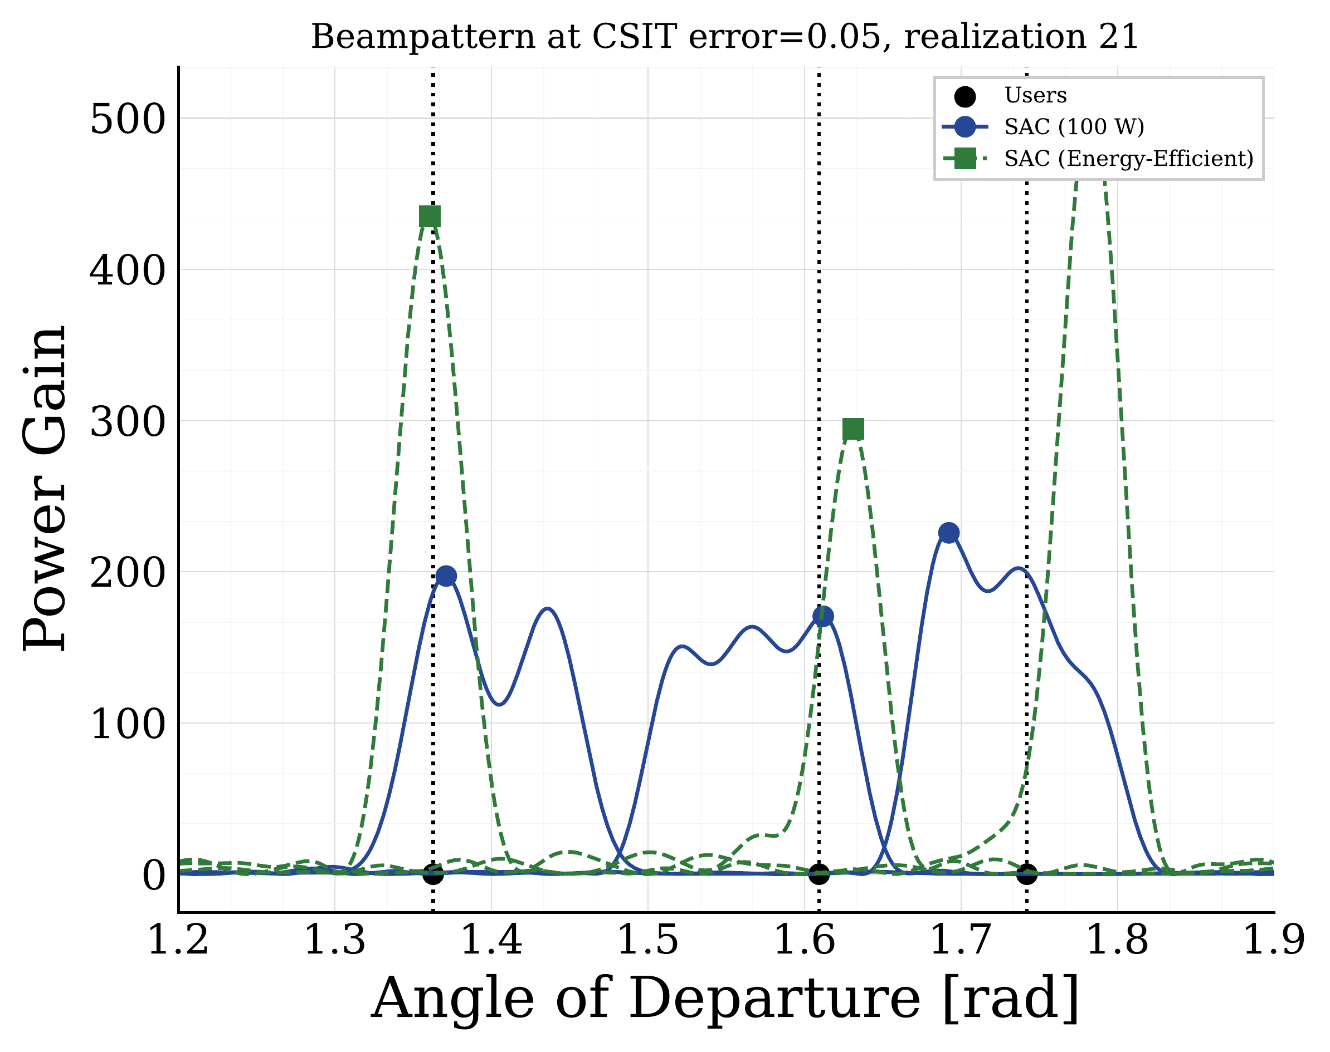
Results: What This Looks Like Spatially
Comparing where the regular (100 W) SAC checkpoint and the Energy-Efficient checkpoint actually point their antenna beams, for the same users:
Both checkpoints aim at the same 3 users — the Energy-Efficient checkpoint's beams are just sharper and taller, delivering the same coverage with less spread-out (and therefore less wasted) transmit energy.

Slide 11
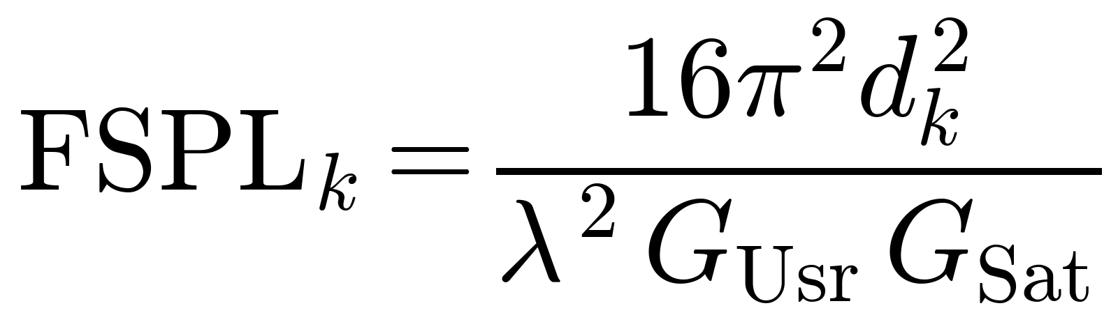
Appendix: Parameter Reference (Paper vs. Our Code)
Parameter | Paper (Table I) | Our code (config.py)
Noise power σₙ² | 6×10⁻¹³ W | 6.02×10⁻¹³ W
Transmit power P | 100 W | 100 W
Satellite altitude d₀ | 600 km | 600 km
Antenna Nr. N | {10, 16} | 16
User Nr. K | 3 | 3
Overall Sat. Gain G_Sat | 20 dBi | 20 dBi
Wavelength λ | 15 cm | 15 cm (f = 2 GHz)
Gain per user G_Usr | 0 dBi | 0 dBi
Inter-antenna distance dₙ | 3λ/2 | 3λ/2 ≈ 22.5 cm
SGD optimizer | Adam | Adam
Training batch size B | 1024 | 1024
Init. LR CrNN, AcNN | 1e-4, 1e-5 | 8.8e-6, 4.2e-5 (Optuna-tuned)
Learning buffer size | 100,000 | 100,000
Inference / Learning ratio | 10 : 1 | 10 : 1
L2 scales α_Q̂, α_μ | 0.1 | 0.01
log Entropy scale α_e | Variable | Adaptive (target entropy fixed at 1.0)
Free-space path loss (paper Eq. 2):
EE-only additions, no analogue in the paper: η_PA=0.60, P_c=1.0 W/antenna (16 W total), Dinkelbach λ window=5000 steps, Δε ∈ {0.0, 0.025, 0.05}, discount γ=0.0 (bandit-style)

