Slide 1
Energy-Efficient Robust Beamforming for LEO Satellite
Prakrit Parajuli

Slide 2
Motivation
Real satellites have limited onboard power
Sum-rate maximization→always spends fill power budget.
The real question isn't "how much rate" but " how much rate per watt"
Solving this rate-per-watt problem optimally means re-solving a non-convex fractional program every channel updates, too costly for real-time onboard use.
RL instead learns a direct policy; channel errors→beamforming decisions: near-optimal efficiency, no per step optimization.

Slide 3
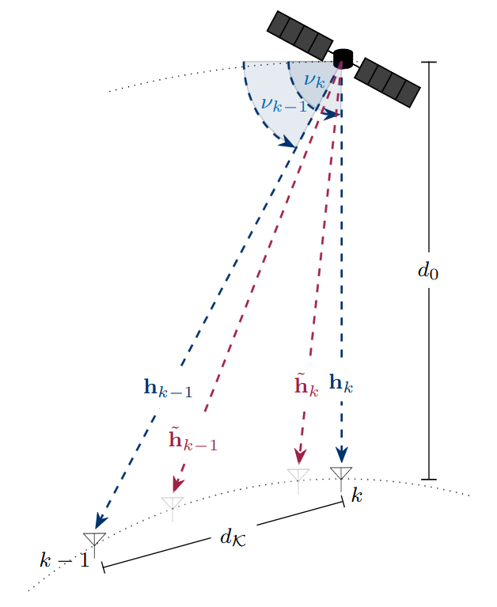
System model
Single LEO satellite, Uniform Lineararray(ULA), N=16 antennas.
K=3 single antenna ground users
Satellite alditude d₀ = 600 km, carrier frequency f=2GHz, transmit power budget P = 100W
LoS channel model with CSIT error model as AoD error +large-scale fading

Slide 4
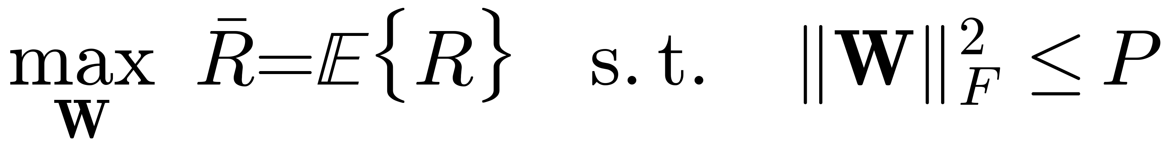
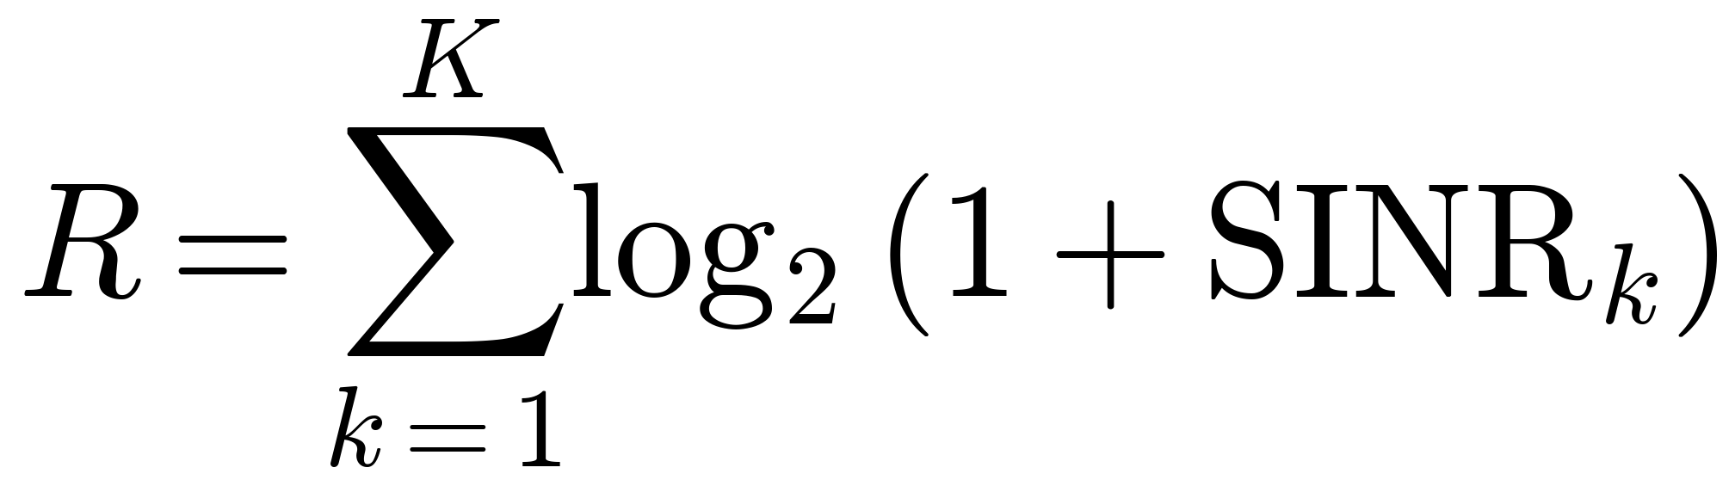
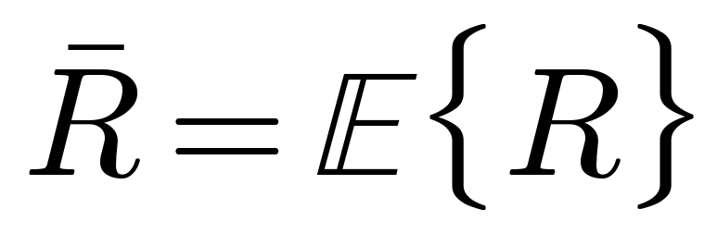
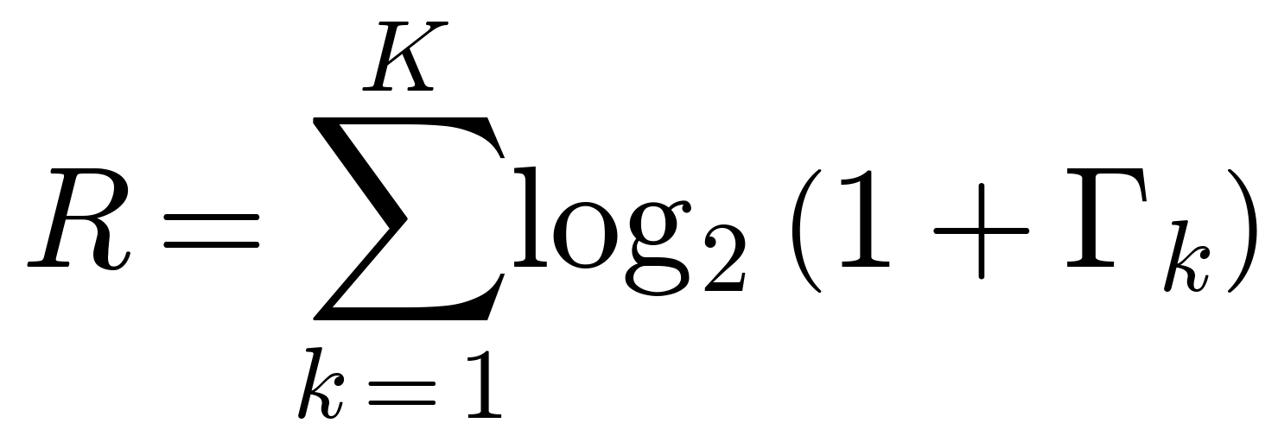
Baseline: Sum Rate Maximization
Our earlier work on this system maximizes the following objective:
Where the instantaneous sum rate over all K users is:
Subject to the total radiated power budget P.
The precode (MMSE, learned SAC precoder) rescales ist output to land exactly on this power budget.
Underthis rate-only objective, using more tranmsit power is never worse, so the optimum always saturates the full power budget.

Slide 5
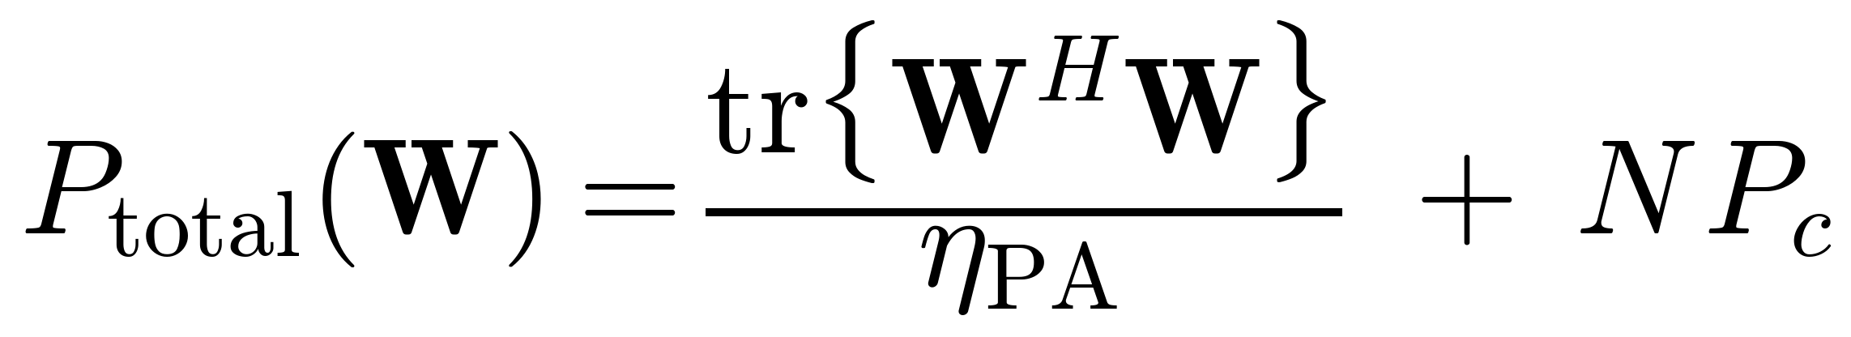
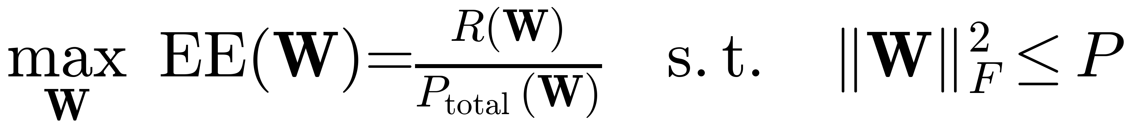
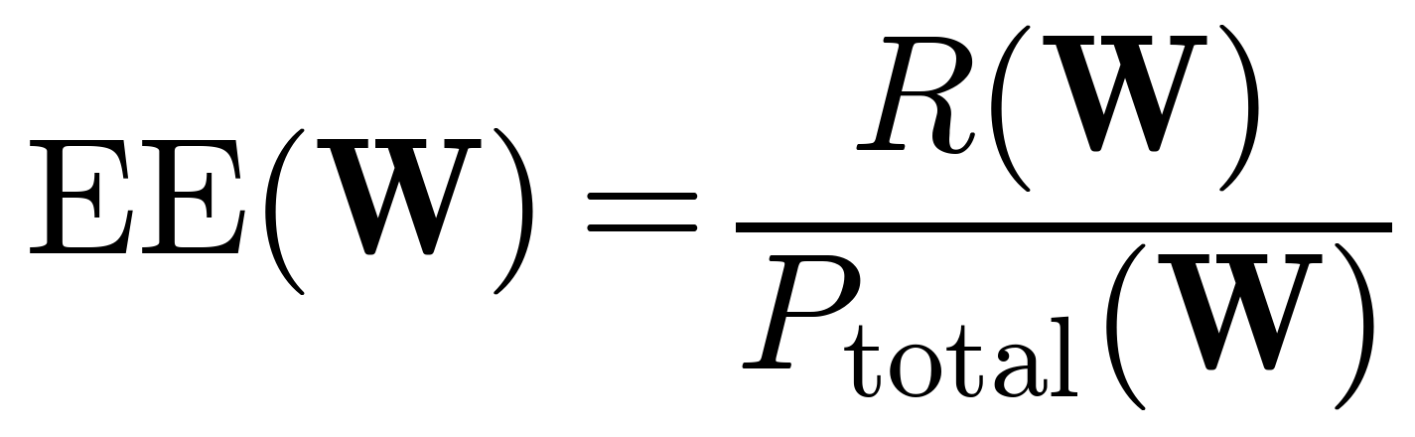
Our new objective: Energy Efficiency
We have consider the more realistic scenario by adding electrical power consumption model:
And formulate a new maximization problem – Energy efficiency:
Precoder now only rescale down when hte power is over budget, this lets the policy choose to use less than the full budget when that is more efficient.
η_PA = amplifier efficiency
P_c = per-antenna circuit power

Slide 6
How we solve it
Each simulation step, in a loop:
channel estimate → Actor network → proposed precoding matrix W → reward → store & learn
Rate-over-power is ratio, akward for RL to maximize directly, classical Dinkelbach's transmormation gave us the motivation to turn it into the substraction, implement directly into the reward:

Slide 7
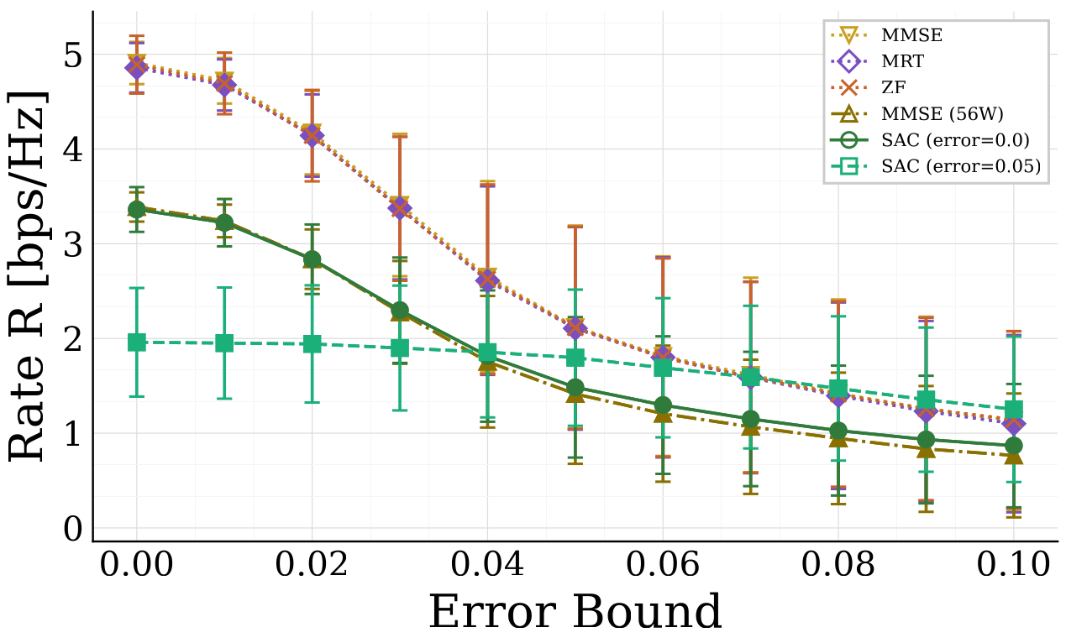
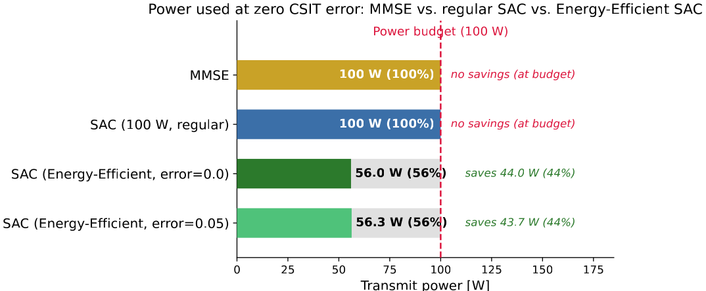
Results
MMSE and SAC maximize for rate always sped full power budget; our energy-Efficient SAC do not and stays robust as CSIT error grows:

Slide 8
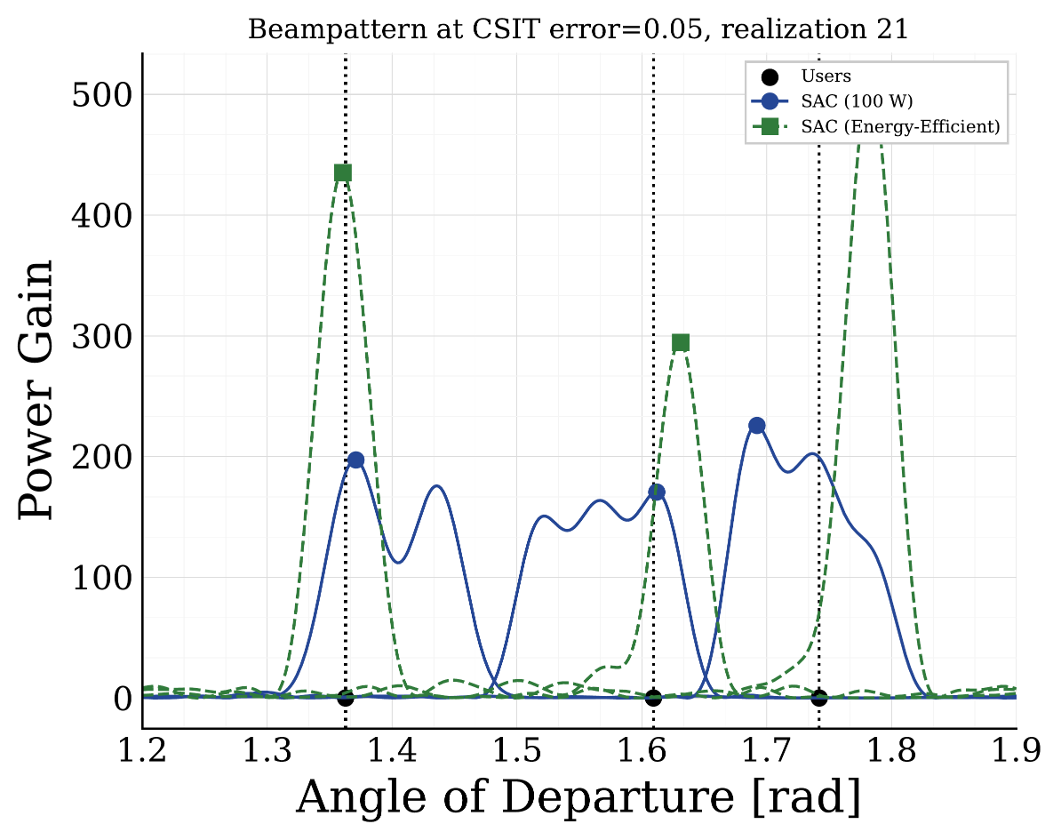
Results: What this Looks like Spatially
Comparing where the regular (100 W) SAC and Energy Efficient SAC actually point their antenna beamd for the same users:

Slide 9
Contact
Name
Telefon
Email
Name
Telefon
Email
Name
Telefon
Email
Name
Telefon
Email
Name
Telefon
Email
Name
Telefon
Email

