Slide 1
Birth/Death Registration Integration with Services
PIP2001 Capstone Project
Final Review
Batch Number:CSE-G199
Under the Supervision of,
Mr.Amarnath JL
Assistant Professor
School of Computer Science and Engineering
Presidency University
Roll Number | Student Name
20211CSE0628 | Prakruthi S
20211CSE0677 | Nidhisha N
20211CSE0618 | Deepthi R
Name of the Program: CSE
Name of the HoD: Dr.Asif Mohammed H.B
Name of the Program Project Coordinator: Mr. Amarnath J.L
Name of the School Project Coordinators: Dr. Abdul Khadar A

Slide 2
Introduction
Birth and death registration is crucial for public health and governance, providing essential data for understanding population dynamics and informing policy decisions. Traditional manual registration methods are often inadequate, especially in rapidly growing populations. Integrating vital records with services like healthcare, education, and social welfare can enhance efficiency, improve data quality, reduce administrative burdens, and increase accessibility for citizens. The aim is to create a more efficient, effective, and equitable governance system.

Slide 3
Literature Review
Birth and death registration is crucial for effective population management, public health, and legal identity. Integrating these services with government databases enhances efficiency, accuracy, and accessibility.
Current trends highlight a shift toward digitalization, with many countries adopting electronic systems for better data management (McKinsey & Company, 2020). Interoperability is vital, enabling systems to interact with health and social security services (Smith et al., 2021). User-centric design focuses on creating accessible interfaces for registrars and citizens (Johnson & Lee, 2022).
However, challenges persist. Data privacy concerns complicate the protection of personal information during integration (Davis & Thompson, 2020). Inconsistent technology adoption across regions poses technological barriers (World Bank, 2021), and unclear legislative frameworks can hinder system development (Garcia & Patel, 2019).
Case studies from Kenya and India illustrate both successes and challenges. Kenya's national civil registration system has improved data accuracy (UNICEF, 2021), while India's integration with health services enhances demographic data collection (Ministry of Health, 2022).

Slide 4
Literature Review
Best practices for successful integration include engaging community members and building capacity. Involving stakeholders fosters acceptance (Nguyen et al., 2023), and training registrars on new technologies is crucial for effective service delivery (WHO, 2021).
Looking ahead, advancements in AI and machine learning can enhance data analysis and predictive modeling (Zhang & Kim, 2022). Global partnerships can improve registration systems and facilitate the sharing of best practices (International Organization for Migration, 2023).
In conclusion, integrated registration services offer significant benefits for public administration and health outcomes, but more research is needed to understand their long-term impacts. Studies provide valuable insights into trends and challenges in this field.

Slide 5
Existing method Drawback
Drawbacks of Existing Methods for Birth and Death Registration Integration ServicesThe integration of birth and death registration services, while crucial for public health and demographic analysis, faces several challenges. Here are some of the common drawbacks of existing methods:
Data Quality and Consistency: Inaccurate or Incomplete Data:Data Discrepancies.
Interoperability Issues: Standardization ChallengesLegacy Systems.
Privacy and Security Concerns: Data BreachesRegulatory Compliance.
Technological Limitations: Infrastructure ConstraintsDigital Divide.
Resource Constraints: Funding ShortagesHuman Resource Limitations.
Cultural and Social Factors: Cultural BarriersSocial Inequality.

Slide 6
Proposed Method
Proposed Methods for Birth and Death Registration Integration Services Overcoming the challenges associated with birth and death registration integration requires a combination of technological, organizational, and policy-based approaches. Here are some proposed methods:
Technological Solutions: Standardized Data FormatsCloud-Based PlatformsMobile ApplicationsBlockchain Technology.
Organizational Approaches: Interagency CollaborationCapacity BuildingCommunity Engagement.
Policy-Based Initiatives: Legal FrameworksIncentives and DisincentivesData Quality Assurance.
Specific Case Studies: India's National Health MissionGhana's Civil Registration and Vital Statistics (CRVS) System.
It's important to note that the most effective approach will depend on the specific context and challenges faced by a particular country or region. A combination of these methods, tailored to local needs, is likely to yield the best results.

Slide 7
Objectives
Enhances data quality and accuracy by reducing errors and duplications.
Ensures timely and complete birth and death registrations.
Increases efficiency and accessibility for individuals and families.
Creates a comprehensive database as a single source of truth for stakeholders.
Supports evidence-based decision-making across various sectors.
Prioritizes protection of individuals' rights, ensuring data confidentiality and access to personal records.
Strengthens national statistical systems and provides reliable demographic data.
Contributes to sustainable development and improves public health outcomes..

Slide 8
Methodology/Modules
The integration of birth and death registration services requires a systematic approach that involves various components or modules. Here's a breakdown of the key methodology and modules:
Data Collection and Standardization: Data CollectionData Standardization.
Data Entry and Validation: Data EntryData Validation.
Data Integration: InteroperabilityData Mapping.
Data Storage and Management: Database DesignData SecurityData Backup and Recovery.
Data Analysis and Reporting: Data Analysis ToolsReporting.
Quality Assurance and Monitoring: Data Quality AuditsPerformance Monitoring.
Capacity Building and Training: TrainingCapacity Building.
Community Engagement and Outreach: Awareness RaisingCommunity Participation.
Awareness RaisingCommunity ParticipationBy following this methodology and implementing these modules, countries can establish effective birth and death registration integration services that contribute to improved public health, evidence-based decision-making, and national development.

Slide 9
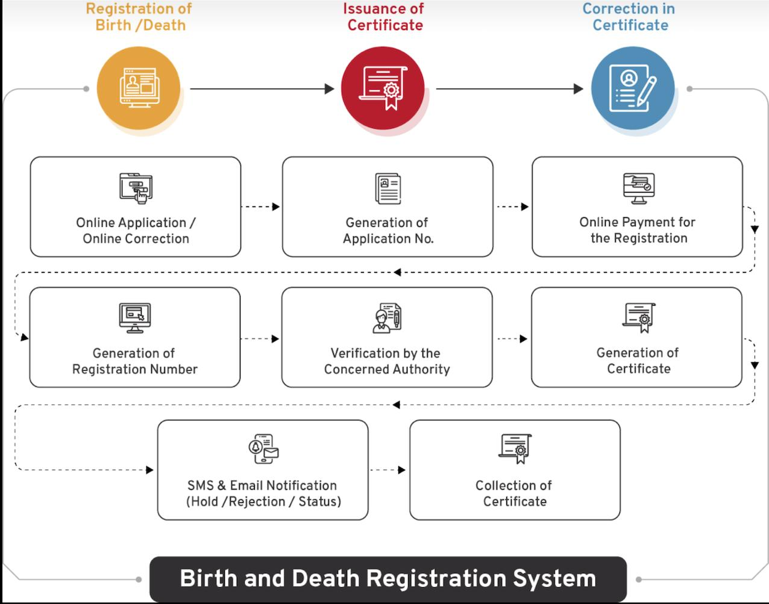
Architecture

Slide 10
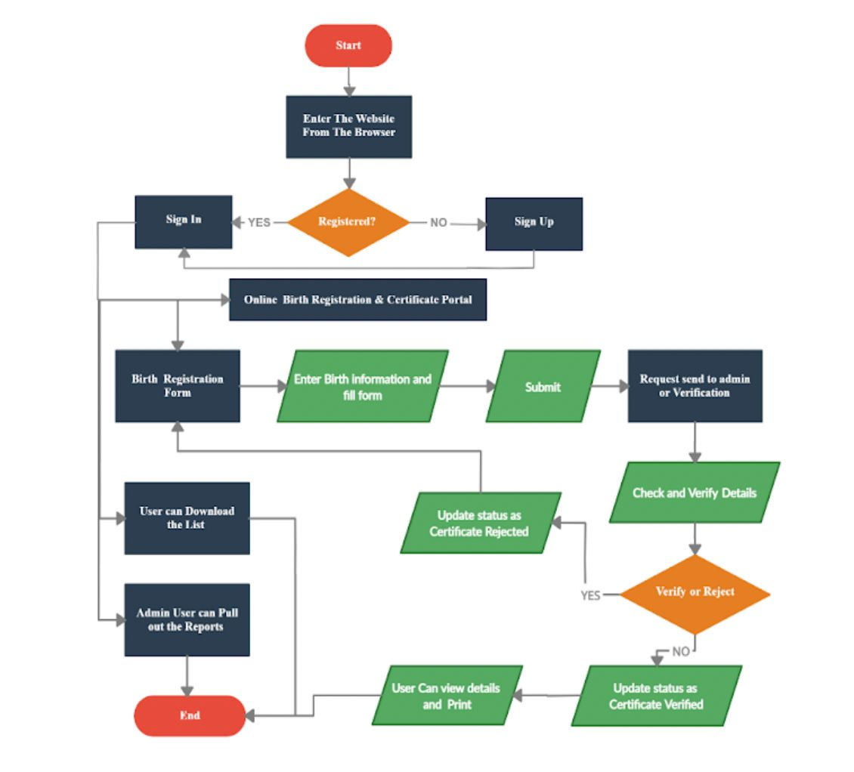
Architecture Flow Chart

Slide 11
Software Components
Front-end technology- Javascript with CSS
JavaScript is a dynamic scripting language used for creating interactive and responsive web interfaces. It enhances the frontend of your Django application by enabling real-time form validation, dynamic content updates, and improved user experience with libraries like jQuery or frameworks such as React or Vue.js.
Back-end technology- Python with django framework
Django is a high-level Python web framework that simplifies backend development with features like an ORM for database handling, built-in authentication, and an MVT (Model-View-Template) architecture for clean separation of logic, presentation, and data. It enables rapid development and secure, scalable web applications.
Database- SQLlite
SQLite is a lightweight, file-based database system used as Django's default database for quick setup and development. It requires no additional configuration and stores all data in a single db.sqlite3 file.

Slide 12
Software Components
API’s and Web Services- Django’s development server and REST framework
APIs in Django can be implemented using Django REST Framework (DRF) to create RESTful services for interacting with external applications or mobile clients.
Django includes a lightweight development server for testing, while production deployments typically use servers like Gunicorn, uWSGI, or Daphne for better performance and scalability.
Authentication- Django’s built-in authentication system
Django provides a built-in authentication system to handle user registration, login, logout, and session management securely with features like password hashing and login_required decorators.
Version Control- GitHub
GitHub can be used for version control allows developers to track code changes, collaborate effectively, and ensure a smooth development workflow.

Slide 13
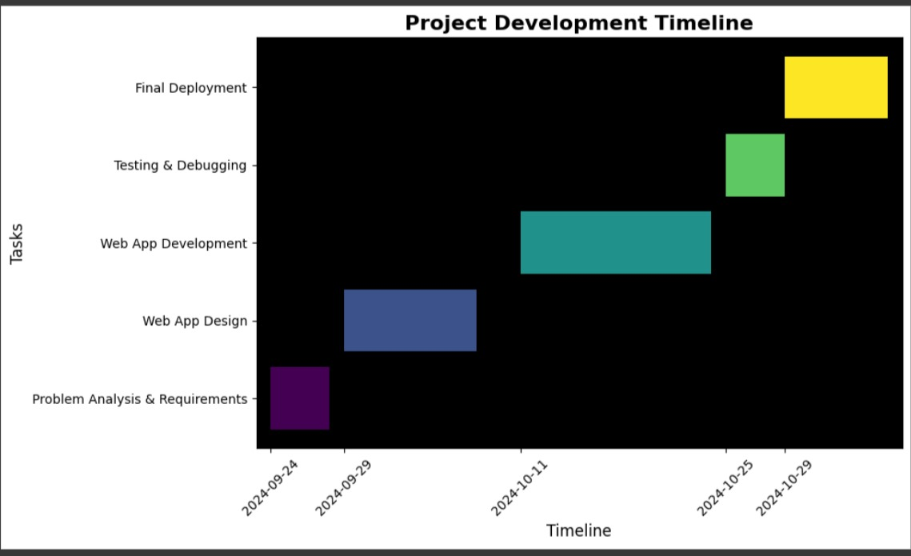
Timeline of Project

Slide 14
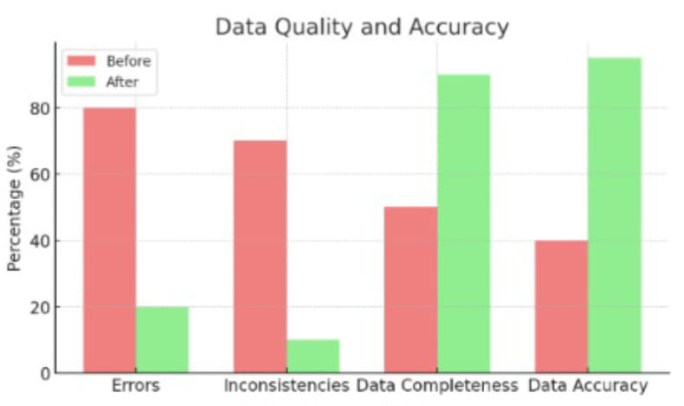
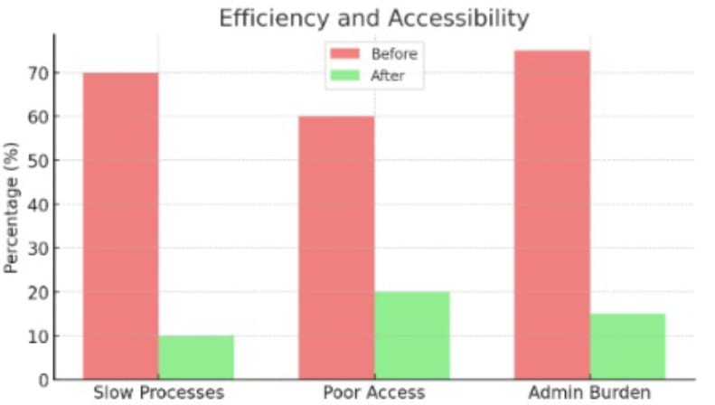
Expected Outcomes
Improved Data Quality and Accuracy:
It can enhance data quality and accuracy by offering user-friendly interfaces, data validation, and secure storage, leading to reliable information for public health decision-making.
.
2.Enhanced Efficiency and Accessibility:
A birth/death registration app improves efficiency and accessibility, leading to faster registration, complete data, and better public health management.

Slide 15
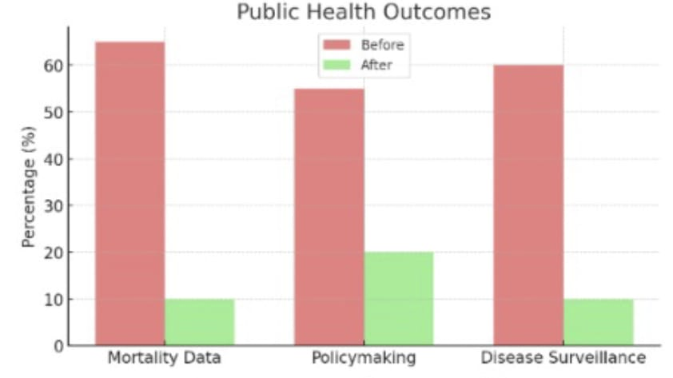
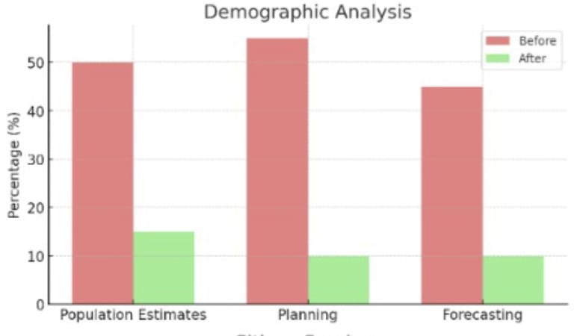
Expected Outcomes
3.Improved Public Health Outcomes:
It contribute to improved public health outcomes by enabling complete and accurate data collection, which strengthens disease surveillance, resource allocation, and overall public health initiatives.
4. Enhanced Demographic Analysis:
It facilitates demographic analysis by providing real-time, accurate data on population trends, vital for informed policymaking and resource allocation.

Slide 16
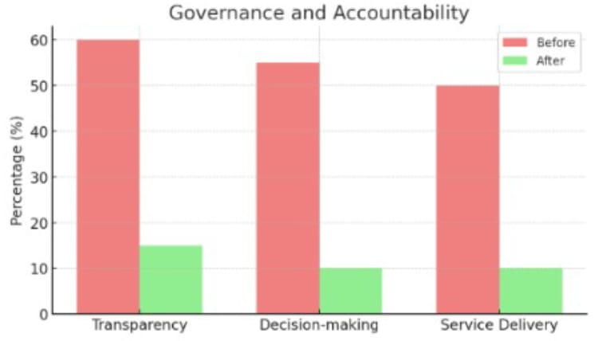
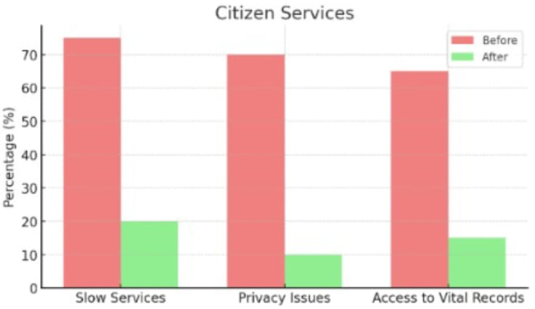
Expected Outcomes
6. Improved Citizen Services:
It improves citizen services by providing a convenient and accessible platform for registering vital events, leading to more efficient and accurate data collection.
5. Strengthened Governance and Accountability:
It enhance governance and accountability by offering transparent and accessible data collection, empowering policymakers with accurate information for informed decision-making.

Slide 17
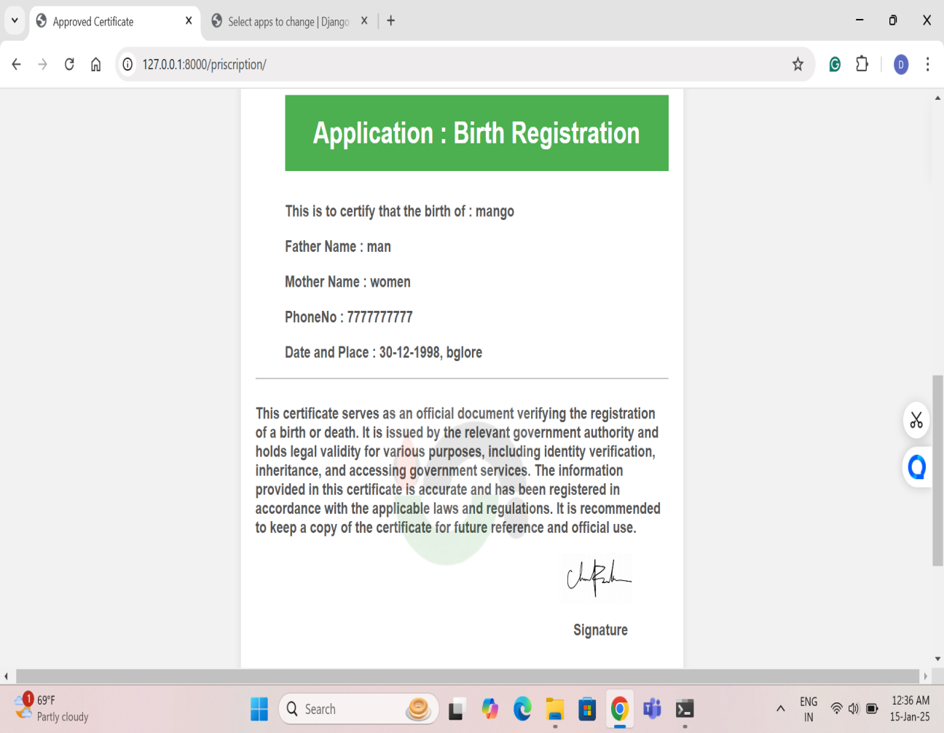
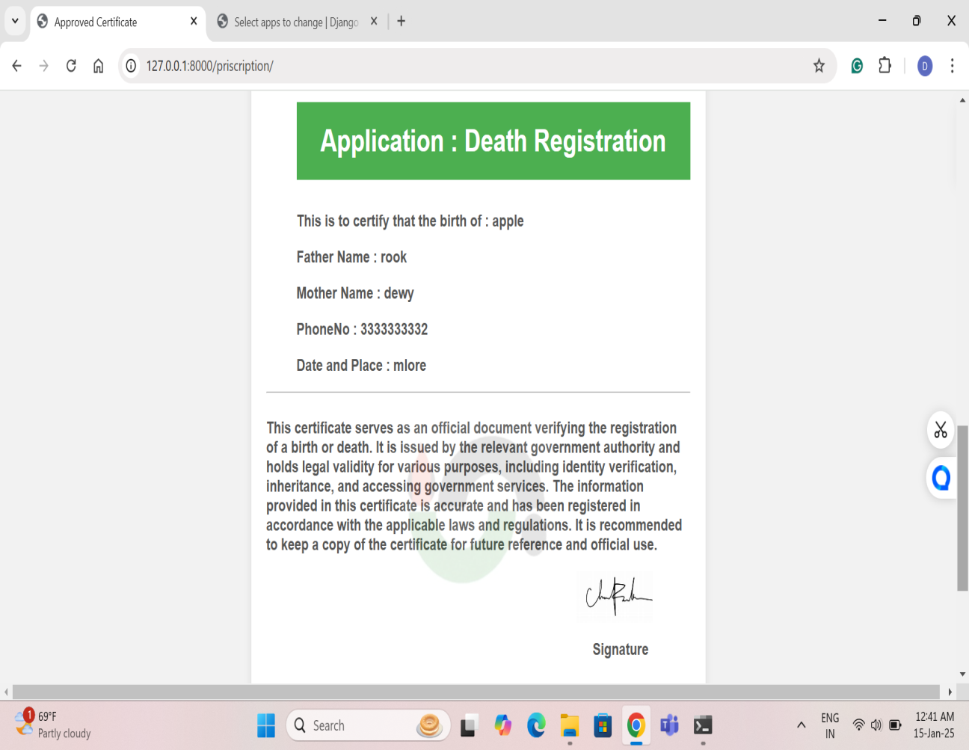
Output

Slide 18
Conclusion
Birth and death registration integration services are crucial for effective public health, demographic analysis, and governance. By improving data quality, enhancing efficiency, and supporting informed decision-making, these services contribute to a more equitable and sustainable future. The integration of birth and death registration data can provide valuable insights into population dynamics, inform policy decisions, and improve the delivery of essential services.

Slide 19
Github Link
Github Link
https://github.com/Prakruthi27441/Project.git

Slide 20
References
R. Kumar, "Birth and Death Registration in India: Current Status and Future Directions," Indian Journal of Public Health, vol. 64, no. 1, pp. 23-29, 2020.
Government of India, "National Health Mission: Guidelines for Birth and Death Registration," Ministry of Health and Family Welfare, New Delhi, India, 2019.
M. Sharma and P. Gupta, "Challenges in Birth and Death Registration: A Study of Urban and Rural Disparities," Journal of Community Health, vol. 45, no. 2, pp. 234-240, 2021.
S. Verma and A. Chatterjee, "Digital Initiatives for Birth and Death Registration in India: A Review," in Proceedings of the International Conference on E-Governance, Bangalore, India, 2022, pp. 112-117.
C. R. Sahu and T. K. Mohanty, "Integrating Vital Registration with Health Services in India: A Systematic Approach," International Journal of Health Systems and Services, vol. 11, no. 3, pp. 155-162, 2023.
Davis, G. 2009. Stillbirth registration and perceptions of infant death, 1900–60: The Scottish case in national context. Economic History Review 62.3: 629–654.
Jewkes, R., and K. Wood. 1998. Competing discourses of vital registration and personhood: Perspectives from rural South Africa. Social Science & Medicine 46.8: 1043–1056.
Li, S., Y. Zhang, and M. W. Feldman. 2010. Birth registration in China: Practices, problems and policies. Population Research and Policy Review 29.3: 297–317.
Zhang, Y., & Kim, S. (2022). The Role of AI in Public Registration Services: Journal of Information Technology, 37(2), 145-160.
Davis, J., & Thompson, R. (2020). Data Privacy in Integrated Registration Systems: Journal of Public Administration, 45(3), 123-134.

Slide 21

Project work mapping with SDG

Slide 22
Thank You

